Slide 1
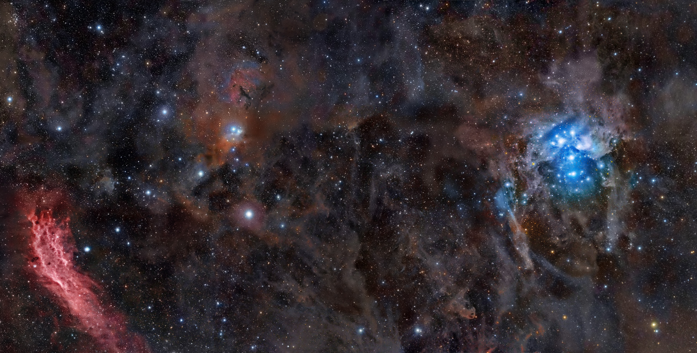
Stargazer
Automatic Telescope Control System
Jason Dunscombe
Rob Grmek
Robert Smith

Slide 2
What is it?
This automatic, telescope control system allows users to:
set schedules to position the telescope at a certain area of the sky at a certain time of day
using a digital camera, take pictures of that area
compile the images to form a high-resolution image
compare the image with libraries of celestial objects in hopes of finding new objects
if new objects are found, email the user with the coordinates for that new object

Slide 3
Why is it needed?
The automatic nature of the system allows mainly for a time-saving benefit, which eliminates the need for many time-consuming, manual operations.

Slide 4
Web Application Requirements
Mobile device connectivity
Authentication
Authorization
Optional SSL
View images per a schedule
Online help
Notes:
Mobile device connectivity: users should be able to easily access and use the web application through a handheld browser such as the iPhone’s Safari.
Authentication: users must have accounts in order to access the system in order to prevent outside, anonymous users from controlling the telescope.
Authorization: there are two types of users. Admins have no restrictions and can manage users (add, edit, update), and can make changes to any schedule. Regular users can only add new schedules as well as edit and update their own schedules. They are also able to view other schedules, but not make any changes to them, and edit their own profile (change username, password, email).
Optional SSL: the web application supports HTTPS but the web server uses a self-signed certificate (for now, since getting a certificate signed from a certificate authority i.e. Verisign costs money) so the user has the ability to encrypt their session although it is self-signed and not a mandatory requirement for the user to connect via HTTPS.
Viewing images: an image belongs to a schedule; once an image is compiled, it will be added to the web application in case the user wishes to view it. Some image processing is done to create a medium-resolution and thumbnail image in order for it to make it more presentable to users when images are listed. They can be clicked for the full, high-resolution image to be shown.
Online help: online help is added to further document how to correctly use the system if users are unsure as what they should do. However, the system is fairly intuitive so it should be intrinsically usable.

Slide 5
Customers
Astronomy is a hobby of theirs, so they own and operate over 10 telescopes.
As of now, Sasha and Nan (our customers), use a manual process for achieving their goals of positioning the telescope and finding new celestial objects.
Video showing images they have captured: http://www.youtube.com/user/lyuks
Notes:
Show youtube video

Slide 6
Hardware Used
Telescope: Meade LX200
Digital camera: Sony A900 DSLR
Mobile device: Nokia phones, Apple iPhone
Notes:
We receive the digital camera next semester; too early, not needed yet

Slide 7
Software Used
Documentation: Microsoft Word
Modeling: NetBeans, Rational Rose, RailRoad
Text editors: E, gedit, vim
Web browsers: Google Chrome, Mozilla Firefox
Notes:
RailRoad = Ruby plugin for automatically generating domain models

Slide 8
Customer’s Programs
!
Notes:
Show meade autostars program and winstar2 program

Slide 9
Xtreme Programming
Pair programming
Test-driven development
Whole team
Customer tests
Collective code ownership
Sustainable pace
Metaphor
Simple design
Design improvement
Planning game
Small releases
Coding Standards
Continuous integration

Slide 10
Xtreme Programming SPIKE + Demo
In order to learn the fundamentals of XP, we had a 6 week SPIKE project whose goal is to emulate a board game called DVONN.
Written in Java using the SWING package.
For more information on the game, see: http://www.gipf.com/dvonn/index.html
Notes:
Demo the DVONN game.

Slide 11
Web Application Components
Framework: Ruby on Rails
Language: Ruby
Presentation: CSS
Operating System: Fedora 11
Web Server: Apache2 (Mongrel for development)
Database: SQLite
Notes:
ROB:
Ruby on Rails is a framework for developing web applications using the Ruby language. Rails will be discussed more on the next slide.
We use CSS for presentation. We have different stylesheets depending on which media the user is connecting from: either from PC or from a handheld device.
We use a Linux operating system to host our web application. In this case, we chose Fedora 11 which is a Red Hat based distribution.
We use apache2 as our web server for our production environment, but most development is done on local computers like my laptop using Mongrel which I believe is written in Ruby and works well since its small and fast but doesn’t offer much in terms of configuration or stability which is why Apache2 is needed for a production environment.
Also, for a database right now we use SQLite which is small, serverless, transactional database which requires zero configuration. It is very simple and doesn’t have many features so we may need to change this later to a database which can handle a larger data set for a production environment such as PostgreSQL which is the most powerful open source database out there at the moment. Other databases can be used such as MySQL or Oracle but I’d like to keep everything open source as much as possible as it would prevent any additional costs to the user.

Slide 12
Ruby on Rails
Framework for generating web applications quickly.
Comparatively easy to learn.
Enforces software patterns such as Model-View-Controller.
“DRY” code.
RESTful architecture.
Convention Over Configuration
Notes:
ROB:
Ruby on Rails is a framework for generating web applications quickly. It’s said that it can be up 10x more productive and efficient to use Rails over some other frameworks espicially those using Java as they usually require a lot of configuration and redundancy.
It’s comparatively easy to learn. Some other frameworks take a long time to master such as the Java Spring framework, but there really isn’t anything magically that goes on behind the scenes as far as I can tell with Ruby on Rails. The most difficult part is learning the Ruby language which can take some time.
Rails also enforces some patterns such as Model-View-Controller, which is usually just called MVC.
In the case of Rails, models are primarily used for managing the rules of interaction with a corresponding database table. In most cases, one table in your database will correspond to one model in your application.
In Rails, views are often HTML files with embedded Ruby code that performs tasks related solely to the presentation of the data.
In Rails, controllers are responsible for processing the incoming requests from the web browser, interrogating the models for data, and passing that data on to the views for presentation.
So basically what it does is:
- isolate the business logic from the user interface
- help keep code DRY. DRY means Don’t Repeat Yourself which basically means its a bad idea to duplicate code as it becomes harder to maintain and harder to understand.
- it also makes the applications easier to maintain as it is clear where different types of code belong
The Rails philosophy also includes several guiding principles such as:
REST (which stands for Representational State Transfer) is the best pattern for web applications – organizing your application around resources and standard HTTP verbs is the fastest way to go. What this means is we use URLs to represent resources and then use HTTP actions to determine what kind of response the controller should have.
Convention Over Configuration – means that Rails makes assumptions about what you want to do and how you’re going to do it, rather than letting you tweak every little thing through endless configuration files which eliminates a lot of redundancy and allows for greater productivity.

Slide 13
Versioning Control
Used “Git”. Why?
See: http://whygitisbetterthanx.com/
Fast
Small
Easy to learn
Distributed
GitHub account, see: http://github.com/RedTeamCOSC470/Stargazer
Notes:
ROB:
For our versioning control tool we used Git. A lot of people nowadays are using Git for the reasons mentioned at the link. What drove me to choose git as our versioning tool was a presentation Linus Torvalds gave at a Google conference listing all the reasons which explains his reasons for developing this tool.
It’s small, fast, easy to learn and can be used in a distributed environment. The reason why it’s so fast is because everything is local except when pushing and pulling commits to and from remote destinations which is the most time consuming activity and allows for work to be done offline as well. Network access isn’t necessary for most actions.
We use a GitHub account to host our source code and acts as our remote repository and it can be seen at the following link location.
http://www.youtube.com/watch?v=4XpnKHJAok8

Slide 14
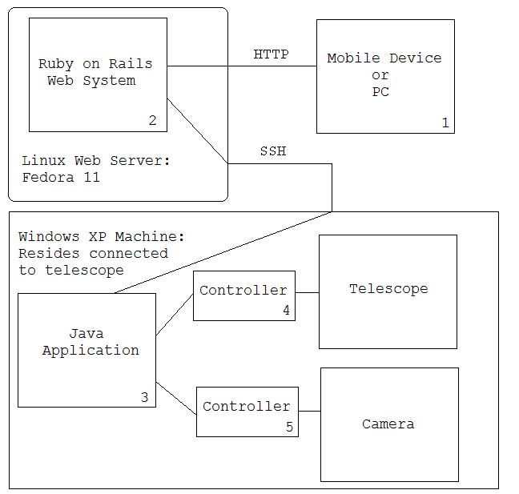
Architecture
Notes:
ROB:
So here is how the architecture of our system will look like once all the components are completed. Right now, we still need to create the Java application which is a very large core of our system which will do the actual communication with the telescope and camera.
Using a web browser, users will access the web application using either HTTP or HTTPS. Once they login they can create new schedules for positioning the telescope. Once a schedule is created, using a cronjob or some other scheduling tool, we will run a script at the specific time the telescope should position itself which will connect to the machine connected to the telescope using say SSH and then will be able to call the Java program with command line arguments to move at such and such a location for such and such a duration. The Java application will also compile the images and save it to that local disk.
Note:
users may also connect to the web application via HTTPS
application which controls the telescope and camera may be written in C#

Slide 15
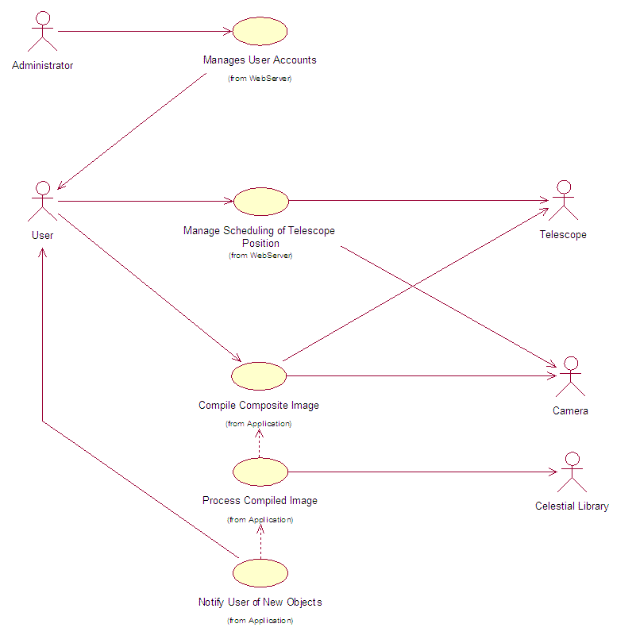
Use Case Diagram

Slide 16
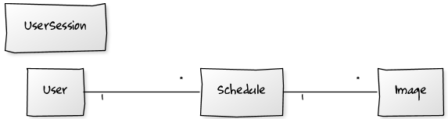
Domain Model
Notes:
Rob:
Here we have a sample domain model which shows our models which represent tables in the database.
A user can create many schedules and a schedule belongs to a user. We keep track of this association so we can display schedules that a certain user has created.
Also, a schedule can have many images.

Slide 17
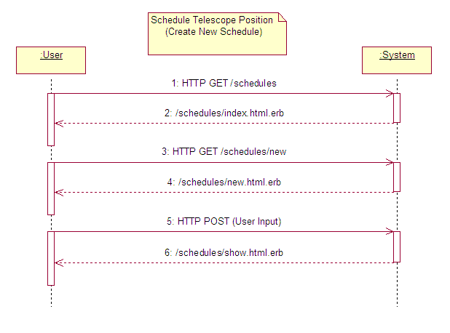
SSD: Create New Schedule
Notes:
To be added

Slide 18
Example: Ruby Code
class Schedule < ActiveRecord::Base
belongs_to :user
has_many :images
# make sure schedule cannot be before present time
validates_datetime :start_time, :after => lambda { Time.now }, :after_message => "must be in the future"
# make some fields required
validates_presence_of :exposure, :declination, :right_ascension
end
Notes:
ROB:
Here is an example of a Ruby class.
This class is a snippet of code from the Schedule model and holds some validations and relationships with other objects.
As you can see from the top, it inherits the base Active Record class which is a part of the Rails API and acts as base for the models in a Rails application. It provides database independence, basic CRUD functionality, advanced finding capabilities, and the ability to relate models to one another, among other services.
The first thing we did here was create the relationships a schedule has with other models. Since a user creates a schedule, a schedule belongs to a user and a user may have many schedules. This allows us to keep track of which user created the schedule which makes our job of authorization as a user may only be able to edit or delete his own schedules if he is not an admin.
Also, a schedule may have many images. A particular image will be associated with a particular schedule. This relationship allows us to easily list images belonging to a particular schedule.
We also have two validation methods.
Ruby is very lax when it comes to coding regulations. validates_datetime and validates_presence_of are methods but its optional to enclose the parameters such as :start_time , :after_message, etc in brackets. Most Ruby on Rails applications don’t use brackets so we stick with that standard when possible.
Anyways, the first ensures no schedules can be created before the current date and time. We use a plugin, called validates_timeliness which was built exactly for these purposes. The great thing about ruby on rails is that there is a wide developer community and very extensible through using plugins for reusable code.
We pass in the parameters :start_time which is a symbol that only holds a string of a “datetime” datatype. Symbols are objects which hold a string representation and a numeric representation. An example of the string representation for this start_time symbol could be “2009-11-27 19:39:38”. Symbols are mostly used for performance reasons as its easier for a program to lookup an object reference based on an numeric representation than a string representation.
We also pass in to the symbol :after => lambda { Time.now }. A lambda is the equivalence of saying Proc.new which creates a new Proc object which to hold a block of ruby code and then execute it. We use this here to ensure that the current time is calculated right before the schedule object is about to be saved to the database. We also pass in an after_message which will be displayed to the user in the form if the inputted start date and time is invalid.
The last method checks that the following fields, exposure, declination and right ascension have values in them. Its not allowed for these fields to be blank or null. These symbols are attributes of the schedule model.

Slide 19
Testing
Unit tests:
“Black box” tests to ensure functionality correctness. A test suite is used to run all unit tests whenever new code is added to the system
All tests must pass after the new code is added
Notes:
ROB:
So because we use test-driven development, we need to have unit tests.
Unit tests are “Black box” tests to ensure functionality correctness. A test suite is used to run all unit tests whenever new code is added to the system. Also, all tests must pass after the new code is added.
For unit testing, we use the built-in ruby libraries which have functionality similiar to that of JUnit testing.

Slide 20
Example: Unit Test + Demo
require 'test_helper'
class UserTest < ActiveSupport::TestCase
# create a user with necessary, correct input values for the following tests
def setup
@user = User.new
@user.username = "unit_test"
@user.email = "unit@test.com"
@user.password = "test"
@user.password_confirmation = "test"
end
def test_username_cannot_be_null
@user.username = ""
assert !@user.save
end
end
Notes:
ROB:
Here is an example of a ruby unit test.
The first thing we do is load the test_helper file which sets the rails environment into “test” mode (Rails functions in three different modes: test, development and production). By doing this, it automatically loads a test database we can use to input sample data to test our functionality and validations.
the class extends the test case class much like JUnit Tests which gives us access to some methods.
The first thing we do is create a user with correct input values so later we can just override an attribute of that object with a value that shouldn’t work. For instance, we shouldn’t be able to create a new user when we haven’t supplied a username. Here we made it null and we make an assertion to test that our application should not allow us to save this object. If this assertion was false (not and true), a visible error message would occur when we run this test.
Now to run the tests we go to the command line and simply type rake test:units

Slide 21
Project Timeline
Iteration 1: Inception
Iteration 2: SPIKE project
Iteration 3: Release #1
Iteration 4: Release #2
Iteration 5: Final Refactored Release
Each iteration = ~1 week

Slide 22
Risk Management
Risk | Probability | Effect | Solution
Underestimate the time the project will take. | Medium to high. | Serious – we run out of time. | Remove non-essential features.
Illness to team members. | Low to medium. | Tolerable – We work without that team member until they are better. | Assign and distribute their tasks to other team members.
Not understanding requirements. | Medium to high. | Serious -The system behaves incorrectly. | Keep in close contact with the customer.
Scheduling conflicts between team members. | Low to medium. | Serious – Individual programming is not XP programming. | Schedule well before hand.
No available lab space. | Medium. | Tolerable – need to find other areas to work. | Use laptops in meeting rooms or other areas.
Server or technical issues. | Low to medium. | Catastrophic – May lose work. | Backup regularly; use a versioning control system.
Campus network problems | High. | Serious – Reduced productivity, difficulty accessing development server. | Work directly on development server or work locally on a laptop computer.
Lack of time at end of semester | High. | Tolerable – Reduced ability to work outside of class/lab time. | Use class/lab time as productively as possible.
Client unavailable or unresponsive. | Medium. | Catastrophic – No customer input. | Use alternative methods of communication (phone or email).
Notes:
Probabilities can be: low, moderate, high.
Effects can be: tolerable, serious and catastrophic

Slide 23
Project Evaluation and Metrics
Time spent: (1 unit = 15 minutes)
Total time: 438 units
Coding:
Models: 4
Views: 26
Controllers: 6
Tests:
Unit tests: 3
Test cases: 17
Assertions: 29

Slide 24
What did we learn?
New methodology: Xtreme Programming
Pair programming
New framework: Ruby on Rails
New language: Ruby
New versioning tool: Git

Slide 25
Issues and Project Difficulties
Needed additional time to learn new framework and language
Difficulties contacting customers and getting user input
Technological difficulties: trouble communicating with telescope through Java programs

Slide 26
Demonstrations
!
Notes:
Web App:
Show using different browsers
Show using PC and handheld devices
Also DEMO:
Meade Autostars program
Winstars2
Hardware (telescope)

Slide 27
Questions
?

