Slide 1
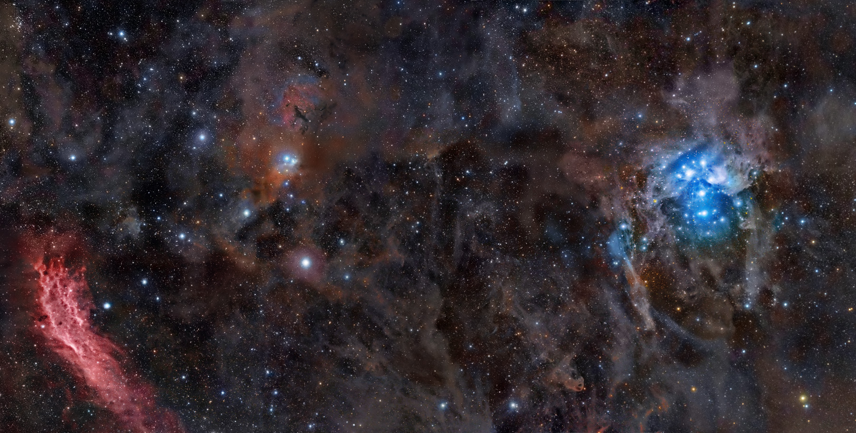
Stargazer
Automatic Telescope Control System
Jason Dunscombe
Rob Grmek
Robert Smith

Slide 2
What is it?
This automatic, telescope control system allows users to:
set schedules to position the telescope at a certain area of the sky at a certain time of day
using a digital camera, take pictures of that area
compile the images to form a high-resolution image
compare the image with libraries of celestial objects in hopes of finding new objects
if new objects are found, email the user with the coordinates for that new object

Slide 3
Why is it needed?
The automatic nature of the system allows mainly for a time-saving benefit, which eliminates the need for many time-consuming, manual operations.

Slide 4
Web Application Requirements
Mobile device connectivity
Authentication
Authorization
Optional SSL
View images per a schedule
Online help
Notes:
Mobile device connectivity: users should be able to easily access and use the web application through a handheld browser such as the iPhone’s Safari.
Authentication: users must have accounts in order to access the system in order to prevent outside, anonymous users from controlling the telescope.
Authorization: there are two types of users. Admins have no restrictions and can manage users (add, edit, update), and can make changes to any schedule. Regular users can only add new schedules as well as edit and update their own schedules. They are also able to view other schedules, but not many changes to them, and edit their own profile (change username, password, email).
Optional SSL: the web application supports HTTPS but the web server uses a self-signed certificate (for now, since getting a certificate signed from a certificate authority i.e. Verisign costs money) so the user has the ability to encrypt their session although it is self-signed and not a mandatory requirement for the user to connect via HTTPS.
Viewing images: an image belongs to a schedule; once an image is compiled, it will be added to the web application in case the user wishes to view it. Some image processing is done to create a medium-resolution and thumbnail image in order for it to make it more presentable to users when images are listed. They can be clicked for the full, high-resolution image to be shown.
Online help: online help is added to further document how to correctly use the system if users are unsure as what they should do. However, the system is fairly intuitive so it should be intrinsically usable.

Slide 5
Customers
Astronomy is a hobby of theirs, so they own and operate over 10 telescopes.
As of now, Sasha and Nan (our customers), use a manual process for achieving their goals of positioning the telescope and finding new celestial objects.
Video showing images they have captured: http://www.youtube.com/user/lyuks
Notes:
Show youtube video

Slide 6
Hardware Used
Telescope: Meade LX200
Digital camera: Sony A900 DSLR
Mobile device: Nokia phones, Apple iPhone
Notes:
We receive the digital camera next semester; too early, not needed yet

Slide 7
Software Used
Documentation: Microsoft Word
Modeling: NetBeans, Rational Rose, RailRoad
Text editors: E, gedit, vim
Web browsers: Google Chrome, Mozilla Firefox

Slide 8
Customer’s Programs
!
Notes:
Show meade autostars program and winstar2 program

Slide 9
Xtreme Programming
Pair programming
Test-driven development
Whole team
Customer tests
Collective code ownership
Sustainable pace
Metaphor
Simple design
Design improvement
Planning game
Small releases
Coding Standards
Continuous integration

Slide 10
Xtreme Programming SPIKE + Demo
In order to learn the fundamentals of XP, we had a 6.5 week SPIKE project whose goal is to emulate a board game called DVONN.
Written in Java using the SWING package.
For more information on the game, see: http://www.gipf.com/dvonn/index.html

Slide 11
Web Application Components
Framework: Ruby on Rails
Language: Ruby
Presentation: CSS
Operating System: Fedora 11
Web Server: Apache2 (Mongrel for development)
Database: SQLite

Slide 12
Ruby on Rails
Framework for fast generation of web applications.
Comparatively easy to learn.
Enforces software patterns such as Model-View-Controller.
RESTful architecture.
“DRY” code.
Convention Over Configuration
Notes:
http://guides.rubyonrails.org/getting_started.html
The Rails philosophy includes several guiding principles:
DRY – “Don’t Repeat Yourself” – suggests that writing the same code over and over again is a bad thing.
Convention Over Configuration – means that Rails makes assumptions about what you want to do and how you’re going to do it, rather than letting you tweak every little thing through endless configuration files.
REST is the best pattern for web applications – organizing your application around resources and standard HTTP verbs is the fastest way to go.
Rails is organized around the Model, View, Controller architecture, usually just called MVC. MVC benefits include:
Isolation of business logic from the user interface
Ease of keeping code DRY
Making it clear where different types of code belong for easier maintenance
2.1.1 Models
A model represents the information (data) of the application and the rules to manipulate that data. In the case of Rails, models are primarily used for managing the rules of interaction with a corresponding database table. In most cases, one table in your database will correspond to one model in your application. The bulk of your application’s business logic will be concentrated in the models.
2.1.2 Views
Views represent the user interface of your application. In Rails, views are often HTML files with embedded Ruby code that performs tasks related solely to the presentation of the data. Views handle the job of providing data to the web browser or other tool that is used to make requests from your application.
2.1.3 Controllers
Controllers provide the “glue” between models and views. In Rails, controllers are responsible for processing the incoming requests from the web browser, interrogating the models for data, and passing that data on to the views for presentation.

Slide 13
Versioning Control
Used “Git”. Why?
See: http://whygitisbetterthanx.com/
Fast
Small
Local
Easy to learn
Distributed
GitHub account, see: http://github.com/RedTeamCOSC470/Stargazer

Slide 14
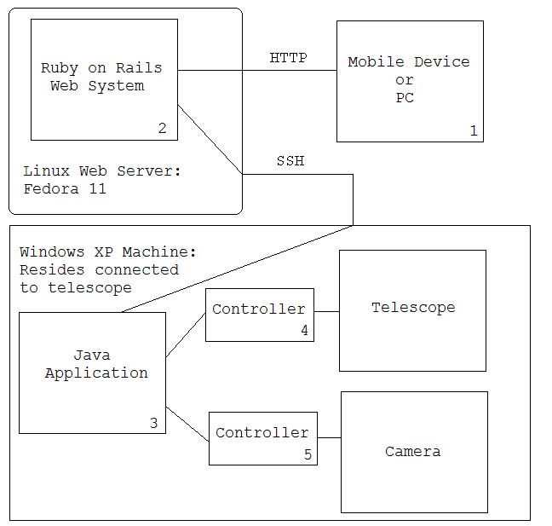
Architecture
Notes:
Note:
users may also connect to the web application via HTTPS
application which controls the telescope and camera may be written in C#

Slide 15
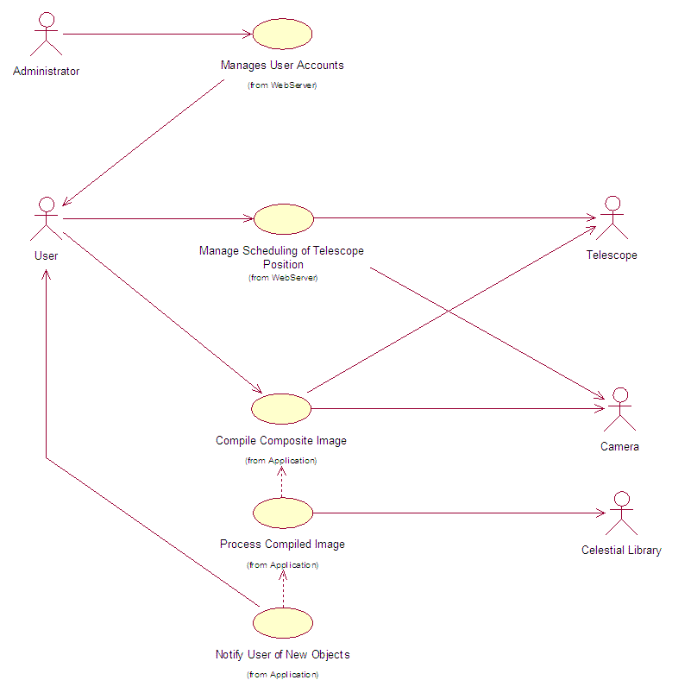
Use Case Diagram

Slide 16
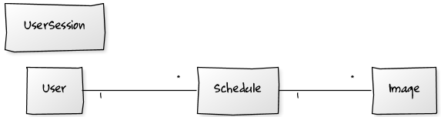
Domain Model

Slide 17
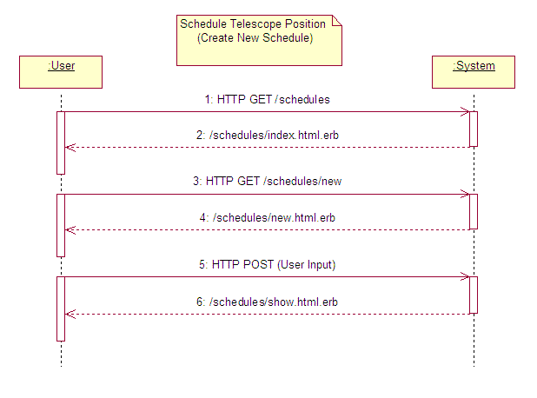
SSD: Create New Schedule
Notes:
To be added

Slide 18
Example: Ruby Code
class Schedule < ActiveRecord::Base
belongs_to :user
has_many :images
# make sure schedule cannot be before present time
validates_datetime :start_time, :after => lambda { Time.now }, :after_message => "must be in the future"
# make some fields required
validates_presence_of :exposure, :declination, :right_ascension
end

Slide 19
Testing
Unit tests:
“Black box” tests to ensure functionality correctness. A test suite is used to run all unit tests whenever new code is added to the system
All tests must pass after the new code is added
Acceptance tests:
“White box” tests used to ensure business “fit” of the system

Slide 20
Example: Unit Test + Demo
require 'test_helper'
class UserTest < ActiveSupport::TestCase
# create a user with necessary, correct input values for the following tests
def setup
@user = User.new
@user.username = "unit_test"
@user.email = "unit@test.com"
@user.password = "test"
@user.password_confirmation = "test"
end
def test_username_cannot_be_null
@user.username = ""
assert !@user.save
end
end

Slide 21
Project Timeline
Iteration 1: Inception
Iteration 2: SPIKE project
Iteration 3: Release #1
Iteration 4: Release #2
Iteration 5: Final Refactored Release
Each iteration = ~1 week

Slide 22
Risk Management
Risk | Probability | Effect | Solution
Underestimate the time the project will take. | Medium to high. | Serious – we run out of time. | Remove non-essential features.
Illness to team members. | Low to medium. | Tolerable – We work without that team member until they are better. | Assign and distribute their tasks to other team members.
Not understanding requirements. | Medium to high. | Serious -The system behaves incorrectly. | Keep in close contact with the customer.
Scheduling conflicts between team members. | Low to medium. | Serious – Individual programming is not XP programming. | Schedule well before hand.
No available lab space. | Medium. | Tolerable – need to find other areas to work. | Use laptops in meeting rooms or other areas.
Server or technical issues. | Low to medium. | Catastrophic – May lose work. | Backup regularly; use a versioning control system.
Campus network problems | High. | Serious – Reduced productivity, difficulty accessing development server. | Work directly on development server or work locally on a laptop computer.
Lack of time at end of semester | High. | Tolerable – Reduced ability to work outside of class/lab time. | Use class/lab time as productively as possible.
Client unavailable or unresponsive. | Medium. | Catastrophic – No customer input. | Use alternative methods of communication (phone or email).
Notes:
Probabilities can be: low, moderate, high.
Effects can be: tolerable, serious and catastrophic

Slide 23
Project Evaluation and Metrics
Time spent: (1 unit = 15 minutes)
Total time:
Coding:
Models: 4
Views: 26
Controllers: 6
Tests:
Unit tests: 3
Test cases: 17
Assertions: 29

Slide 24
What did we learn?
New methodology: Xtreme Programming
Pair programming
New framework: Ruby on Rails
New language: Ruby
New versioning tool: Git

Slide 25
Issues and Project Difficulties
Needed additional time to learn new framework and language
Difficulties contacting customers and getting user input
Technological difficulties: trouble communicating with telescope through Java programs

Slide 26
Demonstrations
!
Notes:
Web App:
Show using different browsers
Show using PC and handheld devices
Also DEMO:
Meade Autostars program
Winstars2
Hardware (telescope)

Slide 27
Questions
?

