Slide 1
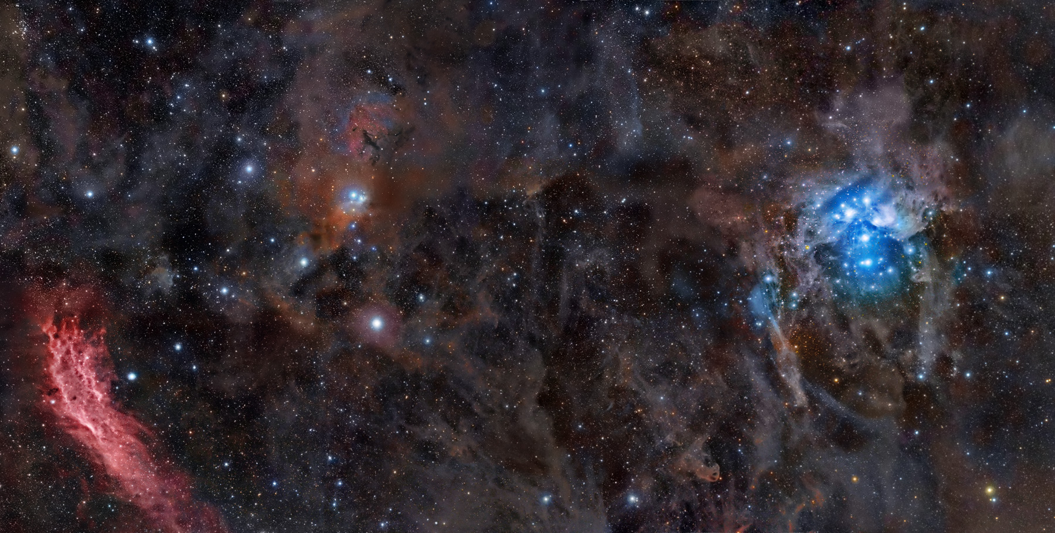
Stargazer: Automatic Telescope Control System
Course: COSC 470/471
Instructor: Youry Khmelevsky
Project Team: Red Team
Students: Rob Grmek, Robert Smith

Slide 2
Background Information
What is it?
telescope control system
set schedules to position the telescope
capture images of an area of the sky
Why is it needed?
to automate the process

Slide 3
Additional Requirements
Mobile device connectivity
Authentication and authorization
Optional SSL
Online help

Slide 4
Customers
Astronomy is a hobby of theirs
Currently use a manual process
Had good initial communication
Notes:
Astronomy is a hobby of theirs, so they own and operate over 10 telescopes.
As of now, Sasha and Nan (our customers), use a manual process for achieving their goals of positioning the telescope and finding new celestial objects.

Slide 5
Hardware Used
Telescope: Meade ETX-60AT-TC
Digital camera: Canon 30D
Mobile device: Nokia N97, Apple iPhone
Notes:
Telescope: Meade LX200 (Customer)
Digital camera: Sony A900 DSLR (Customer)
Mobile device: Nokia phones, Apple iPhone

Slide 6
Software Used
Documentation: Microsoft Word, Project
Modeling: Rational Rose
Ruby on Rails IDE: RubyMine
C# IDE: Microsoft Visual Studio

Slide 7
Software Development Methodology
Xtreme Programming
Rational Unified Process

Slide 8
Web Server Machine Details
Framework: Ruby on Rails
Operating System: Fedora 11
Web Server: Apache2

Slide 9
Telescope Machine Details
Language: C#
Operating System: Windows XP
Database: Oracle 10g Express Edition

Slide 10
Versioning Control: GIT
Fast
Small
Easy to learn

Slide 11
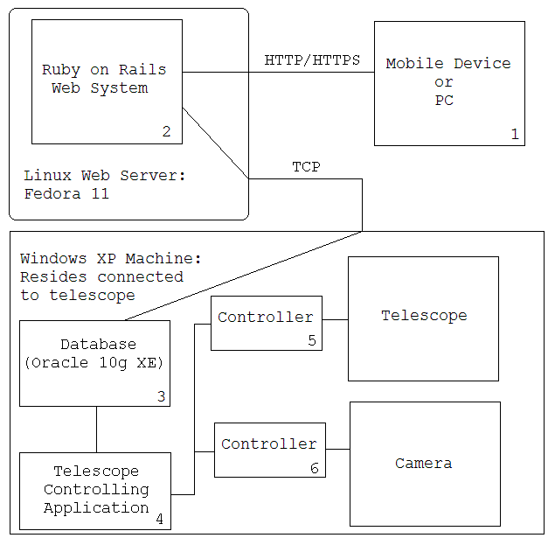
Architecture

Slide 12
Testing
Unit tests
Acceptance tests

Slide 13
Project Timeline
Iteration 5: Automated Scheduling and Telescope Positioning
Iteration 6: Libraries and GUI Enhancements
Iteration 7: Mobile Views
Iteration 8: Image Capturing
Iteration 9: The Final Release
Each iteration = 2-3 weeks

Slide 14
Project Evaluation and Metrics
Time spent: (1 unit = 15 minutes)
Total time: [??] units
Coding:
Models: [??]
Views: [??]
Controllers: [??]
Tests:
Unit tests: [??]
Test cases: [??]
Assertions: [??]

Slide 15
What Did We Learn?
More experienced with Ruby on Rails
Improved planning

Slide 16
Issues and Project Difficulties
Time constraints
Equipment delays

Slide 17
Summary
Automatic Telescope Control System
Can:
Schedule telescope for future dates
Capture images of that area

Slide 18
Acknowledgements
Thanks to the following:
Customers: Sasha and Nan
Youry Khmelevsky
Dave Goodall
Nokia
Notes:
Customers for giving us such an interesting project and supplying us with the Meade telescope
Youry for guiding us through the software development lifecycle
Dave Goodall for giving us a domain name for our project allowing outside access to our web server
Nokia for supplying us with two Nokia N97’s used for testing

