Slide 1
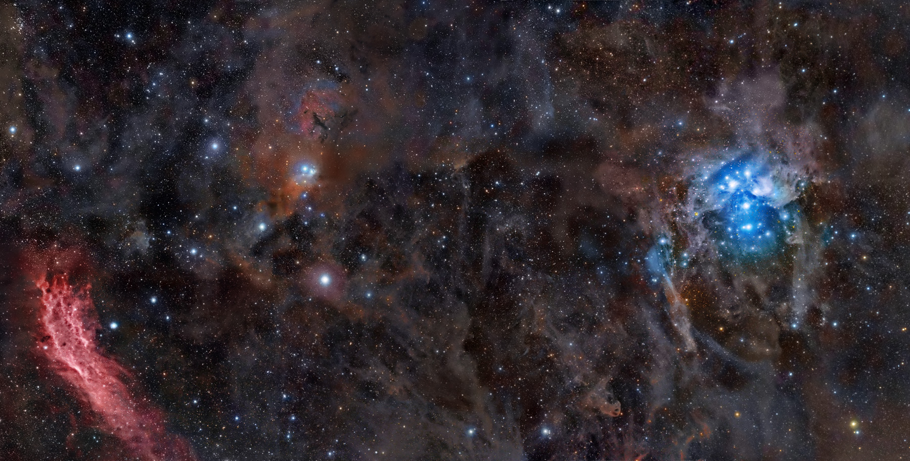
Stargazer: Automatic Telescope Control System
Course: COSC 470/471
Instructor: Youry Khmelevsky
Project Team: Red Team
Students: Rob Grmek, Robert Smith

Slide 2
Background Information
What is it?
telescope control system
set schedules to position the telescope
capture images of an area of the sky
Why is it needed?
to automate the process

Slide 3
Additional Requirements
Mobile device connectivity
Authentication and authorization
Optional SSL
Online help
Notes:
Mobile device connectivity: users should be able to easily access and use the web application through a handheld browser such as the iPhone’s Safari.
Authentication: users must have accounts in order to access the system in order to prevent outside, anonymous users from controlling the telescope.
Authorization: there are two types of users. Admins have no restrictions and can manage users (add, edit, update), and can make changes to any schedule. Regular users can only add new schedules as well as edit and update their own schedules. They are also able to view other schedules, but not make any changes to them, and edit their own profile (change username, password, email).
Optional SSL: the web application supports HTTPS but the web server uses a self-signed certificate (for now, since getting a certificate signed from a certificate authority i.e. Verisign costs money) so the user has the ability to encrypt their session although it is self-signed and not a mandatory requirement for the user to connect via HTTPS.
Viewing images: an image belongs to a schedule; once an image is compiled, it will be added to the web application in case the user wishes to view it. Some image processing is done to create a medium-resolution and thumbnail image in order for it to make it more presentable to users when images are listed. They can be clicked for the full, high-resolution image to be shown.
Online help: online help is added to further document how to correctly use the system if users are unsure as what they should do. However, the system is fairly intuitive so it should be intrinsically usable.

Slide 4
Customers
Astronomy is a hobby of theirs.
Currently use a manual process.
Had good initial communication.
Notes:
Astronomy is a hobby of theirs, so they own and operate over 10 telescopes.
As of now, Sasha and Nan (our customers), use a manual process for achieving their goals of positioning the telescope and finding new celestial objects.
Video showing images they have captured: http://www.youtube.com/user/lyuks

Slide 5
Hardware Used
Telescope: Meade ETX-60AT-TC
Digital camera: Canon 30D
Mobile device: Nokia N97, Apple iPhone
Notes:
Telescope: Meade LX200 (Customer)
Digital camera: Sony A900 DSLR (Customer)
Mobile device: Nokia phones, Apple iPhone

Slide 6
Software Used
Documentation: Microsoft Word and Project
Modeling: Rational Rose
Ruby on Rails IDE: RubyMine
C# IDE: Microsoft Visual Studio
Time Tracking: Anuko Time Tracker
Notes:
RailRoad = Ruby plugin for automatically generating domain models

Slide 7
Software Development Methodology
Xtreme Programming
Rational Unified Process

Slide 8
Web Server Details
Framework: Ruby on Rails
Operating System: Fedora 11
Web Server: Apache2
Notes:
ROB:
Ruby on Rails is a framework for developing web applications using the Ruby language. Rails will be discussed more on the next slide.
We use CSS for presentation. We have different stylesheets depending on which media the user is connecting from: either from PC or from a handheld device.
We use a Linux operating system to host our web application. In this case, we chose Fedora 11 which is a Red Hat based distribution.
We use apache2 as our web server for our production environment, but most development is done on local computers like my laptop using Mongrel which I believe is written in Ruby and works well since its small and fast but doesn’t offer much in terms of configuration or stability which is why Apache2 is needed for a production environment.
Also, for a database right now we use SQLite which is small, serverless, transactional database which requires zero configuration. It is very simple and doesn’t have many features so we may need to change this later to a database which can handle a larger data set for a production environment such as PostgreSQL which is the most powerful open source database out there at the moment. Other databases can be used such as MySQL or Oracle but I’d like to keep everything open source as much as possible as it would prevent any additional costs to the user.

Slide 9
Telescope Machine Details
Language: C#
Operating System: Windows XP
Database: Oracle 10g Express Edition
Notes:
ROB:
Ruby on Rails is a framework for developing web applications using the Ruby language. Rails will be discussed more on the next slide.
We use CSS for presentation. We have different stylesheets depending on which media the user is connecting from: either from PC or from a handheld device.
We use a Linux operating system to host our web application. In this case, we chose Fedora 11 which is a Red Hat based distribution.
We use apache2 as our web server for our production environment, but most development is done on local computers like my laptop using Mongrel which I believe is written in Ruby and works well since its small and fast but doesn’t offer much in terms of configuration or stability which is why Apache2 is needed for a production environment.
Also, for a database right now we use SQLite which is small, serverless, transactional database which requires zero configuration. It is very simple and doesn’t have many features so we may need to change this later to a database which can handle a larger data set for a production environment such as PostgreSQL which is the most powerful open source database out there at the moment. Other databases can be used such as MySQL or Oracle but I’d like to keep everything open source as much as possible as it would prevent any additional costs to the user.

Slide 10
Ruby on Rails
Comparatively easy to learn.
Enforces software patterns.
RESTful architecture.
Notes:
ROB:
Ruby on Rails is a framework for generating web applications quickly. It’s said that it can be up 10x more productive and efficient to use Rails over some other frameworks espicially those using Java as they usually require a lot of configuration and redundancy.
It’s comparatively easy to learn. Some other frameworks take a long time to master such as the Java Spring framework, but there really isn’t anything magically that goes on behind the scenes as far as I can tell with Ruby on Rails. The most difficult part is learning the Ruby language which can take some time.
Rails also enforces some patterns such as Model-View-Controller, which is usually just called MVC.
In the case of Rails, models are primarily used for managing the rules of interaction with a corresponding database table. In most cases, one table in your database will correspond to one model in your application.
In Rails, views are often HTML files with embedded Ruby code that performs tasks related solely to the presentation of the data.
In Rails, controllers are responsible for processing the incoming requests from the web browser, interrogating the models for data, and passing that data on to the views for presentation.
So basically what it does is:
- isolate the business logic from the user interface
- help keep code DRY. DRY means Don’t Repeat Yourself which basically means its a bad idea to duplicate code as it becomes harder to maintain and harder to understand.
- it also makes the applications easier to maintain as it is clear where different types of code belong
The Rails philosophy also includes several guiding principles such as:
REST (which stands for Representational State Transfer) is the best pattern for web applications – organizing your application around resources and standard HTTP verbs is the fastest way to go. What this means is we use URLs to represent resources and then use HTTP actions to determine what kind of response the controller should have.
Convention Over Configuration – means that Rails makes assumptions about what you want to do and how you’re going to do it, rather than letting you tweak every little thing through endless configuration files which eliminates a lot of redundancy and allows for greater productivity.

Slide 11
Versioning Control
Used “Git”. Why?
Fast
Small
Easy to learn
Distributed
GitHub account, see: http://github.com/RedTeamCOSC470/Stargazer
Notes:
ROB:
For our versioning control tool we used Git. A lot of people nowadays are using Git for the reasons mentioned at the link. What drove me to choose git as our versioning tool was a presentation Linus Torvalds gave at a Google conference listing all the reasons which explains his reasons for developing this tool.
It’s small, fast, easy to learn and can be used in a distributed environment. The reason why it’s so fast is because everything is local except when pushing and pulling commits to and from remote destinations which is the most time consuming activity and allows for work to be done offline as well. Network access isn’t necessary for most actions.
We use a GitHub account to host our source code and acts as our remote repository and it can be seen at the following link location.
http://www.youtube.com/watch?v=4XpnKHJAok8

Slide 12
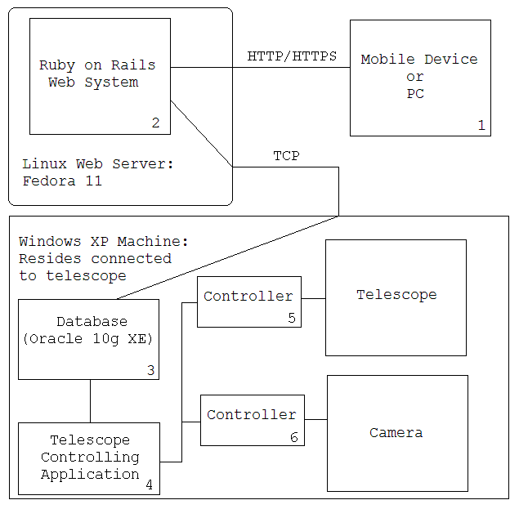
Architecture
Notes:
ROB:
So here is how the architecture of our system will look like once all the components are completed. Right now, we still need to create the Java application which is a very large core of our system which will do the actual communication with the telescope and camera.
Using a web browser, users will access the web application using either HTTP or HTTPS. Once they login they can create new schedules for positioning the telescope. Once a schedule is created, using a cronjob or some other scheduling tool, we will run a script at the specific time the telescope should position itself which will connect to the machine connected to the telescope using say SSH and then will be able to call the Java program with command line arguments to move at such and such a location for such and such a duration. The Java application will also compile the images and save it to that local disk.
Note:
users may also connect to the web application via HTTPS
application which controls the telescope and camera may be written in C#

Slide 13
Testing
Unit tests
Acceptance tests
Notes:
ROB:
So because we use test-driven development, we need to have unit tests.
Unit tests are “Black box” tests to ensure functionality correctness. A test suite is used to run all unit tests whenever new code is added to the system. Also, all tests must pass after the new code is added.
For unit testing, we use the built-in ruby libraries which have functionality similiar to that of JUnit testing.

Slide 14
Project Timeline
Iteration 5: Automated Scheduling and Telescope Positioning
Iteration 6: Libraries and GUI Enhancements
Iteration 7: Mobile Views
Iteration 8: Image Capturing
Iteration 9: The Final Release
Each iteration = 2-3 weeks

Slide 15
Project Evaluation and Metrics
Time spent: (1 unit = 15 minutes)
Total time: [??] units
Coding:
Models: [??]
Views: [??]
Controllers: [??]
Tests:
Unit tests: [??]
Test cases: [??]
Assertions: [??]

Slide 16
What did we learn?
??

Slide 17
Issues and Project Difficulties
Time constraints
Equipment delays

Slide 18
Summary

Slide 19
Acknowledgements
Thanks to the following:
Customers: Sasha and Nan
Youry Khmelevsky
Dave Goodall
Nokia
Notes:
Customers for giving us such an interesting project and supplying us with the Meade telescope
Youry for guiding us through the software development lifecycle
Dave Goodall for giving us a domain name for our project
Nokia for supplying us with two Nokia N97’s used for testing

Slide 20
Demonstrations
!
Notes:
Web App:
Show using different browsers
Show using PC and handheld devices
Also DEMO:
Meade Autostars program
Winstars2
Hardware (telescope)

Slide 21
Questions
?

