Slide 1
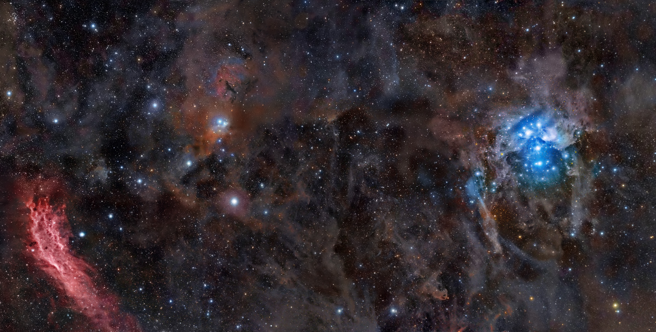
Stargazer: Automatic Telescope Control System
Course: COSC 470/471
Instructor: Youry Khmelevsky
Project Team: Red Team
Students: Rob Grmek, Robert Smith
Notes:
Rob

Slide 2
Background Information
What is it?
telescope control system
set schedules to position the telescope
capture images of an area of the sky
Why is it needed?
to automate the process
Notes:
robert

Slide 3
Why is it Unique?
Others do not have scheduling
Few are web systems
Few have mobile device functionality
Notes:
robert

Slide 4
Additional Requirements
Mobile device connectivity
Authentication and authorization
Optional SSL
Online help
Notes:
Rob

Slide 5
Customers
Astronomy is a hobby of theirs
Currently use a manual process
Had good initial communication
Notes:
Rob
Astronomy is a hobby of theirs, so they own and operate over 10 telescopes.
As of now, Sasha and Nan (our customers), use a manual process for achieving their goals of positioning the telescope and finding new celestial objects.

Slide 6
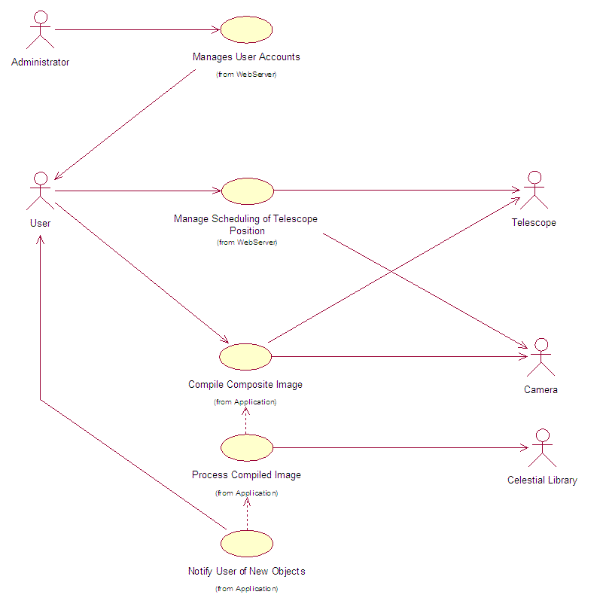
Use Case Diagram
Notes:
Robert

Slide 7
Risk Management
Risk | Probability | Effect | Solution
Underestimate the time the project will take. | Medium to high. | Serious – we run out of time. | Remove non-essential features.
Scheduling conflicts between team members. | Low to medium. | Serious – Individual programming is not XP programming. | Schedule well before hand.
Server or technical issues. | Low to medium. | Catastrophic – May lose work. | Backup regularly; use a versioning control system.
Lack of time at end of semester | High. | Tolerable – Reduced ability to work outside of class/lab time. | Use class/lab time as productively as possible.
Client unavailable or unresponsive. | Medium. | Catastrophic – No customer input. | Use alternative methods of communication (phone or email).
Not receiving equipment necessary to complete project. | Medium. | Catastrophic – Not able to complete project to requirements. | Use alternative devices (such as a different digital camera) and try to use a generalized solution that should work for both devices.
Notes:
Robert
Probabilities can be: low, moderate, high.
Effects can be: tolerable, serious and catastrophic

Slide 8
Hardware Used
Telescope: Meade ETX-60AT-TC
Digital camera: Canon 30D
Mobile device: Nokia N97, Apple iPhone
Notes:
Rob
Telescope: Meade LX200 (Customer)
Digital camera: Sony A900 DSLR (Customer)
Mobile device: Nokia phones, Apple iPhone

Slide 9
Software Used
Documentation: Microsoft Word, Project
Modeling: Rational Rose
Ruby on Rails IDE: RubyMine
C# IDE: Microsoft Visual Studio
Testing: ASCOM Telescope Simulator, NUnit Testing
Notes:
robert

Slide 10
Software Development Methodology
Xtreme Programming
Rational Unified Process
Notes:
Rob

Slide 11
Web Server Machine Details
Framework: Ruby on Rails
Operating System: Fedora 11
Web Server: Apache2
Notes:
Rob

Slide 12
Telescope Machine Details
Language: C#
Operating System: Windows XP
Database: Oracle 10g Express Edition
Telescope drivers: ASCOM
Camera drivers: Camera EDSDK
Notes:
Robert

Slide 13
Versioning Control: GIT
Fast
Small
Easy to learn
Notes:
Rob

Slide 14
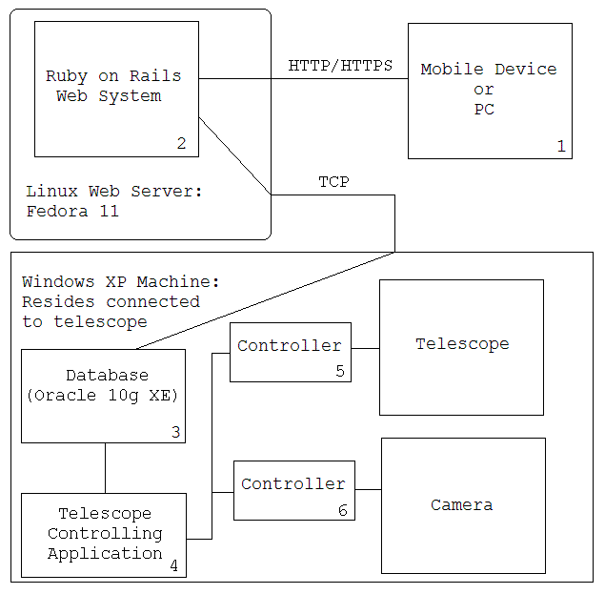
Architecture
Notes:
Rob

Slide 15
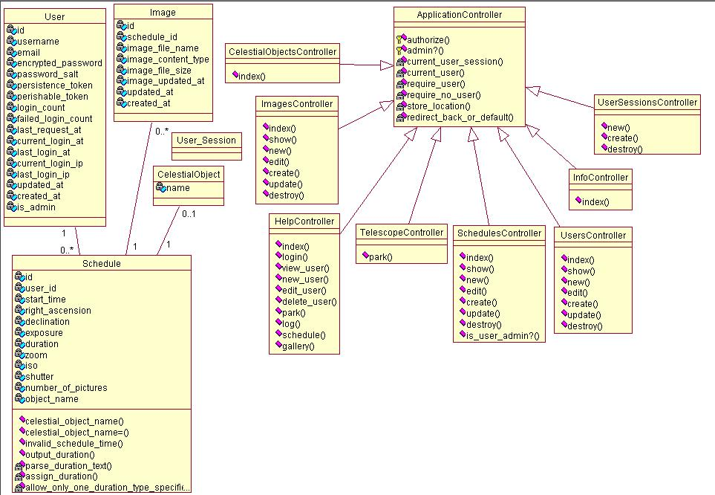
Class Diagram: Web Application
Notes:
Rob

Slide 16
Testing
Unit tests
Acceptance tests
Notes:
Robert

Slide 17
Example: Unit Test + Demo
require 'test_helper'
class UserTest < ActiveSupport::TestCase
# create a user with necessary, correct input values for the following tests
def setup
@user = User.new
@user.username = "unit_test"
@user.email = "unit@test.com"
@user.password = "test"
@user.password_confirmation = "test"
end
def test_username_cannot_be_null
@user.username = ""
assert !@user.save
end
end
Notes:
Rob:
Here is an example of a ruby unit test.
The first thing we do is load the test_helper file which sets the rails environment into “test” mode (Rails functions in three different modes: test, development and production). By doing this, it automatically loads a test database we can use to input sample data to test our functionality and validations.
the class extends the test case class much like JUnit Tests which gives us access to some methods.
The first thing we do is create a user with correct input values so later we can just override an attribute of that object with a value that shouldn’t work. For instance, we shouldn’t be able to create a new user when we haven’t supplied a username. Here we made it null and we make an assertion to test that our application should not allow us to save this object. If this assertion was false (not and true), a visible error message would occur when we run this test.
Now to run the tests we go to the command line and simply type rake test:units

Slide 18
Project Timeline: Semester 1
Iteration 1: Inception
Iteration 2: SPIKE project
Iteration 3: Authentication and Authorization
Iteration 4: Image Gallery
Iteration 5: Final Refactored Release
Each iteration = ~1 week
Notes:
robert
Mention that we only had prototype web system complete
no parking
no scheduling
no image gathering
few, rough mobile device views

Slide 19
Project Timeline: Semester 2
Iteration 5: Automated Scheduling and Telescope Positioning
Iteration 6: Libraries and GUI Enhancements
Iteration 7: Mobile Views
Iteration 8: Image Capturing
Iteration 9: The Final Release
Each iteration = 2-3 weeks
Notes:
robert

Slide 20
Metrics: Semester 2
Time spent: (1 unit = 15 minutes)
Total time: 580 units
Coding:
Models: 5
Views: 43
Controllers: 9
Tests:
Unit tests: 3
Test cases: 17
Assertions: 29
Notes:
rob

Slide 21
What Did We Learn?
More experienced with Ruby on Rails
Improved planning
Hardware interfacing with drivers
Notes:
Robert

Slide 22
Issues and Project Difficulties
Time constraints
Equipment delays
Customer communication issues
Notes:
Robert

Slide 23
Summary
Automatic Telescope Control System
Can:
Schedule telescope for future dates
Capture images of that area
Automatically upload images to web server
Notes:
Robert

Slide 24
Acknowledgements
Thanks to the following:
Customers: Sasha and Nan
Youry Khmelevsky
Dave Goodall
Nokia
Canon
Notes:
Rob
Customers for giving us such an interesting project and supplying us with the Meade telescope
Youry for guiding us through the software development lifecycle
Dave Goodall for giving us a domain name for our project allowing outside access to our web server
Nokia for supplying us with two Nokia N97’s used for testing
Canon for development kit and drivers

