Slide 1
Mobile Testing II
Tobias Redl
25.05.2018

Slide 2
AGENDA
App - Introduction
Types of Tests in Android
Unit Tests
Instrumented Tests
Other Testing Frameworks
Live - Examples
Notes:
Introduce a app we are going to test at the end and for which we are collecting Tests scenarios during the presentation.
In the next step I want to discuss different types of tests in android
After that I will talk about other testing frameworks.
At the end there will be a live example part.

Slide 3
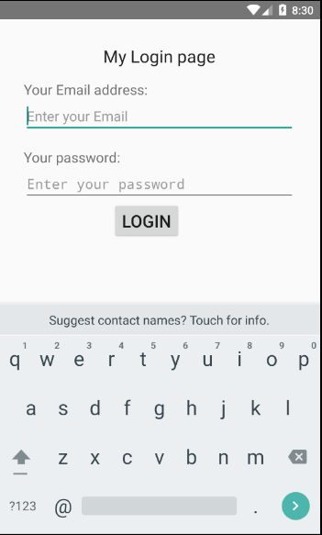
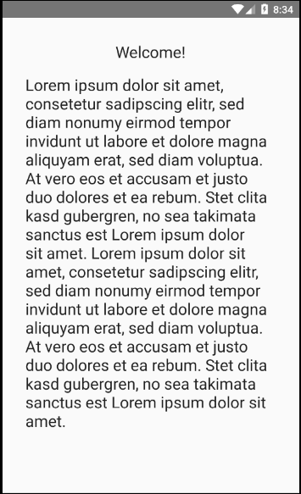
App - Introduction

Slide 4
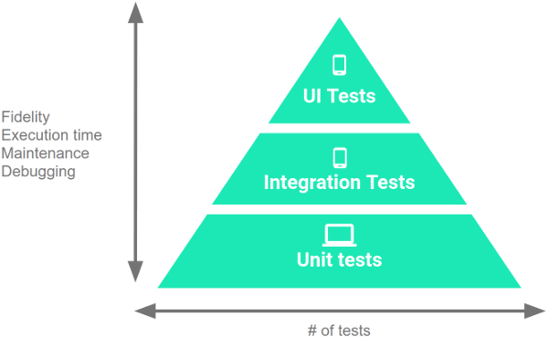
Types of Tests in Android
Notes:
70 – 20 – 10 %
Quellen:
https://developer.android.com/training/testing/fundamentals

Slide 5
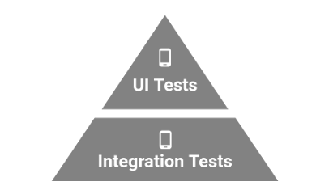
Unit Tests
Tests a single function / method
Do not need a running app
Normally no Android dependencies
Try to mock them
It‘s fast
Runs on local JVM

Slide 6
Unit Tests
Examples
E-Mail validation
Some Text in front of @
@ - symbol
Domain after @
Password validation
Long enough
All needed symbols are included
Login validation (with mock)
Content delivery (with mock)
Store data locally (with mock)
Notes:
Login -> Look up if the account exists

Slide 7
Instrumented Tests
Run on real / virtual device
Slower than unit Tests
Have more access
App – Context
Android dependencies like ressources

Slide 8
Instrumented Tests
Instrumented Unit Tests
Integration Tests
Functional UI Tests
Notes:
Instrumented Unit Tests – Unit Tests that depend on Android dependencies which we can not mock up
Integration Tests – Test components the User do not directly interact with
Functional UI Tests - Test UI components and their behaviour

Slide 9

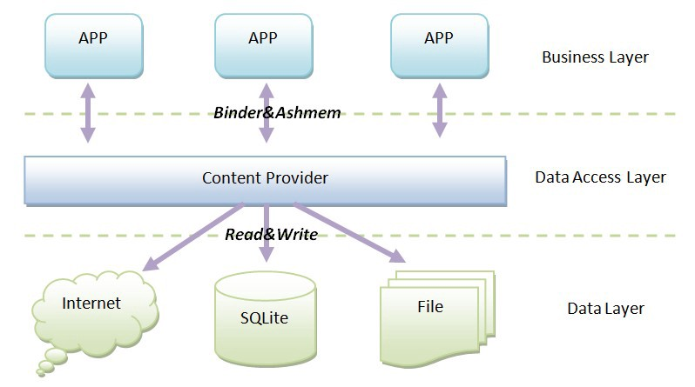
Instrumented Tests
IntegrationTests
Services
Content Provider
Notes:
Test components the User do not directly interact with
Services
Content Providers
Test behaviour when components run on a device
Service https://developer.android.com/guide/components/services
Performe long-running operations
No user interface
Content Provider https://developer.android.com/guide/topics/providers/content-providers
Manage access to data stored by itself or by other apps
Provide a way to share data with other apps
Quellen:
https://developer.android.com/training/testing/integration-testing/
http://businessbharat.com/fix-internet-connection-problem-android-hindi/
https://medium.com/@mariadesilva012/android-content-providers-its-creation-in-easy-steps-3dd78a24ca53

Slide 10
Instrumented Tests
Integration Tests - Examples
Login validation (no mock)
Connect to server
Transfer data to and from server
Content delivery (no mock)
Connect to server
Transfer data from server
Sharing data
Send data to other apps
Receive data from other apps
Store data locally (no mock)
Store in Database

Slide 11


Instrumented Tests
Functional UI Tests
Single App
Multiple Apps
Target app behaviour
Always the same context
User like interactions
Interaction between apps
Changing context
User and system like interactions
UiAutomator
Notes:
Single App:
All pages should be tested
All components should be in the view etc etc
Multiple Apps:
Beispiel CiE App – Contact via Mail
Tap link and expect that the opend app is the default E-Mail app
Or share a link via Whatsapp, open Google Maps and so on
Quellen:
https://mobileappstesting.com/looking-for-google-espresso-trainer-android-automation-tool/
https://alexilyenko.github.io/uiautomator-basics/

Slide 12
Instrumented Tests
Functional UI Tests - Examples
Login Form
E-Mail input is available
Password input is available
Login Button is available
Failed Login is visible
Successfull Login in visible
Content Page
Content is displayed
Textboxes are visible
Keep logged in
Send app to background an bring it back to foreground

Slide 13
Other Testing Frameworks
iOS - Frameworks
XCTest
Unit Tests
Integration Tests
Functional UI Tests (XCUITests)
KIF
Earl Grey (Espresso for iOS)

Slide 14

Other Testing Frameworks
Appium
Based on Selenium (browser testing tool)
Webserver with REST API
Client / Server architecture
Possibility to write tests in different languages (http client API)
Server and tests can be on different machines
Tests use XCUITest (iOS)
Tests use UIAutomator (Android)
Notes:
Heart of Appium is a webserver written in node.js
Languages: PHP, Ruby, C#.Net

Slide 15


Other Testing Frameworks
Roboelectirc & Mockito
Mocking frameworks
Mock up
Data
Classes
System parts

Slide 16
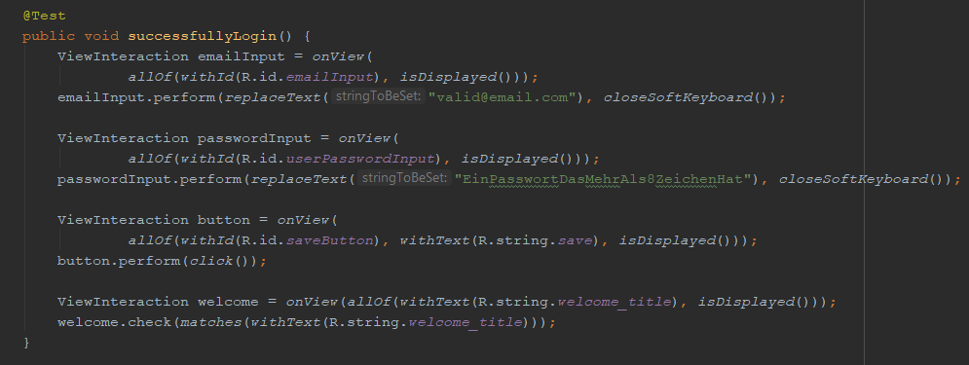
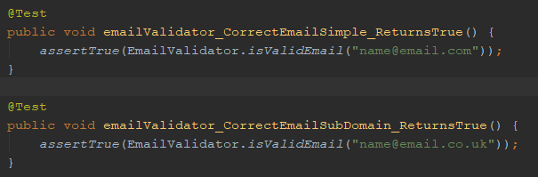
Live - Examples
Notes:
Loginscreen einer App testen
Unit Test
Teste Validierung
Passwort muss mindestens 8 Zeichen lang sein und darf nicht die E-Mail enthalten
E-Mail muss valide sein
Esspresso:
Teste ob alle Objekte (Textfelder und Button) vorhanden sind
Teste, dass Textfelder beschreibbar sind
Teste, dass Button gedrückt werden kann
Teste, dass Fehlermeldung angezeigt wird
Teste, dass valider Login funktioniert

