Slide 1
PitCrew
Prepared response for
data center teams
Sector agents investigate developing issues.
Technicians arrive with the evidence and keep it through every handoff.
Notes:
10 seconds. Say: PitCrew prepares data center teams to act on developing issues, then preserves their evidence when responsibility changes.
Reference only: The NMC² focus is operational readiness and continuity. No measured uptime claim. Uptime Institute identifies unclear procedures and failure to follow them as operational risks. Research: https://connect.uptimeinstitute.com/about-ui/press-releases/uptime-announces-annual-outage-analysis-report-2026. Source: PitCrew repository, docs/sector-operations.md, services/core/fleet.ts and services/agents/fleet-agent.ts. Verified seeded demo on November 8, 2026.

Slide 2
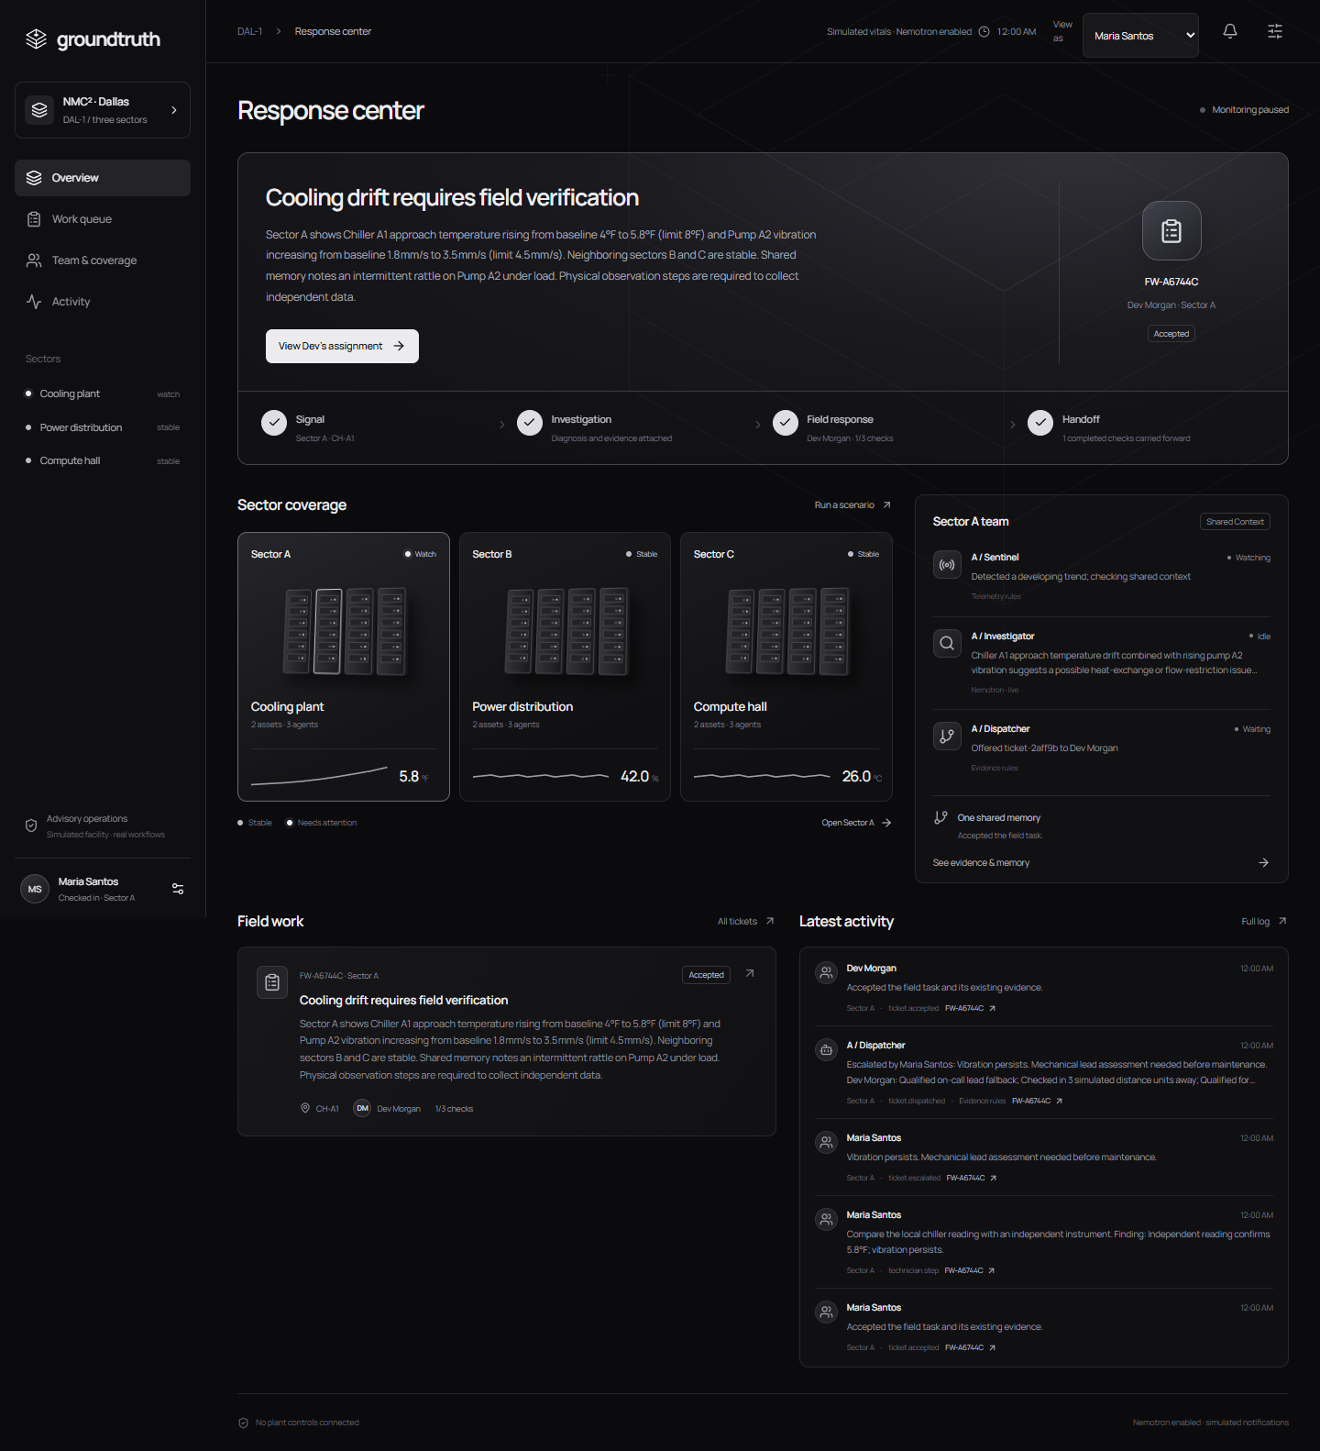
The first visit starts with evidence
A developing cooling fault
The investigator compares the trend with nearby sectors and the previous shift’s observations.
The dispatcher offers physical checks to a qualified sector responder with the right tools and access.
Proximity uses a sector check-in.
Notes:
15 seconds. Say: The investigator checks a cooling trend against neighboring sectors and shift history. The dispatcher chooses a qualified sector responder with the right equipment and access. Location comes from a manual check-in.
Reference only: In the seeded cooling case, Maria meets the server-enforced eligibility requirements. Screenshot: the running prototype with synthetic facility data. Source: PitCrew repository, docs/sector-operations.md, services/core/fleet.ts and services/agents/fleet-agent.ts. Verified seeded demo on November 8, 2026.

Slide 3
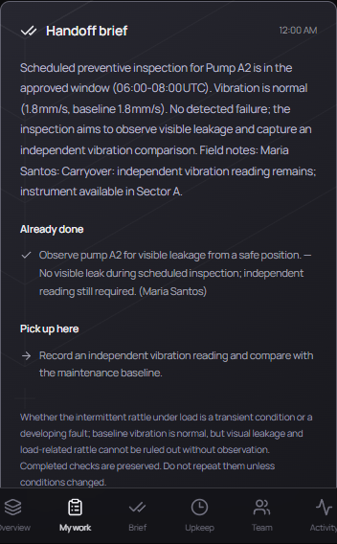
The next responder keeps the context
Maria records a field check.
Dev receives her finding, completed work, remaining checks and unresolved questions.
Shared history also informs upkeep.
The team checks maintenance readiness before a due date and keeps blocked work visible.
Notes:
20 seconds. Say: Maria records a field check on her phone. When Dev takes over, he receives her finding, completed steps and the checks still needed. The same shared history supports upkeep planning, so teams can see upcoming work and blockers before maintenance is due.
Reference only: The pictured preventive handoff preserves Maria's completed observation and the remaining independent reading. Workflow benefits are demonstrated, not measured production savings. Source: PitCrew repository, docs/sector-operations.md, services/core/fleet.ts and services/agents/fleet-agent.ts. Verified seeded demo on November 8, 2026.

Slide 4
Nemotron works through real tools
Investigator
Dispatcher
Reads vitals, neighboring sectors,
maintenance plans and sector memory.
Reads the new case, shared memory
and eligible responders.
propose_diagnosis
write_shared_memory
get_eligible_responders
choose_dispatch
The server enforces qualifications and approved work.
Every tool call leaves an inspectable record.
Notes:
25 seconds. Say: Nemotron runs two collaborating roles through real tools. The investigator reads telemetry, maintenance plans and shared history, then writes a provisional case. The dispatcher reads that case and the eligible roster before selecting a responder. The server enforces qualifications and approved work. Every tool call leaves a visible record.
Reference only: Verified hosted model nvidia/nemotron-3.5-lightning-30b-a3b. Investigator tools: read_maintenance_plan, read_shared_memory, read_sector_vitals, compare_neighboring_sectors, propose_diagnosis, write_shared_memory. Dispatcher tools: read_case_brief, read_shared_memory, get_eligible_responders, choose_dispatch. The sentinel uses deterministic telemetry rules. No plant control or external messaging tools. Source: PitCrew repository, docs/sector-operations.md, services/core/fleet.ts and services/agents/fleet-agent.ts. Verified seeded demo on November 8, 2026.

Slide 5
The three-minute demonstration
1
Prepared cooling case
2
One phone check
Review the diagnosis and
saved live tool calls.
Accept the assignment and
record a field observation.
3
Preserved handoff
4
Shift readiness
The next technician sees findings
and unfinished work.
A brief view of the shift report
and upcoming maintenance.
Synthetic facility data. Real model tool calls. No plant actuation.
Notes:
5 seconds. Say: Here is the prepared case, one field check and the handoff.
Presentation budget: slides 10 + 15 + 20 + 25 + 5 seconds = 1:15. App walkthrough target 2:30. Total presentation 3:45. Demo video must stay below 3:00.
Before recording: run Cooling drift with Live Nemotron enabled and wait for its real investigation and assignment to finish. Keep monitoring paused. The video shows the saved live execution trace, not an inference run happening during recording. State this plainly while opening Activity. Use Maria on the phone and Dev on the laptop, both connected to the same running server.
App walkthrough, 2:30 target:
0:00–0:35 Prepared cooling case. Show diagnosis, uncertainty and actual saved tool calls. Say: This case was investigated by Nemotron before recording; these are its recorded tool inputs and results.
0:35–1:20 One phone check. Accept as Maria, record an independent reading, then request senior support.
1:20–2:05 Preserved handoff. Switch to Dev, accept, and point to Already done and Pick up here. Show Maria's finding and unfinished checks.
2:05–2:30 Shift readiness. Briefly show the shift brief and upkeep list with ready, scheduled and blocked work. Do not launch another investigation.
Do not reset or change scenarios during the recording: a new scenario resets the shared case. Sensor mismatch is backup only, outside the primary timed demonstration. Facility data, people and in-app notifications are synthetic. Real model inference and bounded tool execution were completed before recording. No plant actuation or measured uptime gains are claimed. Source: PitCrew repository, docs/sector-operations.md, services/core/fleet.ts and services/agents/fleet-agent.ts. Verified seeded demo on November 8, 2026.

