Slide 1

Load Balancing 101 & Building a Traditional Linux Load Balancer

Slide 2
About me
Andrew Howe
@AndrewXanadu
-------------------------------------------------------------------------

Slide 3


Slide 4
Contents
What is load balancing?
Why would you use a load balancer?
Load balancing methods (x 4)
Building a Linux load balancer

Slide 5
Contents
What is load balancing?
Why would you use a load balancer?
Load balancing methods (x 4)
Building a Linux load balancer
Something for everyone!

Slide 6
What is load balancing?

Slide 7
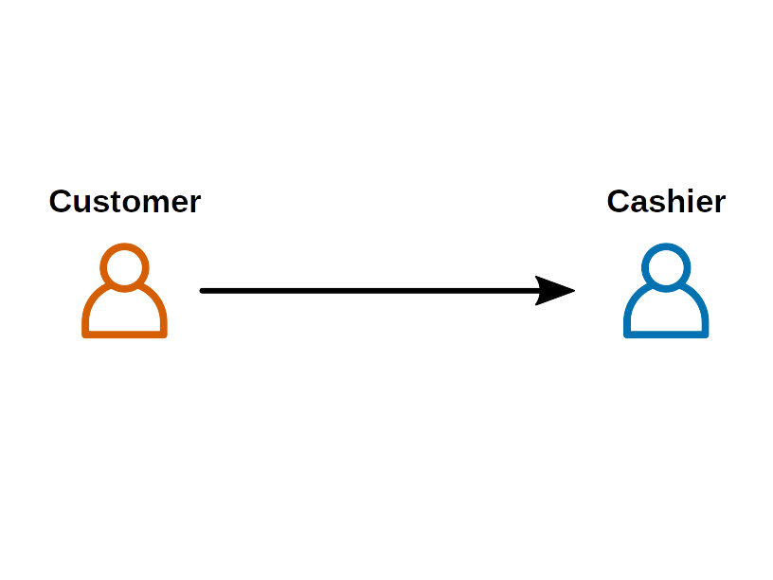

Slide 8
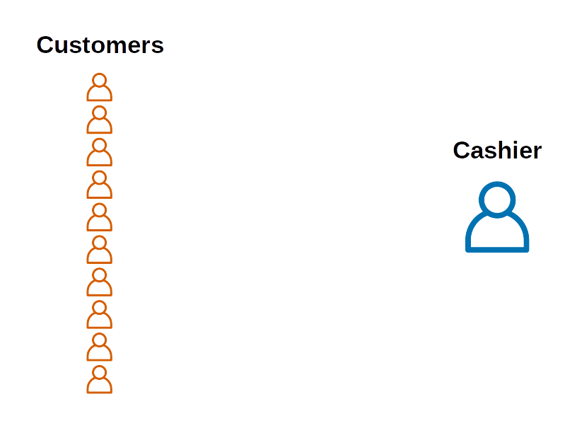

Slide 9
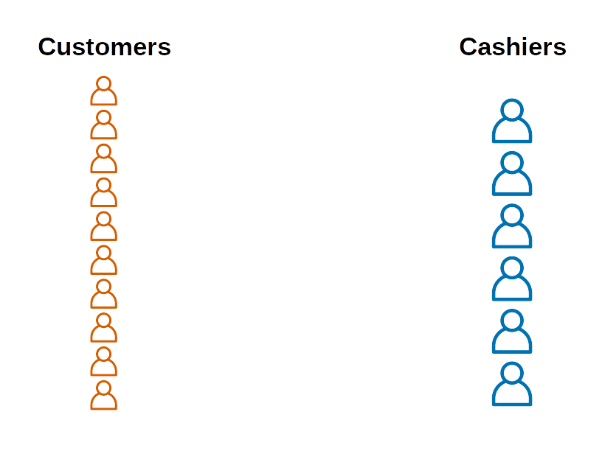

Slide 10
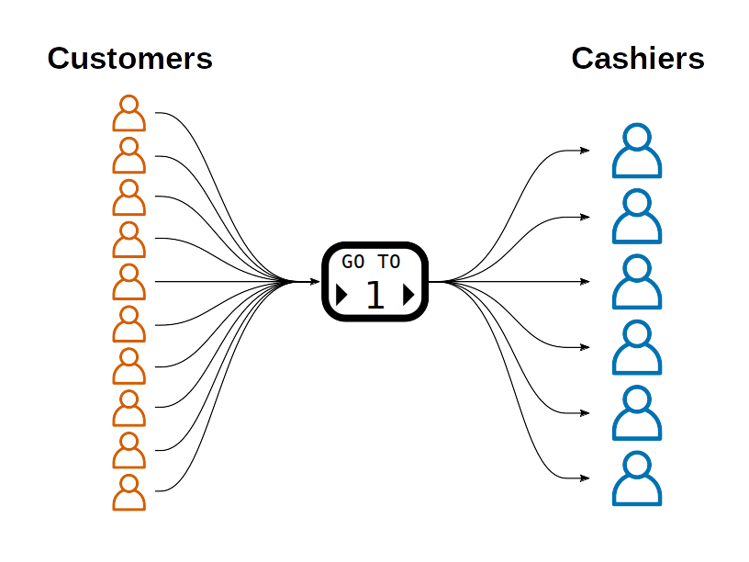

Slide 11
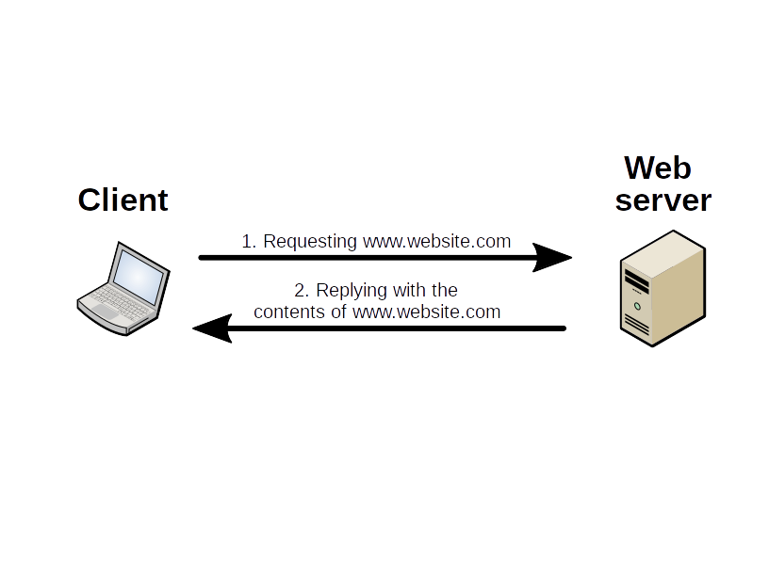

Slide 13
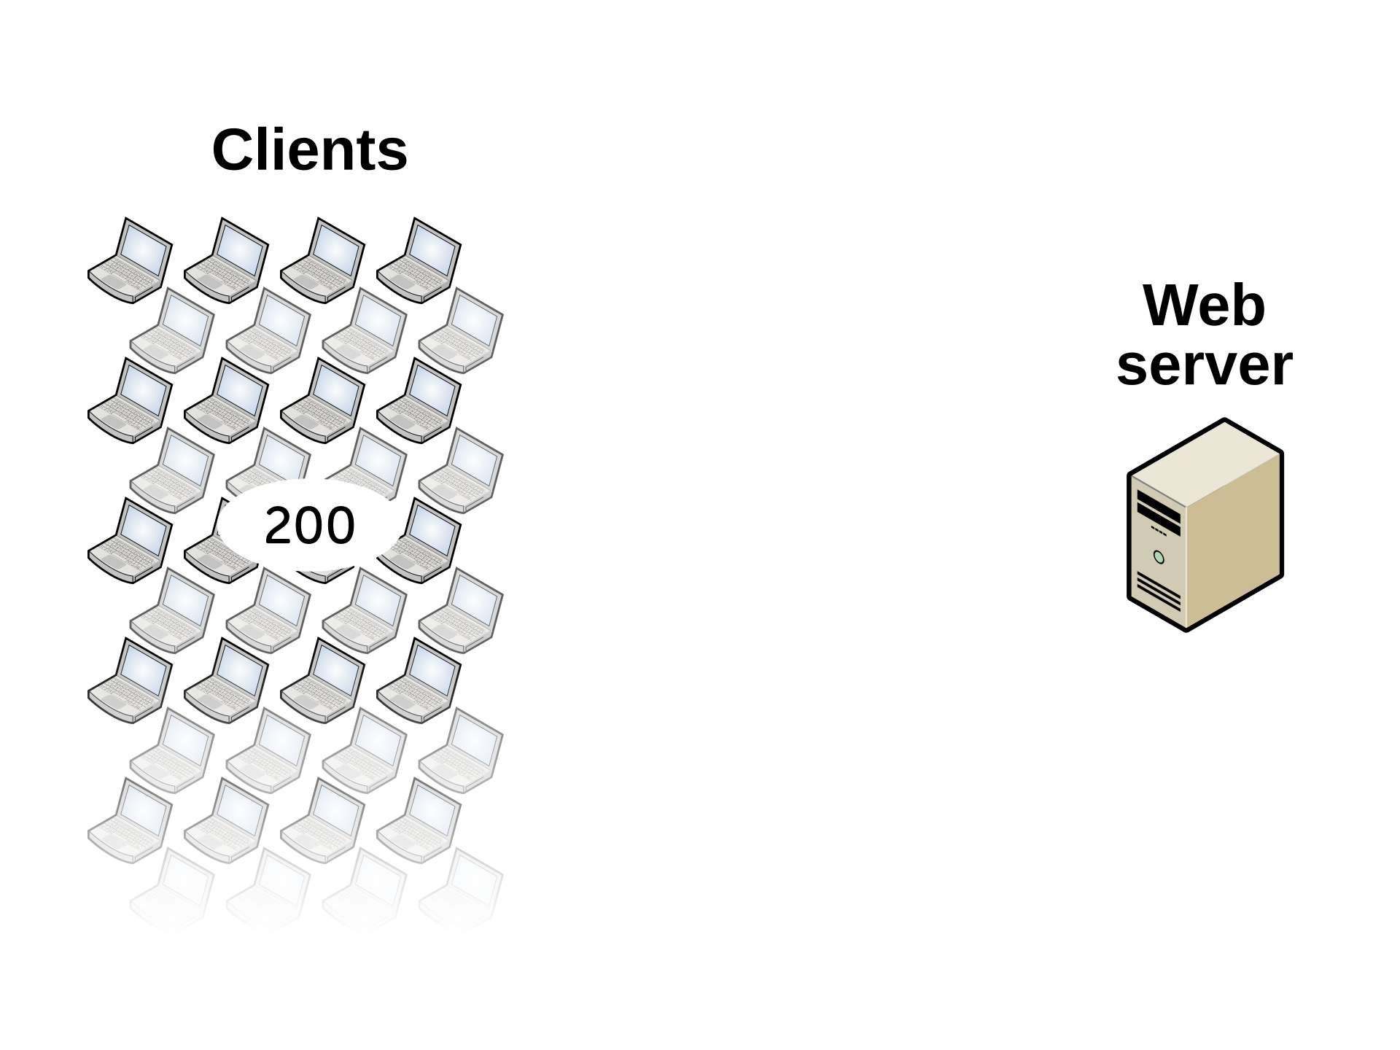

Slide 14
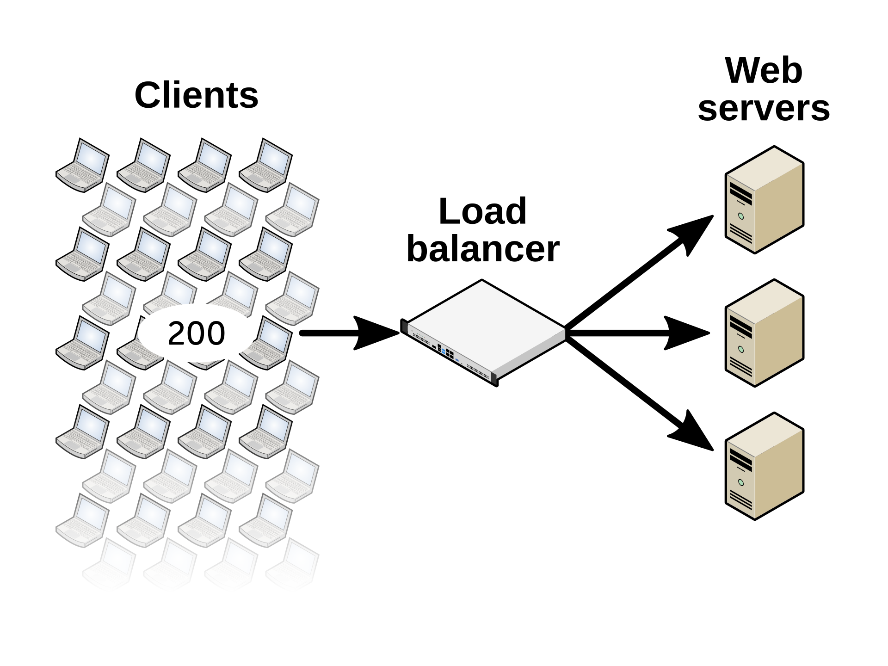

Slide 16
Why would you use a load balancer?

Slide 17
Why would you use a load balancer?
Scalability

Slide 18
Why would you use a load balancer?
Scalability
High availability

Slide 19
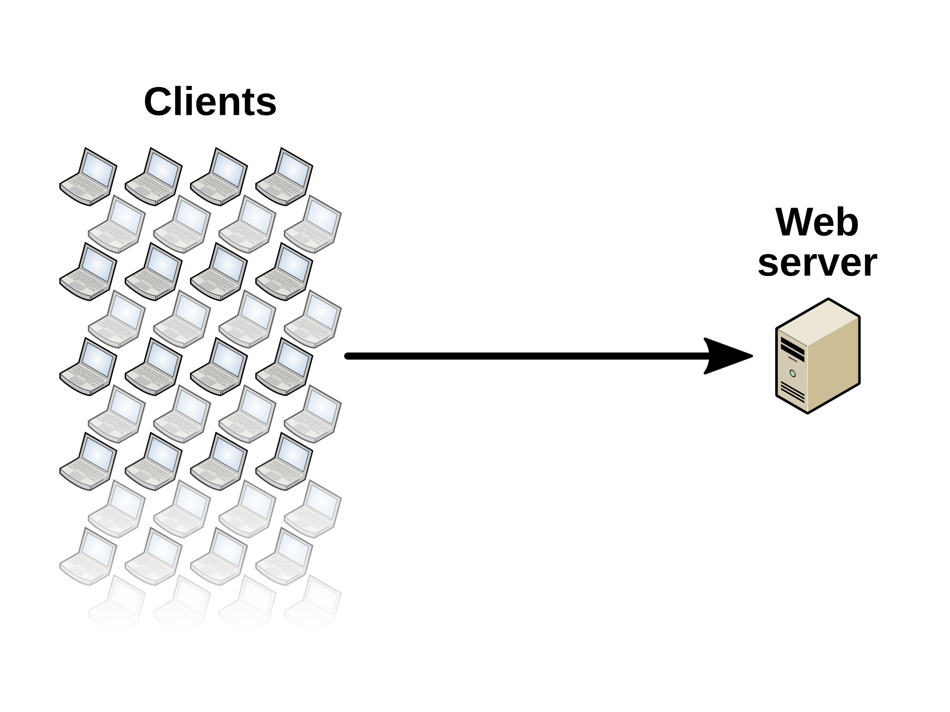

Slide 20
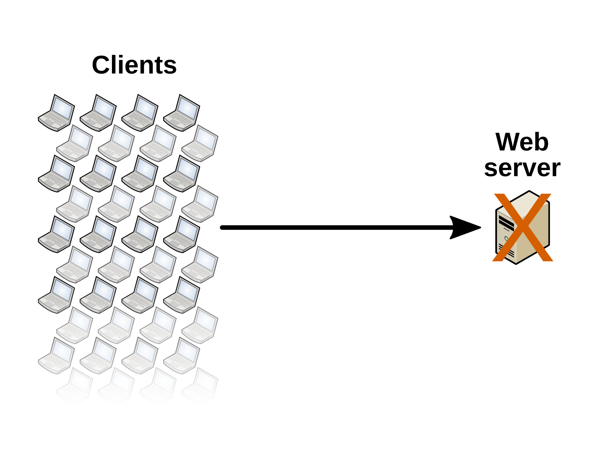

Slide 21


Slide 22
Why would you use a load balancer?
Scalability
High availability
Easy server maintenance

Slide 23
What services might you load balance?
Web servers
E-mail servers
Web proxies
Remote desktop services
Print servers

Slide 24
Load balancing methods
Layer 4 Layer 7

Slide 25

Load balancing methods
Layer 4 Layer 7

Slide 26
Load balancing methods
Layer 4 Layer 7

Slide 27
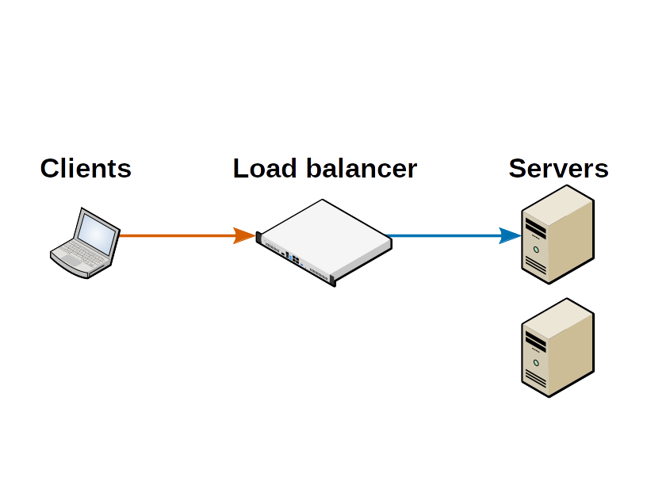
Layer 7 load balancing

Slide 28
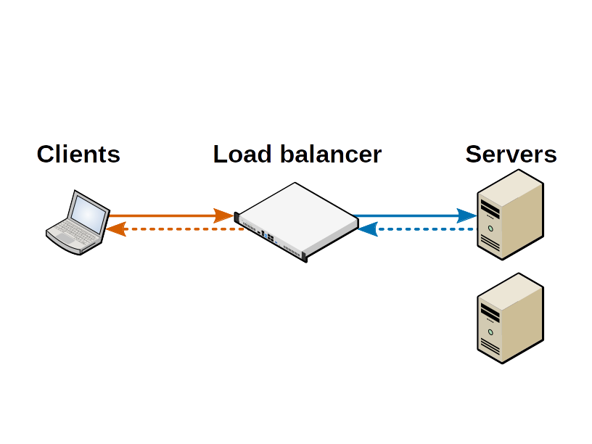
Layer 7 load balancing

Slide 29
Layer 7 load balancing
VIP: 192.168.10.20
IP: 192.168.10.100
IP: 192.168.10.101

Slide 30
Layer 4 load balancing: NAT mode
NAT mode (Network Address Translation)
Changing the destination IP address of load
balanced traffic

Slide 31
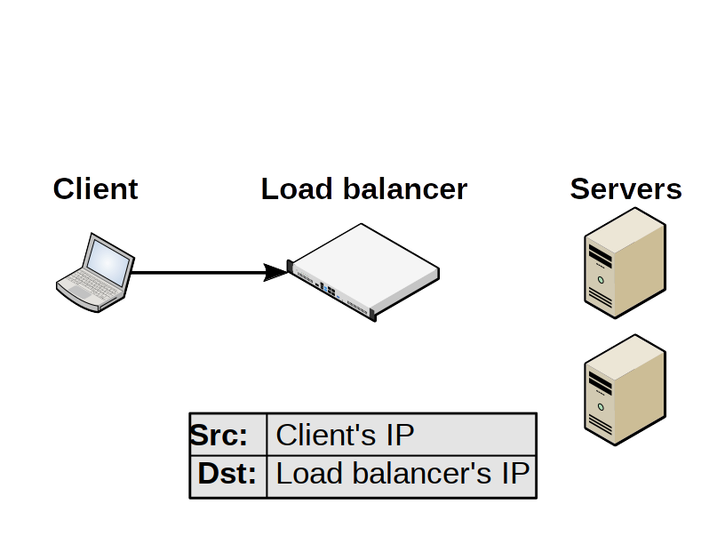

Slide 32


Slide 33
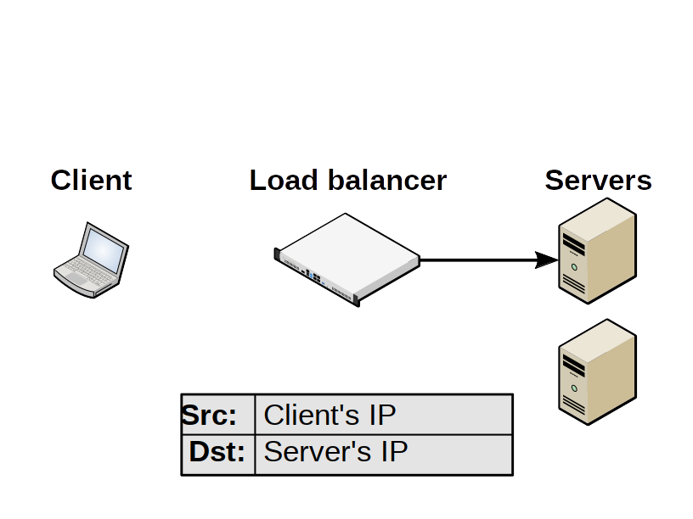

Slide 34
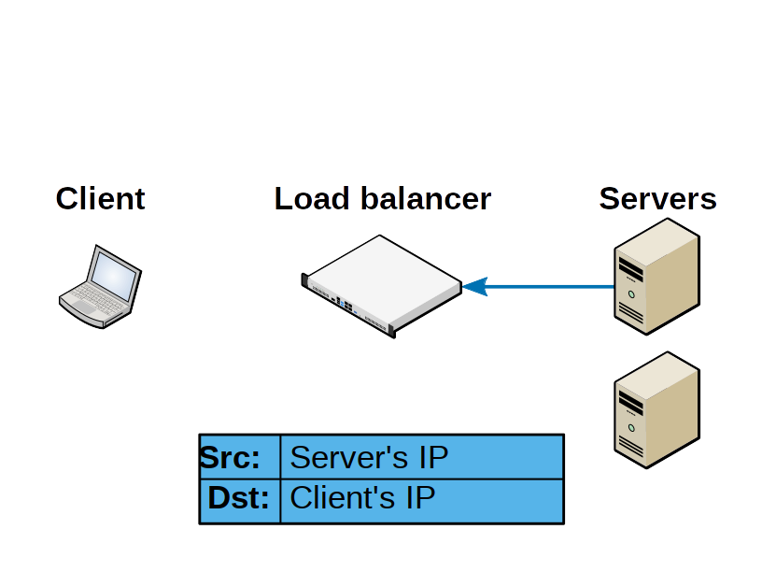

Slide 35
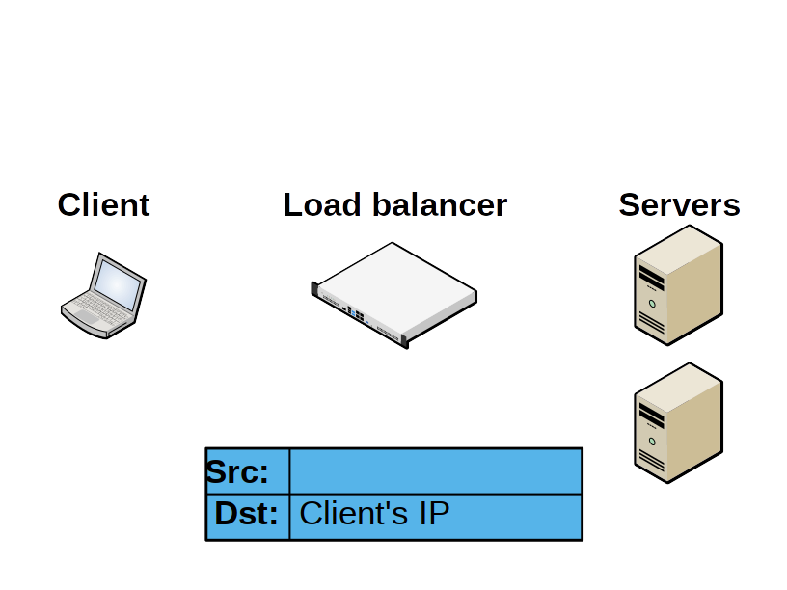

Slide 36
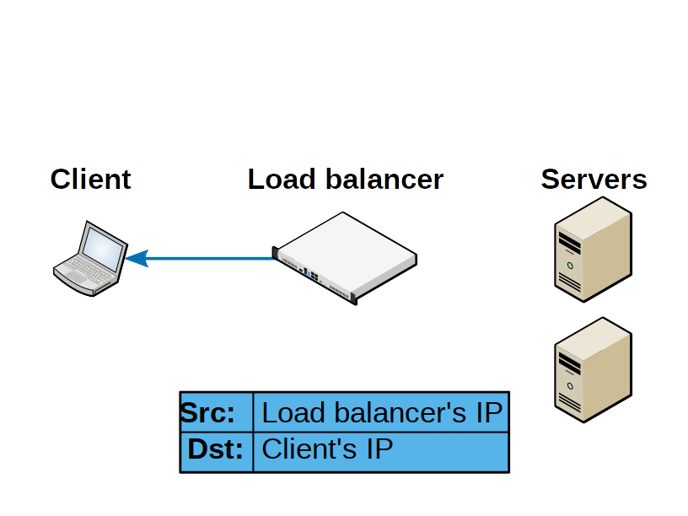

Slide 37
Layer 4 load balancing: DR mode
DR mode (Direct Routing)
Some vendors refer to this as DSR, ‘Direct
Server Return’
Changing the destination MAC address of
load balanced traffic

Slide 38
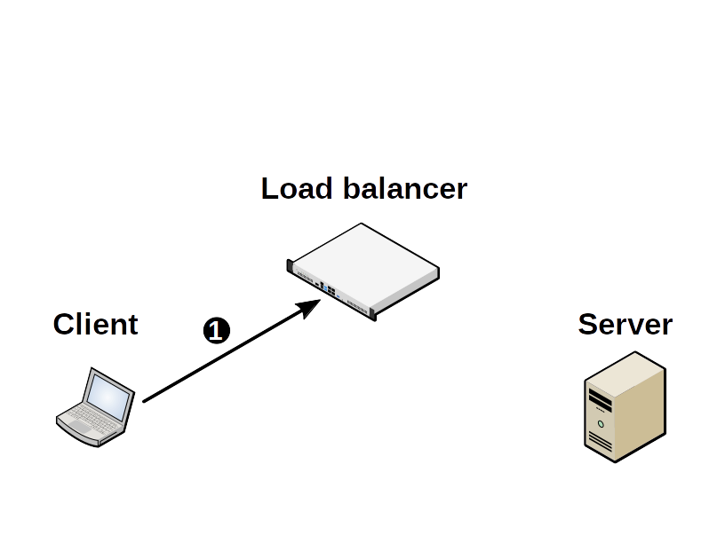
Layer 4 load balancing: DR mode

Slide 39
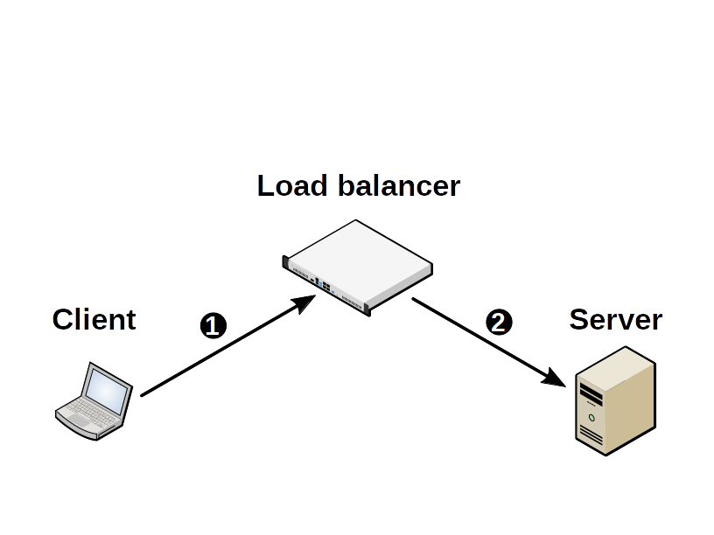
Layer 4 load balancing: DR mode

Slide 40
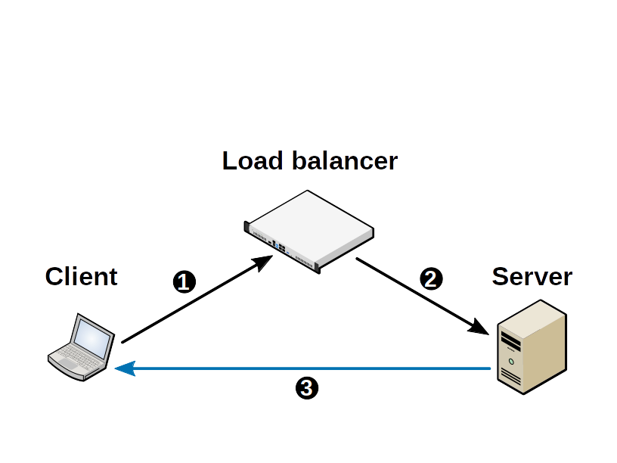
Layer 4 load balancing: DR mode

Slide 41
Layer 4 load balancing: TUN mode
TUN mode (Tunnel)
Similar to DR (Direct Routing) mode, but the
back end servers don’t have to be located on
the same network segment as the load
balancer
Uses IP in IP tunnels (not Microsoft friendly)

Slide 42
Building a Linux load balancer
The component parts are all free & open
source!

Slide 43
Building a Linux load balancer
Layer 4 load balancing
LVS: Linux Virtual Server

Slide 44
Building a Linux load balancer
Layer 4 load balancing
LVS: Linux Virtual Server
IPVS: IP Virtual Server

Slide 45
Building a Linux load balancer
Layer 4 load balancing
LVS: Linux Virtual Server
IPVS: IP Virtual Server
ipvsadm

Slide 46
Building a Linux load balancer
Layer 4 load balancing
LVS: Linux Virtual Server
IPVS: IP Virtual Server
ipvsadm
ldirectord: Linux Director Daemon

Slide 47
Building a Linux load balancer
Layer 7 load balancing
HAProxy

Slide 48
Summary
What is load balancing
Many clients
Accessing the same service at once
Distributing the load
Multiple instances (servers)

Slide 49
Summary
Why you would use a load balancer
Scalability
High availability
Easy maintenance
Load balancing is used everywhere!

Slide 50
Summary
Load balancing methods
Layer 7
Layer 4 (NAT, DR, & TUN)

Slide 51
Summary
Building a Linux load balancer

Slide 52
Thanks for listening! :)
Andrew Howe
@AndrewXanadu
-------------------------------------------------------------------------
Useful sites:
www.haproxy.org
www.linuxvirtualserver.org

