Slide 1

Load Balancing using the
Linux Kernel

Slide 2
About me
Andrew Howe
@AndrewXanadu
-------------------------------------------------------------------------

Slide 3


Slide 4
Introduction
(cannibalised from an OggCamp talk)

Slide 5
What is load balancing?

Slide 6
What is load balancing?
Providing a service or application across
multiple servers

Slide 7
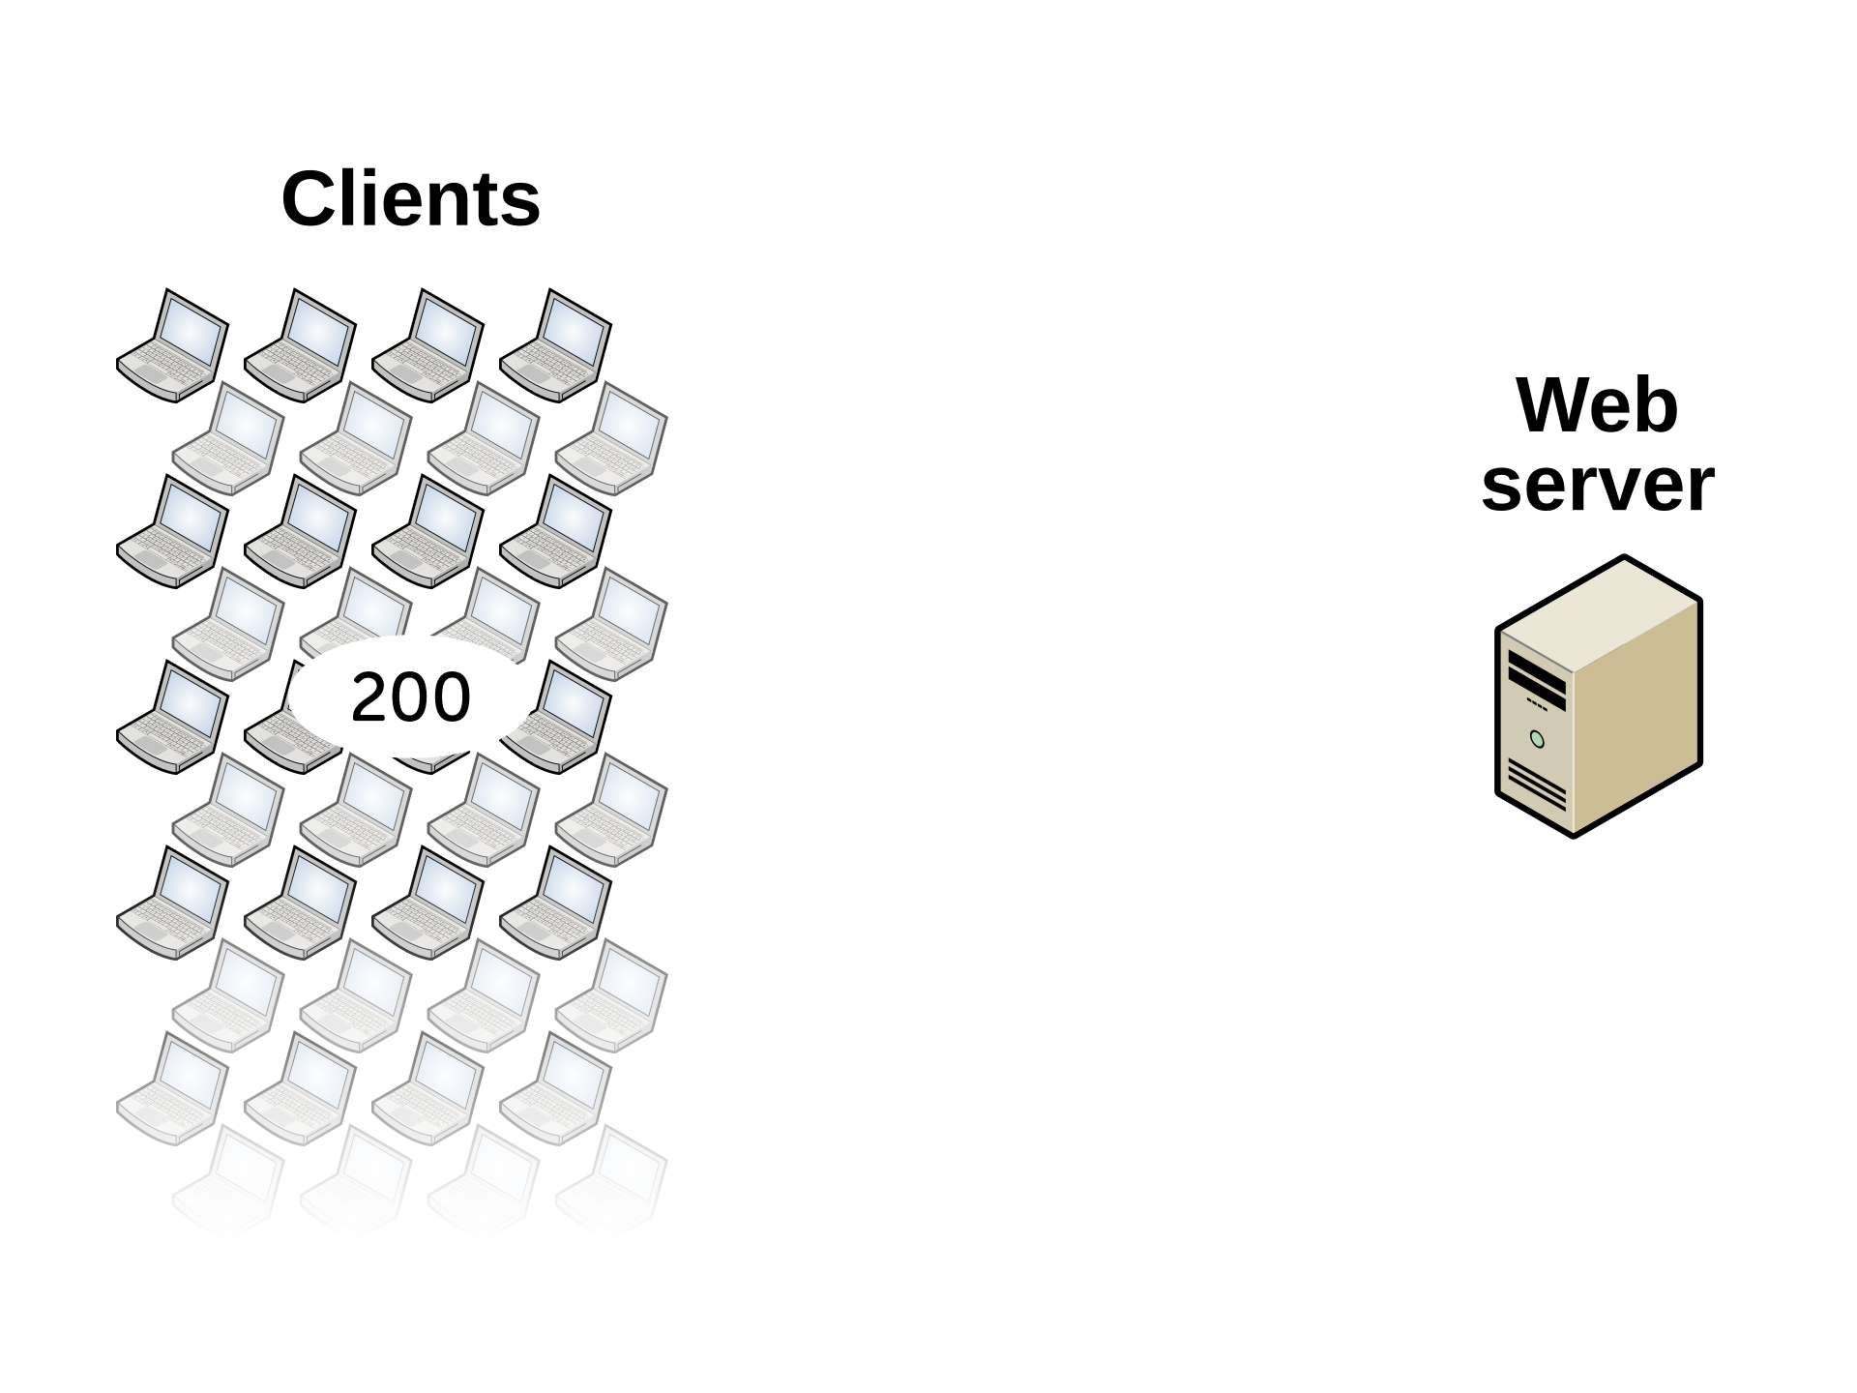
Max capacity:
100 concurrent client connections

Slide 9
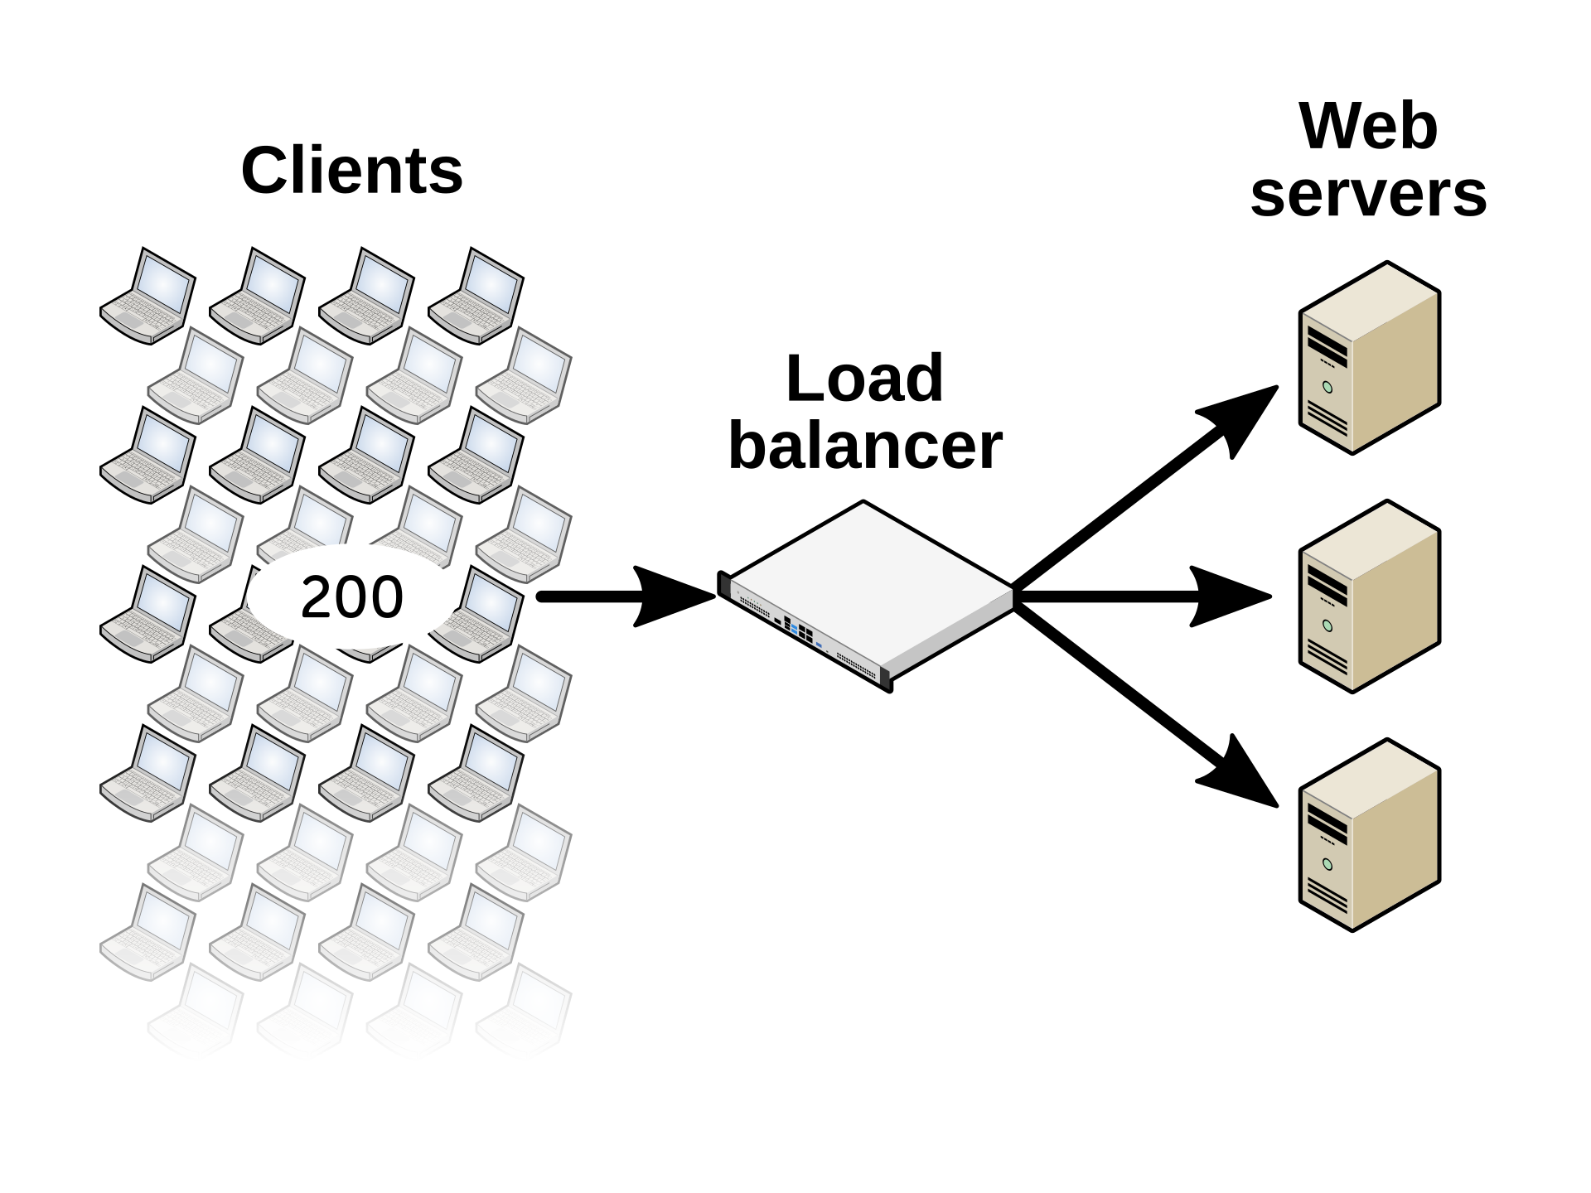

Slide 11
Why would you use a load balancer?

Slide 12
Why would you use a load balancer?
Scalability

Slide 13
Why would you use a load balancer?
Scalability
High availability

Slide 14
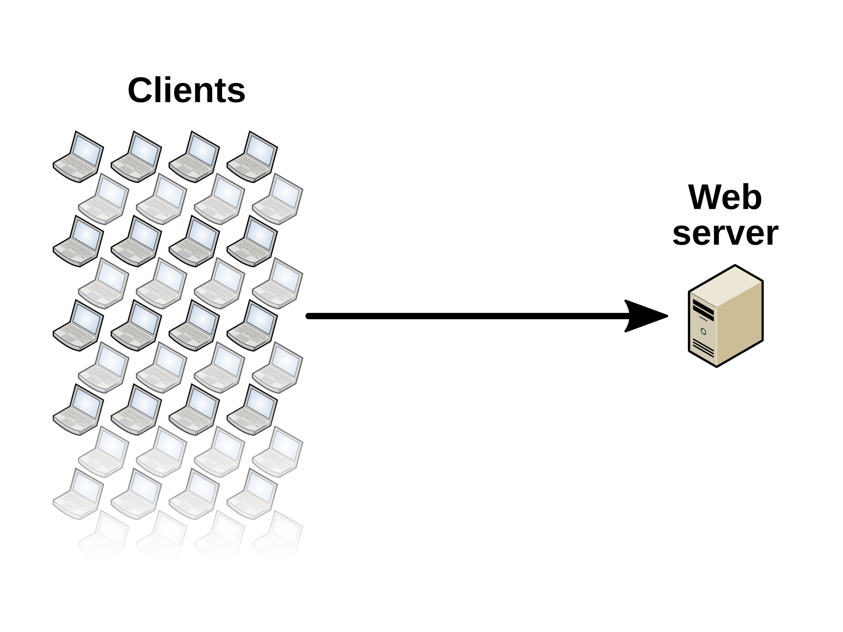

Slide 15
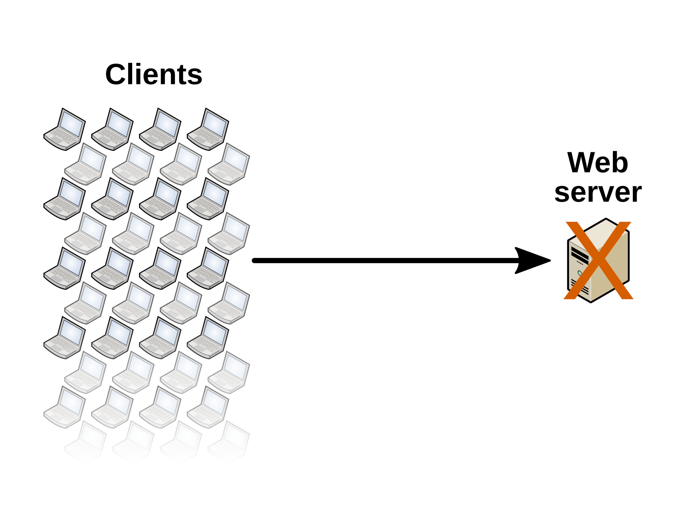

Slide 16


Slide 17
Why would you use a load balancer?
Scalability
High availability
Easy server maintenance

Slide 18
Load balancing methods
Layer 4 Layer 7

Slide 19
Load balancing methods
(“up to and including”)
Layer 4 Layer 7

Slide 20
Load balancing methods
(“up to and including”)
Layer 4 Layer 7
Simple
Exceptional performance

Slide 21
Load balancing methods
(“up to and including”)
Layer 4 Layer 7
Simple
Exceptional performance

Slide 22
Load balancing methods
(“up to and including”)
Layer 4 Layer 7
Simple
Exceptional performance
Complex and clever
Slow

Slide 23
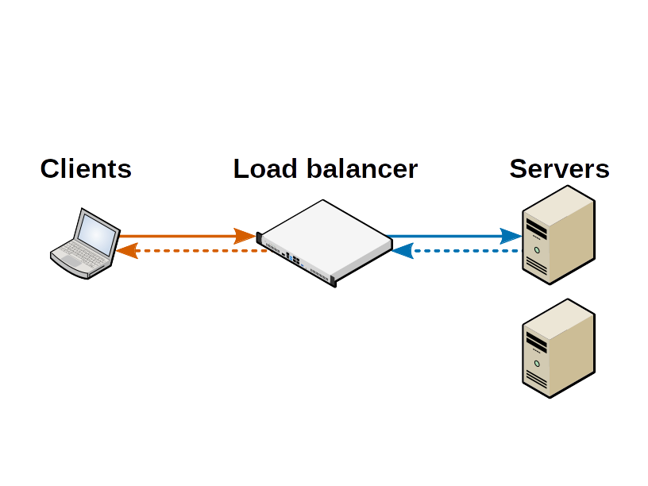
Layer 7 load balancing

Slide 24
Building a Linux load balancer
The component parts are all free & open
source!
Focusing on the layer 4 aspect here (as these
are lightning fast and built into the kernel)

Slide 25
Building a Linux load balancer
Multiple pieces which all fit together

Slide 26
Building a Linux load balancer
Layer 4 load balancing
LVS: Linux Virtual Server (project)
Notes:
Based on IBM NetDispatcher
Developed in the late 1990s
Used to serve the HTTP traffic for the Olympic Games in Atlanta 1996 and Sydney 2000
Powered the Deep Blue versus Garry Kasparov chess matches
Powered the Wimbledon tennis championship website in 1998
The work done by IBM was turned into the Linux Virtual Server project in 1998
It’s been an integrated part of the Linux kernel since 2008

Slide 27
Building a Linux load balancer
Layer 4 load balancing
LVS: Linux Virtual Server (project)
IPVS: IP Virtual Server (kernel modules)

Slide 28
Building a Linux load balancer
Layer 4 load balancing
LVS: Linux Virtual Server (project)
IPVS: IP Virtual Server (kernel modules)
ipvsadm (utility)

Slide 29
Building a Linux load balancer
Layer 4 load balancing
LVS: Linux Virtual Server (project)
IPVS: IP Virtual Server (kernel modules)
ipvsadm (utility)
ldirectord: Linux Director Daemon
Notes:
ldirectord: written in Perl
We’ve financially supported the development of features and fixes

Slide 30
VS-NAT (NAT mode)
NAT mode (Network Address Translation)
Changing the destination IP address of load
balanced traffic

Slide 31
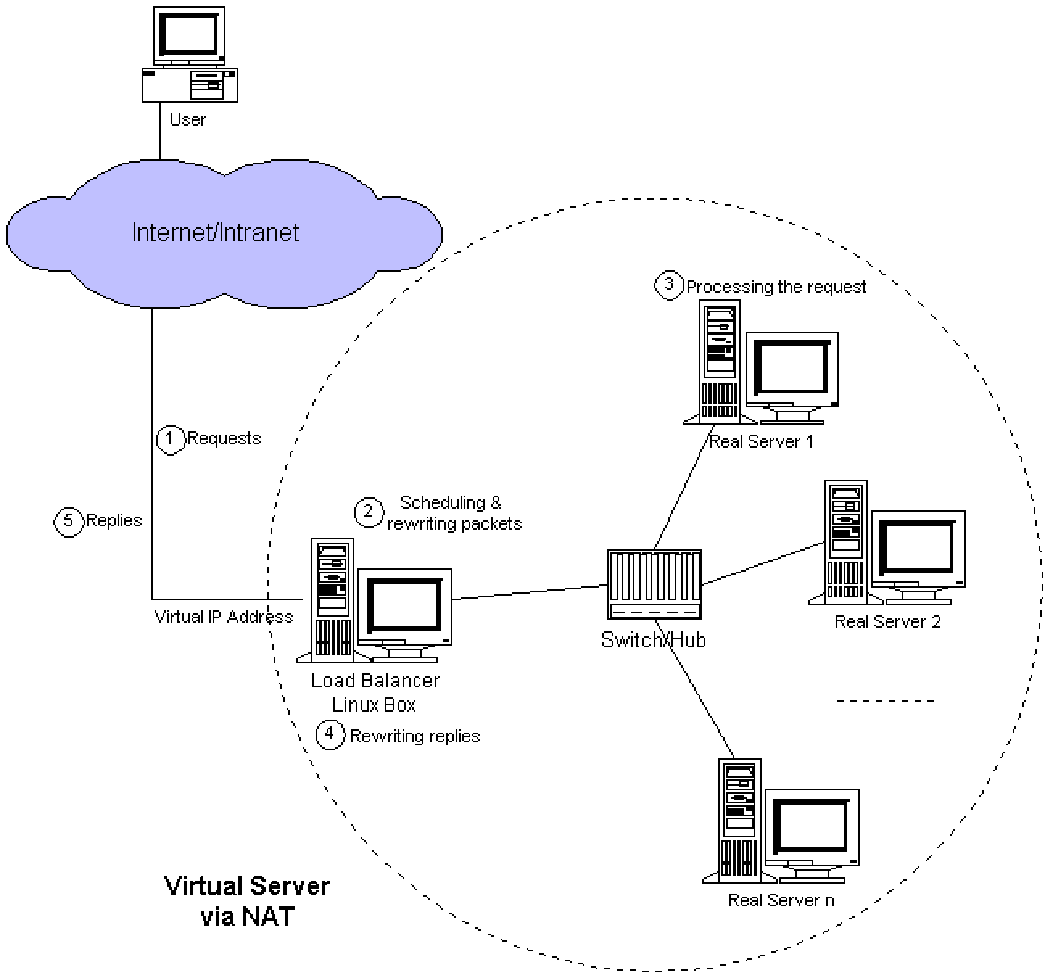

Slide 32
VS-DR (DR mode)
DR mode (Direct Routing)
Some vendors refer to this as DSR, ‘Direct
Server Return’, or ‘nPath Routing’
Changing the destination MAC address of
load balanced traffic

Slide 33
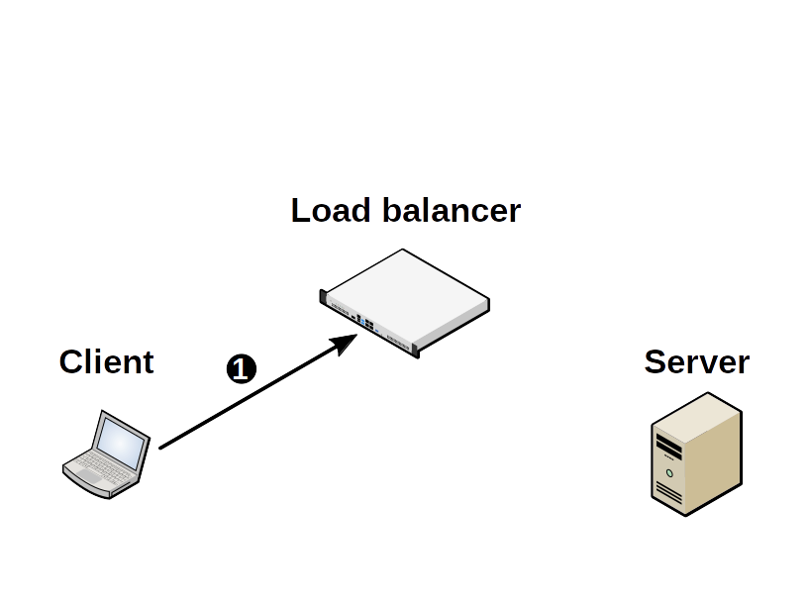
Layer 4 load balancing: DR mode

Slide 34
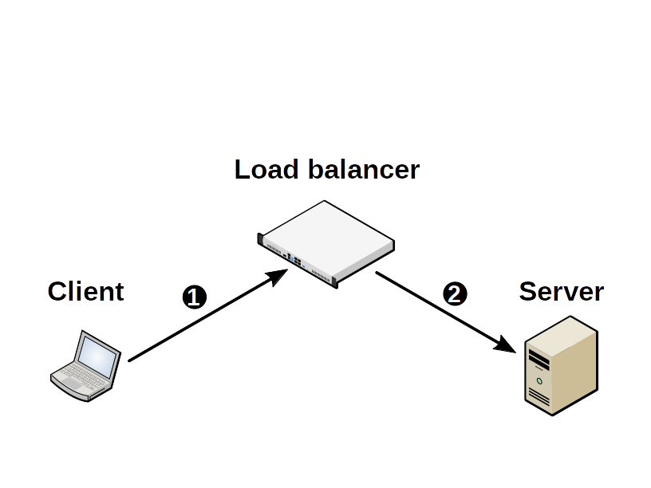
Layer 4 load balancing: DR mode

Slide 35
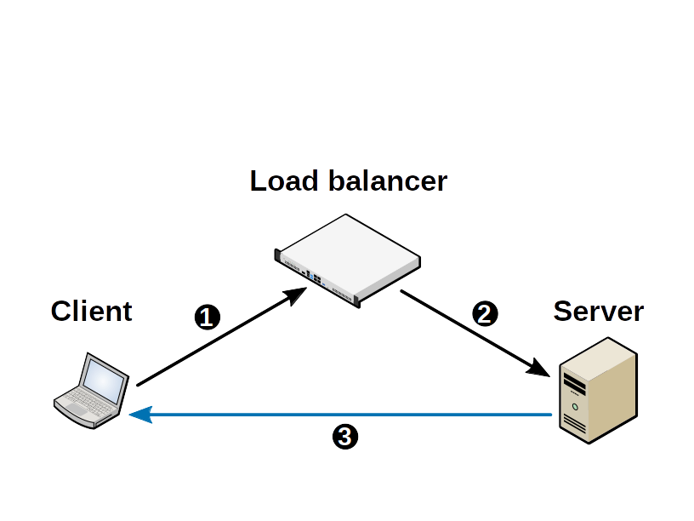
Layer 4 load balancing: DR mode

Slide 36
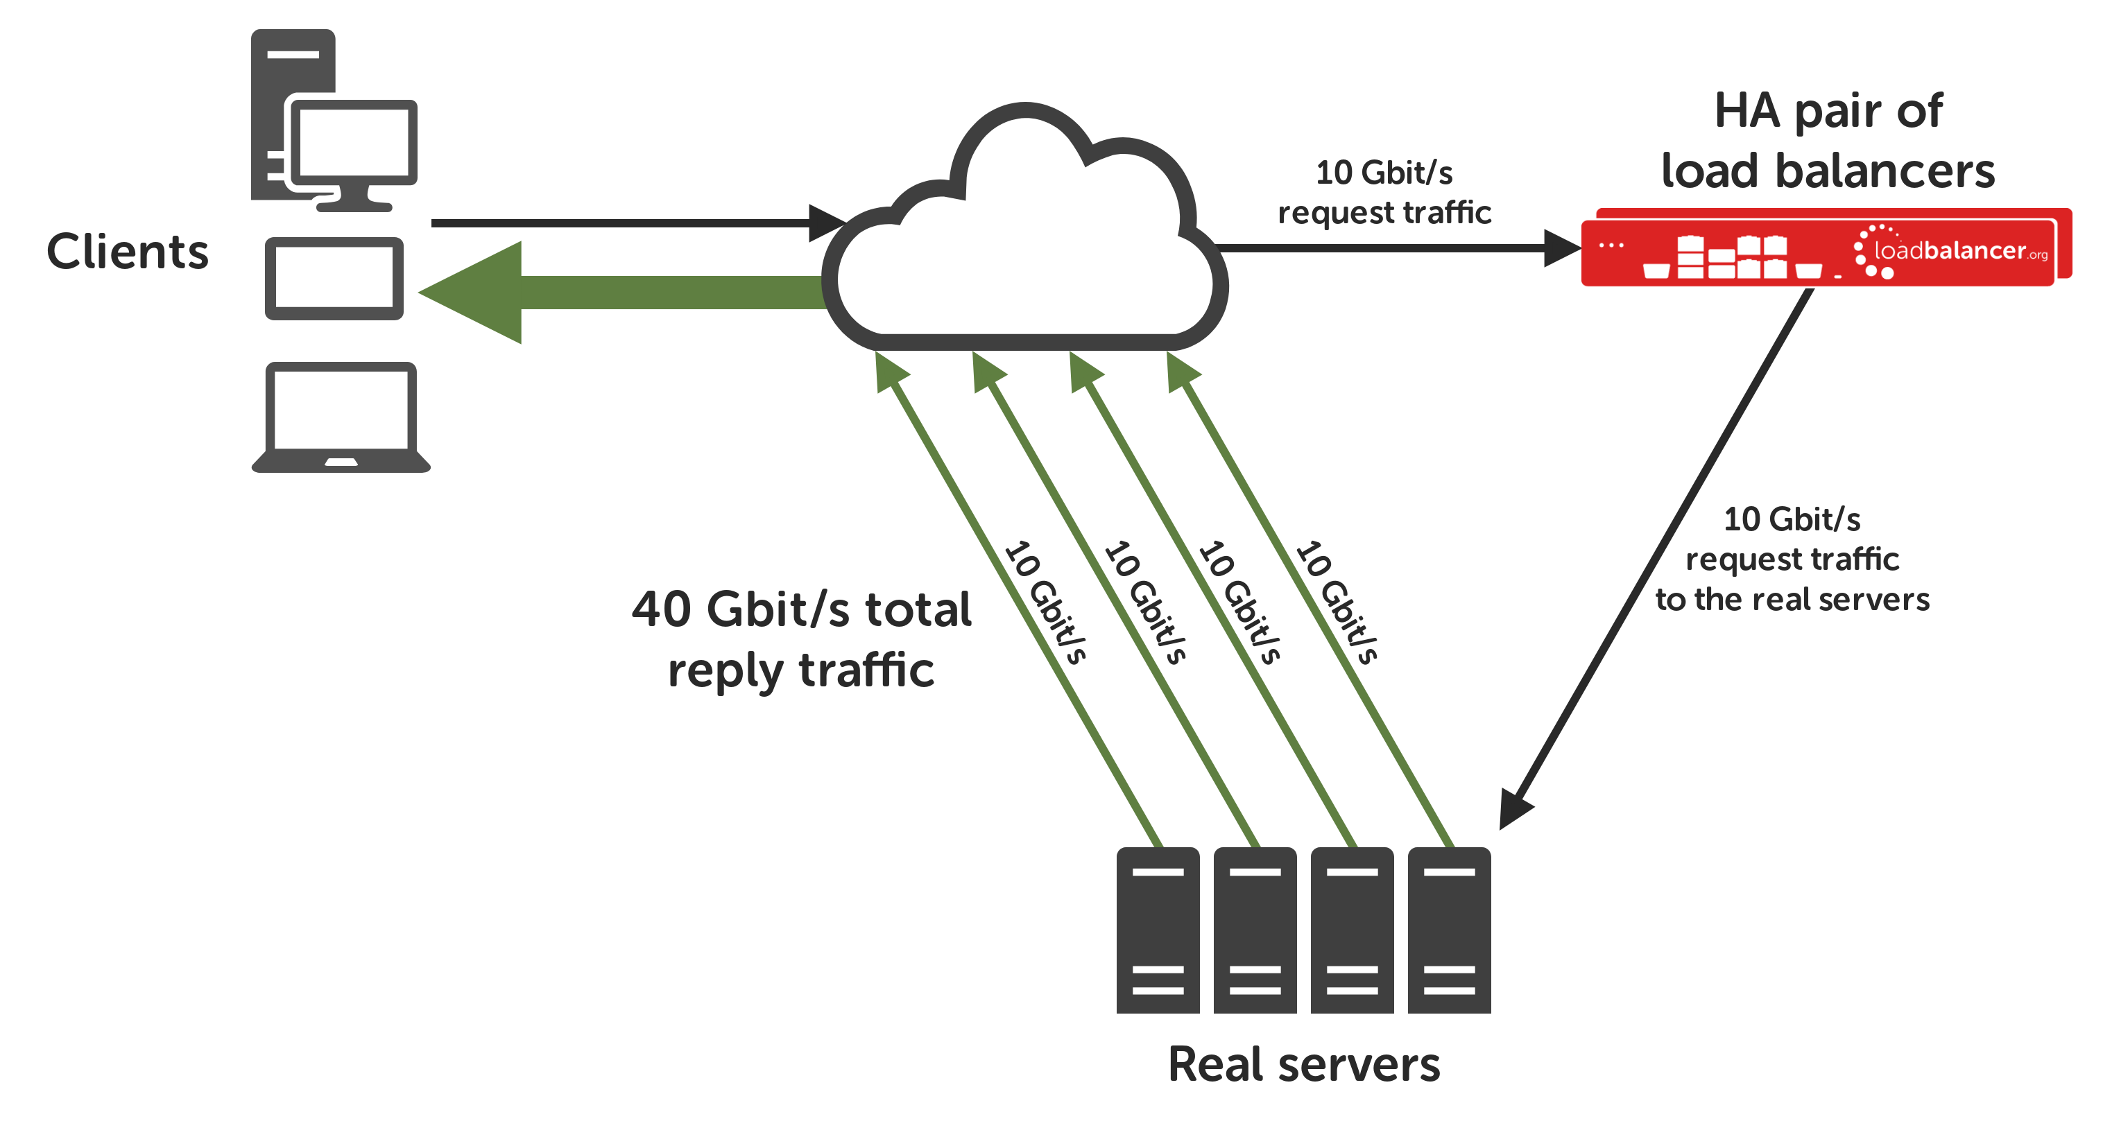

Slide 37
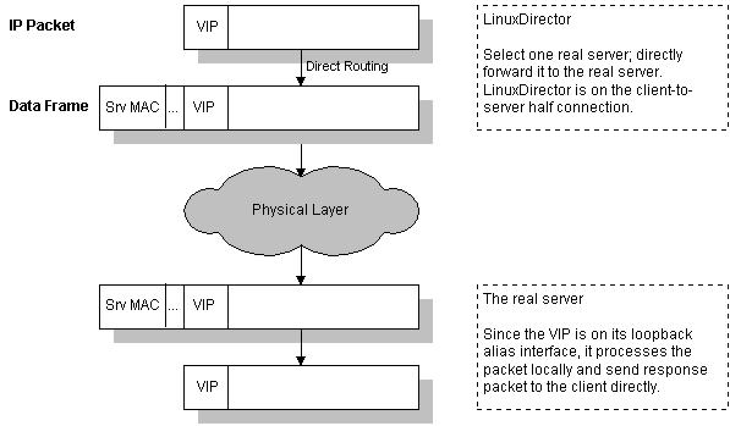
VIP: Virtual IP (address)

Slide 38
Layer 4 load balancing: DR mode
VIP

Slide 39
VIP

Slide 40
VIP
VIP
VIP
VIP
VIP

Slide 41
VIP
VIP
VIP
VIP
VIP

Slide 42
Layer 4 load balancing: TUN mode
TUN mode (Tunnel)
Similar to DR (Direct Routing) mode, but the
back end servers don’t have to be located on
the same network segment as the load
balancer
Uses IP in IP tunnels (not Microsoft friendly)

Slide 43


Slide 44
Site 1
Site 2

Slide 45
IPVS Scheduling Algorithms
Round Robin (rr)
Weighted Round Robin (wrr)
Least Connection (lc)
Weighted Least Connection (wlc)
Locality-Based Least Connection (lblc)
Locality-Based Least Connection with Replication (lblcr)
Destination Hashing (dh)
Source Hashing (sh)
Shortest Expected Delay (seq)
Never Queue (nq)
Overflow-Connection (ovf)

Slide 46
Demo?

Slide 47
Thanks for listening! :)
Andrew Howe
@AndrewXanadu
-------------------------------------------------------------------------
Useful sites:
www.linuxvirtualserver.org

