Slide 1

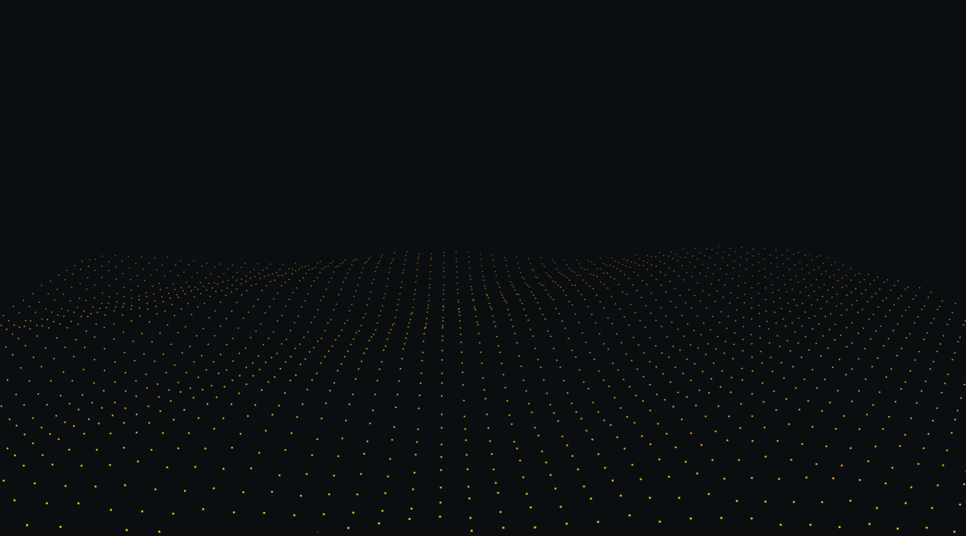
Milestone 3
Project plan and management for the selected topic: Disease State Conversation and Sentiment Analysis: Examination of Digital Community Conversations Within Specific Disease States Via Reddit
Team 4: Reda Mastouri & Kalyani
10/13/2021
Modeling

Slide 2
CONTENTS
Topic Modeling
Used Techniques
Algorithms in Scope
Visualization Techniques (WIP)
Perspective
App: Proof-of-Concept
appendix

Slide 3
TOPIC MODEL?
What is it?
A type of statistical model for discovering the abstract "topics" that occur in a collection of documents.
A document typically concerns multiple topics in different proportions; thus, in a document that is 10% about prevention and 90% about medication, there would probably be about 9 times more drugs prescription words than preventive advices words.
The "topics" produced by topic modeling techniques are clusters of similar words. A topic model captures this intuition in a mathematical framework, which allows examining a set of documents and discovering, based on the statistics of the words in each, what the topics might be and what each document's balance of topics is.

Slide 4
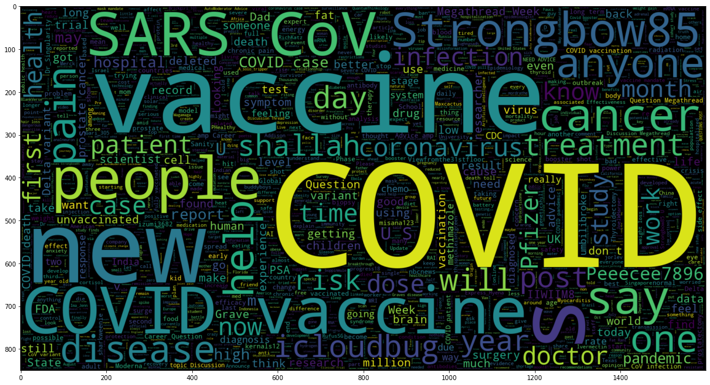
From last milestone
Complete data preprocessing and EDA
From feature engineering through word vector and data lemmatization and tokenization...
We are now about to apply the various approaches to data modeling and fine tuning.

Slide 5
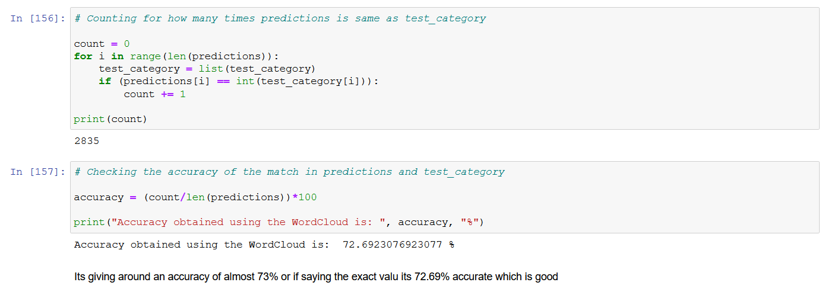
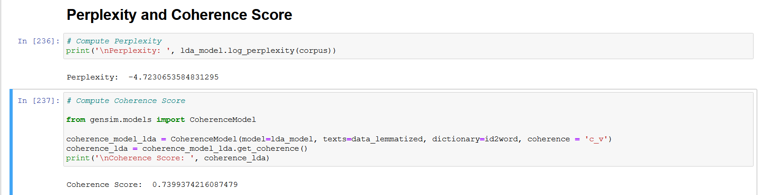
73%
Accuracy based on WordCloud prediction
2835
topics
74%
Coherence Score
-4.72
Perplexy
Model statistics
Saintpeters.edu

Slide 6
Algorithms in Scope
Viable set of algorithms
Popular topic modeling algorithms include Latent Semantic Analysis (LSA) a.k.a Latent Semantic Indexing , Hierarchical Dirichlet Process (HDP), Latent Dirichlet Allocation (LDA) and Non-negative Matrix factorization among which LDA has shown great results in practice and therefore widely adopted.
Latent Semantic Analysis
Latent Dirichlet Allocation
Hierarchical Dirichlet Process
Non-negative Matrix factorization

Slide 7
Techniques implemented
From StopWords to Perplexy computation
LDA represents documents as mixtures of topics that spit out words with certain probabilities.
Latent Dirichlet Allocation (where documents are represented by latent topics, and topics are represented by a distribution over words) Non-negative Matrix Factorization (where a document-term matrix is approximately factorized into term-feature and feature-document matrices).
Will check this on the jupyter Notebook

Slide 8
Visualization Techniques
From StopWords to Perplexy computation
Livestream Reddit via PRAW
Livestream comments submitted within Subreddits or by Redditors
Livestream submissions submitted within Subreddits or by Redditors
Analytical tools for scraped data
Generate frequencies for words that are found in submission titles, bodies, and/or comments
Generate a wordcloud from scrape results
zobi products
verypossible.com

Slide 9

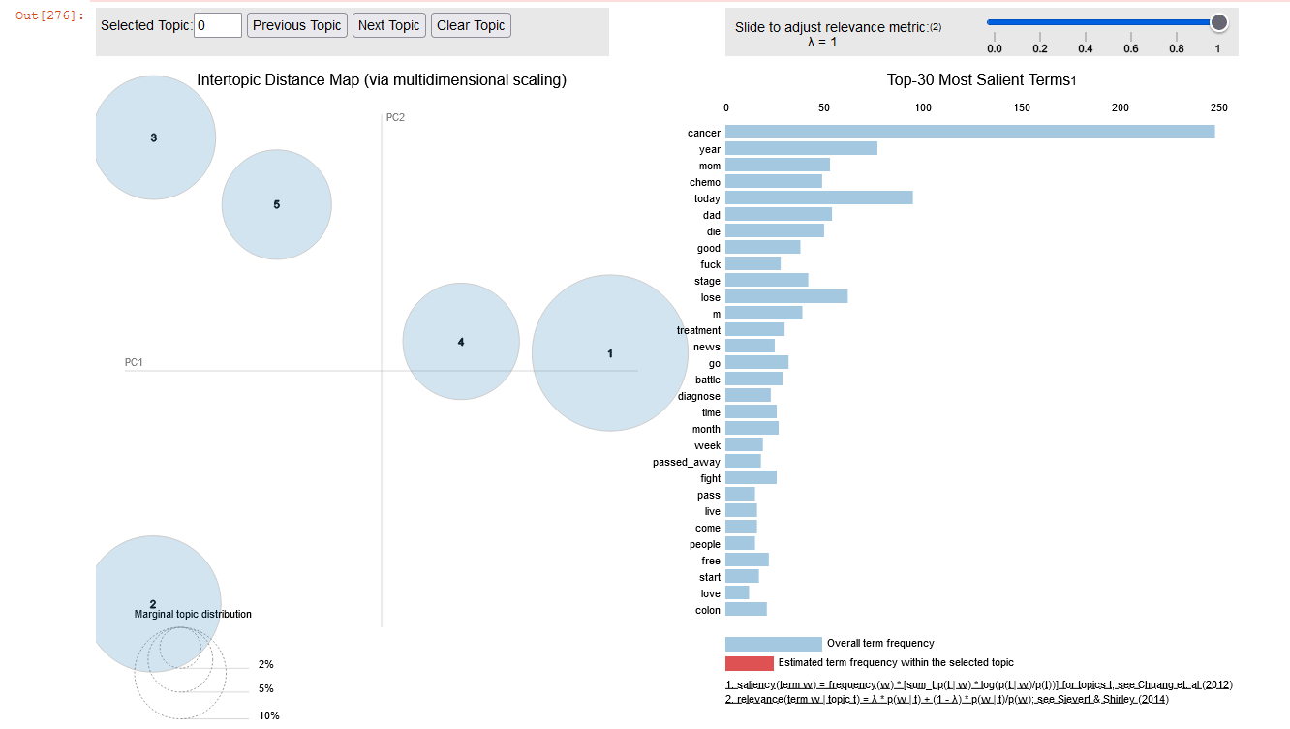
Models: LDA
Implementation
Check the notebook

Slide 10
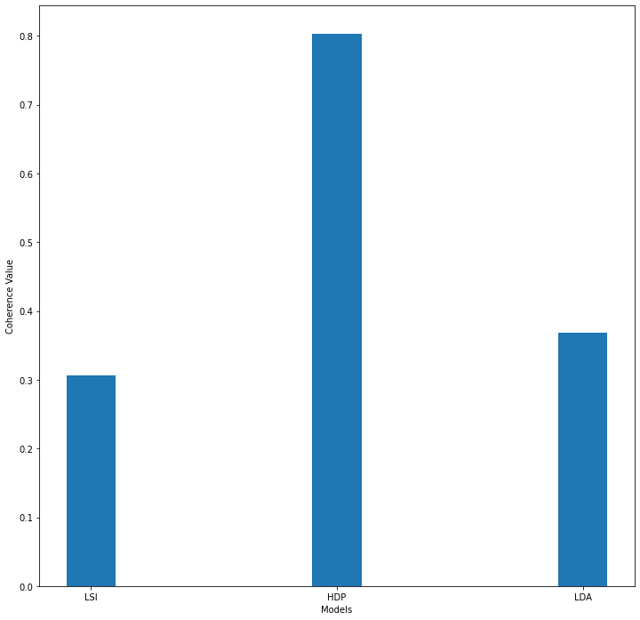
Evaluation
Comparative study
Latent Semantic Analysis
Latent Dirichlet Allocation
Hierarchical Dirichlet Process
Non-negative Matrix factorization

Slide 11
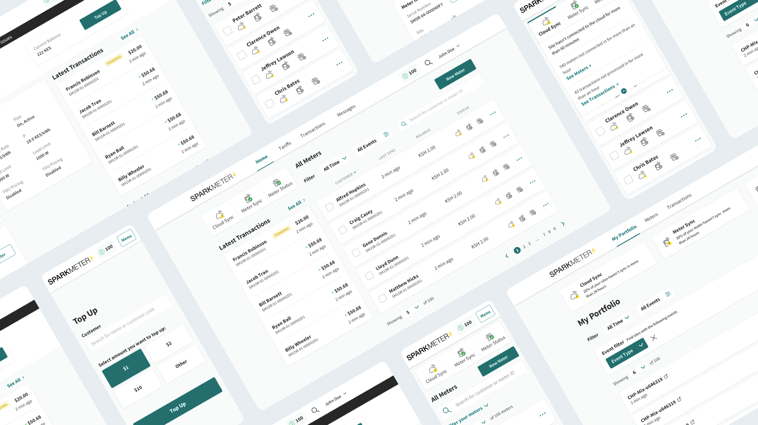
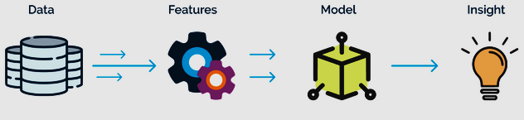
zobi products
verypossible.com

Slide 12

Perspective
What’s next?
Considering more of Livestream Reddit via PRAW
Livestream comments submitted within Subreddits or by Redditors
Livestream submissions submitted within Subreddits or by Redditors
Analytical tools for scraped data
Generate frequencies for words that are found in submission titles, bodies, and/or comments
Generate a wordcloud from scrape results to be included in the final app

Slide 13
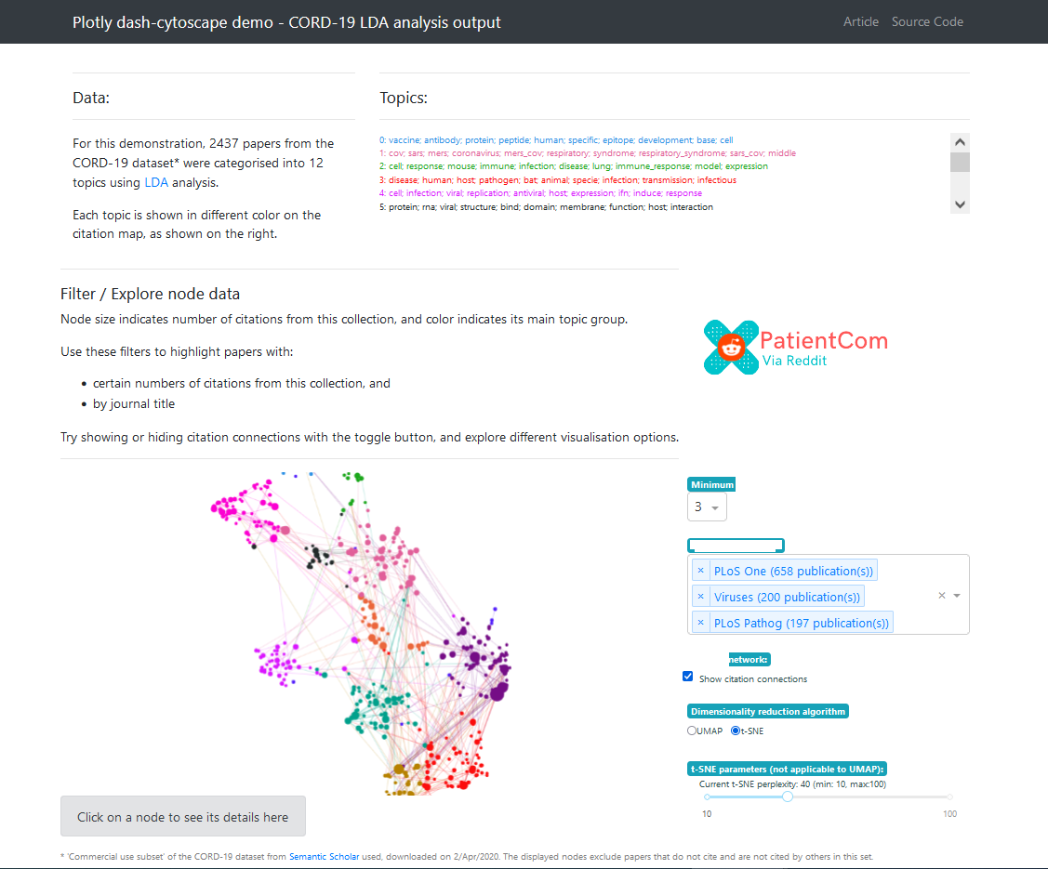
App: Proof-of-Concept
Via Dashly

Slide 14

Please feel free to ask any question

