Slide 1
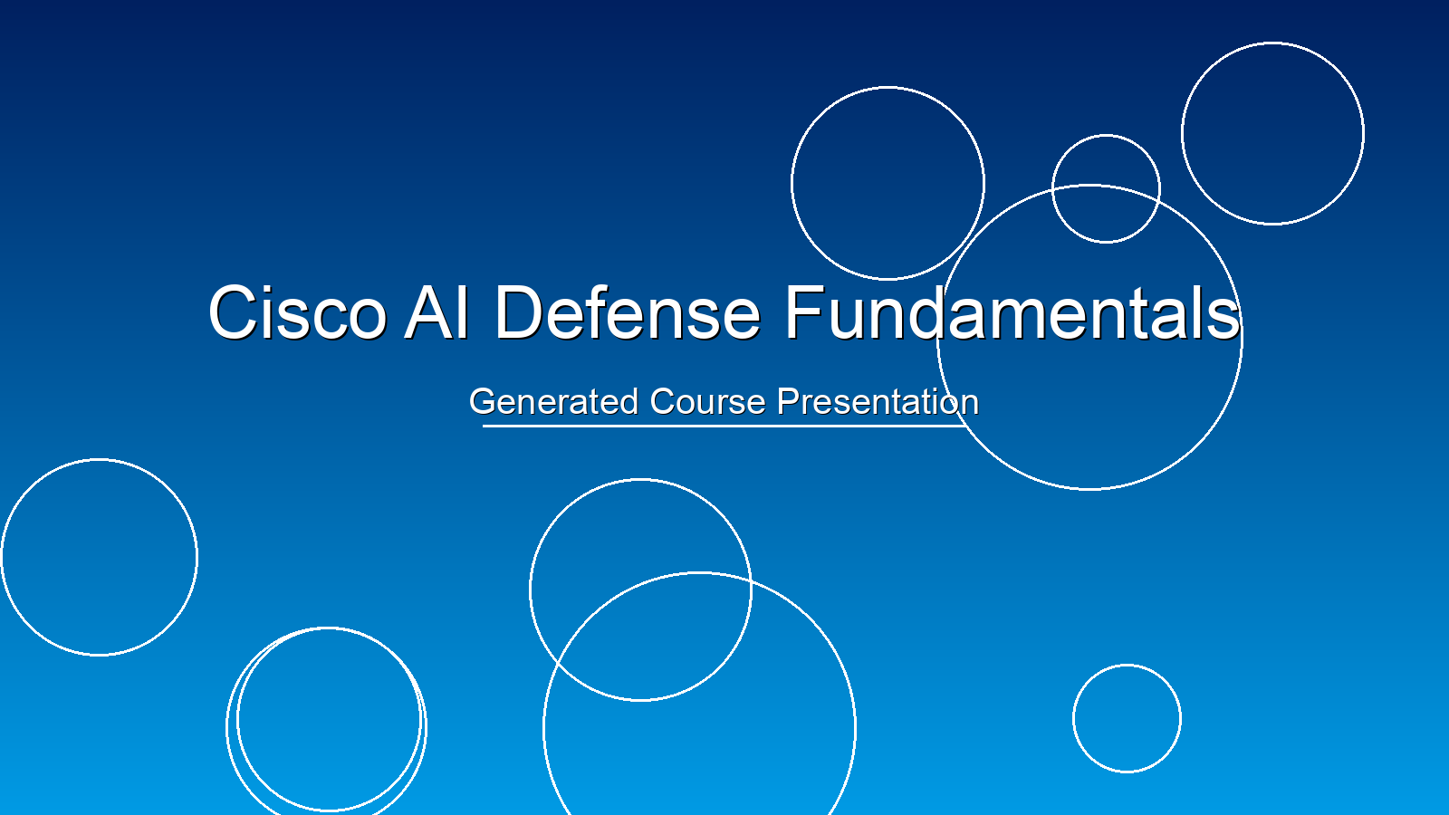
Notes:
Hello and welcome, everyone! I'm excited to have you join us for this comprehensive course on Cisco AI Defense. In today's rapidly evolving threat landscape, artificial intelligence is no longer a futuristic concept; it's a critical component of effective cybersecurity. Over the next [duration, e.g., few hours/days], we will delve deep into how Cisco is leveraging AI to build advanced defense strategies. We'll explore the fundamental concepts of AI, understand its applications in cybersecurity, and specifically examine Cisco's innovative solutions. My goal is to equip you with the knowledge and insights needed to understand and potentially implement AI-driven defenses within your own environments. Let's embark on this learning journey together!

