Slide 1
Understanding and Implementing Cisco SASE

Slide 2

1: Introduction to SASE and Cisco's Approach
Understanding SASE
Cisco SASE Components

Slide 3
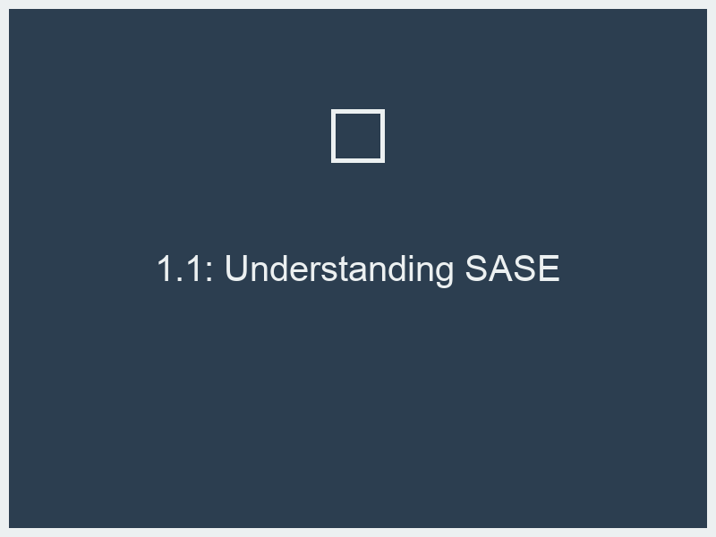
1.1: Understanding SASE
Cloud Computing = Network and Security Disruption
SASE Business Outcomes
Challenges solved by Cisco SASE
Cisco SASE: Connect – Control – Converge

Slide 4
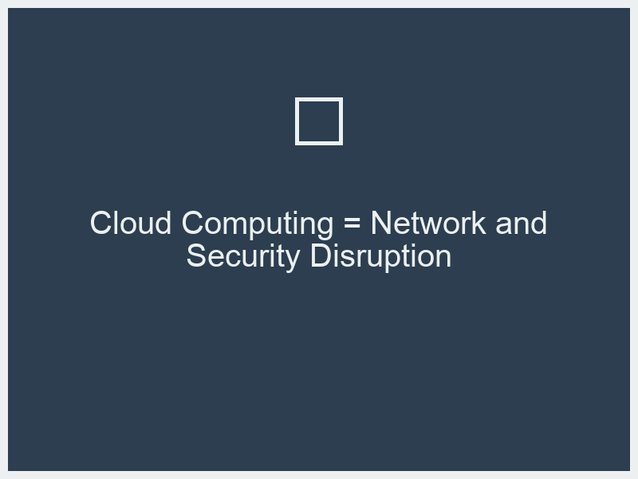
Cloud Computing = Network and Security Disruption
Increased data
Shift to cloud applications
Mobile workforce expansion
Distributed network perimeters
Growing threat landscape
Need for integrated solutions

Slide 5

SASE Business Outcomes
Improved security posture
Enhanced user experience
Reduced operational complexity
Cost optimization
Increased agility and scalability
Better compliance adherence

Slide 6
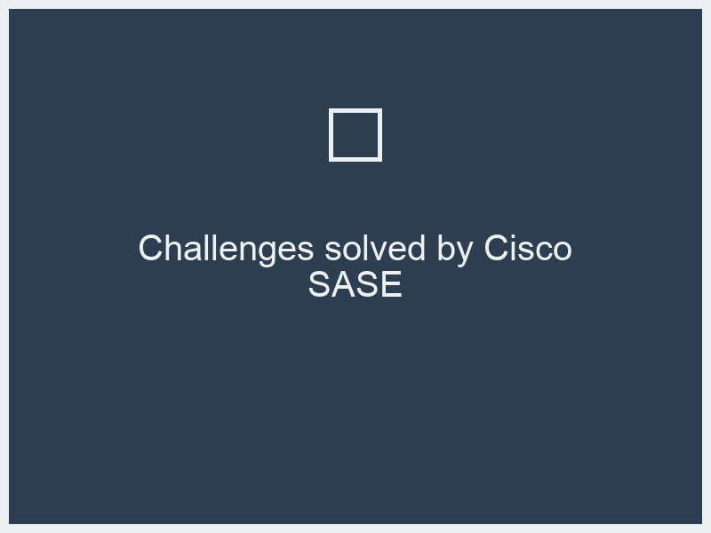
Challenges solved by Cisco SASE
Securing remote access
Protecting against advanced threats
Simplifying network and security management
Ensuring consistent policy enforcement
Providing end-to-end visibility
Adapting to evolving business needs

Slide 7
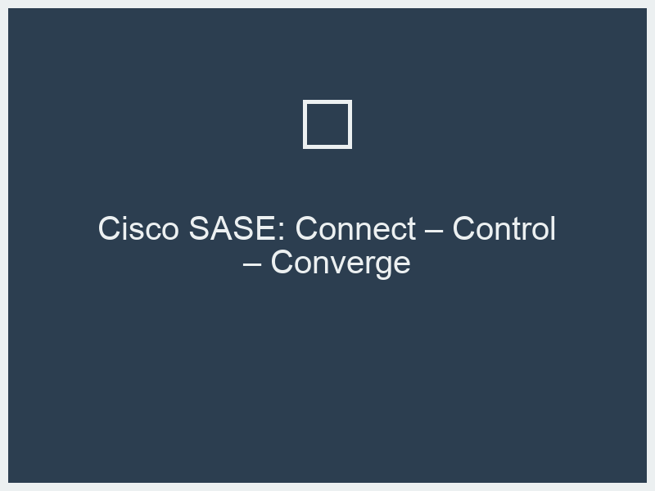
Cisco SASE: Connect – Control – Converge
Connect: Secure connectivity
Control: Granular policy enforcement
Converge: Unified platform integration
Seamless user experience
Integrated threat intelligence
Simplified management console

Slide 8
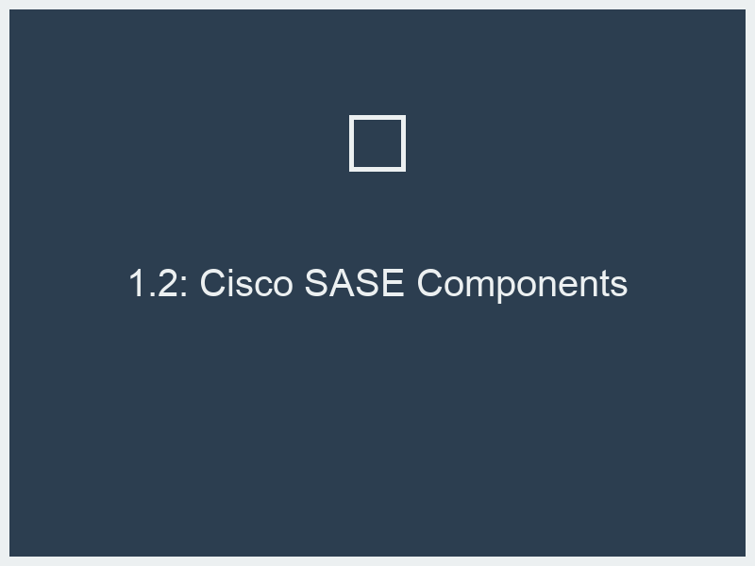
1.2: Cisco SASE Components
Cisco SD-WAN
Cisco Umbrella
Cisco AnyConnect
Cisco DUO

Slide 9
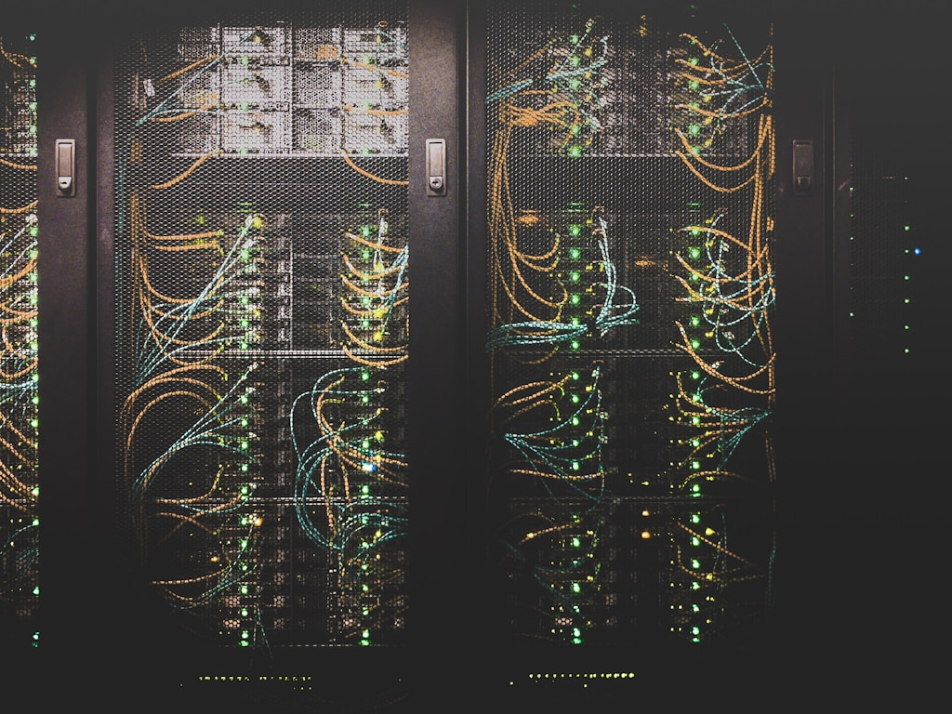
Cisco SD-WAN
Software-Defined Wide Area Networking
Centralized control and orchestration
Application-aware routing
Network segmentation capabilities
Foundation for secure connectivity
Policy-based network management

Slide 10
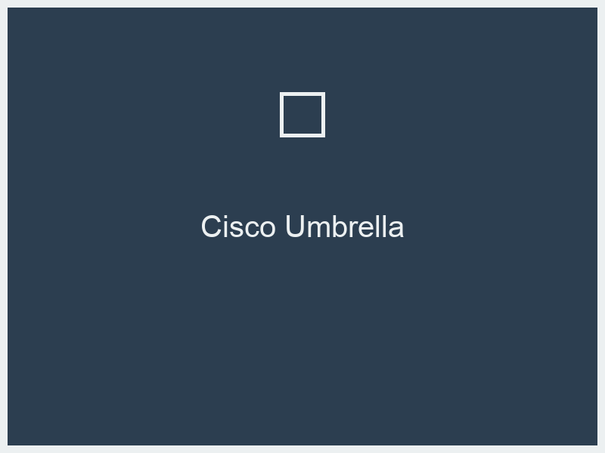
Cisco Umbrella
Cloud-delivered security services
DNS-layer security
Firewall as a Service (FWaaS)
Cloud Access Security Broker (CASB)
Secure Web Gateway (SWG)
Threat intelligence integration

Slide 11
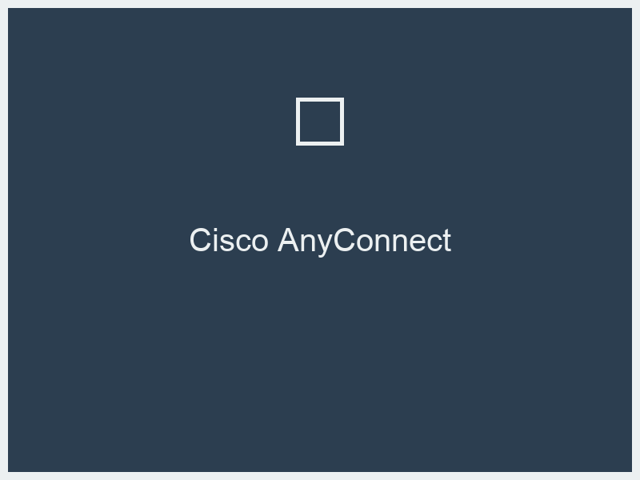
Cisco AnyConnect
Secure endpoint agent
VPN and secure remote access
Network access control (NAC)
Posture assessment
Compliance enforcement
Integrated endpoint security

Slide 12
Cisco DUO
Multi-factor authentication (MFA)
Device trust and health checks
Passwordless authentication
Secure access for applications
Context-aware access policies
Zero Trust Network Access (ZTNA) enablement

Slide 13
2: SASE Use Cases and Implementation
Secure Remote Worker
Secure Endpoint

Slide 14
2.1: Secure Remote Worker
Provisioning
Administration and Monitoring

Slide 15
Provisioning
Onboarding new remote users
Deploying AnyConnect and Duo
Implementing secure VPN profiles
Configuring endpoint security policies
Ensuring device compliance
User self-service options

Slide 16
Administration and Monitoring
User access management
Policy updates and enforcement
Threat monitoring and incident response
Performance analytics
Auditing and compliance checks
User behavior analysis

Slide 17
2.2: Secure Endpoint
Provisioning
Administration and Monitoring

Slide 18
Provisioning
Endpoint agent deployment strategies
Integrating with existing endpoint management
Applying security configurations
Device health monitoring setup
Defining access policies per endpoint type
Automated remediation for compliance issues

Slide 19
Administration and Monitoring
Endpoint security status tracking
Policy enforcement and exceptions
Incident detection and response on endpoints
Endpoint vulnerability management
Compliance reporting for endpoints
Blocking non-compliant devices

Slide 20
3: Operating Cisco SASE Effectively
Achieve greater operating efficiencies via intelligent traffic routing and DiA
Minimize cybersecurity threats via secure access
Putting it all together
ThousandEyes for Observability

Slide 21
3.1: Achieve greater operating efficiencies via intelligent traffic routing and DiA
Intelligent Traffic Routing
Direct Internet Access (DIA) Strategy

Slide 22
Intelligent Traffic Routing
SD-WAN path selection
Application-aware routing policies
Optimizing for performance and security
Dynamic path selection based on conditions
Traffic steering to security services
Quality of Service (QoS) integration

Slide 23
Direct Internet Access (DIA) Strategy
Enabling DIA for cloud-bound traffic
Implementing Umbrella to secure DIA
Policy enforcement at the edge
Reducing WAN backhaul
Improving application performance
Network simplification

Slide 24
3.2: Minimize cybersecurity threats via secure access
Zero Trust Principles
Secure Access Policies

Slide 25
Zero Trust Principles
Never trust, always verify
Least privilege access
Continuous monitoring and validation
Device posture assessment integration
Identity-centric security
Micro-segmentation concepts

Slide 26
Secure Access Policies
Context-aware access controls
Multi-factor authentication enforcement
Device security requirements
Application access management
Dynamic policy adjustments
Role-based access control

Slide 27
3.3: Putting it all together
Integrated Platform Benefits
Cisco SecureX Integration

Slide 28
Integrated Platform Benefits
Unified management experience
Streamlined policy creation
Reduced vendor sprawl
Enhanced visibility across networking and security
Faster threat detection and response
Simplified architecture

Slide 29
Cisco SecureX Integration
Security analytics and visibility platform
Correlation of security events
Orchestration and automation workflows
Incident investigation acceleration
Unified view of security posture
Proactive threat hunting capabilities

Slide 30
3.4: ThousandEyes for Observability
Network and Application Performance Monitoring
Integrating ThousandEyes with SASE

Slide 31
Network and Application Performance Monitoring
End-to-end visibility
Synthetic and real user monitoring
Performance troubleshooting
User experience monitoring
Cloud and SaaS application visibility
Network path analysis

Slide 32
Integrating ThousandEyes with SASE
Contextualizing security events with performance data
Identifying root cause of access issues
Optimizing SASE deployment for performance
Proactive issue detection
Improving mean time to resolution (MTTR)
Enhancing user satisfaction

Slide 33
4: Best Practices and Reporting
Best Practices for Cisco SASE Deployment
Reporting and Analytics

Slide 34
4.1: Best Practices for Cisco SASE Deployment
Phased Deployment Approach
Centralized Policy Management
Security Policy Tuning
Monitoring and Alerting Strategy

Slide 35
Phased Deployment Approach
Start with a pilot program
Roll out by user groups or locations
Incremental feature adoption
Gradual decommissioning of legacy systems
Communication plan for users
Training and support for administrators

Slide 36
Centralized Policy Management
Consistent security across the organization
Reducing configuration drift
Leveraging templates and groups
Regular policy review and updates
Defining clear policy ownership
Implementing change management processes

Slide 37
Security Policy Tuning
Baseline security configurations
Fine-tuning threat prevention rules
Adjusting access controls based on risk
Monitoring for false positives
Iterative refinement of policies
Balancing security and user productivity

Slide 38
Monitoring and Alerting Strategy
Defining key performance indicators (KPIs)
Setting up relevant security alerts
Establishing incident response playbooks
Integrating with SIEM for comprehensive monitoring
Automating alert correlation
Regular review of monitoring effectiveness

Slide 39
4.2: Reporting and Analytics
Security Posture Reporting
Operational Performance Reporting

Slide 40
Security Posture Reporting
Compliance dashboards
Threat landscape overview
Policy effectiveness reports
Vulnerability summaries
Risk assessment reports
Executive-level security summaries

Slide 41
Operational Performance Reporting
Network uptime and availability
Application performance metrics
User access reporting
Bandwidth utilization reports
SASE service health dashboards
Operational efficiency metrics

Slide 42
5: Hands-on Labs and Practical Exercises
Cisco SD-WAN Configuration for SASE Integration
Cisco Umbrella Policy Creation and Management
Cisco AnyConnect Deployment and Secure Access
Cisco DUO Multi-Factor Authentication Setup and Adaptive Policies
Monitoring and Troubleshooting with SecureX and ThousandEyes
ThousandEyes Network Path Analysis

Slide 43
5.1: Cisco SD-WAN Configuration for SASE Integration
Lab Environment Setup

Slide 44
Lab Environment Setup
Accessing the lab environment
Understanding the virtual topology
Network connectivity checks
Pre-configured elements review
Tooling overview
Lab objectives confirmation

Slide 45
5.2: Cisco Umbrella Policy Creation and Management
Basic DNS Policy Configuration

Slide 46
Basic DNS Policy Configuration
Creating a new security policy
Defining allowed and blocked domains
Implementing content filtering categories
Applying policies to specific identities
Enabling malicious activity blocking
Policy testing and verification

Slide 47
5.3: Cisco AnyConnect Deployment and Secure Access
Endpoint Agent Installation

Slide 48
Endpoint Agent Installation
Deploying AnyConnect via agent deployment tools
Manual installation steps
Profile configuration for VPN connections
Verifying successful installation
Initial connection attempts
Understanding agent status indicators

Slide 49
5.4: Cisco DUO Multi-Factor Authentication Setup and Adaptive Policies
User Enrollment and Authentication

Slide 50
User Enrollment and Authentication
Enrolling users in Duo
Setting up authentication methods
Performing a successful MFA login
Testing different authentication factors
Exploring Duo mobile application features
Understanding user self-service portal

Slide 51
5.5: Monitoring and Troubleshooting with SecureX and ThousandEyes
SecureX Workflow Demonstration

Slide 52
SecureX Workflow Demonstration
Investigating a security alert in SecureX
Correlating events across different security products
Initiating automated response actions
Enriching case data with threat intelligence
Generating incident reports
Practicing endpoint investigation

Slide 53
5.6: ThousandEyes Network Path Analysis
Mapping application delivery paths

Slide 54
Mapping application delivery paths
Identifying network hops and latency
Visualizing route changes
Pinpointing network bottlenecks
Analyzing performance against service level agreements (SLAs)
Simulating different network conditions
Correlating network performance with user experience

