Slide 1
Unit Introduction
Lecturer
MSc. Mehmet ERDOĞDU

Slide 2
Unit 4 – Programming
In this course, you will learn about computational thinking skills and the principles of designing and developing computer programs. You will apply computational thinking skills to design, develop, test, refine and review computer programs for a given range of purposes.
By developing your analytical, problem-solving and programming skills, this unit will help you to progress to higher education or to employment as a software developer.

Slide 3
Learning Aims
In this unit you will:
A. Examine the computational thinking skills and principles of computer programming
B. Design a software solution to meet client requirements
C. Develop a software solution to meet client requirements

Slide 4
Learning Aims in Detail
Aim | Key Content Area
A | A1 | Computational thinking skills
 | A2 | Uses of software applications
 | A3 | Features and characteristics of programming languages
 | A4 | Constructs and techniques and their implementation in different languages
 | A5 | Principles of logic applied to program design
 | A6 | Quality of software Solutions
B | B1 | Software development life cycle
 | B2 | Software solutions design
C | C1 | Software solutions development
 | C2 | Testing software solutions
 | C3 | Improvement, refinement and optimisation of software applications
 | C4 | Review of software solutions
 | C5 | Skills, knowledge and behaviors

Slide 5
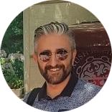
Lecturer
MSc. Mehmet ERDOĞDU
Senior Software Architect – Project Manager
Bachelor Degree Systems Engineering ( Istanbul Technical University 2004 )
Geomatics Engineering ( Istanbul Okan University 2018 )
Master Degree Software Management ( Middle East Technical University 2011 )
Land Management ( Konya Technical University 2020 )
Experience. He has been working in software development industry since 2004 at various positions including software developer, software architect and project manager. He has experience of managing 35+ enterprise level software development projects both local and international and financed by international finance institutions like World Bank, European Union. He is currently the project manager of establishing digitalization of agro-industrial complex project in The Republic of Uzbekistan.

Slide 6
Syllabus
Content
The lectures will be held both online and offline. Online parts will introduce theory since the offline parts will include practical learning.
Offline Schedule

Slide 7



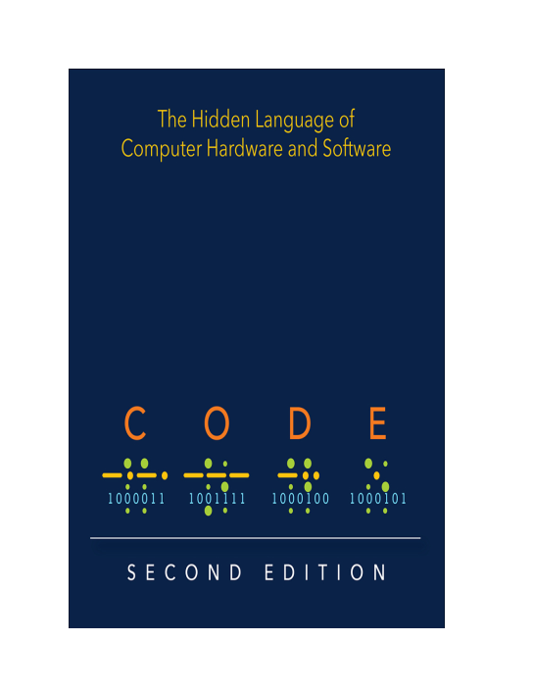

Reference Books

Slide 8

Contact
Email erdogdum@gmail.com Telegram @erdogdum
Telegram Group
Programming / PDP
https://t.me/+s543TgfM3FRmOWQ0

