Slide 1
Input / Output
A4 – Constructs and Techniques and Their Implementation in Programming
MSc. Mehmet ERDOĞDU

Slide 2
Elements
Elements of Program.
Variables
Conditionals
Loops
Functions
Input / Output
To develop any instruction there are some elements needed or we can essentially present in all language.
So any programming language is made up of 5 basic elements of the instructions.

Slide 3
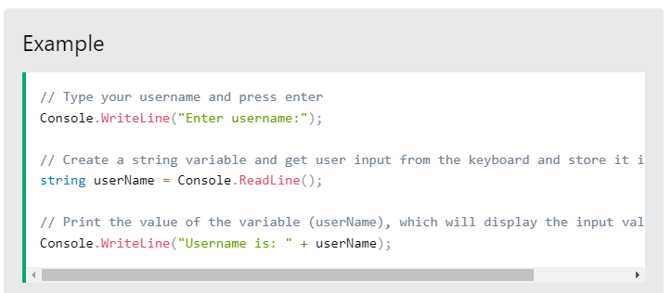

Get User Input
We will use Console.ReadLine() to get user input.
In the following example, the user can input his or hers username, which is stored in the variable userName. Then we print the value of userName:

Slide 4
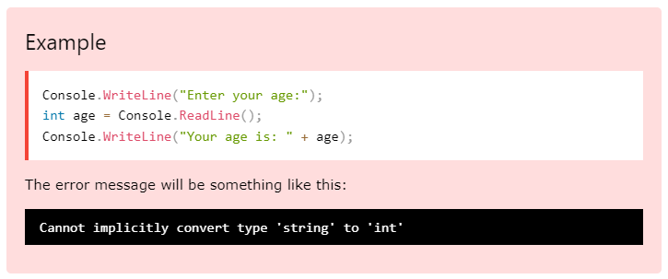
User Input and Numbers
The Console.ReadLine() method returns a string. Therefore, you cannot get information from another data type, such as int. The following program will cause an error:
Like the error message says, you cannot implicitly convert type 'string' to 'int'.

Slide 5
Type Casting
Type casting is when you assign a value of one data type to another type.
In C#, there are two types of casting:
Implicit Casting (automatically) - converting a smaller type to a larger type size
char -> int -> long -> float -> double
Explicit Casting (manually) - converting a larger type to a smaller size type
double -> float -> long -> int -> char

Slide 6
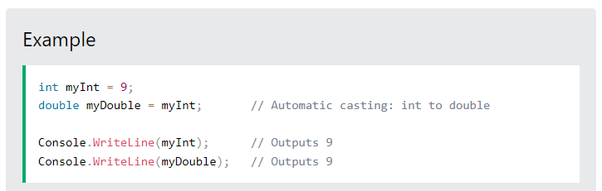
Implicit Casting
Implicit casting is done automatically when passing a smaller size type to a larger size type:

Slide 7
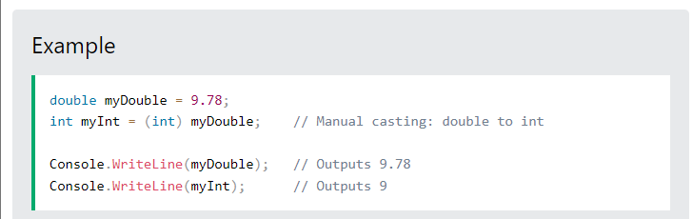
Explicit Casting
Explicit casting must be done manually by placing the type in parentheses in front of the value:

Slide 8
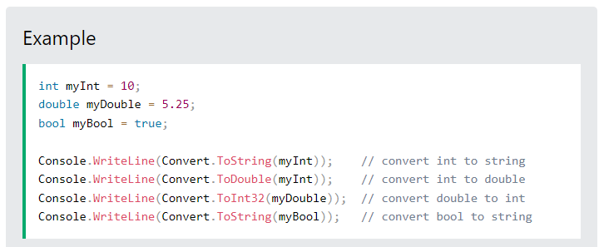
Type Conversion Methods
It is also possible to convert data types explicitly by using built-in methods, such as Convert.ToBoolean, Convert.ToDouble, Convert.ToString, Convert.ToInt32 (int) and Convert.ToInt64 (long):

Slide 9
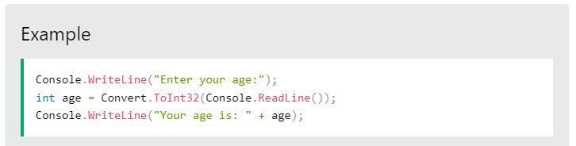
Returning to the Example
Now we know how to convert variables in different types to eachother, so we can complete the example of reading a string value from console and assigning it to an int variable.
If you enter wrong input (e.g. text in a numerical input),
You will get an exception/error message (like System.FormatException:
'Input string was not in a correct format.').

Slide 10
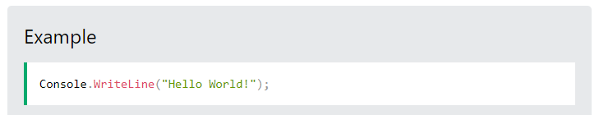
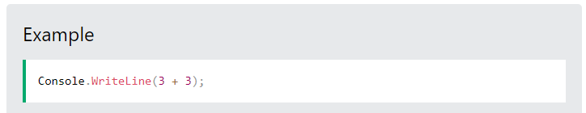
Output
To output values or print text in C#, you can use the WriteLine() method:
You can also output numbers, and perform mathematical calculations:

Slide 11
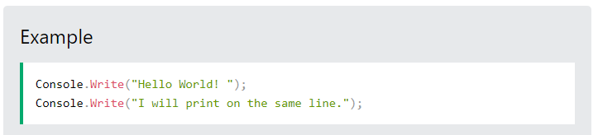
The Write Method
There is also a Write() method, which is similar to WriteLine().
The only difference is that it does not insert a new line at the end of the output:

Slide 12
Next lecture
In the next lecture we continue focusing on «Principles of Logic Applied to Program Desingn»
“Microsoft Visual C# Step by Step” Microsoft Press

