Slide 1
Loops and Arrays
A4 – Constructs and Techniques and Their Implementation in Programming
MSc. Mehmet ERDOĞDU

Slide 2
Elements
Elements of Program.
Variables
Conditionals
Loops
Functions
Input / Output
To develop any instruction there are some elements needed or we can essentially present in all language.
So any programming language is made up of 5 basic elements of the instructions.

Slide 3
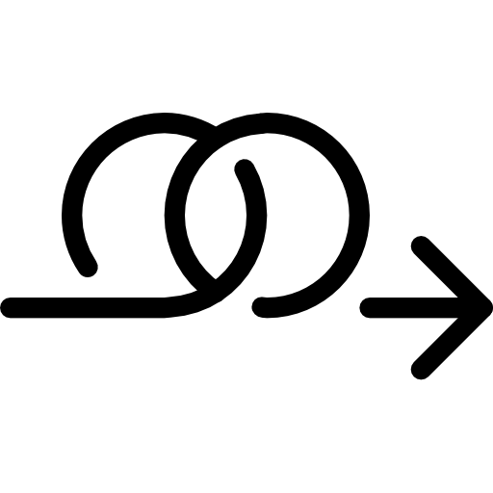
Loops
Almost all the programming languages provide a concept called loop, which helps in executing one or more statements up to a desired number of times.
A loop is a sequence of instruction s that is continually repeated until a certain condition is reached.
Loops can execute a block of code as long as a specified condition is reached.
Loops are handy because they save time, reduce errors, and they make code more readable.

Slide 4
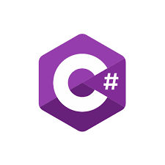
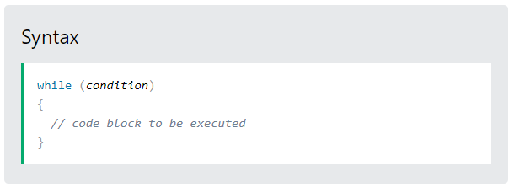

Loops – While Loop
The while loop loops through a block of code as long as a specified condition is True:

Slide 5
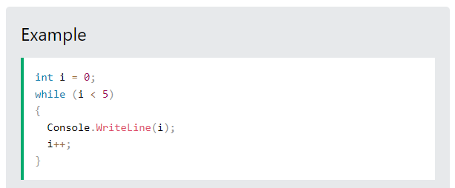
Loops – While Loop
In the example below, the code in the loop will run, over and over again, as long as a variable (i) is less than 5:
Note: Do not forget to increase the variable used in the condition, otherwise the loop will never end!

Slide 6
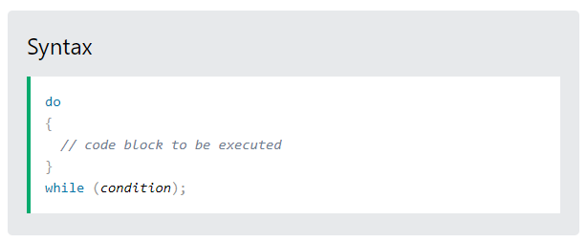
Loops – Do/While Loop
The do/while loop is a variant of the while loop. This loop will execute the code block once, before checking if the condition is true, then it will repeat the loop as long as the condition is true.

Slide 7
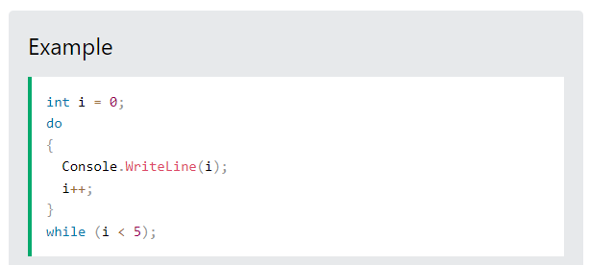
Loops – Do/While Loop
The example below uses a do/while loop. The loop will always be executed at least once, even if the condition is false, because the code block is executed before the condition is tested:
Note: Do not forget to increase the variable used in the condition, otherwise the loop will never end!

Slide 8
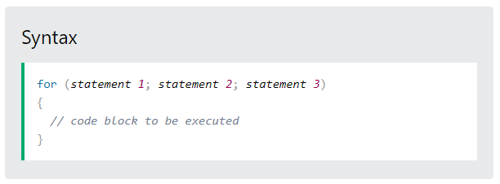
Loops – For Loop
When you know exactly how many times you want to loop through a block of code, use the for loop instead of a while loop:

Slide 9
Loops – For Loop
Statement 1 is executed (one time) before the execution of the code block.
Statement 2 defines the condition for executing the code block.
Statement 3 is executed (every time) after the code block has been executed.

Slide 10
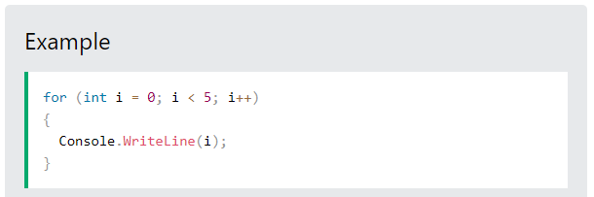
Loops – For Loop
Statement 1 sets a variable before the loop starts (int i = 0).
Statement 2 defines the condition for the loop to run (i must be less than 5). If the condition is true, the loop will start over again, if it is false, the loop will end.
Statement 3 increases a value (i++) each time the code block in the loop has been executed.

Slide 11

Loops – For Loop
This example will only print even values between 0 and 10:

Slide 12
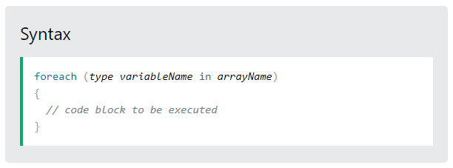
Loops – Foreach Loop
There is also a foreach loop, which is used exclusively to loop through elements in an array:

Slide 13
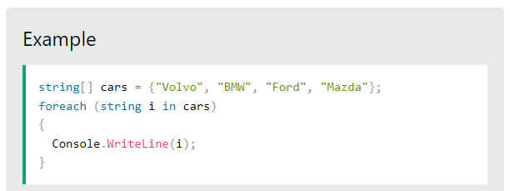
Loops – Foreach Loop
The following example outputs all elements in the cars array, using a foreach loop:
Don't worry if you don't understand the example above.
We will discuss Arrays soon.

Slide 14
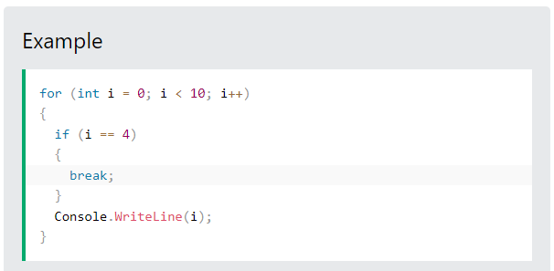
Loops – Break
We have already seen the break statement used in an earlier slide of this lesson. It was used to "jump out" of a switch statement.
The break statement can also be used to jump out of a loop.
This example jumps out of the loop when i is equal to 4:

Slide 15
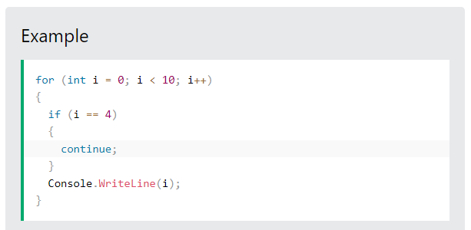
Loops – Continue
The continue statement breaks one iteration (in the loop), if a specified condition occurs, and continues with the next iteration in the loop.
This example skips the value of 4:

Slide 16
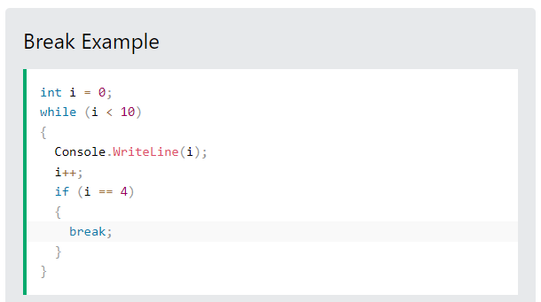
Loops – Break and Continue in While
You can also use break and continue in while loops:

Slide 17
Loops – Break and Continue in While
You can also use break and continue in while loops:

Slide 18
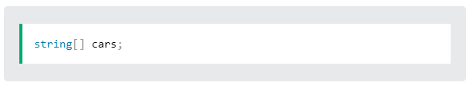
Arrays
Arrays are used to store multiple values in a single variable, instead of declaring separate variables for each value.
To declare an array, define the variable type with square brackets:
We have now declared a variable that holds an array of strings.

Slide 19
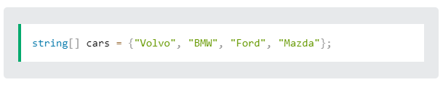
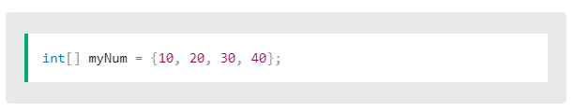
Arrays
To insert values to it, we can use an array literal - place the values in a comma-separated list, inside curly braces:
To create an array of integers, you could write:

Slide 20
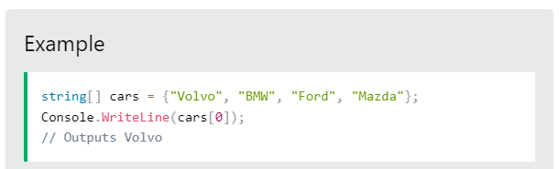
Access the Elements of an Array
You access an array element by referring to the index number.
This statement accesses the value of the first element in cars:
Array indexes start with 0: [0] is the first element.
[1] is the second element, etc.

Slide 21
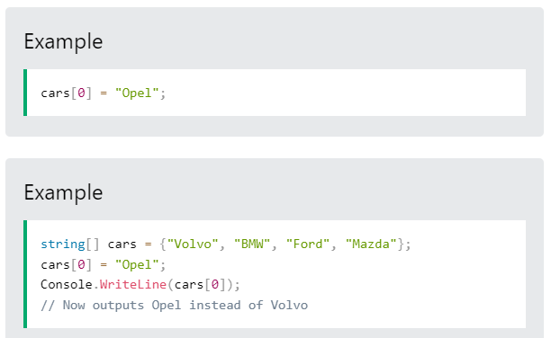
Change an Array Element
To change the value of a specific element, refer to the index number:

Slide 22
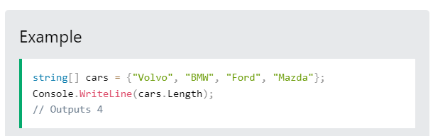
Array Length
To find out how many elements an array has, use the Length property:

Slide 23
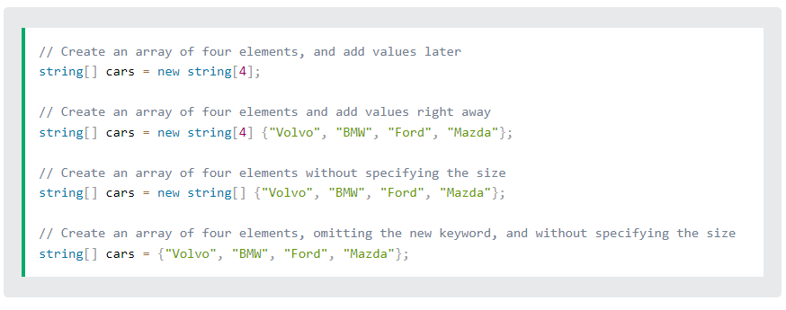
Other Ways to Create an Array
If you are familiar with C#, you might have seen arrays created with the new keyword, and perhaps you have seen arrays with a specified size as well. In C#, there are different ways to create an array:

Slide 24
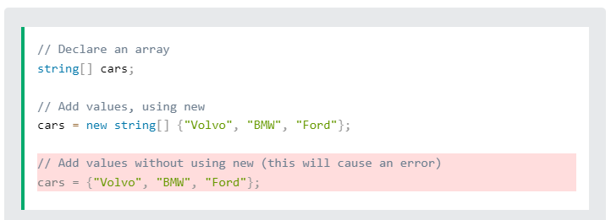
Other Ways to Create an Array
It is up to you which option you choose. In our tutorial, we will often use the last option, as it is faster and easier to read.
However, you should note that if you declare an array and initialize it later, you have to use the new keyword:

Slide 25
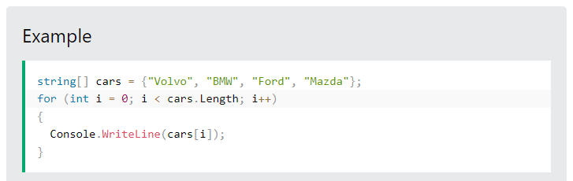
Loop Through Arrays
You can loop through the array elements with the for loop, and use the Length property to specify how many times the loop should run.
The following example outputs all elements in the cars array:

Slide 26
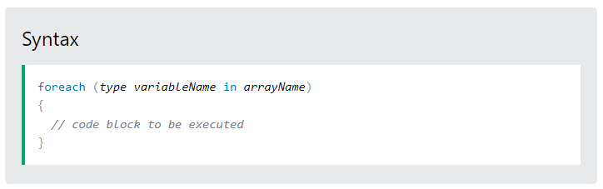
Loop Through Arrays – Foreach Loop
There is also a foreach loop, which is used exclusively to loop through elements in an array:

Slide 27
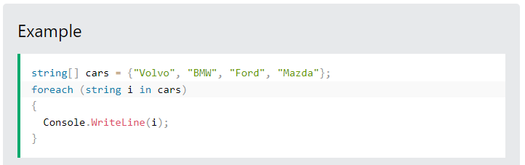
Loop Through Arrays – Foreach Loop
The following example outputs all elements in the cars array, using a foreach loop:
If you compare the for loop and foreach loop, you will see that the foreach method is easier to write, it does not require a counter (using the Length property), and it is more readable.

Slide 28
Next lecture
In the next lecture we continue focusing on «Constructs and techniques and their implementation»
“Microsoft Visual C# Step by Step” Microsoft Press

