Slide 1

Machine Learning Hackathon CG 2022
Team Name - Tensor HOD
Team Leader Name - Soumen Sardar
Team Leader Email Address - soumensardarintmain@gmail.com

Slide 2
Brief description of the problem at hand:
Attacker use various fraudulent techniques to perform phishing attract while user is visiting certain websites.
Here we have a dataset containing 30 features indicating 3 flags:
-1 : Phishing
0 : Suspicious
1 : Legitimate
We have a Result column in the dataset which indicates:
-1 : Phishing (56%)
1 : Legitimate (44%)
Good balance between classes
Our task is to identify whether a certain website is Legitimate(1) or Phishing(-1) based on given 30 features.

Slide 3
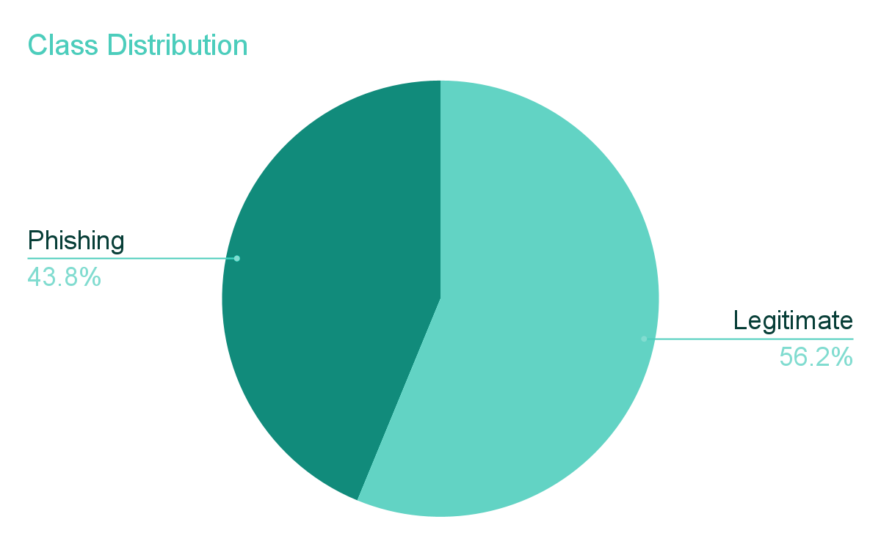
Solution proposed and description:
The given dataset does not contain any null value which is good for us.
Our target variable is - Result.
All features are categorical in nature.
On performing Exploratory Data Analysis(EDA), we found few features are highly correlated with the target variable.
We wish to build machine learning classification model to perform our classification task

Slide 4
Technology/Tool Stack Used:
Language: Python
Data Processing Libraries: Pandas, Numpy
Data Visualization Libraries: Matplotlib, Seaborn, Sweetviz
Machine Learning Library: scikit-learn
Platform: Google Collab
Model Serializer: Joblib 1.1.0

Slide 5
Approach:
Performance Metric:
Our idea is to keep the False Negative Rate(FNR) as low as possible.
We took ROC_AUC as our evaluation metric.
Model:
As the number of features is not too high, we started with simple logistic regression model
We used 11 folds cross-validation. As we have almost 9000 data, each fold is having 800 samples for validation
Later we have chosen Decision Tree model for better and reliable result.
We performed Hyperparameter tuning and Fine Tuning to find our best decision tree.
We have saved our best decision tree model as dt6.joblib file and feature encoder object as enc.joblib file.

Slide 6
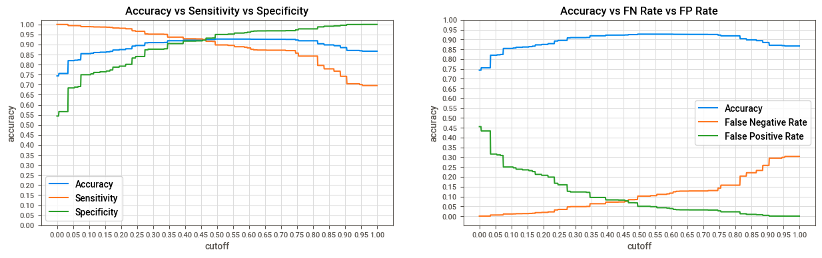

Execution Demo(Video/Screenshots) of the solution:
Optimal Probability cutoff: 0.455

Slide 7
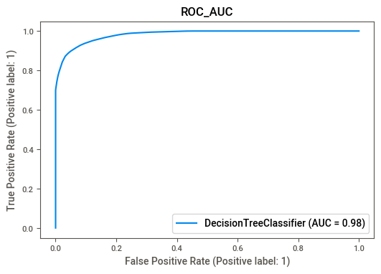
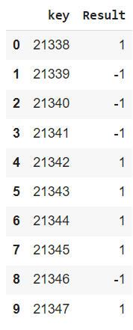
Execution Demo(Video/Screenshots) of the solution:
To keep FNR lower we have chosen 0.25 as our probability cutoff to generate the submission file

Slide 8
Source code as ZIP or Github URL:
GitHub URL:
https://github.com/Redcof/HPE_Machine_Learning_Hackathon_CG_2022

Slide 9
THANK YOU

