Slide 1

Machine Learning Hackathon CG 2022
Team Name - Tensor HOD
Team Leader Name - Soumen Sardar
Team Leader Email Address - soumensardarintmain@gmail.com

Slide 2
Brief description of the problem at hand:
Attacker use various fraudulent techniques to perform phishing attract while user is visiting certain websites.
Here we have a dataset containing 30 features indicating 3 flags:
-1 : Phishing
0 : Suspicious
1 : Legitimate
We have a Result column in the dataset which indicates:
-1 : Phishing
1 : Legitimate
Good balance between classes
Our task is to identify whether a certain website is Legitimate(1) or Phishing(-1) based on given 30 features.

Slide 3
Solution proposed and description:
The given dataset does not contain any null value which is good for us.
After dropping duplicate records, we have 5000 records
Our target variable is - Result.
All features are categorical in nature. We dropped `key` variable
On performing Exploratory Data Analysis(EDA), we found few features are highly correlated with the target variable.
We wish to build machine learning classification model to perform our classification task

Slide 4
Technology/Tool Stack Used:
Language: Python
Data Processing Libraries: Pandas, Numpy
Data Visualization Libraries: Matplotlib, Seaborn, Sweetviz
Machine Learning Library: scikit-learn, StatsModel, XGBoost
Platform: Google Collab
Model Serializer: Joblib 1.1.0
Algorithms: Logistic Regression, Decision Tree, Random Forest, XGBoostClassifier

Slide 5
Feature Engineering:
We have compared all identical records from both(train and test) dataset and found 653 unseen records in test data.
For feature engineering we have chosen three different techniques:
Automated Approach
Recursive Feature Elimination (RFE) technique
Manual Approach
Variance Inflation Factor Analysis
P-Value analysis
Top 8 Features
'having_IP',
'Google_Index',
'SFH',
'Links_pointing_to_page’
'URL_of_Anchor',
'Request_URL',
'Links_in_tags',
'SSLfinal_State'

Slide 6
Approach:
Performance Metric:
Our idea is to keep the False Negative Rate(FNR) as low as possible.
We took ROC_AUC as our evaluation metric.
Model:
As the number of features is not too high, we started with simple logistic regression model
We used 5 folds cross-validation. As we have almost 5000 data, each fold is having 1000 samples for validation
Later we have experimented with Decision Tree, Random Forest and XGBoost models for better and reliable result.
We performed Hyperparameter tuning and Fine Tuning to all the variants.
We have chosen XGBoost Classifier as our final model

Slide 7
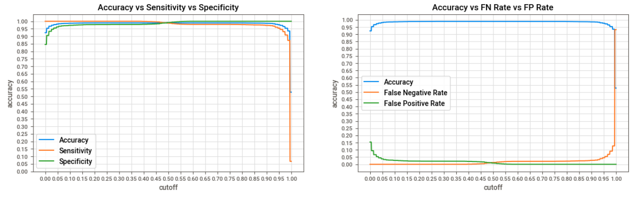

Execution Demo(Video/Screenshots) of the solution:
Optimal Probability cutoff: 0.486

Slide 8
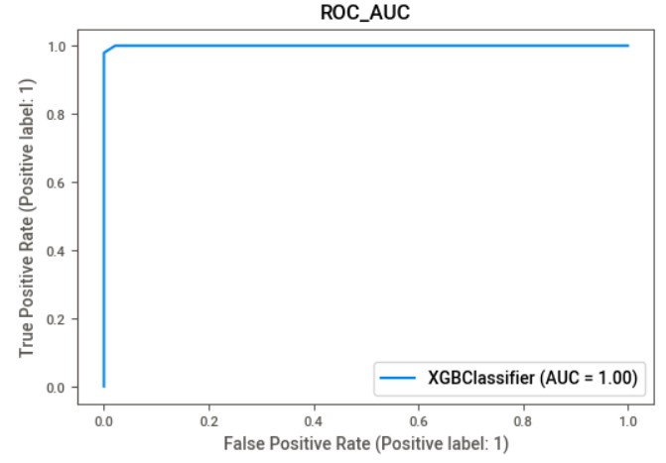
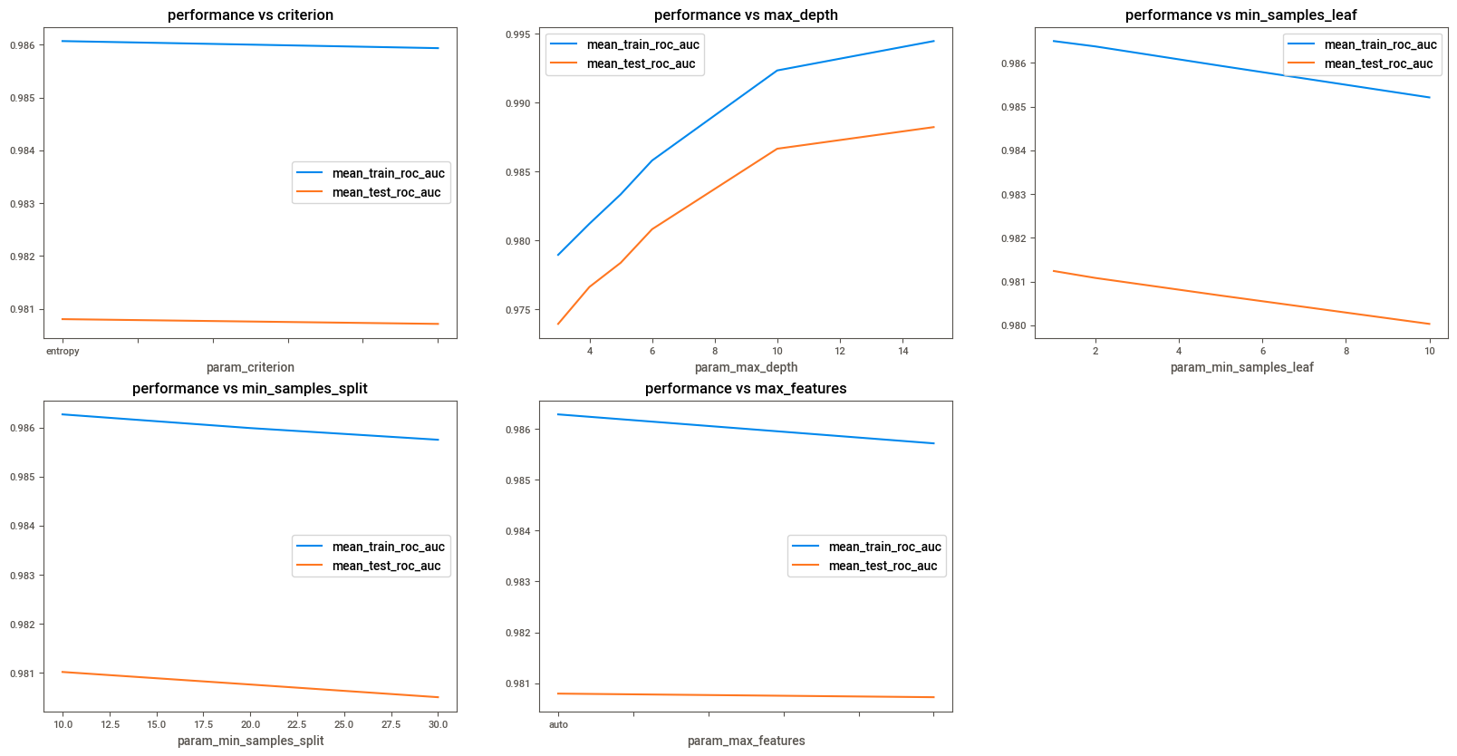
Execution Demo(Video/Screenshots) of the solution:
AUC: 0.9997774237814413

Slide 9
Source code as ZIP or Github URL:
GitHub URL:
https://github.com/Redcof/HPE_Machine_Learning_Hackathon_CG_2022

Slide 10
THANK YOU

