Slide 1
Air-Synth ProjeT Geste et Intelligence Artificielle
Xiangnan, Xu
Tuteur : Edgar

Slide 2
Table of Content
Outil
Leap Motion
Ableton Live
Introduction Midi
Gesture recognition
Algorithm

Slide 3
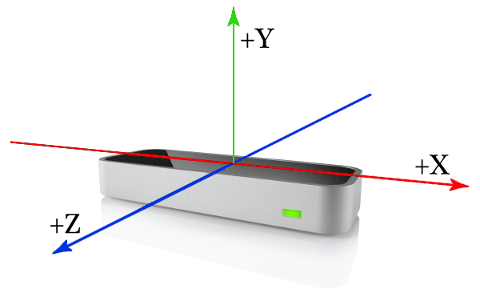
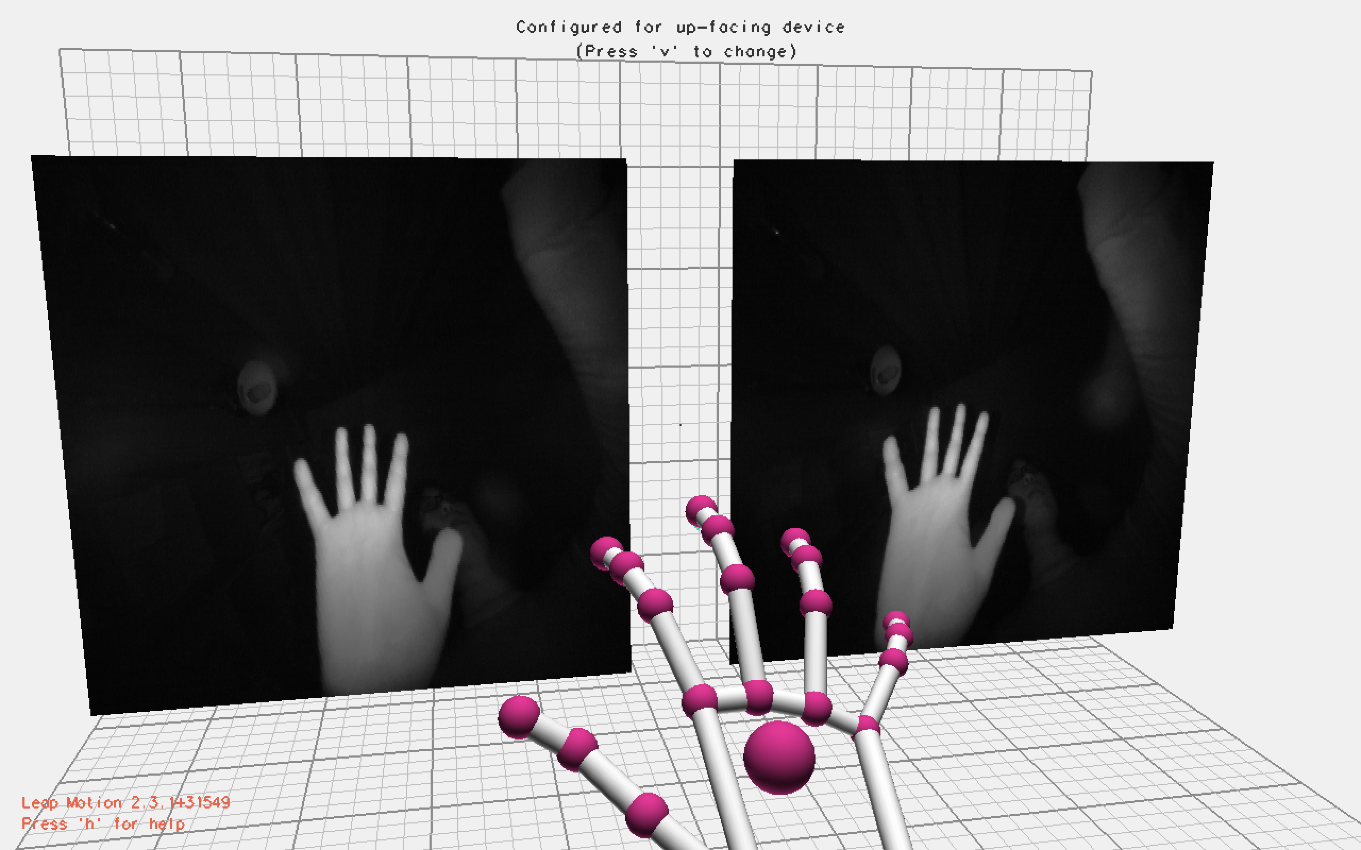
Leap Motion

Slide 4
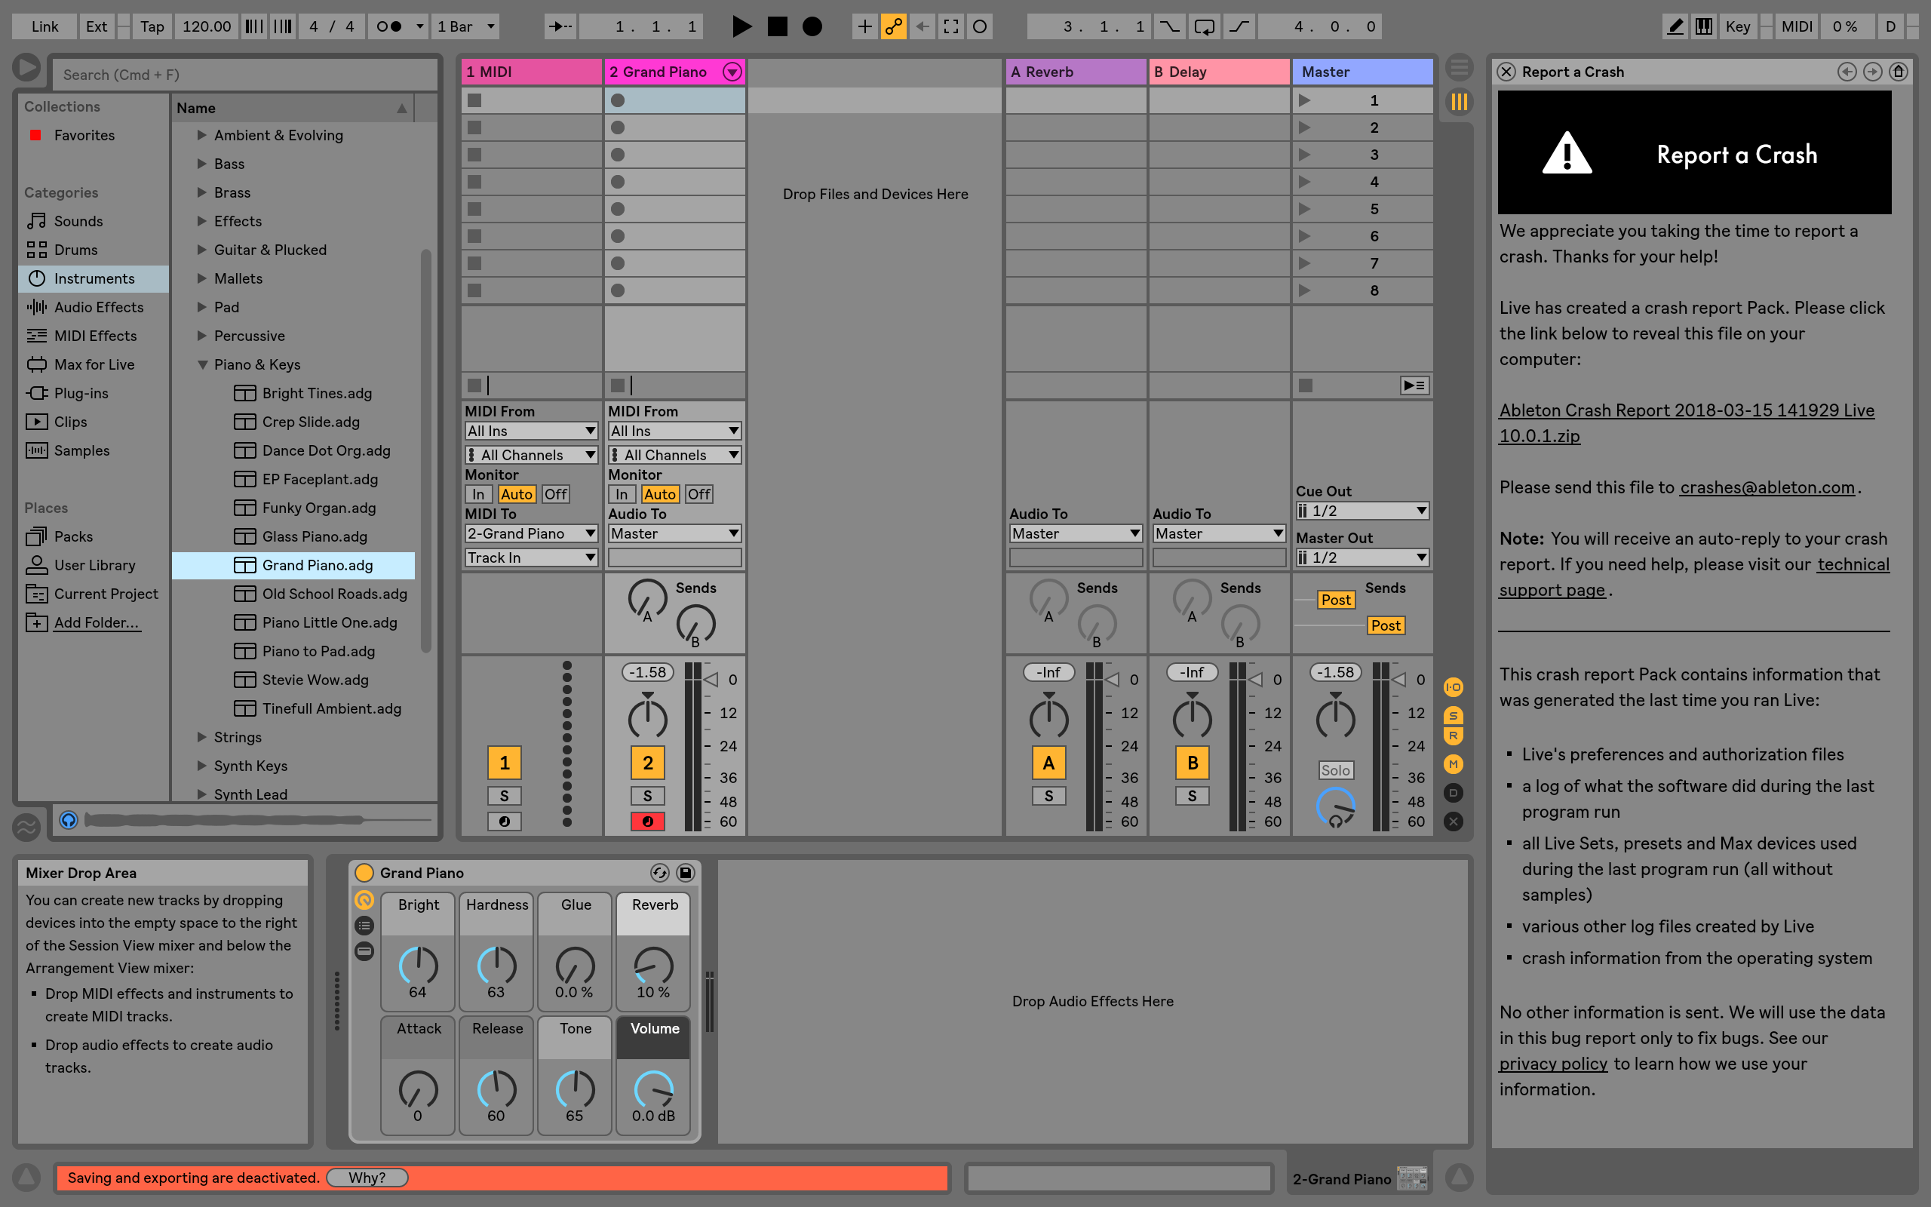
Albeton Live

Slide 5
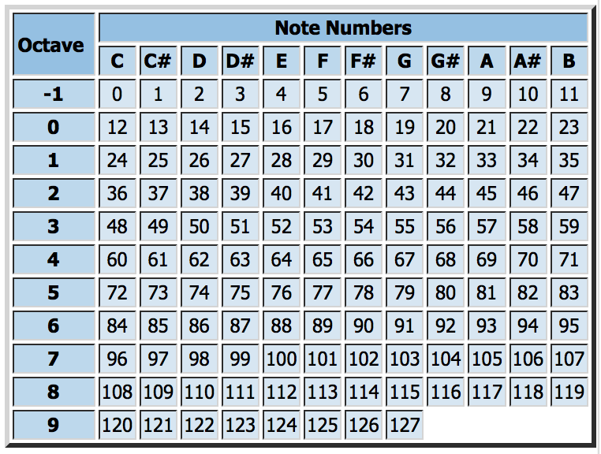
Midi
Musical Instrument Digital Interface
Key parameter:
Notation
Pitch
Velocity
Python library: python-rtmidi 1.1.0
Usage example: note_on = [0x90, 60, 112] note_off = [0x80, 60, 0] midiout.send_message(note_on) time.sleep(0.5) midiout.send_message(note_off)

Slide 6
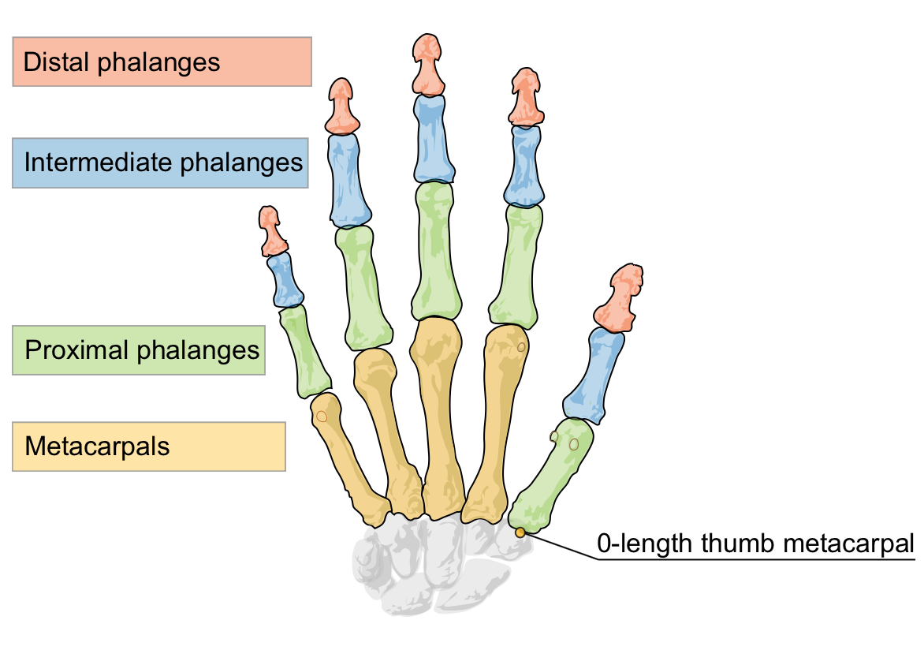
Gesture recognition

Slide 7
Finger Moving
Simulation : play the piano
Condition:
The velocity of fingertip changes direction
Distance from leap motion < h = 6cm
Distance of fingertip to palm center reduces
Position change of fingertip is large enough

Slide 8
Conclusion
Live Demostration
Difficulties: thumb moving conditions different from others

Slide 9
Thanks QUESTIONs?

