Slide 1
Air-Synth ProjeT Geste et Intelligence Artificielle
Xiangnan, Xu
Tuteur : Edgar

Slide 2
Table of Content
Introduction
Tools
Leap Motion
Ableton Live
Introduction Midi
Music Stream
Gesture recognition
Algorithm
Conclusion

Slide 3
Introduction
Create music from gesture.
Control the sounds notation and octave.

Slide 4
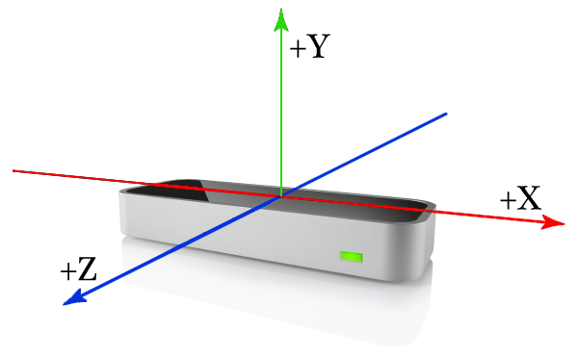
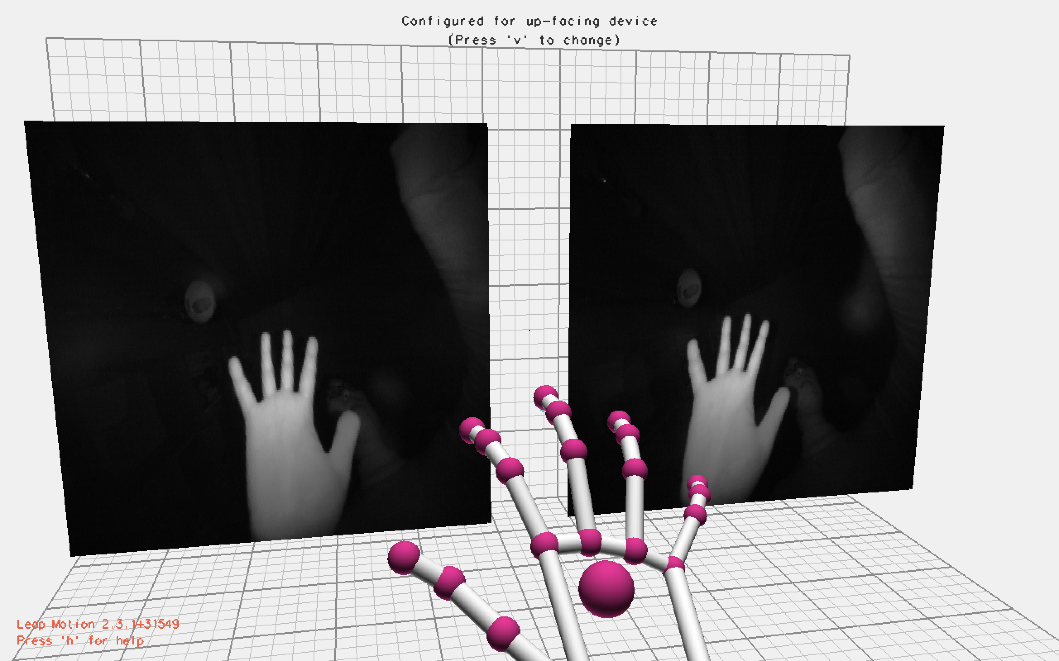
Leap Motion

Slide 5
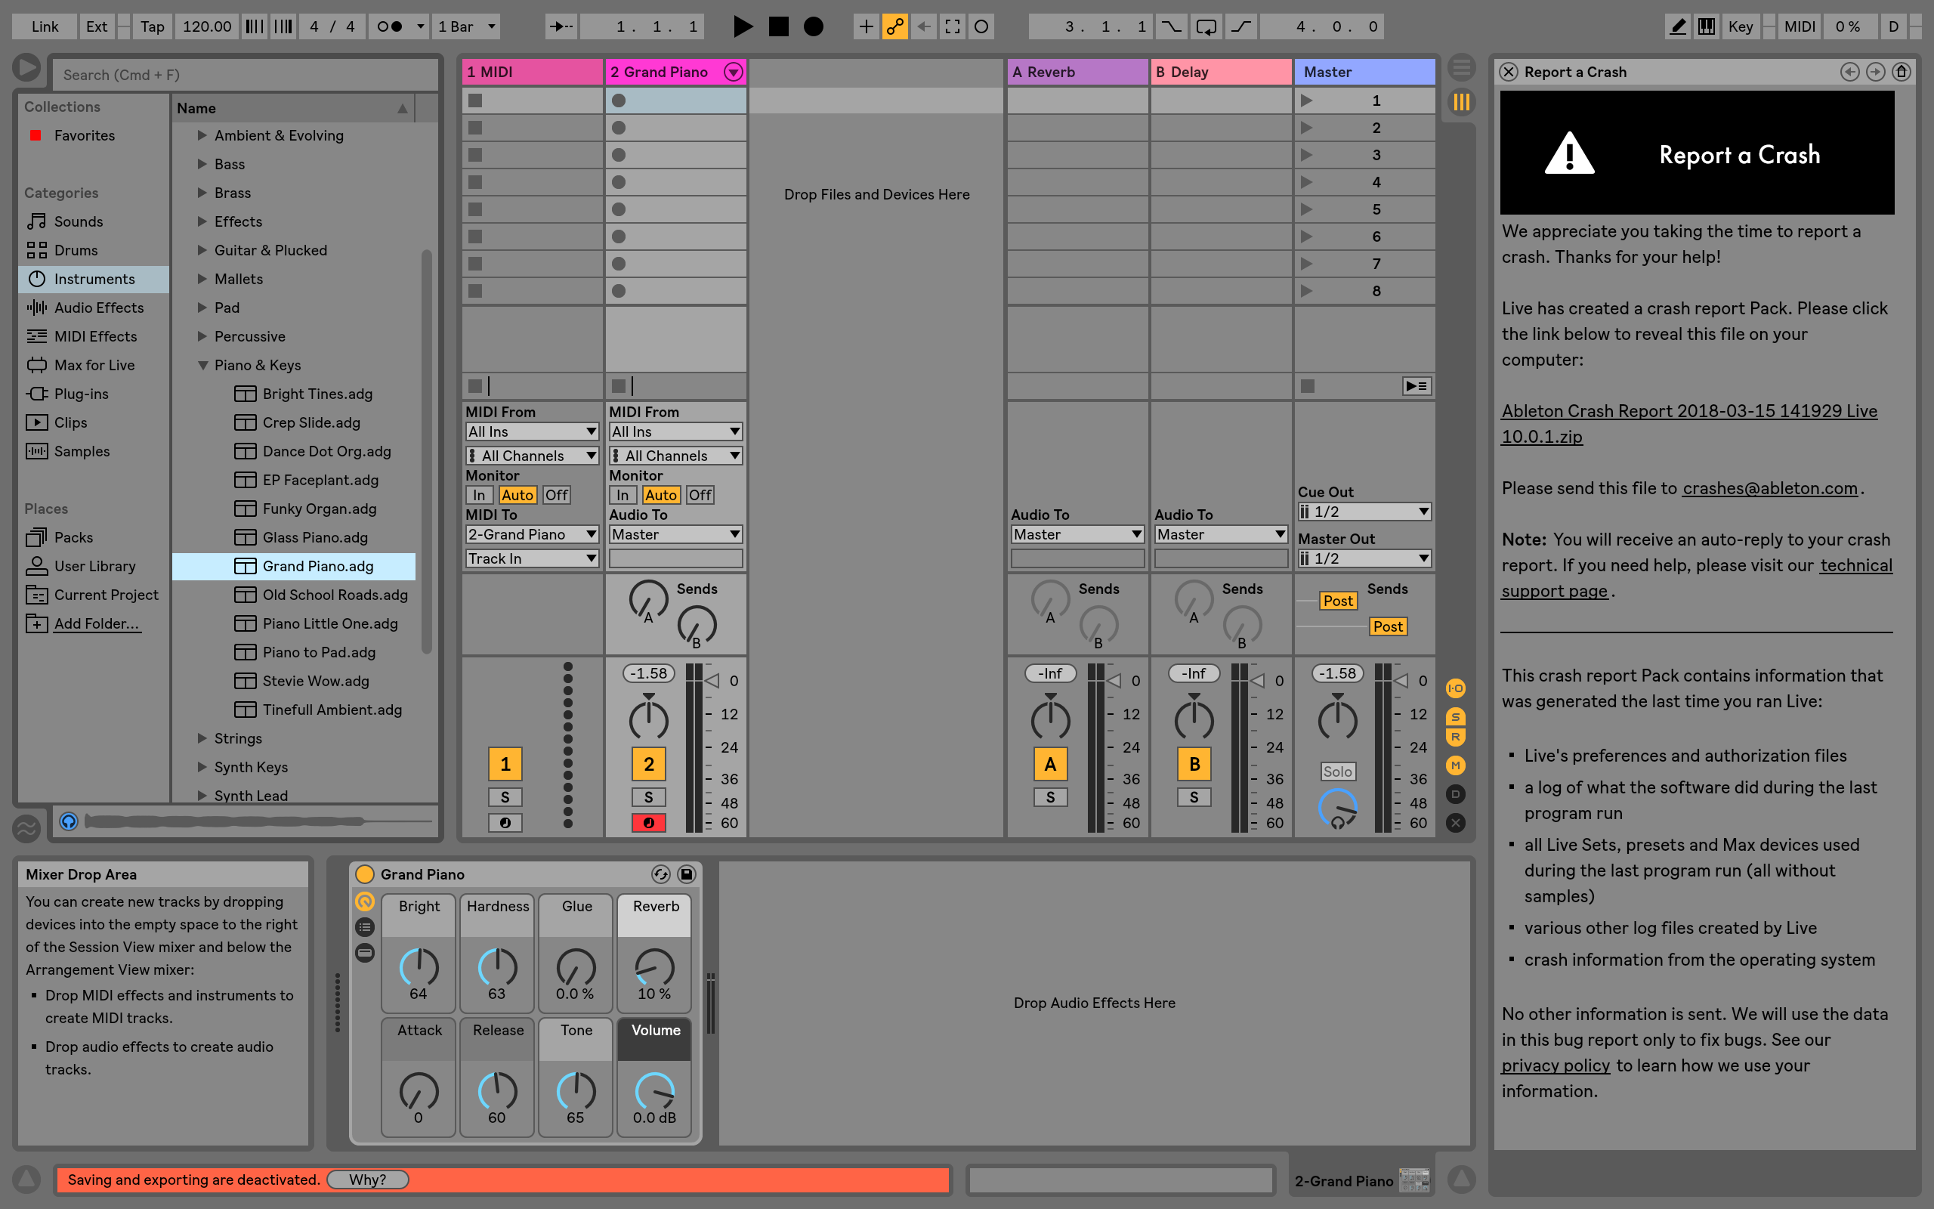
Ableton Live

Slide 6
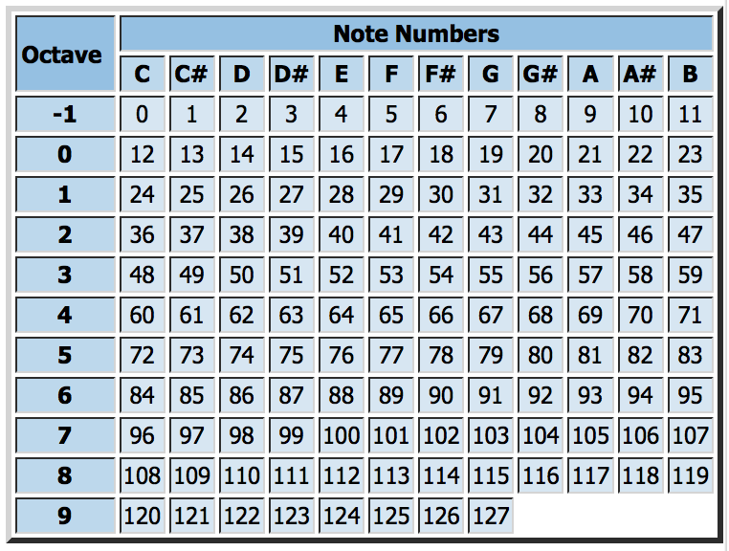
Midi
Musical Instrument Digital Interface
Key parameter:
Notation
Pitch
Velocity
Python library: python-rtmidi 1.1.0
Usage example: note_on = [0x90, 60, 112] note_off = [0x80, 60, 0] midiout.send_message(note_on) time.sleep(0.5) midiout.send_message(note_off)

Slide 7
Music Stream
Leap Motion
API Python
Create midi stream
virtual port
Ableton Live

Slide 8
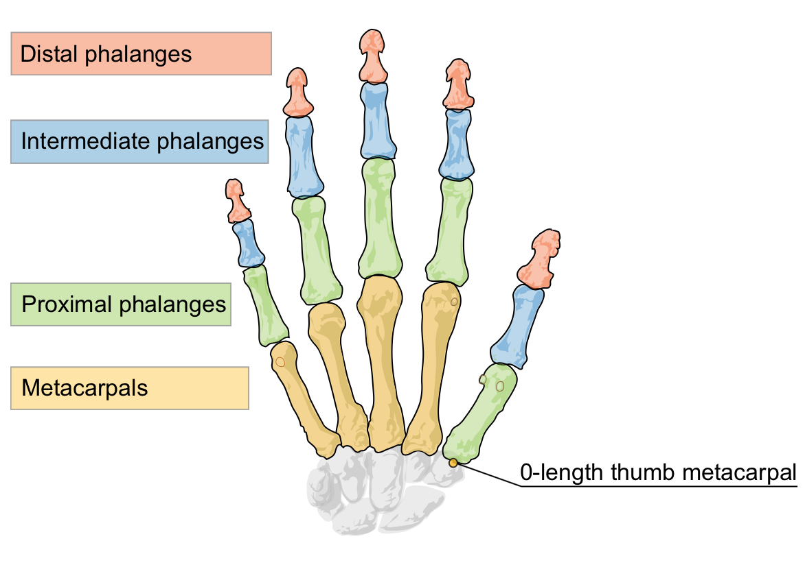
Gesture recognition

Slide 9
Finger Moving
Simulation : play the piano in the air
Condition:
The velocity of fingertip changes direction
Distance from leap motion < h = 6cm
Distance of fingertip to palm center reduces
Position change of fingertip is large enough
Parameters sent to midi stream
Velocity: velocity of fingertip
Time of a note: one frame( about 0.05 s)

Slide 10
Notation Distribution
'left4':'C', 'left3':'D', 'left2':'E', 'left1':'F', 'left0':'F#', 'right0':'G', 'right1':'G#', 'right2':'A', 'right3':'A#', 'right4':'B'

Slide 11
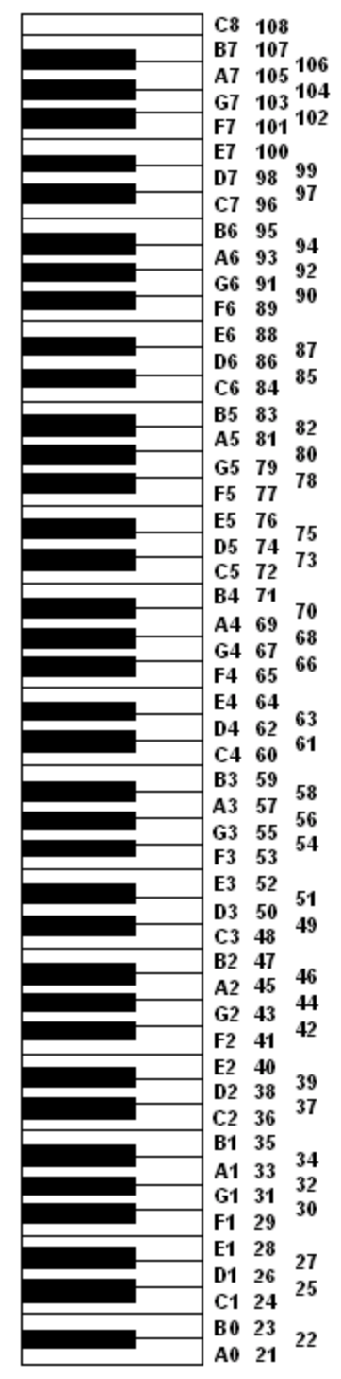
Octave Distribution
Leap Motion

Slide 12
Conclusion
Live Demostration
To be improved:
Distinguish the initiative movement and passive movement of fingers
Thumb moving conditions different from others
Ring Finger and Pinky Finger Move together
Sensitivity difference between left and right hand, and among different users
Find the best threshold parameters (distance, velocity)
Use different criteria as the Leap Motion is sometimes insensitive

Slide 13
Thanks QUESTIONs?

