Slide 1
PRESENTATION ON COVID19 DATASET BY – MOHAMMED IMRAN TuringMinds.Ai

Slide 2
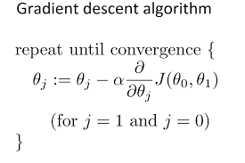
GRADIENT DESCENT
Gradient descent is a method of determining the values of a function's parameters (coefficients) in order to minimize a cost function (cost). It may be used to decrease the Cost function (minimizing MSE value) and achieve the best fit line.
If the learning rate is too high, we might OVERSHOOT the minima and keep bouncing, without reaching the minima
If the learning rate is too small, the training might turn out to be too long

Slide 3
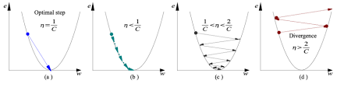
a) Learning rate is optimal, model converges to the minimum
b) Learning rate is too small, it takes more time but converges to the minimum
c) Learning rate is higher than the optimal value, it overshoots but converges ( 1/C < η <2/C)
d) Learning rate is very large, it overshoots and diverges, moves away from the minima, performance decreases on learning

Slide 4
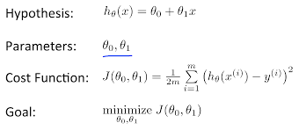
COST FUNCTION
Distance between the predicted value and the actual value.

Slide 5
FLOW CHART
Import libraries
Read data
preprocessing
Feature selection
Feature scaling
Train data
model
prediction
Test on new data

Slide 6
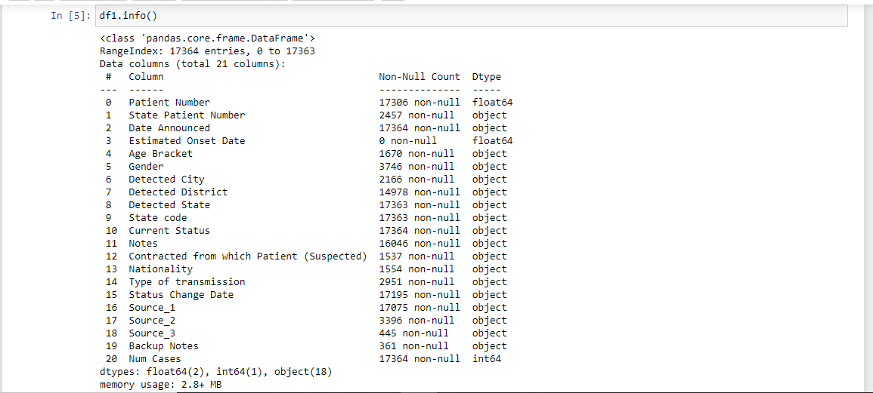
EXPLORING THE DATA

Slide 7
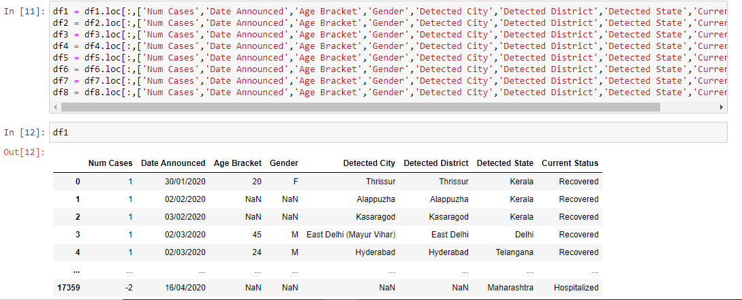
RETAIN NECESSARY COLUMNS

Slide 8
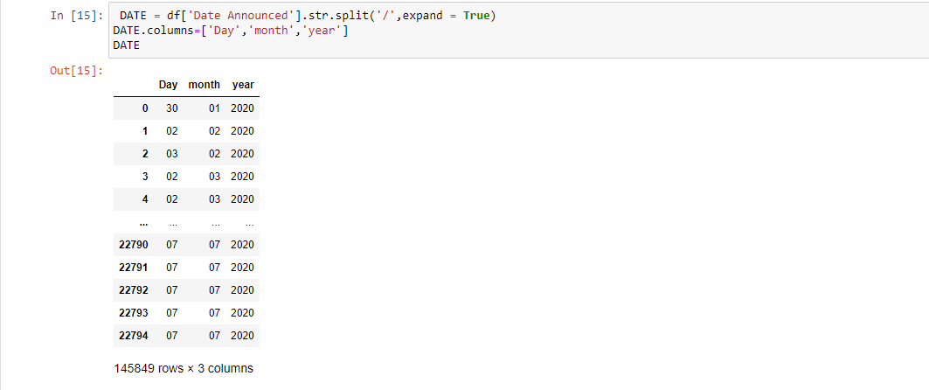
MAKING SEPARATE COLUMNS FOR DAY, MONTH AND YEAR

Slide 9
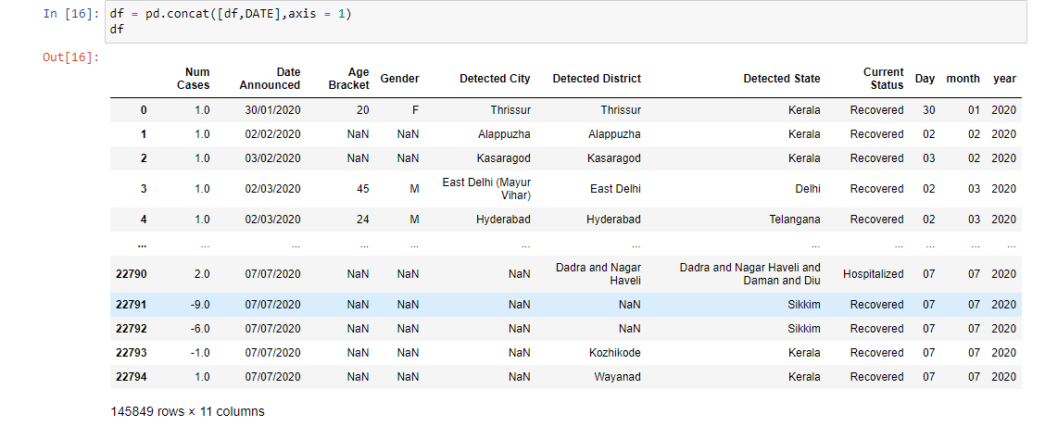
CONCATINATE BOTH THE DATA FRAMES ALONG THE AXIS = 1

Slide 10
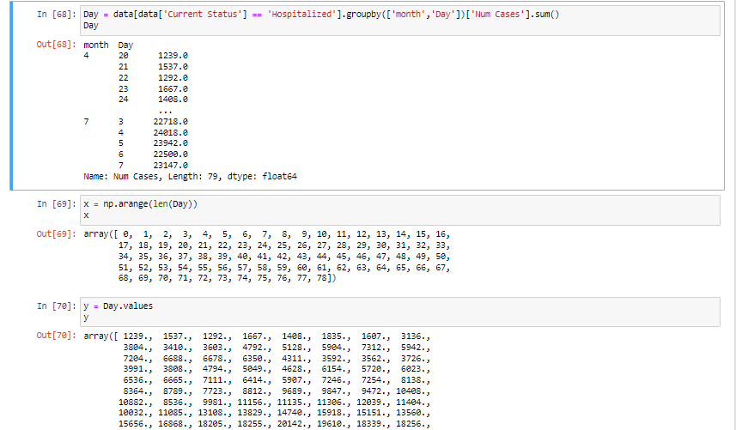
SEPARATE DEPENDENT AND INDEPENDENT VALUES

Slide 11
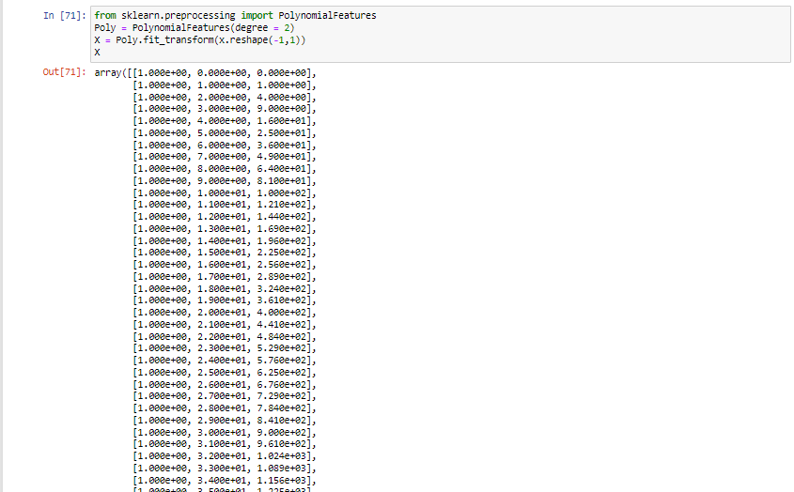
PREDICT NO.OF COVID CASES USING POLYNOMIAL REGRESSION

Slide 12
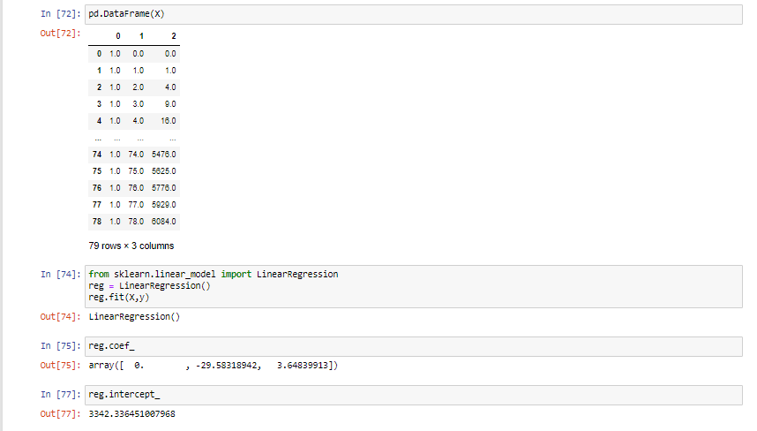
MODEL

Slide 13
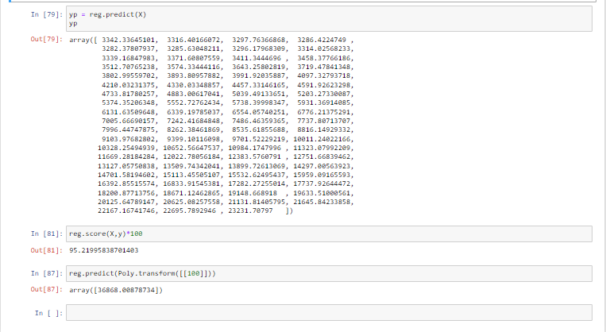
MODEL ACCURACY

