Slide 1
Final Presentation
Presented By:- Adrian, Aman, Ankit

Slide 2
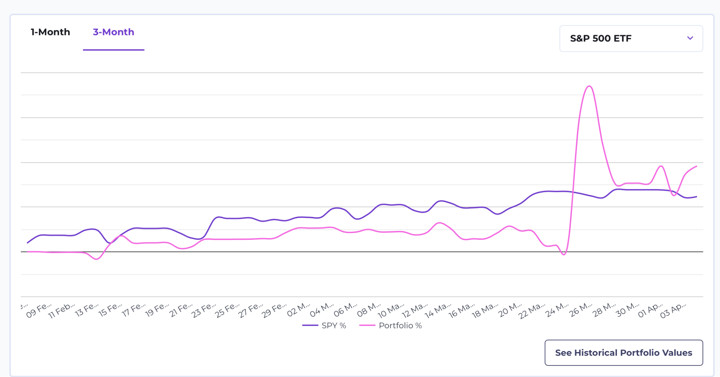
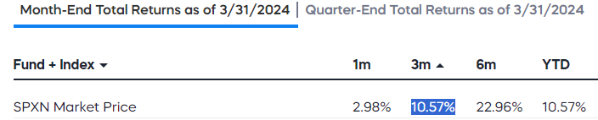
Summary
Overall, our stock portfolio achieved a commendable performance, surpassing the S&P 500 index with a solid return of 10.6% over the past three months. Our strategy evolved from a conservative diversification approach to a more opportunistic stance, as depicted in the graph. Initially prioritizing risk mitigation, we laid a foundation for steady growth. However, as market conditions shifted, we adapted, incorporating calculated risks that contributed to our positive returns. This dynamic approach enabled us to effectively navigate changing market dynamics and ultimately led to the success of our portfolio which once touched a high of 20% return for both active and buy/hold portfolio.

Slide 3


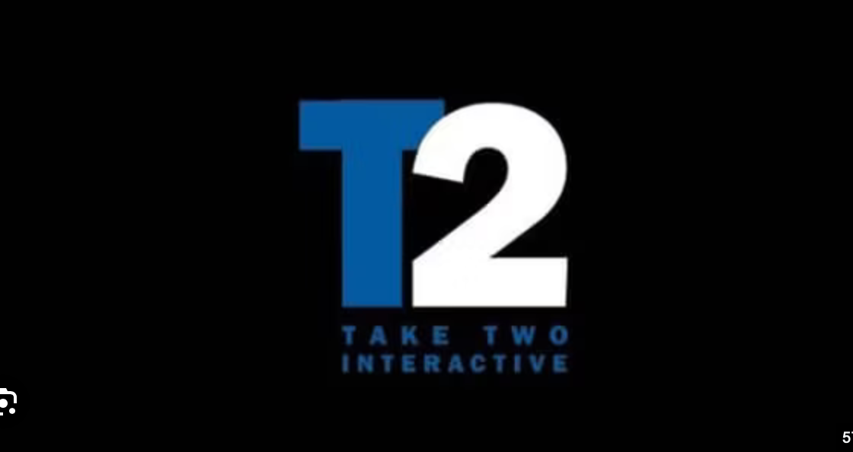
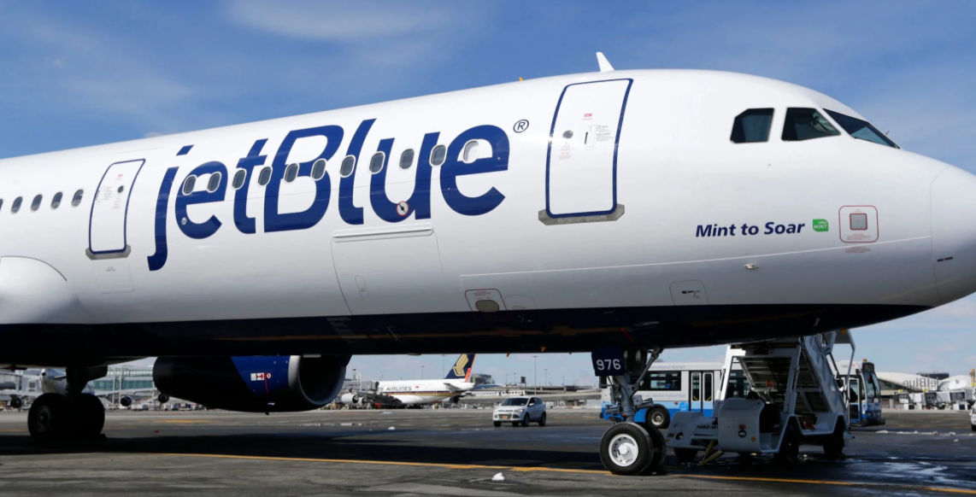
Strengths & Weaknesses
In terms of perceived timing and selection strengths, our decision to invest in Rockstar Games, Uber and Reddit's IPO showcased our capacity to identify promising opportunities based on our research and understanding of market sentiment. The anticipation surrounding the highly anticipated game release and the potential for an underpriced IPO provided compelling entry points that initially yielded positive returns. Additionally, our investment in Astera Labs reflected our ability to align our portfolio with emerging technological trends, leveraging partnerships with industry giants like Nvidia as indicators of future growth potential.
However, despite these strengths, our portfolio also exhibited weaknesses in terms of risk management and response to adverse developments. For instance, our investment in JetBlue, based on the potential acquisition by Spirit Airlines, underscored the risks associated with speculative moves reliant on external factors beyond our control, such as regulatory decisions. While our strategy initially seemed sound, the failure of the proposed merger highlighted the importance of diversification and thorough risk assessment.

Slide 4
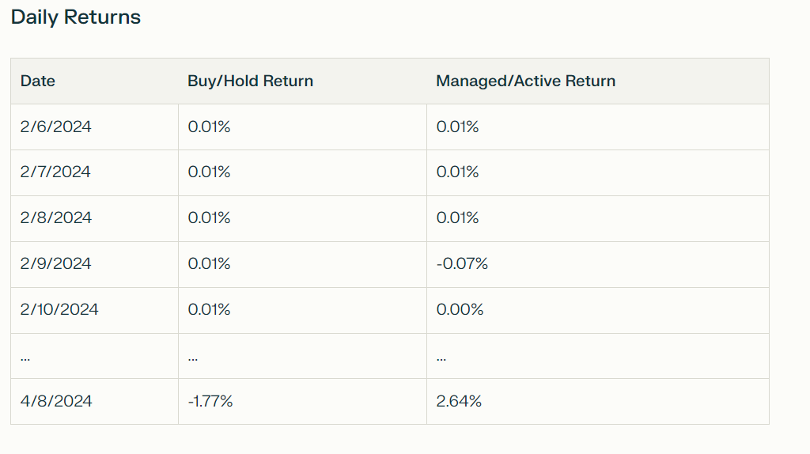
Portfolio Returns Comparison

Slide 5
Portfolio Returns Comparison
Overall Performance
Total Return (4/8/2024):Buy/Hold Portfolio: 0.97%
Total Return (4/8/2024):Managed/Active Portfolio: 10.60%
The Managed/Active Portfolio outperformed the Buy/Hold Portfolio.
Risk-Adjusted Performance
Sharpe Ratio:Buy/Hold Portfolio: 0.0227
Sharpe Ratio:Managed/Active Portfolio: 1.2972
The Managed/Active Portfolio had a higher Sharpe ratio, indicating better risk-adjusted performance.
Risk Analysis
Standard Deviation:Buy/Hold Portfolio: 0.0227
Standard Deviation:Managed/Active Portfolio: 0.0217
The Buy/Hold Portfolio was riskier than the Managed/Active Portfolio.
The higher return of the Managed/Active Portfolio likely compensated for the additional risk.

Slide 6
Short-Term Strategies
One of our strategies for the next six months is to research IPOs that are going public and closely monitor the company's fundamentals and earnings reports. If we find that they meet our criteria, we plan to invest approximately 30% of our portfolio's value in these IPOs, while the 40% will be invested in other equities. We also plan to actively trade, as we did in the project for the active portfolio.
The strategy was to invest in companies which were investing in Artificial Intelligence or watch out for hot investments according to the ongoing news and set up a entry or a exit range.

Slide 7

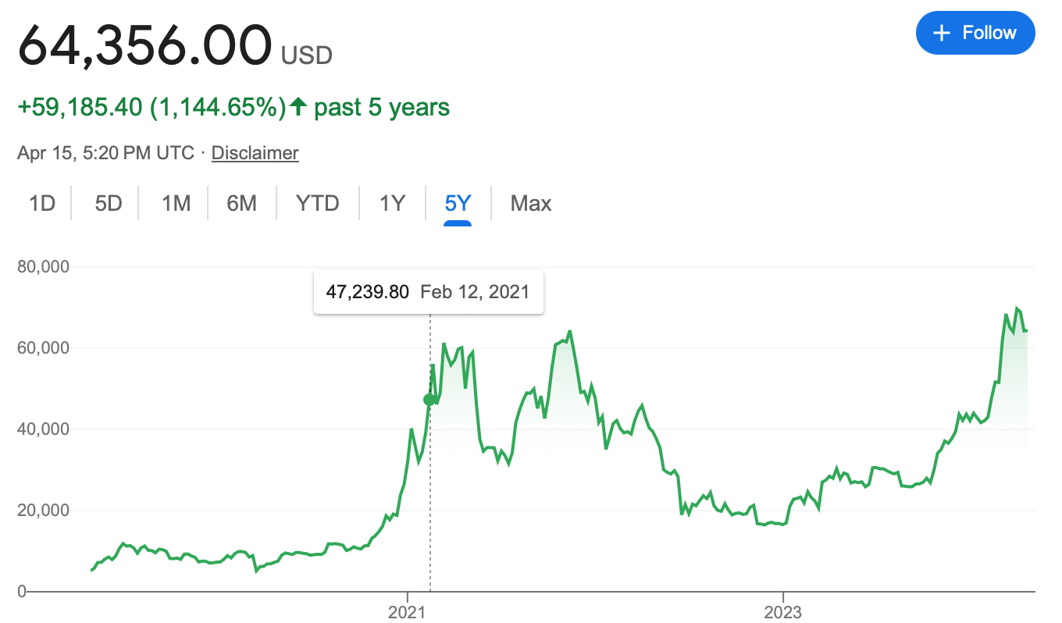
Long-Term Strategies
If we talk about the long run, Investing the remaining 30% in Technological sector seems the best option right now due to the revolution of the AI industry and watch out for major events happening in the industry.
Also in the next year or so one of the most popular games GTA 6 will be released which will be the biggest thing in the industry in the past decade, So keep a lookout for Take Two Interactive(TTWO) which has projected over $8 billion revenue in the fiscal year 2025.
As the government keeps printing money, the dollar's value drops, making Bitcoin an attractive long-term investment. Bitcoin's limited supply of 21 million coins contrasts with the endless printing of dollars, making it a scarce asset. Comparing Bitcoin's appreciation over five years to the dollar's decline highlights its potential for wealth preservation and growth. This trend suggests that Bitcoin, with its scarcity and increasing adoption, offers better prospects than traditional fiat currencies for long-term investment.

Slide 8
Thank You

