Slide 1

St louis crime rate regression on R
Aman, Brandon

Slide 2



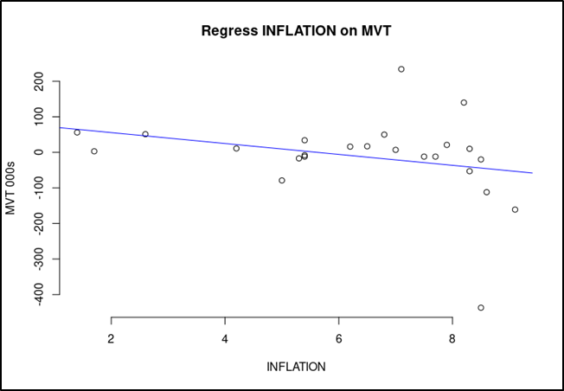
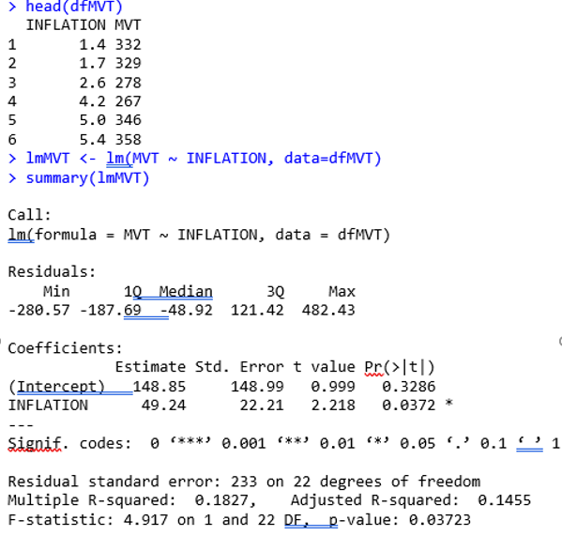

Our First Approach
Unfortunately, This approach failed to materialize
Surprisingly, The low R-Square and Adjusted R-Square had
Negative correlation.

Slide 3

What Crimes Have Greatest Influence in Crime Rating
From the National Incident Based Reporting System (NIBRS) we pulled all crime data for Saint louis City
Specifically which crimes have the most influence on overall crime rate.
Crime Rate in STL City
Determined by the total crimes compared to population

Slide 4
Comparing the Median
Following graph which is for box and whisker we can determine that the median values for assault, motor vehicle theft and destruction of property are 316.5, 332.5 and 736 respectively.
​ | Assault ​ | MVT​ | DOP​
Mean​ | 328.833333​ | 325.75​ | 700.0833​
Median​ | 316.5​ | 332.5​ | 736​

Slide 5
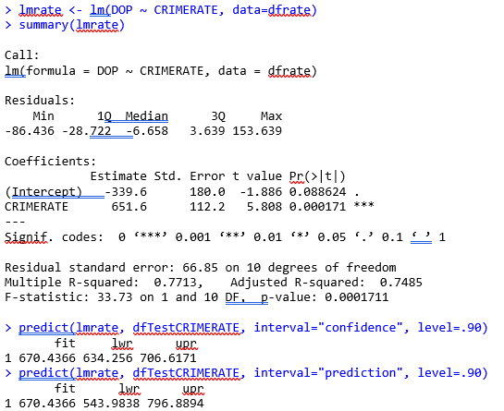

R Regression Analysis for DoP on Crime Rate
From our regression analysis in R to determine the relationship between destruction of property and the crime rate and what we observed here from the R square that 77% of the data can be explained from this model and the p-value is <0.05 therefore we can confirm there is a linear relationship.

Slide 6
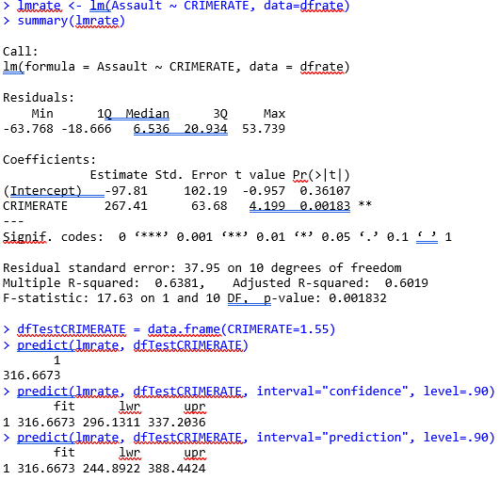
R Regression Analysis for Assault on Crime Rate
From our regression analysis in R to determine the relationship between assault on the crime rate and what we observed here from the R square that 63% of the data can be explained from this model and the p-value is <0.05 therefore we can confirm there is also a linear relationship.

Slide 7

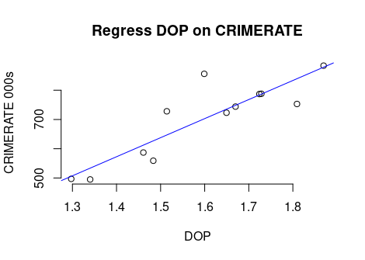
Destruction Of Property (DoP) on Crime Rate
> plot (dfrate$CRIMERATE, dfrate$DOP, main="Regress DOP on CRIMERATE",+ xlab="DOP", ylab="CRIMERATE 000s", frame=FALSE)> abline(lmrate, col="blue")
From this Scatter Plot we can see a positive correlation between DoP and the overall Crime Rate.

Slide 8

For our hypothesis we used mean of assault as μ1, motor Vehicle Theft is μ2, and the mean of Destruction if Property is μ3. As we can see that μ3 is greater than μ2 and u1 and it affects the crime rate the most among these variables which we can see in the R console regression. Thus, we are checking whether μ1is greater than μ2 i.e., which contributes more to the crime rate.

Slide 9



What has the greater influence on Crime Rate
SUMMARY OUTPUT
Regression Statistics
Multiple R | 0.97187537
R Square | 0.94454173
Adjusted R Square | 0.92374488
Standard Error | 0.04961037
Observations | 12
ANOVA
 | df | SS | MS | F | Significance F
Regression | 3 | 0.33534332 | 0.11178111 | 45.4175334 | 2.27566E-05
Residual | 8 | 0.01968951 | 0.00246119
Total | 11 | 0.35503283
 | Coefficients | Standard Error | t Stat | P-value | Lower 95% | Upper 95% | Lower 95.0% | Upper 95.0%
Intercept | 0.31750322 | 0.13401877 | 2.36909517 | 0.04531037 | 0.008455383 | 0.62655106 | 0.00845538 | 0.62655106
Assault | 0.00073602 | 0.00037082 | 1.98481964 | 0.08243148 | -0.000119102 | 0.00159113 | -0.0001191 | 0.00159113
Motor Vehicle Theft | 0.00134553 | 0.00050236 | 2.67841856 | 0.02799453 | 0.000187085 | 0.00250396 | 0.00018709 | 0.00250396
Destruction of Property | 0.0008537 | 0.00013844 | 6.16659384 | 0.00026906 | 0.000534459 | 0.00117294 | 0.00053446 | 0.00117294

Slide 10
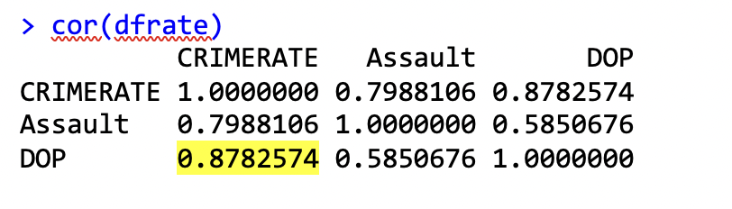
Conclusion
From this analysis we can agree that assault and Motor vehicle theft have relatively an equal influence on the total crime rate.
What we can conclusively determine from our regression model ran in R is that the above-mentioned variables destruction of property by far has a greater impact on the total crime rate. As seen below we can determine that with a .8782574 correlation destruction of property is closer to 1.

