Slide 1
EP PROJECT
Course Instructor: Dr Priyanka Dwivedi
Group – 4
K Sreenivasulu Reddy(S20190020217)
Kakarla V S S Pavan Teja(S20190020216)

Slide 2
About Project
Aim of the project is to build a pcb which performs motion sensor based light system.
Passive infrared sensor is used to sense motion, almost always used to detect whether a human has moved in or out of the sensors range.
Passive infrared sensors are small, inexpensive, low-power.

Slide 3
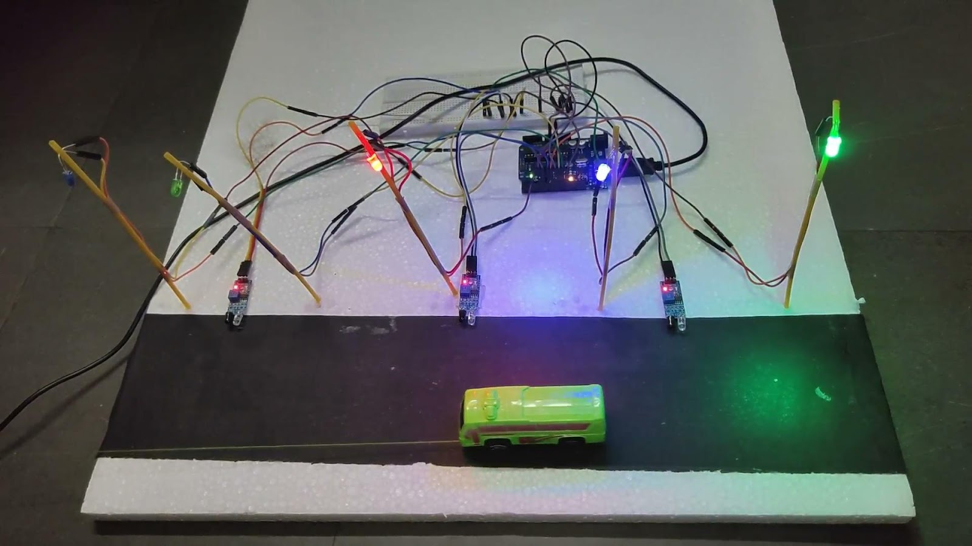
Idea behind project
Smart STREET LIGHT SYSTEM Project done in control system & ICPS course

Slide 4
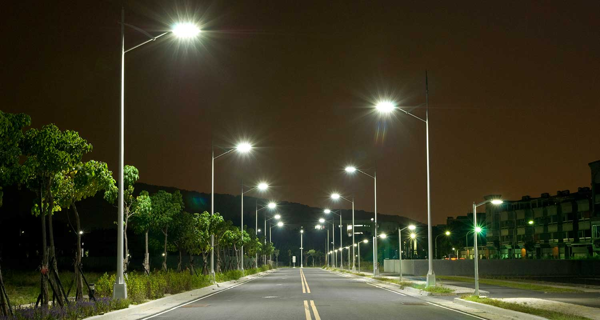
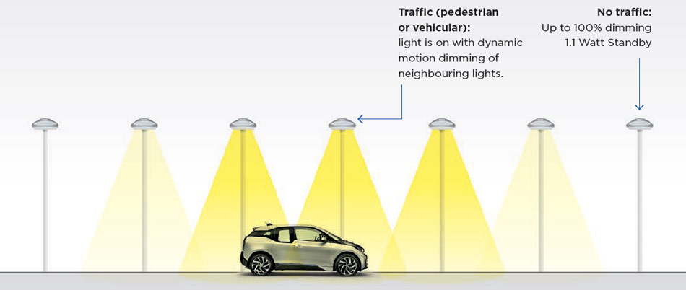
Old vs future

Slide 5
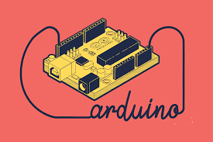
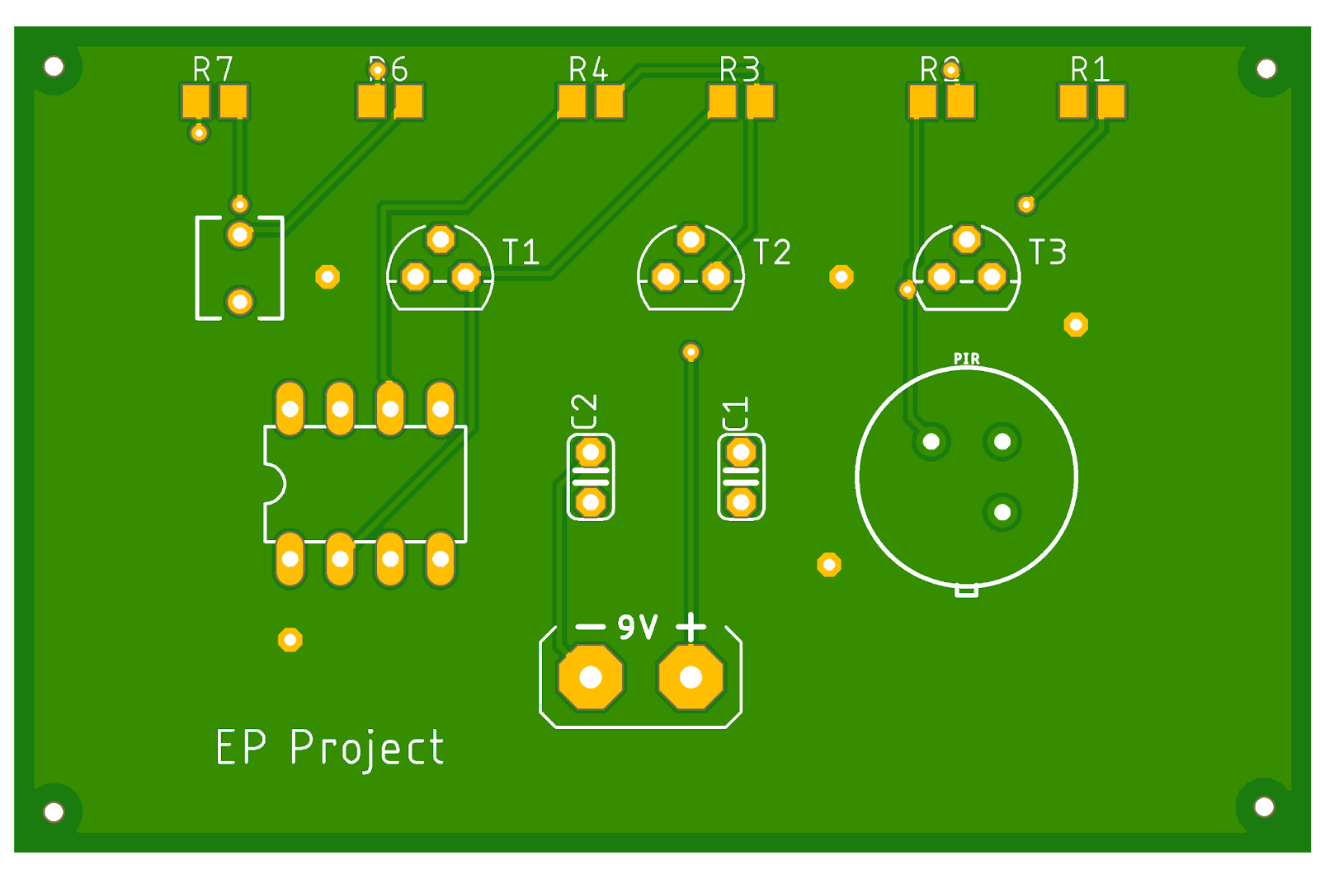

Application and uses

Slide 6
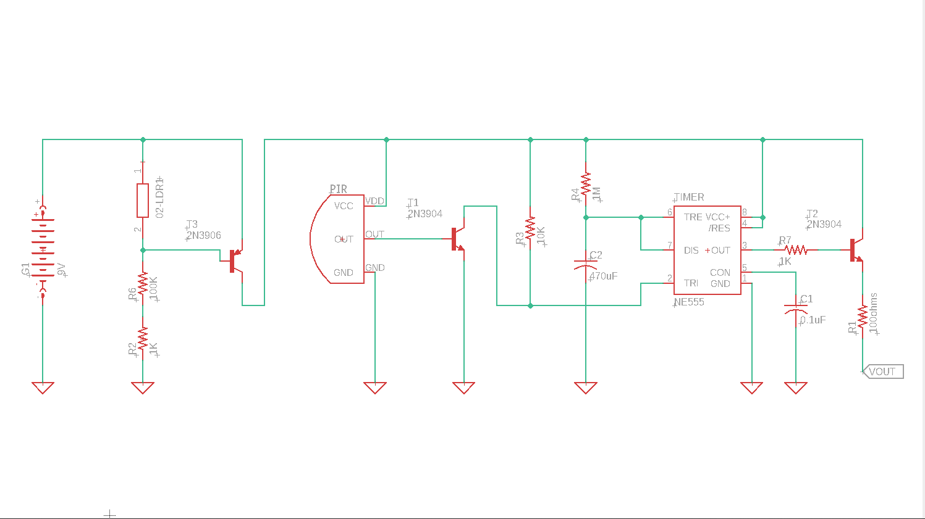
Schematic Design

Slide 7
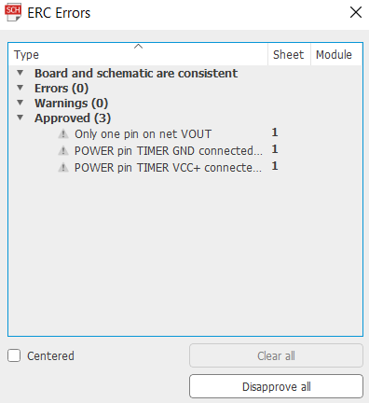
Electrical Rule Check
Light System is labelled as Vout

Slide 8
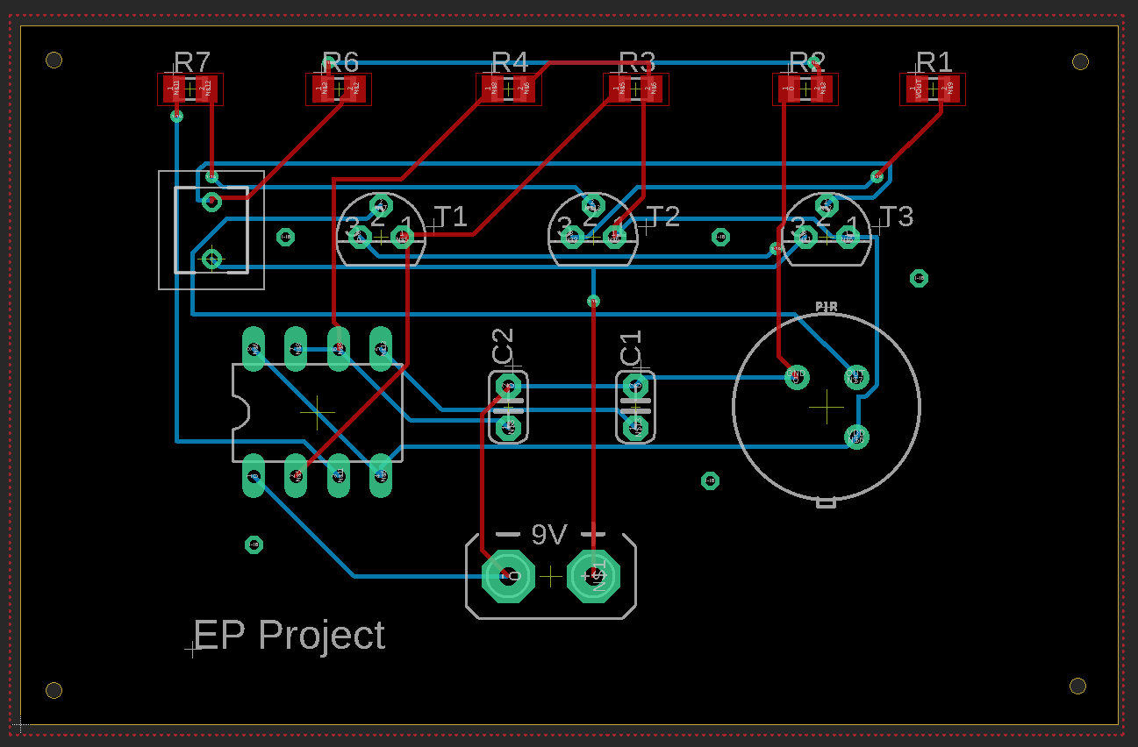
Board Design

Slide 9
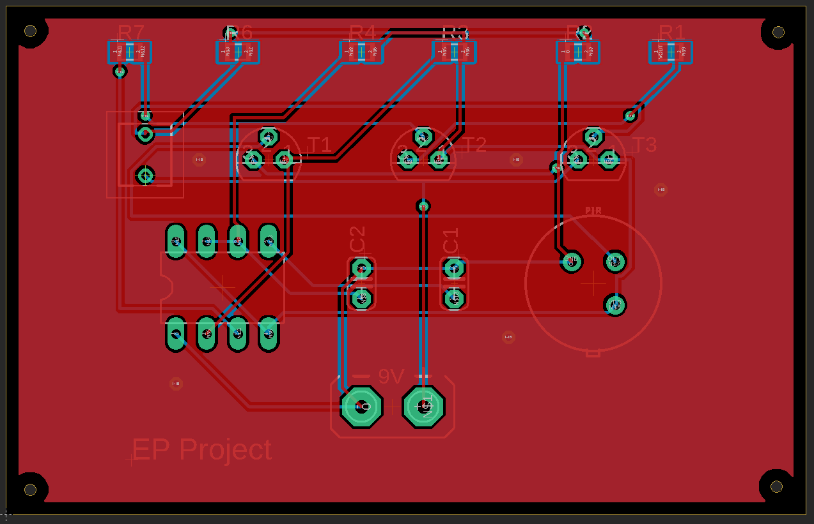
Board Design - Top Layer

Slide 10
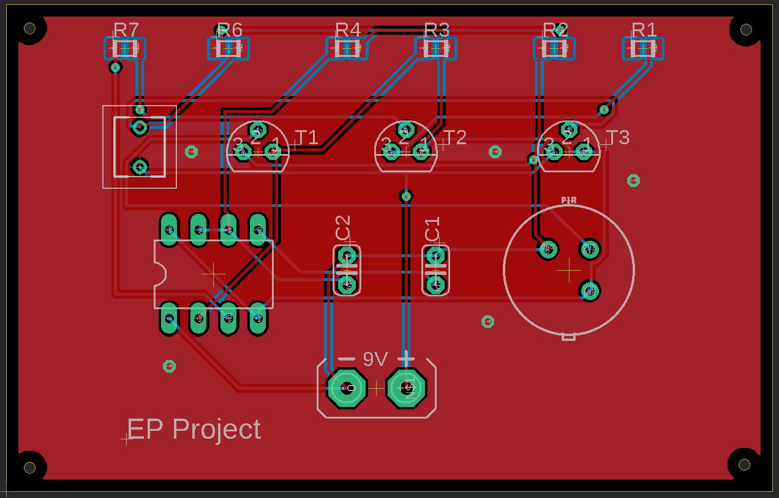
Board Design - tnames layer

Slide 11
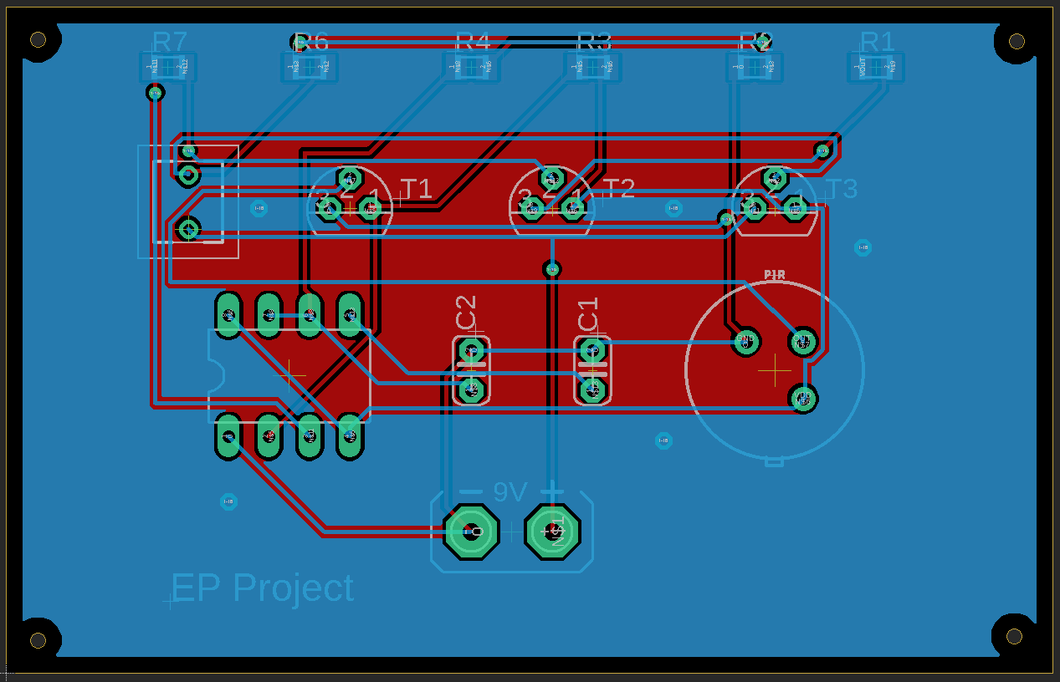
Board Design - Bottom Layer

Slide 12
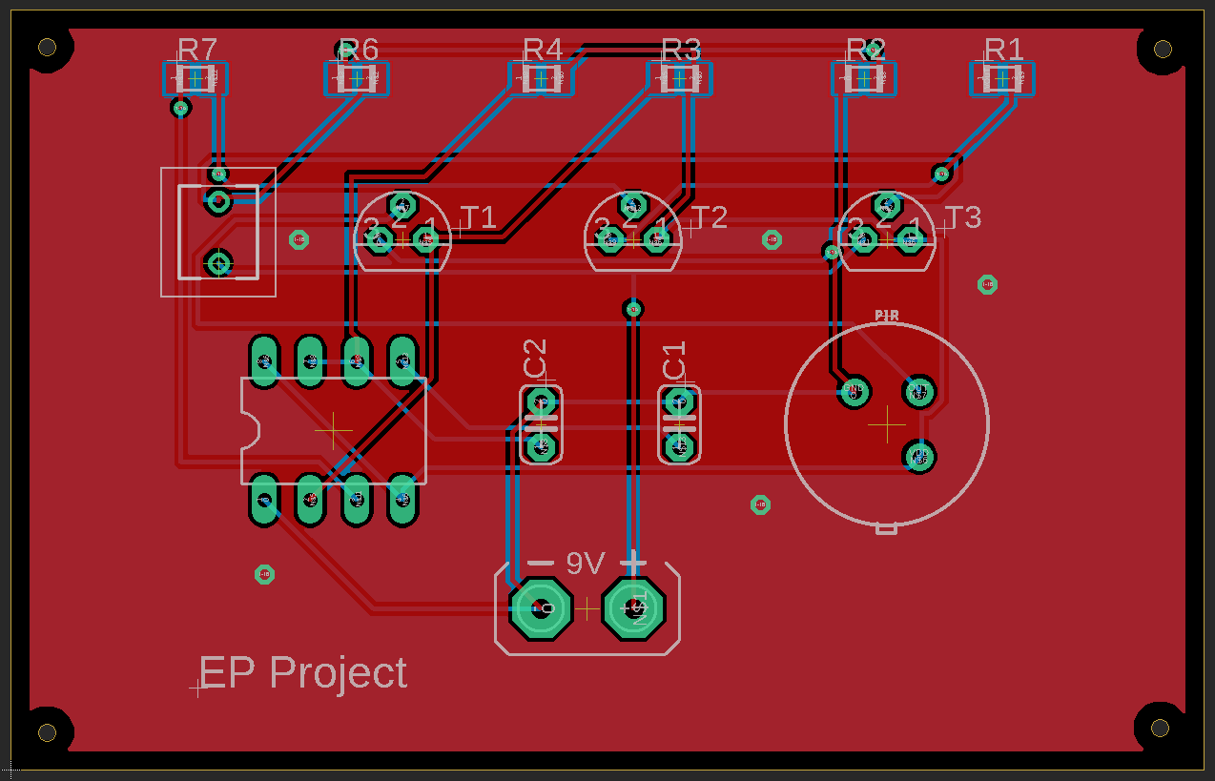
Board Design - Pad Layer

Slide 13
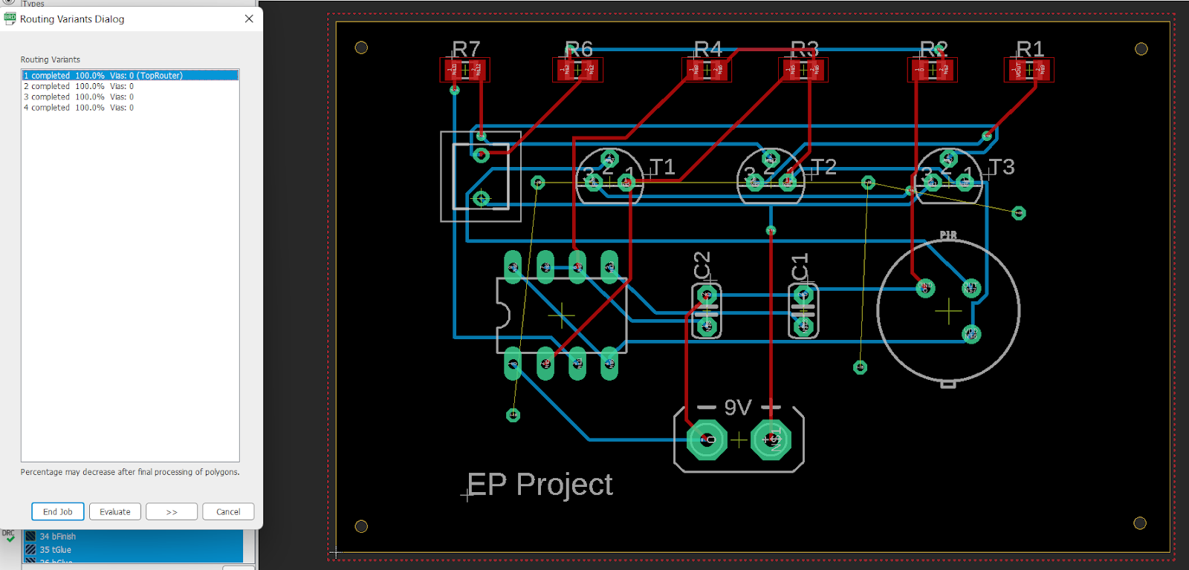
Auto Router
100% Optimized

Slide 14
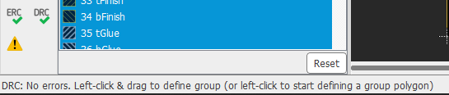
Design Rule Check Design Rule Check
Design Rule Checking (DRC) verifies as to whether a specific design meets the constraints imposed by the process technology to be used for its manufacturing. main objective of DRC check is to achieve a high overall yield and reliability for the design.
DRC check verified – No errors

Slide 15
Designed PCB - Top View

Slide 16
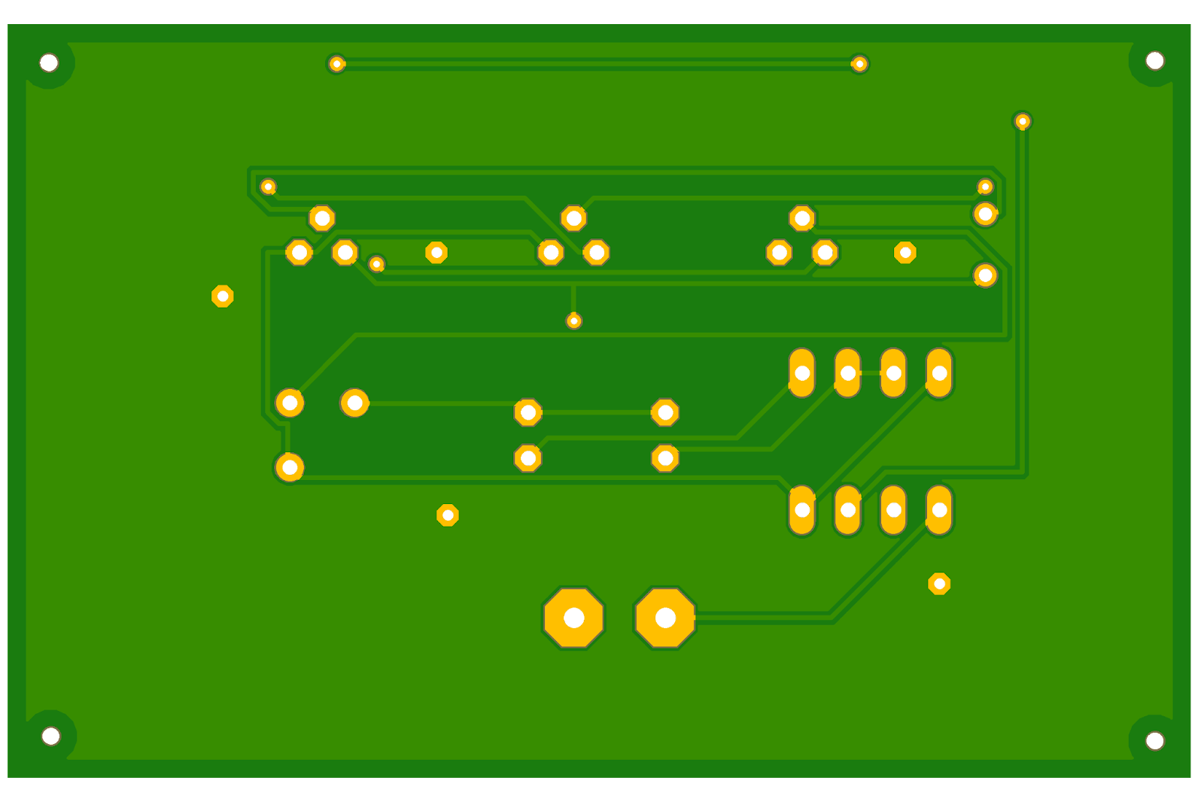
Designed PCB - Bottom View

Slide 17
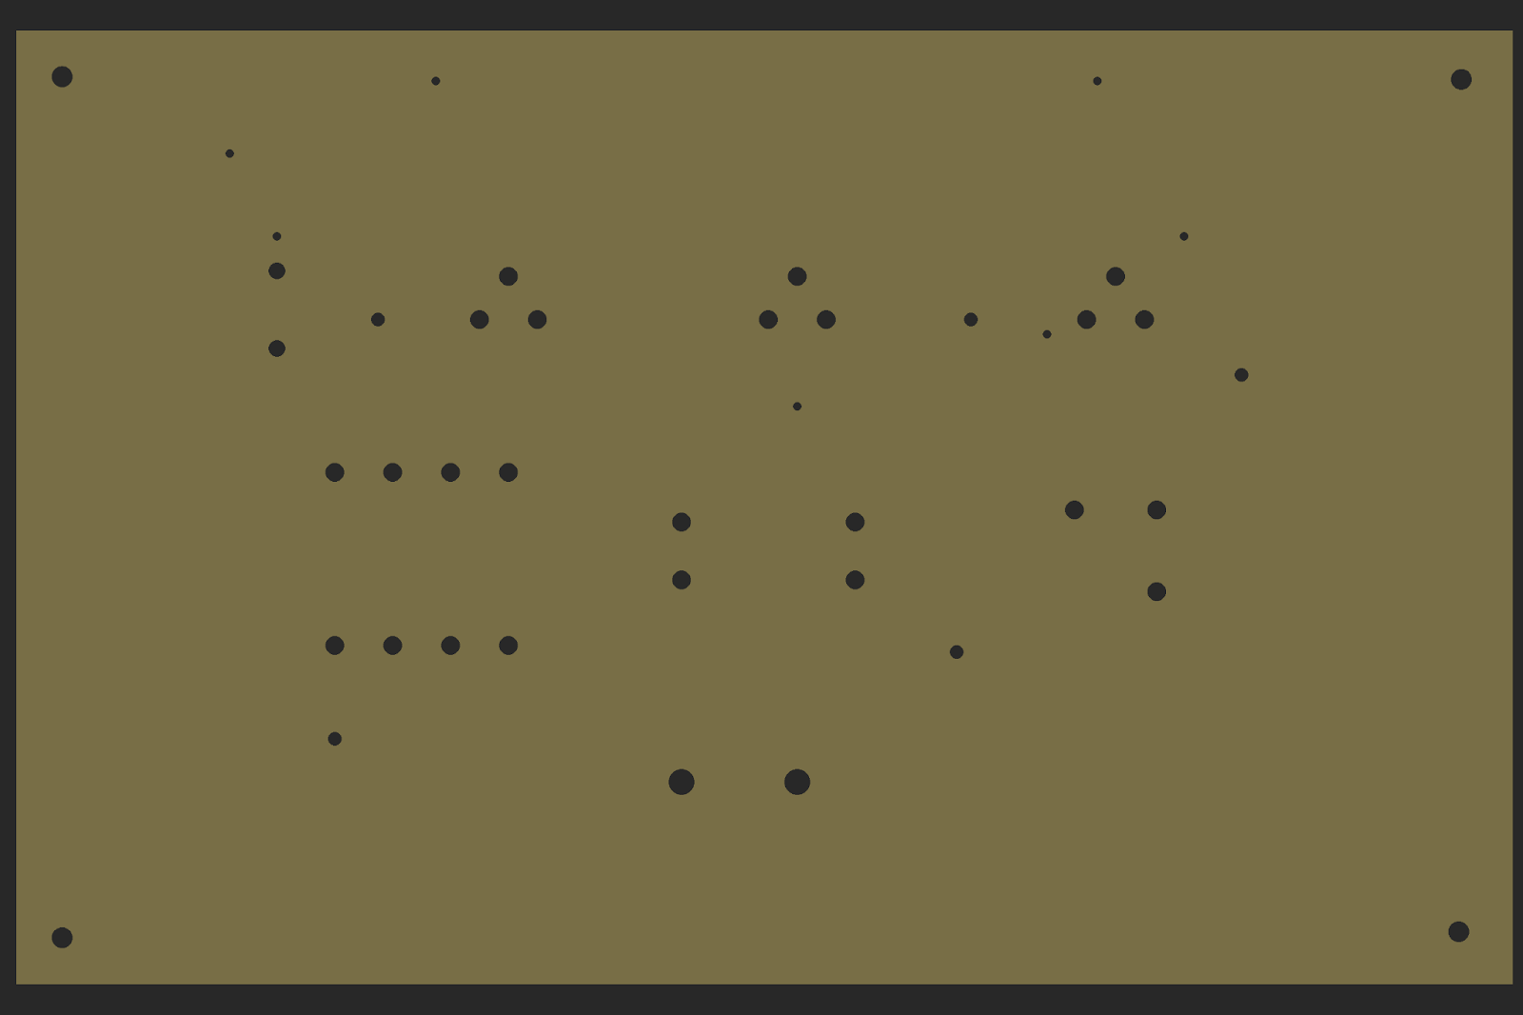
Drills on Designed PCB

Slide 18
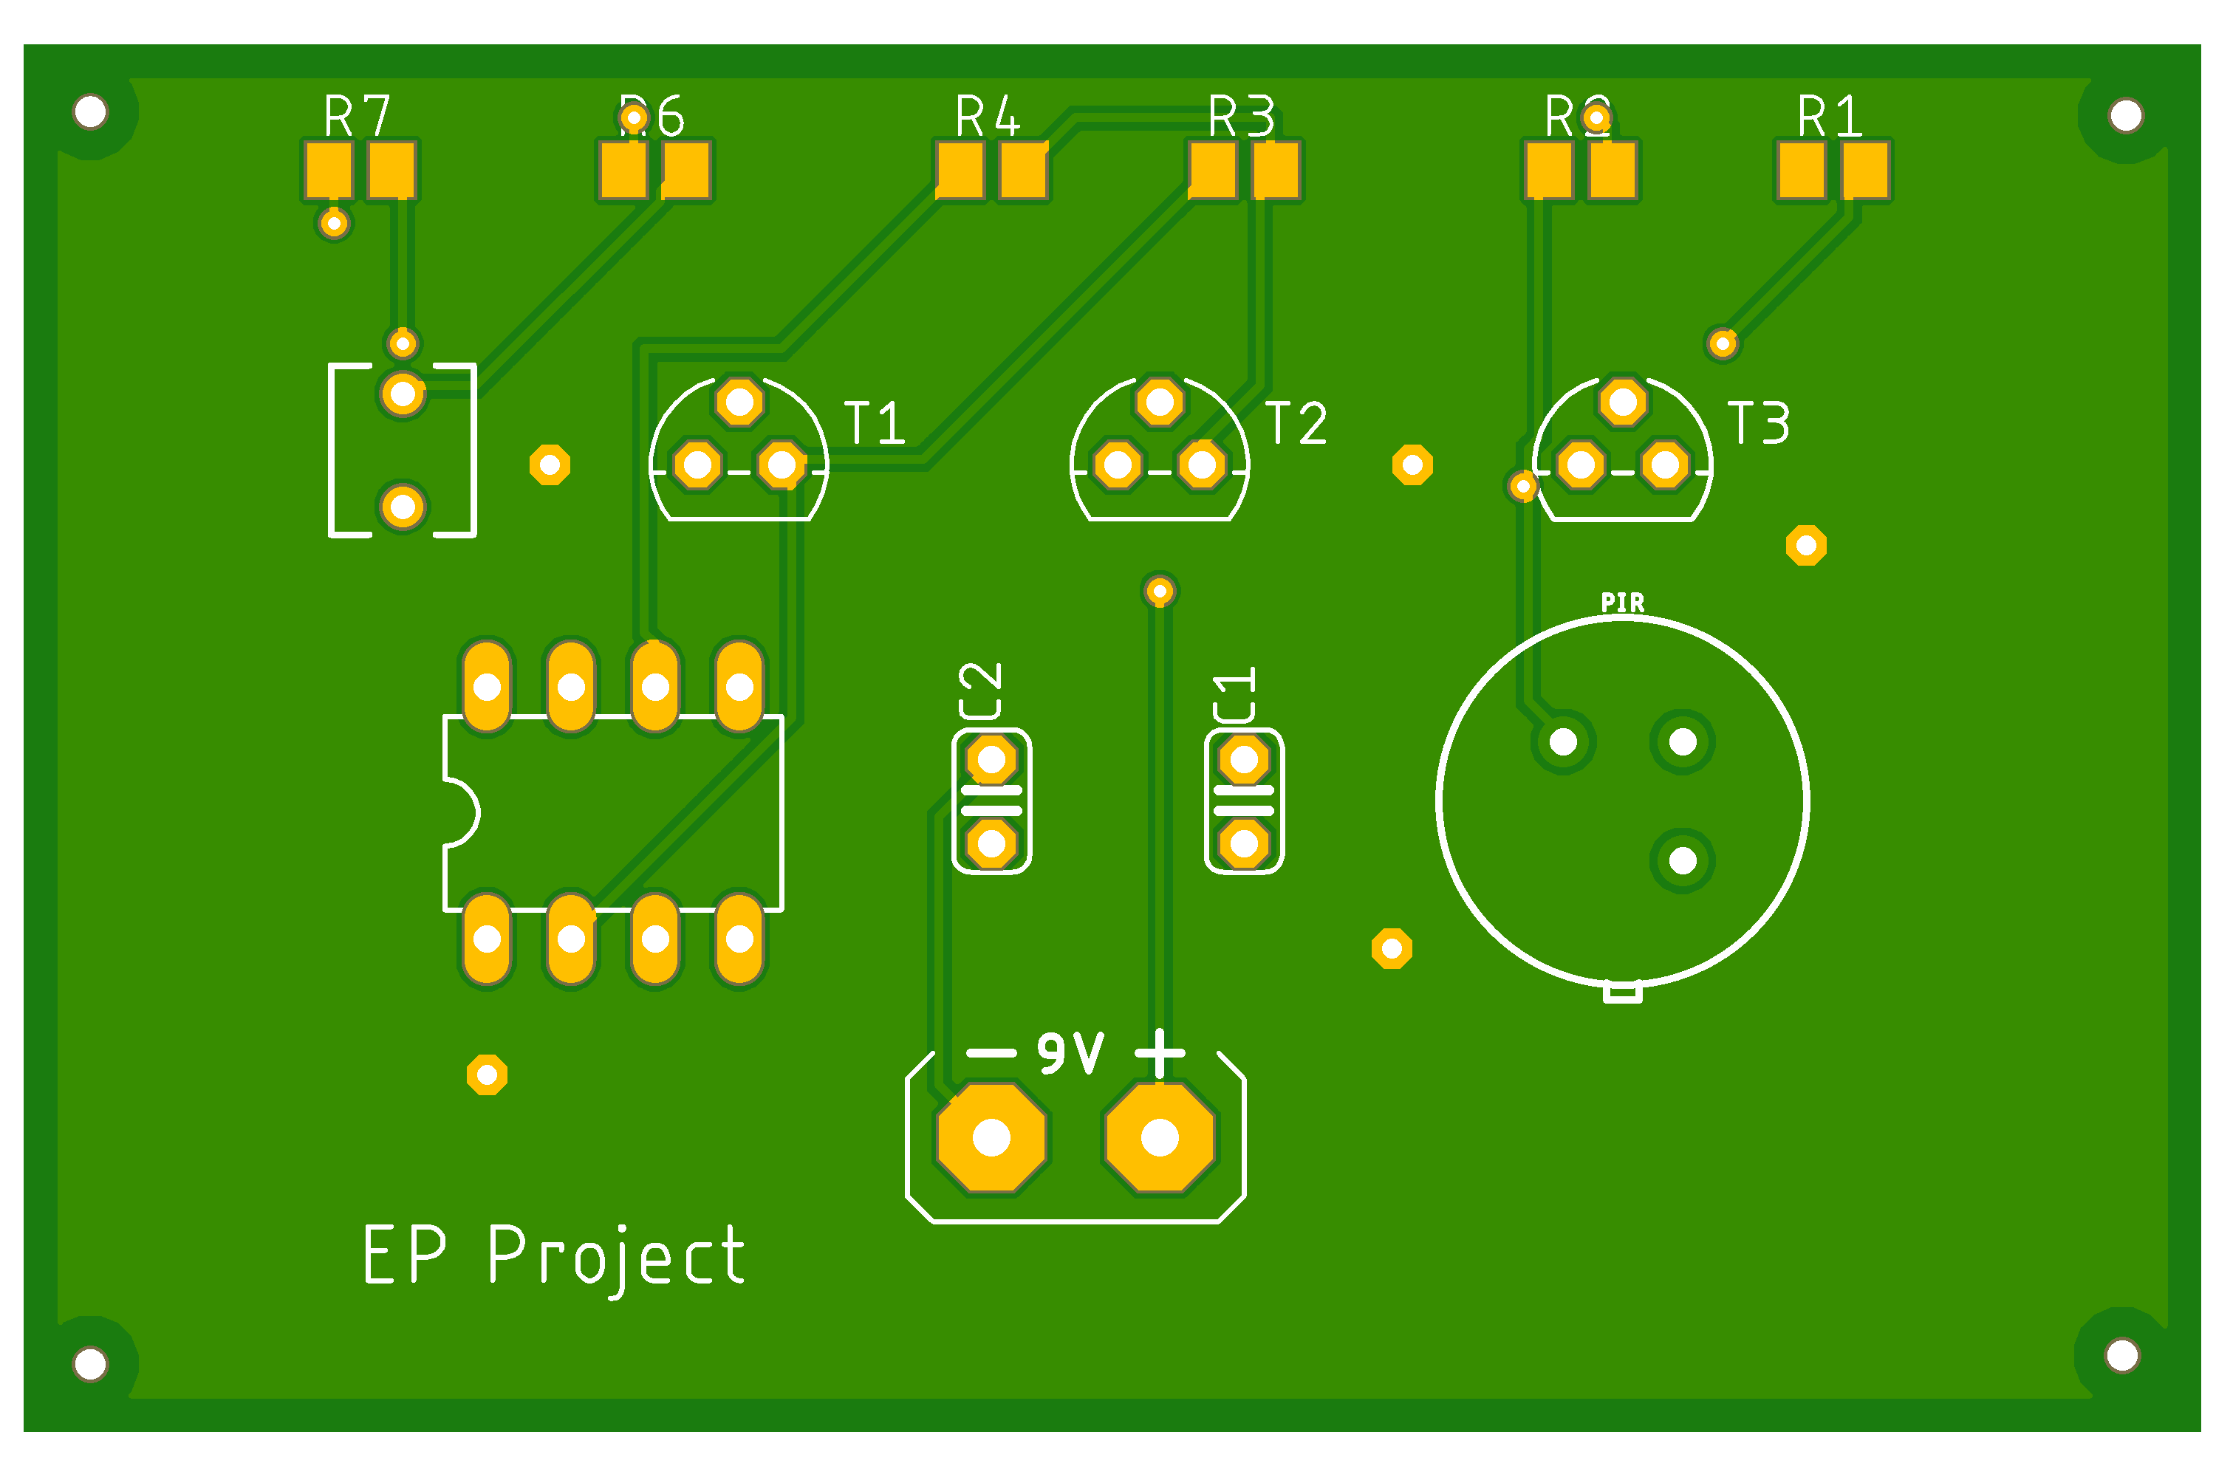
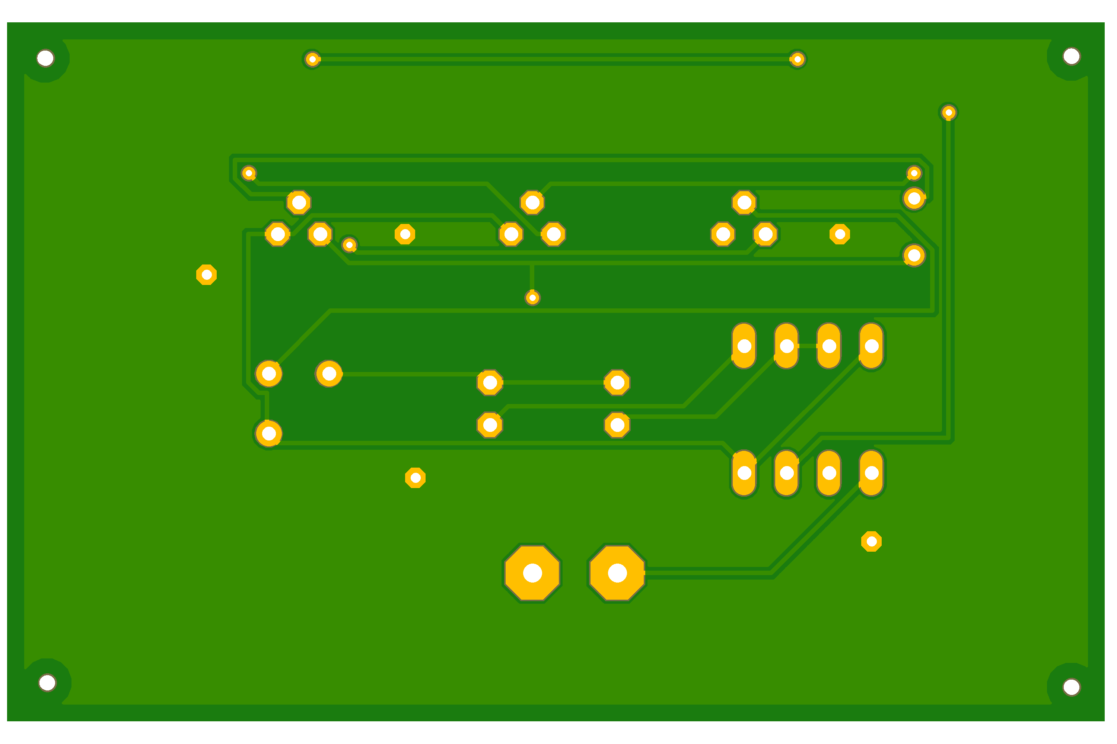

Designed pcb
BOTTOM VIEW
DRILLS
TOP VIEW

Slide 19
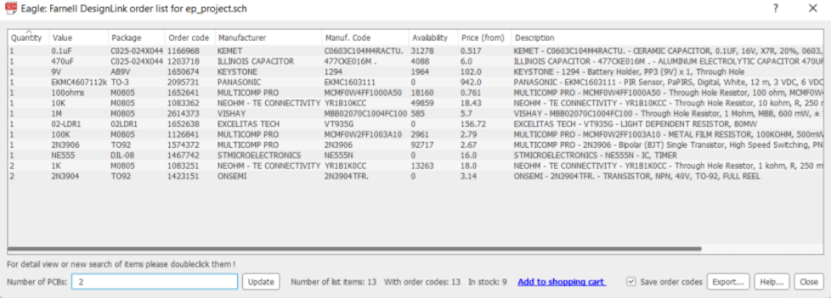
Design Link Order List

Slide 20
Contribution Contribution
K Sreenivasulu Reddy {S20190020217} - Schematic design, gerber file, report
Kakarla V S S Pavan Teja {S20190020216} - Board design, libraries, ppt

Slide 21
Thank you Thank you

