Slide 1
USING WIRESHARK TOOL TO TRAFFIC INSPECT AND CONTENT FLOWING ON WEBSITE
About wireshark:
Wireshark is a free and open source network protocol analyzer that enables users to interactively browse the data traffic on a computer network. The development project was started under the name Ethereal, but was renamed Wireshark in 2006.
Many networking developers from all around the world have contributed to this project with network analysis, troubleshooting, software development and communication protocols. Wireshark is used in many educational institutions and other industrial sectors.

Slide 2
Wireshark is a network or protocol analyzer (also known as a network sniffer) available for free at the Wireshark website. It is used to analyze the structure of different network protocols and has the ability to demonstrate encapsulation.
The analyzer operates on Unix, Linux and Microsoft Windows operating systems, and employs the GTK+ widget toolkit and pcap for packet capturing.
Wireshark and other terminal-based free software versions like Tshark are released under the GNU General Public License.
Wireshark shares many characteristics with tcpdump. The difference is that it supports a graphical user interface (GUI) and has information filtering features. In addition, Wireshark permits the user to see all the traffic being passed over the network.

Slide 3
Features of Wireshark
Data is analyzed either from the wire over the network connection or from data files that have already captured data packets.
Supports live data reading and analysis for a wide range of networks (including Ethernet, IEEE 802.11, point-to-point Protocol (PPP) and loopback).
With the help of GUI or other versions, users can browse captured data networks.
For programmatically editing and converting the captured files to the editcap application, users can use command line switches.
Display filters are used to filter and organize the data display.
New protocols can be scrutinized by creating plug-ins.
Captured traffic can also trace Voice over Internet (VoIP) calls over the network.
When using Linux, it is also possible to capture raw USB

Slide 4
MAIN FEATURES OF WIRESHARK
Packet Capture: Wireshark listens to a network connection in real time and then grabs entire streams of traffic – quite possibly tens of thousands of packets at a time.
Filtering: Wireshark is capable of slicing and dicing all of this random live data using filters. By applying a filter, you can obtain just the information you need to see.
Visualization: Wireshark, like any good packet sniffer, allows you to dive right into the very middle of a network packet. It also allows you to visualize entire conversations and network streams.

Slide 5
Users of network analyzers
System administrators
Understand system problems and performance
Malicious individuals (intruders)
Capture cleartext data
Passively collect data on the following vulnerable protocols: FTP, POP3, IMAP, SMATP, rlogin, HTTP, and so on.
Capture VoIP data
Map the target network
Discover traffic patterns
Actively break into the network (backdoor techniques)

Slide 6
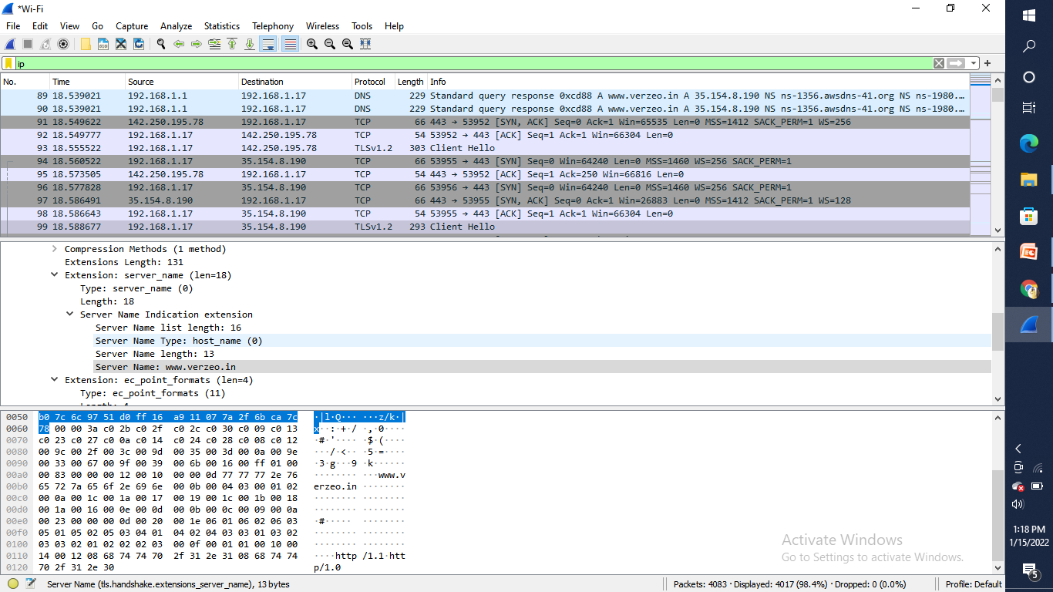
Different protocols

Slide 7
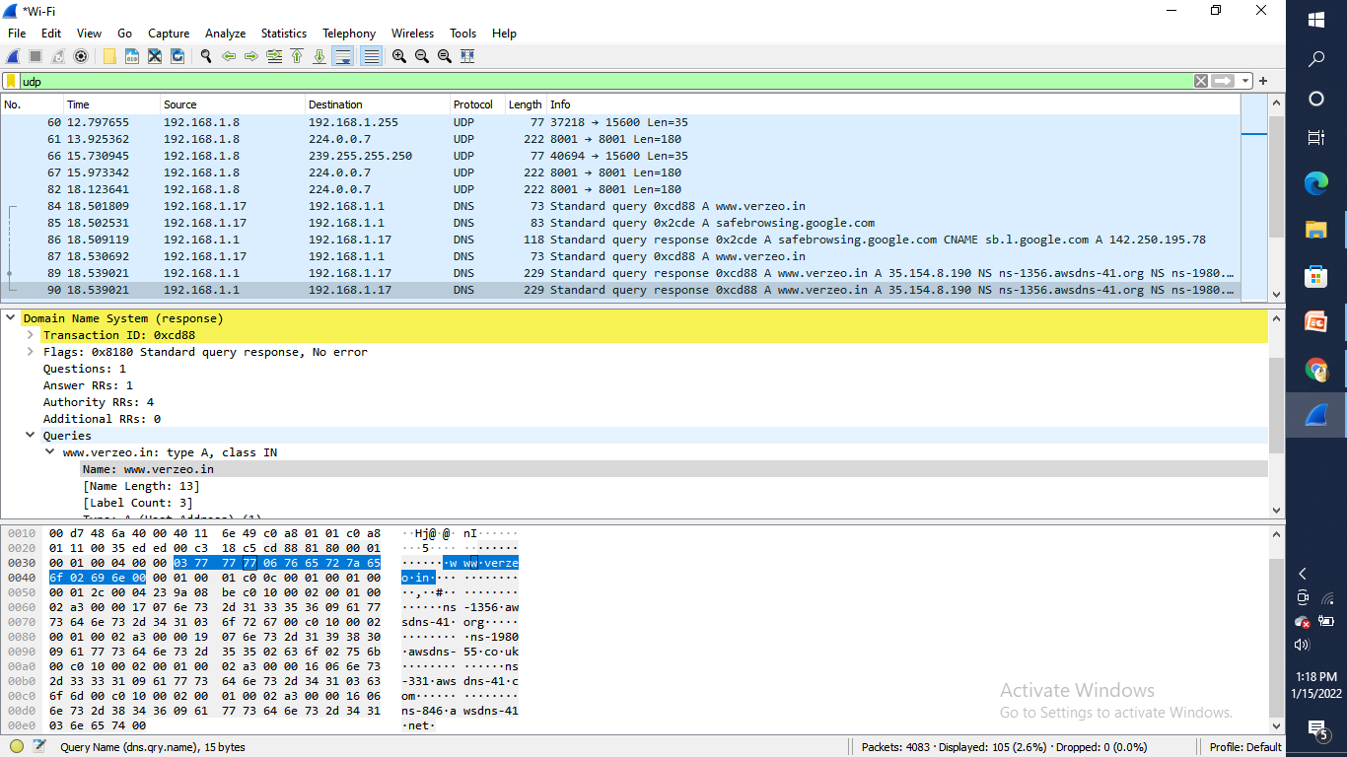
UDP

Slide 8
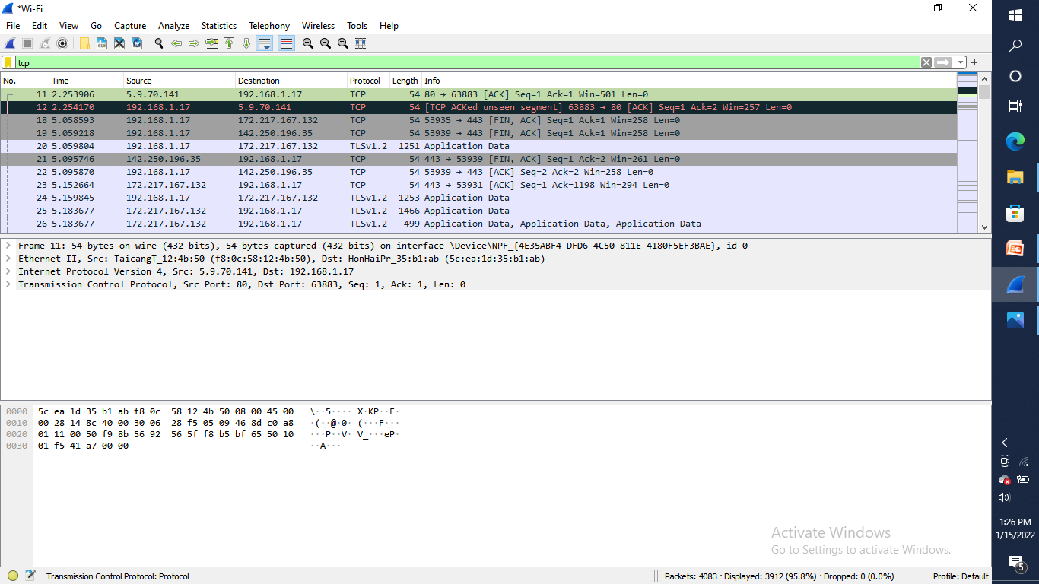
TCP

Slide 9
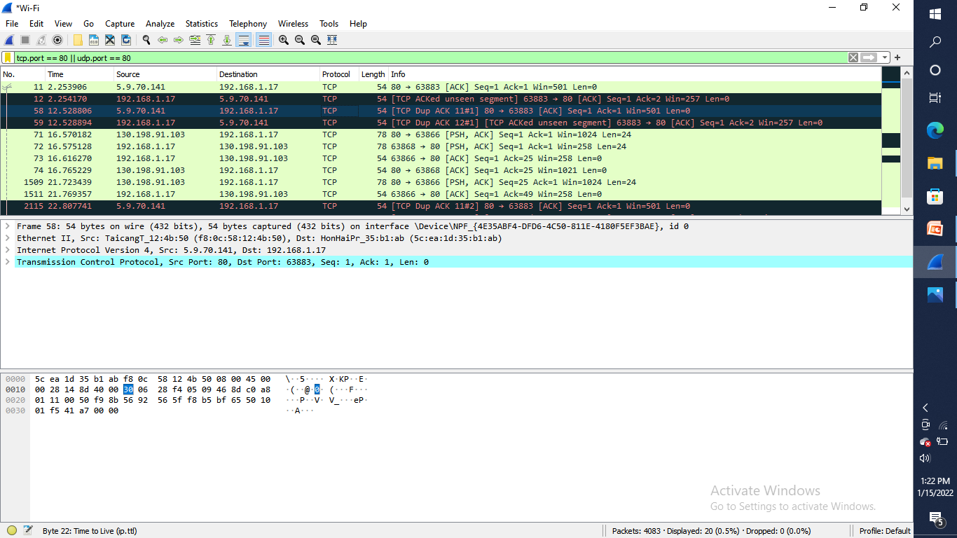
Traffic while accessing website can be find giving filter tcp port ==80

Slide 10
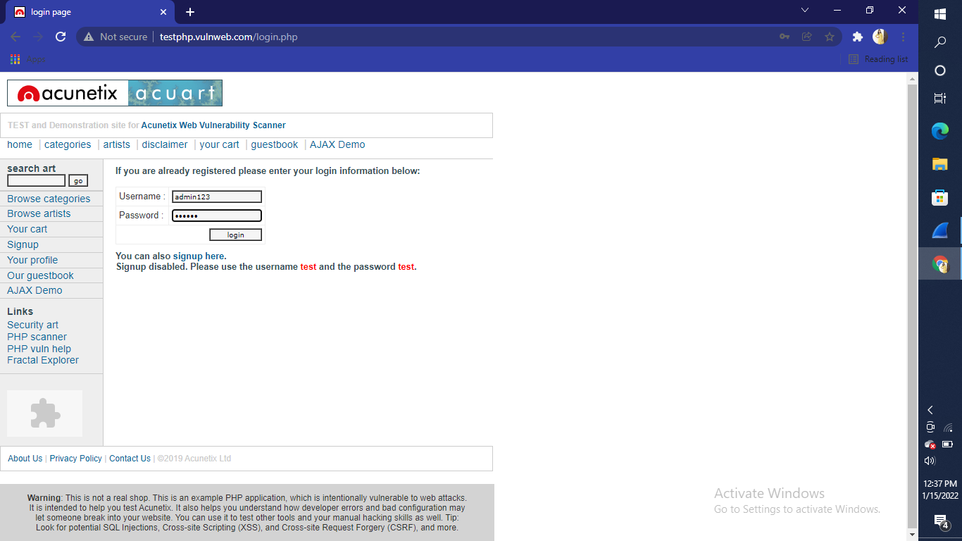
Acuart is an unsecure website if we type an password while packet sniffing scan is running in wireshark , it can find password

Slide 11
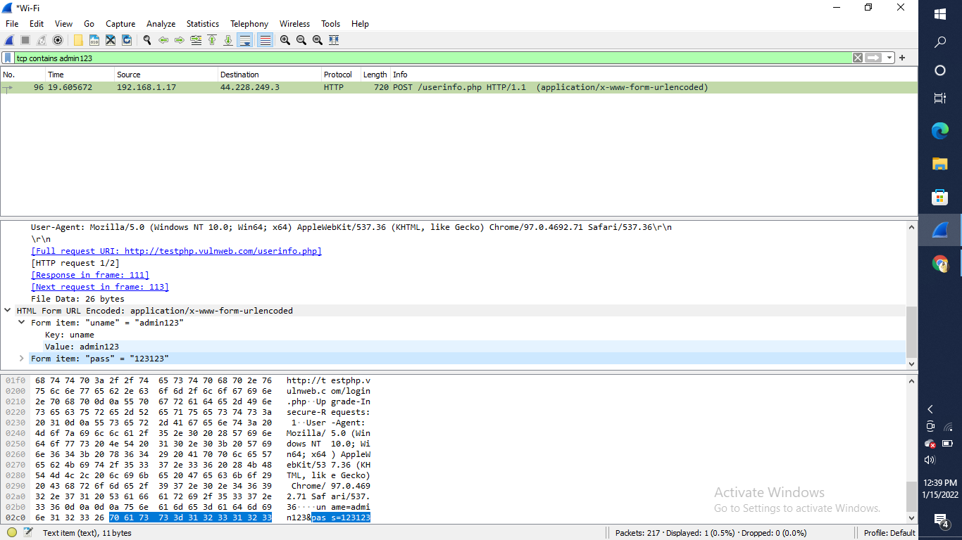
By typing my username in filter box it is giving password of acuart website

Slide 12
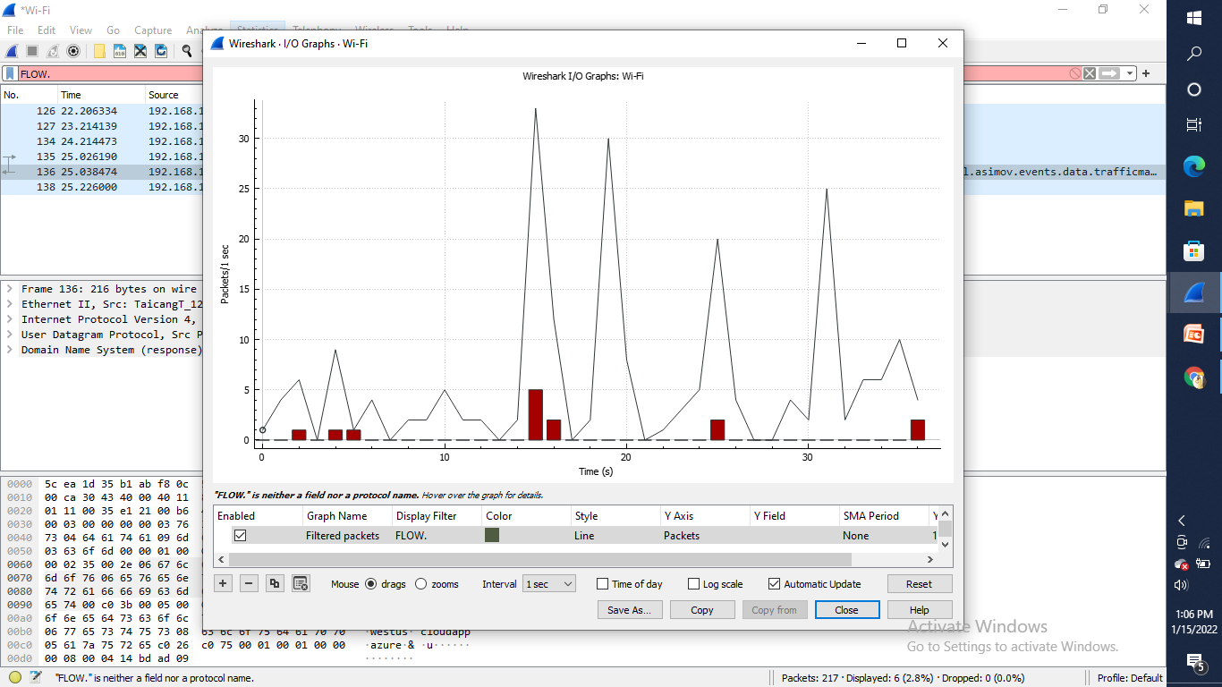
Wireshark i/o graph will show the overall traffic seen in a capture file where X axis shows time(s) and Y axis is packet/1sec

Slide 13
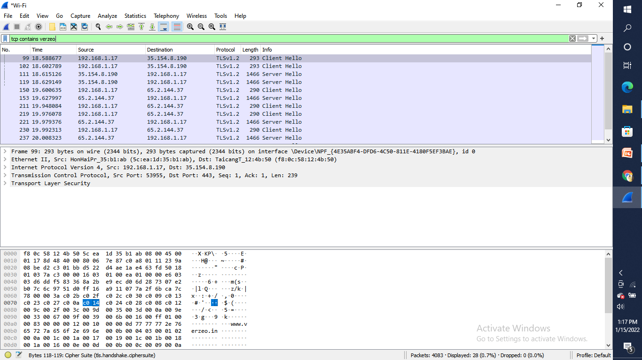
Content flowing while accessing verzeo website filter used for content is tcp contains verzeo

Slide 14
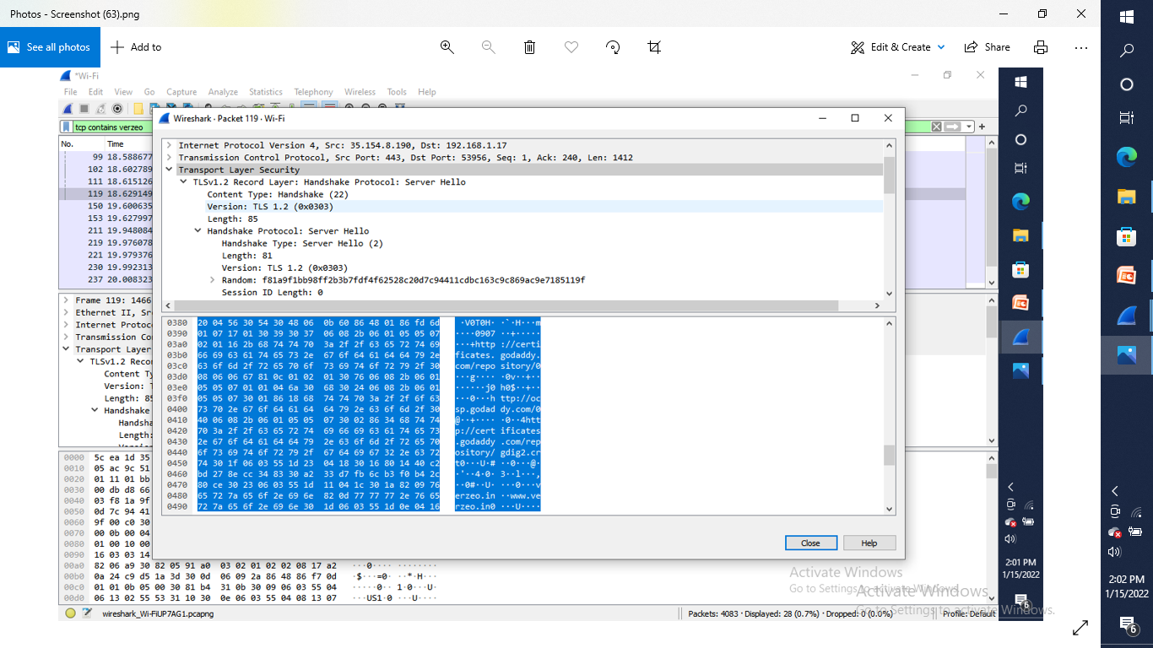
It is showing that Godaddy ,which is hosting the website

Slide 15
How to defend against sniffing
Restrict the physical access to the network media to ensure that a packet sniffer cannot be installed.
Use encryption to protect confidential information.
Permanently add the MAC address of the gateway to the ARP cache.
Use static IP addresses and static ARP tables to prevent attackers from adding spoofed ARP entries for their machines to the network.
Turn off network identification broadcasts, and if possible, restrict the network to authorized users in order to protect the network from being discovered with sniffing tools.
Use the IPv6 instead of the IPv4 protocol.
Use encrypted sessions such as Secure Shell (ssh) instead of Telnet.
Use Secure Copy (scp) instead of a file transfer protocol (ftp).
Use Secure Socket Layer (SSL) for email connections.

Slide 16
Conclusion
These days, many attacks happen through packet sniffing. Packet sniffers are placed in cyber cafes and on open wifi in restaurants, hotels, and public places. You can protect your data with a little caution.
You should never use open wifi and should stop using open text protocols like ftp, http, IMAP, Telnet, and SNMP V1 and V2. You must install SSL certificates in your websites
use Secure File Transfer Protocol (sftp) instead of ftp, and use SSH instead of telnet. You should use SNMP V3 and opt for encryption.

