Slide 1
Cluster Computing
by Mahedi Hasan

Slide 2
Table of Contents
Introducing Cluster Concept
About Cluster Computing
Concept of whole computers and it’s benefits
Architecture and Clustering Methods
Different clusters catagorizations
Issues to be consitered about clusters
Implementations of clusters
Clusters technology in present and future
Conclusions

Slide 3
Introducing Clusters Computing
A Cluster Computer is a collection of computers connected by a communication network.
Clusters are commonly connected through fast local area networks.
Clusters have evolved to support applications ranging from e-commerce, to high performance database applications.
Notes:
A computer cluster is a group of linked computers, working together closely so that in many respects they form a single computer. The components of a cluster are commonly, but not always, connected to each other through fast local area networks.
Basically it’s the technique of linking two or more computers into a network (usually through a local area network) in order to take advantage of the parallel/total processing power of those computers. For example the Sun cluster that we are currently using.
Clusters are usually deployed to improve performance and/or availability over that provided by a single computer, while typically being much more cost-effective than single computers of comparable speed or availability.
The purpose of Cluster Computing is to distribute a very complex process between the various components of the cluster computers. In essence, a problem that requires a lot of processing power to be solved is decomposed into separate sub-problems which are solved in parallel. This obviously increases the computing power of the system.

Slide 4
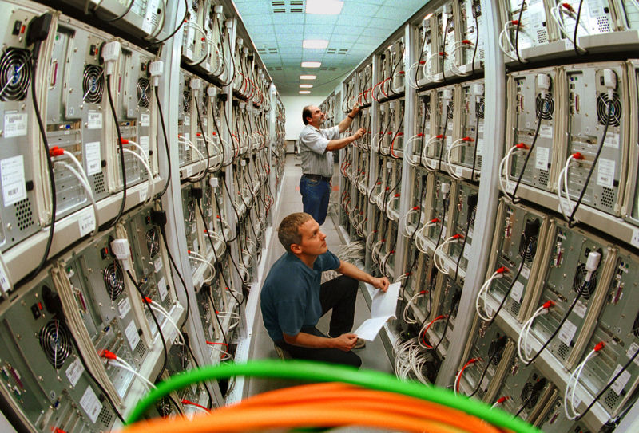
Cluster Computers in view
Linux cluster at the Chemnitz University of Technology, Germany

Slide 5
History
In 1960s IBM's Houston Automatic Spooling Priority (HASP) system and its successor, Job Entry System (JES) allowed the distribution of work to a user-constructed mainframe cluster.
Four Building Blocks - killer-microprocessors, killer-networks, killer-tools, and killer-applications.
The first commodity clustering product was ARCnet, developed by Datapoint in 1977.
The next product was VAXcluster, released by DEC in 1980’s.
Microsoft, Sun Microsystems, IBM, SUN and other leading hardware and software companies offer clustering packages
Notes:
The first inspiration for cluster computing was developed in the 1960s by IBM as an alternative of linking large mainframes to provide a more cost effective form of commercial parallelism
However, cluster computing did not gain momentum until the convergence of three important trends in the 1980s: high-performance microprocessors, high-speed networks, and standard tools for high performance distributed computing. A possible fourth trend is the increasing need of computing power for computational science and commercial applications coupled with the high cost and low accessibility of traditional supercomputers. These four building blocks are known as killer-microprocessors, killer-networks, killer-tools, and killer-applications, respectively.
The first commodity clustering product was ARCnet, developed by Datapoint in 1977.
The next product was VAXcluster, released by DEC in 1980’s.
Microsoft, Sun Microsystems, IBM, and other leading hardware and software companies offer clustering packages

Slide 6
Supercomputers and Clusters
A supercomputer is a computer at the frontline of current processing capacity, particularly speed of calculation.
Supercomputers are used for highly calculation-intensive tasks such as problems including quantum physics, weather forecasting, climate research, oil and gas xploration, molecular modeling, and physical simulations.
Supercomputers were introduced in the 1960s and were designed primarily by Seymour Cray at Control Data Corporation (CDC), and later at Cray Research.
Notes:
A supercomputer is a computer at the frontline of current processing capacity, particularly speed of calculation.
Computer that we used to call supercomputer in 60’s 70’s is no more a supercomputer today.
Supercomputers are used for highly calculation-intensive tasks such as problems including quantum physics, weather forecasting, climate research, oil and gas xploration, molecular modeling, and physical simulations.
Supercomputers were introduced in the 1960s and were designed primarily by Seymour Cray at Control Data Corporation (CDC), and later at Cray Research.

Slide 7
Cont …
Following the success of the CDC 6600 in 1964, the Cray 1 was delivered in 1976, and introduced internal parallelism via vector processing.
Now some of the fastest supercomputers (e.g. the K computer) relied on cluster architectures.
Notes:
while computer clusters used parallelism outside the computer on a commodity network, supercomputers began to use them within the same computer in the 70’s. Following the success of the CDC 6600 (which is generally considered to be the first successful supercomputer) in 1964, the Cray 1 (another supercomputer) was delivered in 1976, and introduced internal parallelism via vector processing.
While early supercomputers excluded clusters and relied on shared memory, in time some of the fastest supercomputers relied on cluster architectures. For example the k Computer, which currently by far the Fastest Supercomputer located in Japan.

Slide 8

What’s Whole Computer
A system that can refer run on its own apart from the cluster; used in server systems are called whole computers.

Slide 9
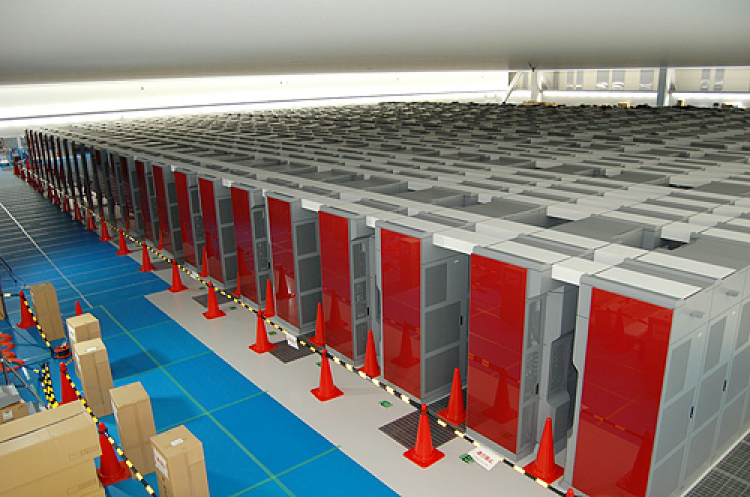
K-Computer

Slide 10
In June 2011, K-computer became the world's fastest supercomputer, with a rating of over 8 petaflops, and in November 2011, K became the first computer to top 10 petaflops or 10 quadrillion calculations per second. It is slated for completion in June 2012.
It uses 88,128 2.0GHz 8-core processors packed in 864 cabinets. Total 705,024 cores
TOP500 maintains a list of worlds fastest supercomputers
Notes:
In June 2011, K-computer became the world's fastest supercomputer, with a rating of over 8 petaflops, and in November 2011, K became the first computer to top 10 petaflops or 10 quadrillion calculations per second. It is slated for completion in June 2012.
It uses 88,128 2.0GHz 8-core processors packed in 864 cabinets. Total 705,024 cores
second place goes to the Chinese Tianhe-1A system with 2.57 Petaflop/s performance.
TOP500 project ranks and details the 500 (non-distributed) most powerful known computer systems in the world.
The link is http://www.top500.org

Slide 11
Cluster Computing
A group of interconnected WHOLE COMPUTERS works together as a unified computing resource that can create the illusion of being one machine having parallel processing.
The components of a cluster are commonly, but not always, connected to each other through fast local area networks.

Slide 12
Why is Clusters than single 1’s?
Price/Performance
The reason for the growth in use of clusters is that they have significantly reduced the cost of processing power.
Availability
Single points of failure can be eliminated, if any one system component goes down, the system as a whole stay highly available.
Scalability
HPC clusters can grow in overall capacity because processors and nodes can be added as demand increases.
Notes:
Clusters are deployed to improve performance and/or availability over that of a single computer, while typically being much more cost-effective than single computers of comparable speed or availability.

Slide 13
Where does it matter?
The components critical to the development of low cost clusters are:
Processors
Memory
Networking components
Motherboards, busses, and other sub-systems

Slide 14
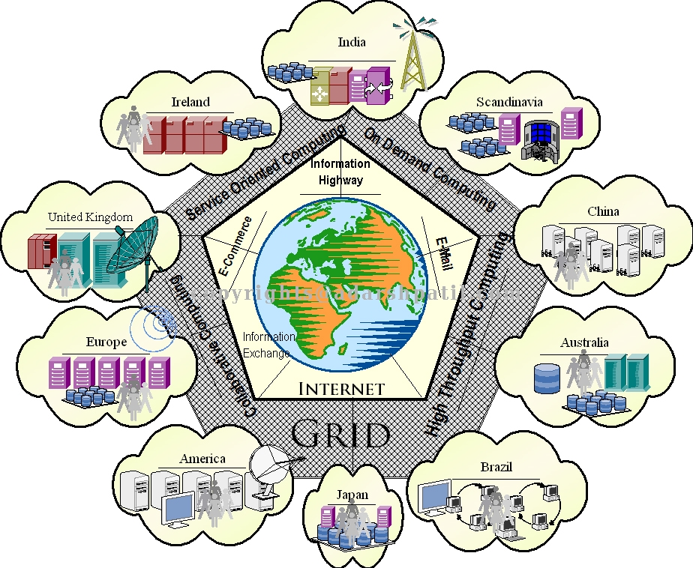
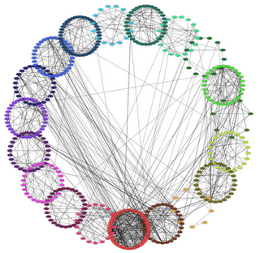
Cluster Catagorization
High-availability
Load-balancing
High- Performance

Slide 15
High Availability Clusters
Avoid single point of failure
This requires atleast two nodes - a primary and a backup.
Always with redundancy
Almost all load balancing cluster are with HA capability.
Notes:
High-availability clusters (also known as Failover Clusters) are implemented primarily for the purpose of improving the availability of services that the cluster provides.
They operate by having redundant nodes, which are then used to provide service when system components fail.
The most common size for an HA cluster is two nodes, which is the minimum requirement to provide redundancy.
HA cluster implementations attempt to use redundancy of cluster components to eliminate single points of failure.
There are commercial implementations of High-Availability clusters for many operating systems. The Linux-HA project is one commonly used free software HA package for the Linux operating system.

Slide 16
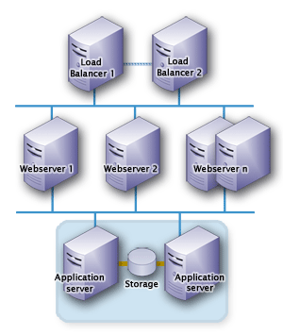
High Availability Clusters

Slide 17
Load Balancing Clusters
PC cluster deliver load balancing performance
Commonly used with busy ftp and web servers with large client base
Large number of nodes to share load
Notes:
Load-balancing is when multiple computers are linked together to share computational workload or function as a single virtual computer.
Logically, from the user side, they are multiple machines, but function as a single virtual machine.
Requests initiated from the user are managed by, and distributed among, all the standalone computers to form a cluster.
This results in balanced computational work among different machines, improving the performance of the cluster system.

Slide 18
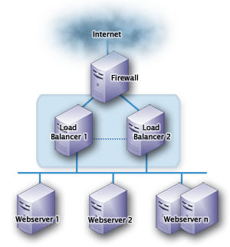
Load Balancing Clusters

Slide 19
High Performance Clusters
Started from 1994
Donald Becker of NASA assembled this cluster.
Also called Beowulf cluster
Applications like data mining, simulations, parallel
processing, weather modeling, etc.
Notes:
The computers are configured to provide extremely high performance. Also known as scientific clusters. The machines break down the processes of a job on multiple machines in order to gain in performance.
Beowulf, which is basically a linux cluster project, was a computing breakthrough conceived at NASA Goddard in late 1993 by Donald Becker (CTO of Penguin Computing) and Thomas Sterling. They demonstrated that commodity clusters could do the work of multi-million dollar supercomputers, delivering the same results at a fraction of the cost. A more extensive history may be found on beowulf.org, the online community dedicated to the subject, or in the whitepaper Breaking New Ground: The Evolution of Linux Clustering.

Slide 20
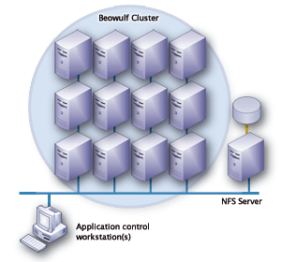
High Performance Clusters

Slide 21
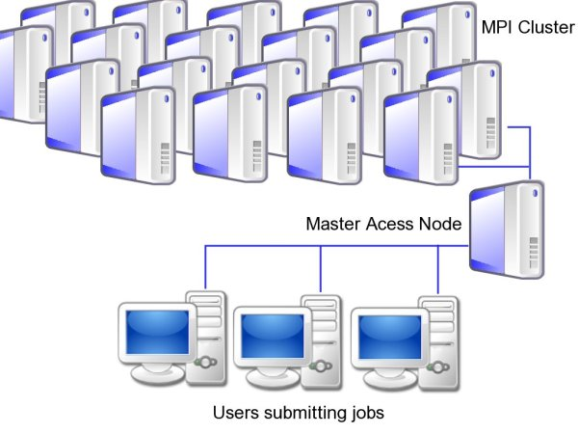
A MPI Cluster
Notes:
This Figure demonstrates a MPI cluster, a well designed application will scale almost linearly (at least theoretically) with the addition of more nodes allowing increases in accuracy and speed for modelling and simulation
The architecture of an MPI cluster depends on the specific application and many Supercomputing clusters are designed specifically with a couple of applications in mind … which means they are domain specific.
However there are some general points to note. A key feature of MPI systems is low latency networks for inter-node communication. As such the newtwork switching technology is important for determining the eventual performance of the system. Additionally the application must be designed to take advantage of the system and should also take advantage of the processors architecture in use.

Slide 22
Cluster Classification
Open Cluster – All nodes can be seen from outside, and hence they need more IPs, and cause more security concern. But they are more flexible and are used for internet/web/information server task
Close Cluster – They hide most of the cluster behind the gateway node. Consequently they need less IP addresses and provide better security. They are good for computing tasks.
Notes:
Cluster Classification according to Architecture

Slide 23
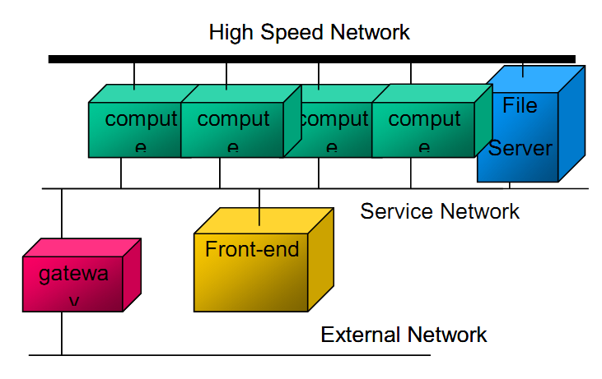
Open Cluster

Slide 24
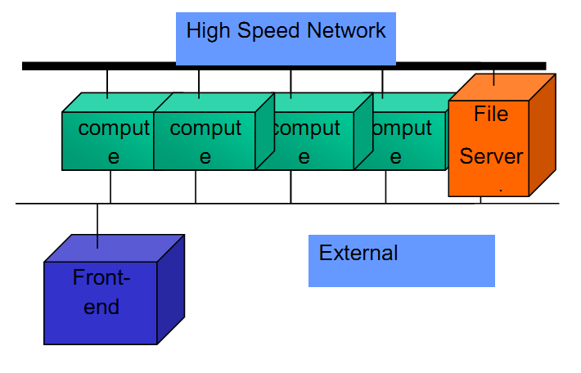
Close Cluster

Slide 25
Benefits
High processing capacity.
Resource consolidation
Optimal use of resources
Geographic server consolidation
24 x 7 availability with failover protection
Disaster recovery
Horizontal and vertical scalability without downtime
Centralized system management
Notes:
A clustered system offers many valuable benefits to a modern high performance computing infrastructure including:
High processing capacity — by combining the power of multiple servers, clustered systems can tackle large and complex workloads. For Example - One can reduce the time for key engineering simulation jobs from days to hours, thereby shortening the time-to-market for its new product.
Resource consolidation — A single cluster can accommodate multiple workloads and can vary the processing power assigned to each workload as required; this makes clusters ideal for resource consolidation and optimizes resource utilization.
Optimal use of resources — Individual systems typically handle a single workload and must be sized to accommodate expected peak demands for that workload; this means they typically run well below capacity but can still "run out" if demand exceeds capacity—even if other systems are idle. Because clustered systems share enormous processing power across multiple workloads, they can handle a demand peak—even an unexpected one—by temporarily increasing the share of processing for that workload, thereby taking advantage of unused capacity.
Geographic server consolidation — some may share processing power around the world, for example by diverting daytime US transaction processing to systems in Japan that are relatively idle overnight.
24 x 7 availability with failover protection — Because processing is spread across multiple machines, clustered systems are highly fault-tolerant: if one system fails, the others keep working.
Disaster recovery — Clusters can span multiple geographic sites so even if an entire site falls victim to a power failure or other disaster, the remote machines keep working.
Horizontal and vertical scalability without downtime — as the business demands grow, additional processing power can be added to the cluster without interrupting operations.
Centralized system management — Many available tools enable deployment, maintenance and monitoring of large, distributed clusters from a single point of control.

Slide 26
Dark side
Clusters are phenomenal computational engines
Can be hard to manage without experience
High performance I/O is not possible
Finding out where something has failed increases at least linearly as cluster size increases.
The largest problem in cluster is software skewing
When software configuration on some nodes is different than others
Small differences (minor version difference in libraries) can cripple a parallel program
The other most critical problem is adequate job control of the parallel processes
Signal Propagation
Cleanup
Notes:
High performance input/output is still unsolved

Slide 27
Challenges in Cluster Computing
Middleware
Program
Elasticity
Scalability
Notes:
Middleware - To produce software environments that provides an illusion of a single system image, rather than a collection of independent computers.
Program – The applications that run on the clusters must be explicitly written which incorporates the division of tasks between nodes, also the communication between them should be taken care of.
Elasticity – the variance in real-time response time when the number of service requests changes dramatically.
Scalability – To meet the additional requirements of a resource thus effecting the performance of the system.

Slide 28
Cluster Applications
Google Search Engine.
Petroleum Reservoir Simulation.
Protein Explorer.
Earthquake Simulation.
Image Rendering.
Whether Forecasting.
…. and many more

Slide 29
Tools for cluster Computing
Nimrod – a tool for parametric computing on clusters and it provides a simple declarative parametric modeling language for expressing a parametric experiment.
PARMON – a tool that allows the monitoring of system resource and their activities at three different levels: system, node and component.
Candor – a specialized job and resource management mechanism, scheduling policy, priority scheme, and resource monitoring and management.
Notes:
Here some of the tools and simulators is highlighted that can be used to develop applications in clusters.
Nimrod - a tool for parametric computing on clusters . By using this it can be easy to create a plan for a parametric computing.
PARMON – a tool that allows the monitoring of system resource and their activities at three different levels: system, node and component.
Candor – a specialized job and resource management mechanism, scheduling policy, priority scheme, and resource monitoring and management. Users submit their jobs, this tool chooses when and where to run them based upon a policy, monitors their progress, and ultimately informs the user upon completion.

Slide 30
Cont….
MPI and OpenMP – message passing libraries provide a high-level means of passing data between process execution.
Other cluster simulators include Flexi-Cluster - a simulator for a single computer cluster, VERITAS - a cluster simulator, etc.
Notes:
MPI and OpenMP – the MPI (Message Passing Interface) has been the main tool of most programmers. MPI as we know, is an API (Applications Programming Interface), or programming library that allows Fortran and C (and sometimes C++) programs to send messages to each other.
On the other hand OpenMP, Unlike MPI, is not an API, but an extension to a compiler. To use OpenMP, the programmer adds "pragmas" (comments) to the program that are used as hints by the compiler. The resulting program uses operating system threads to run in parallel.

Slide 31
Cluster Computing Today
Cluster architecture and application has changed which makes it suitable for a different kinds of problems
clusters are also used today for financial applications, for applications that process very large amounts of data that is data-intensive applications, and for other problems
barriers to entry for using a cluster have become much lower
Notes:
Currently, changes in how clusters can be built and in the kinds of applications they can run are making the idea of cluster computing useful for a wider set of problems across a broader range of
organizations.
Traditional cluster-based applications are still important. In fact, more and more scientific and technical problems can be addressed with software running on clusters. But compute clusters are also used today for financial applications, for applications that process very large amounts of data that is data-intensive applications, and for other problems. Just as important, the barriers to entry for using a cluster have become much lower. The technology is now accessible even to small and mid-size organizations.

Slide 32
What’s Changed: A Modern View of Cluster Computing
Now a cluster can contain any combination of the following:
On-premises servers, as in traditional compute clusters.
Desktop workstations, which can become part of a cluster when they’re not being used. Think of a financial services firm, for instance, which probably has many high-powered workstations that sit idle overnight.
Cloud instances provided by public cloud platforms. These instances can be created on demand, used as long as needed, then shut down.
Notes:
Traditionally, a compute cluster consisted of a group of server machines installed in an organization’s data center.
Creating a cluster meant buying and managing a significant number of these servers, then trying to keep them busy to justify the investment. This made sense only for organizations with a substantial ongoing requirement to run applications on a cluster.
There are more options today.
--SLIDE--
The ability to create compute clusters using desktop workstations and cloud instances is an important advance.
Adding desktops to a cluster essentially provides free resources, since the machines otherwise aren’t being used.
Adding cloud instances isn’t free, but because instances can be created and shut down on demand, the user pays only for the time they’re being used. Both of these options allow creating clusters with a significantly smaller up-front investment than before. Using cluster computing no longer requires buying racks full of on-premises servers.

Slide 33
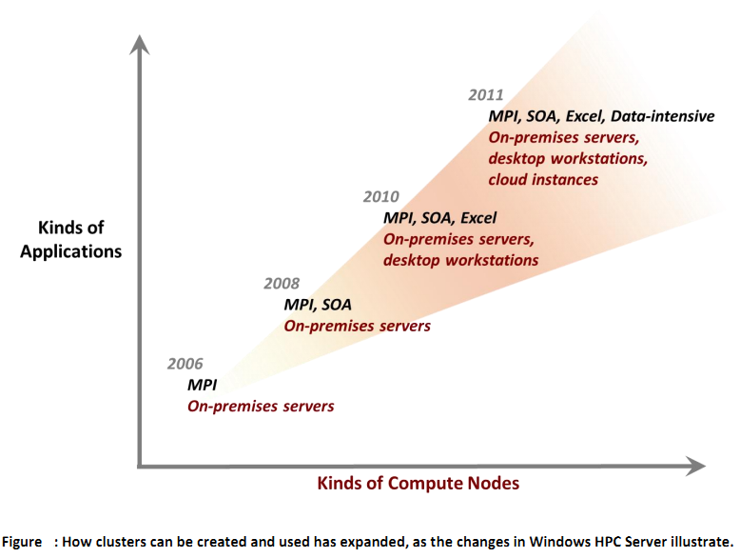
Notes:
Embarrassingly parallel applications, where the components in a running application don’t interact with one another. (The name is used because making this kind of application run in parallel is almost embarrassingly easy.) An embarrassingly parallel application might consist of separate executables or be divided into a group of services invoked by a client while the application runs. In Windows HPC Server, this latter option is known as a service-oriented architecture (SOA) application. One common use of embarrassingly parallel applications is to do financial modeling, such as estimating the risk of an investment portfolio.
Excel applications, where calculations done by an Excel workbook can be offloaded onto a cluster. Work that takes hours on a single desktop workstation might instead be completed in minutes using a cluster.
Data-intensive applications, which need to work with large amounts of unstructured, non-relational data. More and more organizations face these kinds of problems today with customer data, Web logs, information from sensors, and more. Using a compute cluster can sometimes be the best option for storing and processing this information.

Slide 34
Data-Intensive Applications
Applications need to read large amounts of unstructured, non-relational data.
The processing does not require lots of CPU. Challenge is to read a large amount of information from disk as quickly as possible. For applications whose logic can process different parts of that data in parallel, a compute cluster can help.
A cluster can provide two distinct services for data-intensive applications:
It can offer a relatively inexpensive place to store large amounts of unstructured information reliably.
It can provide a framework for creating and running parallel applications that process this data.
Notes:
Cluster computing has traditionally been associated with compute-intensive applications. But clusters can also be used to speed up execution of I/O-bound jobs.
In data-intensive scenarios, for example, applications need to read large amounts of unstructured, non-relational data. The processing done on this data is typically quite simple—lots of CPU power isn’t required. Instead, the challenge is to read a large amount of information from disk as quickly as possible. For applications whose logic can process different parts of that data in parallel, a compute cluster can help.
A cluster can provide two distinct services for data-intensive applications:
It can offer a relatively inexpensive place to store large amounts of unstructured information reliably.
It can provide a framework for creating and running parallel applications that process this data.

Slide 35
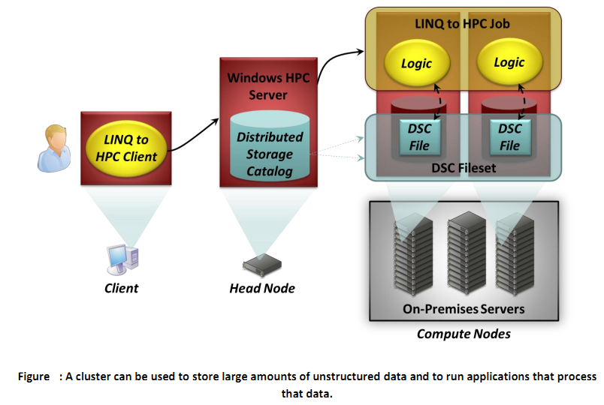
Data-Intensive Applications

Slide 36
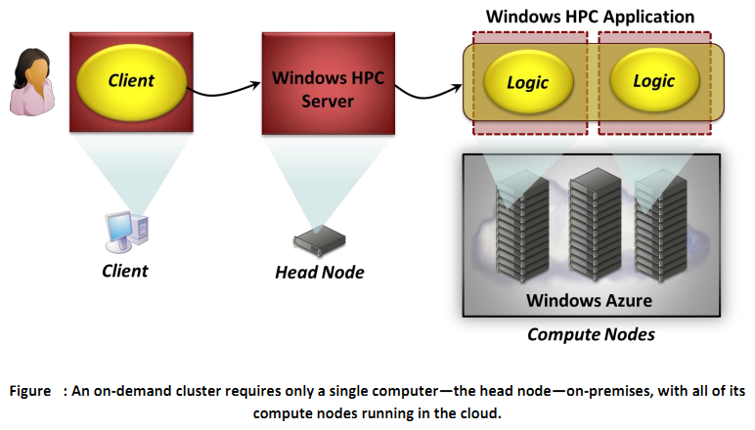
Using an On-Demand Cluster
Notes:
The master/head node must be an on-premises server, but it’s entirely possible to create a cluster where all of the compute nodes are cloud instances. This Figure shows how this looks.
As the figure shows, a client submits an application (also referred to as a job) to the master/head node, which then starts the application running on the cluster’s compute nodes. Here, each chunk of the application’s logic runs in a cloud instance (which is really a virtual machine) provided by Windows Azure. And although the figure shows only two instances, a client can start 10, 20, or 100 if needed.
What this allows? With just a single on-premises machine, an organization can have on-demand access to a cluster. The organization is charged only for the time the cloud instances are running.
Well .. Its clear that not every application will work well in this environment. MPI jobs, for example, require communication between compute nodes while they execute, and so clusters designed for this application style frequently have high-speed networks between those nodes. But, Embarrassingly parallel jobs can work well in this situation.
Given the small investment required—all that’s needed is a master/head node—it’s reasonable to expect many organizations to create this kind of on-demand cluster. Even a small company can now have access to large amounts of affordable computing power. The ability to create a set of cloud instances when required provides a useful and low-risk way to get started with cluster computing.

Slide 37
Conclusion
it’s become more useful.
It’s become more accessible.
Clusters based supercomputers can be seen everywhere !!
Notes:
Because cluster computing can now support a broader range of applications, it’s become more useful.
Because clusters can now contain a range of compute nodes, including on-premises servers, desktop workstations, and cloud instances, cluster computing has become more accessible too.
Clusters based supercomputers is likely to grow and can be seen everywhere !!
So … For anybody who thought this approach to making software run fast wasn’t relevant to them, it’s time to take another look at cluster computing.

Slide 38
Thanks !

