Slide 1
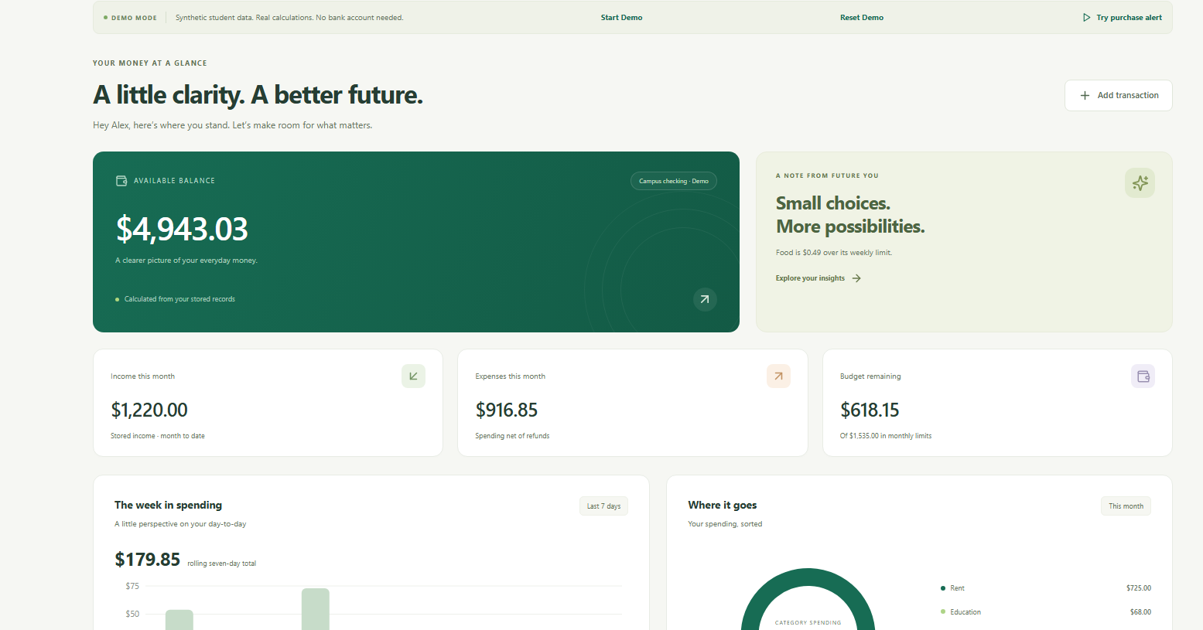
SPENDING, MADE SMARTER.
moniq.
moniq.
Spending,
Made Smarter.
AI-powered personal finance
for college students.
ACTUAL MONIQ DASHBOARD · SYNTHETIC DATA
Presenter: [edit name / team]
Hacklanta 2026 / Fintech
01
Notes:
SLIDE 1 | 10 seconds
Meet Moniq: Spending, Made Smarter. It helps college students track spending, manage shared expenses, and understand their financial future.
Evidence / presenter reminders:
docs/screenshots/12-final-dashboard.png. Alex is a synthetic demo profile, not the presenter. Replace presenter placeholder. No customer/user-count claims.

Slide 2
THE PROBLEM
moniq.
College finances are
unnecessarily complicated.
01
02
03
Money is scattered.
Tracking takes effort.
Planning adds stress.
Bank alerts, spreadsheets,
and separate apps.
New income and purchases
are easy to miss.
Shared bills, rent,
and savings goals.
FIND THE RECORDS
KEEP UP WITH ACTIVITY
KNOW WHAT COMES NEXT
Hacklanta 2026 / Fintech
02
Notes:
SLIDE 2 | 18 seconds
Student money lives in fragments: bank alerts, spreadsheets, and separate apps. A paycheck lands, dinner gets split, and rent is coming. The challenge is connecting those events into a clear picture of what you can spend and what you need to save.
Evidence / presenter reminders:
Problem framing is a use case, not a survey or market-size claim. No quantified impact or testimonials are asserted.

Slide 3
OUR SOLUTION
moniq.
One intelligent home for your money.
1
Bring activity together
Gmail with consent · CSV imports
2
Review and organize
ML categories · Confirmed ledger
3
Plan your next decision
Budgets · Goals · Forecasts · Circles
Confirmed activity refreshes the dashboard.
Hacklanta 2026 / Fintech
03
Notes:
SLIDE 3 | 18 seconds
Moniq brings that picture together. Import transactions or connect Gmail with permission. Review the extracted activity, let machine learning suggest categories, and see confirmed records update your account estimates, budgets, and forecasts. Circles adds your personal share of group spending.
Evidence / presenter reminders:
README; frontend/src/pages; backend/app/finance.py, goals.py, gmail_routes.py, circles.py. 'Organize income' includes rules/event detection; ML is category classification, not deposit verification.

Slide 4
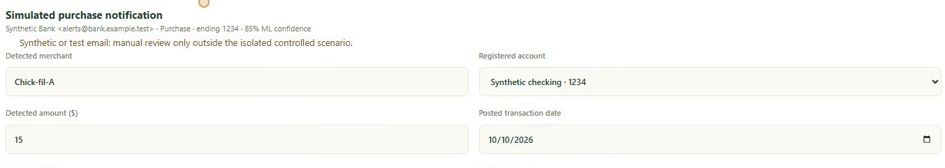
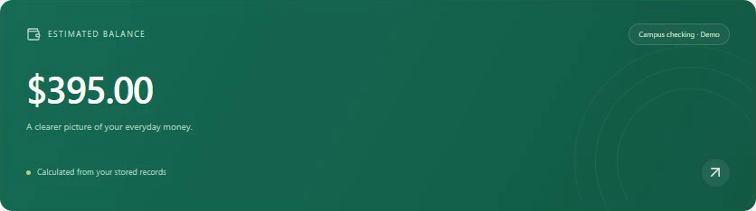
THE WOW MOMENT
moniq.
From an email alert to an updated balance.
SYNTHETIC DEMONSTRATION · ACTUAL PARSER + DATABASE UPDATES
$10
+ $400
$410
− $15
$395
→
→
Starting estimate
Paycheck confirmed
Purchase confirmed
Detect → Extract → Categorize → Assign account → Confirm → Recalculate
Gmail-derived balances are estimates, not verified bank balances.
Hacklanta 2026 / Fintech
04
Notes:
SLIDE 4 | 30 seconds
Here is the working flow, using synthetic data. Start with ten dollars. Moniq detects a four-hundred-dollar paycheck alert. After confirmation, the estimate becomes four hundred ten. A fifteen-dollar restaurant alert is extracted, categorized, and matched to checking. Confirm it, and the estimate becomes three hundred ninety-five. These are actual saved records and calculations, not numbers placed on a mockup. Gmail-derived balances remain estimates, not verified bank balances.
Evidence / presenter reminders:
Video Moniq_Hacklanta_Final.mp4: purchase review 00:29 and confirmed dashboard 00:41. Synthetic account ending 1234. Financial email detection/extraction precedes ML; confirmation gate precedes ledger update. Synthetic scenario doesn't read actual Gmail.

Slide 5
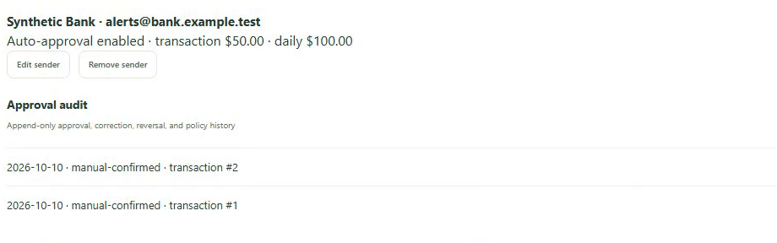
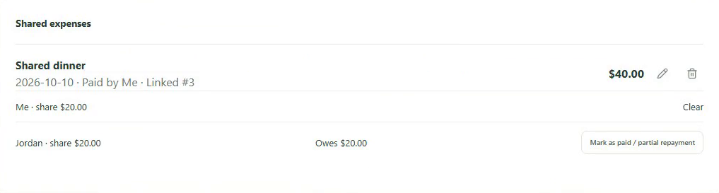
SMARTAPPROVE + MONIQ CIRCLES
moniq.
Automation meets everyday student life.
SmartApprove
Moniq Circles
Your sender rules. Your choice.
Authentication + amount checks.
Uncertain alerts stay in review.
Split expenses; keep the full charge.
Track personal shares and repayments.
Reimbursements are not paycheck income.
OPT-IN · OFF BY DEFAULT
$40 dinner = $20 your share + $20 owed
Synthetic example. Circles records debts and repayments; Moniq sends no money.
Hacklanta 2026 / Fintech
05
Notes:
SLIDE 5 | 26 seconds
SmartApprove is optional. You control trusted sender rules; authentication, account, date, confidence, and amount checks decide whether an alert can skip review. Uncertain messages stay manual. Circles handles everyday roommate bookkeeping: pay forty dollars for dinner, keep the full charge in your cash ledger, and count twenty dollars as your share. A confirmed twenty-dollar repayment clears the debt without becoming paycheck income. Moniq never sends payments.
Evidence / presenter reminders:
backend/app/smartapprove.py checks aligned Google-reported authentication, posted status/date, account, amount/daily caps, confidence, dedup. Test-only sender authentication allowed solely in explicit controlled fixtures. Circles integer-cent allocation/settlement, not live collaboration/payment rails.

Slide 6
THE TECHNOLOGY
moniq.
Real machine learning. Real financial logic.
Gmail API / User imports
ML suggests categories.
Secure FastAPI backend
TF-IDF + logistic regression
94.70% raw synthetic accuracy
Financial event extraction
250 / 264 held-out examples.
Real-bank accuracy is unmeasured.
Scikit-learn classification
Code calculates the money.
Validation + account ledger
Integer cents · Deterministic forecasts
React dashboard, forecasts + Circles
React / TypeScript · Python / FastAPI · SQLite
Google OAuth + Gmail API · pytest / Playwright
Hacklanta 2026 / Fintech
06
Notes:
SLIDE 6 | 25 seconds
The system uses React and TypeScript over a Python FastAPI backend and SQLite. A local TF-IDF and logistic-regression model suggests categories. Deterministic code handles integer-cent balances, splits, and forecasts. An independent evaluation reproduced ninety-four point seven percent raw accuracy on held-out synthetic examples. That is evidence of the ML pipeline, not measured real-bank accuracy. Low-confidence descriptions still need review.
Evidence / presenter reminders:
backend/app/ml.py; scripts/reproduce_ml.py --check; data/ml_independent_evaluation.json. 792 train, 264 test, disjoint merchant families, correlated synthetic formatting, uncalibrated confidence. Threshold .45 gives 58.71% automatic coverage. No generative LLM is used for financial arithmetic or assistant replies. Backend security is local prototype scope, not certification.

Slide 7
WORKING PROTOTYPE + VALIDATION
moniq.
Built, tested, and demonstrated.
109
19
94.70%
Backend tests passed
Browser tests passed
Raw synthetic ML accuracy
pytest
16 local + 3 production · Chromium
250 / 264 · Held-out merchant families
Verified prototype
Clear boundaries
Responsive dashboard and budgets
Goals, forecasts, subscriptions, assistant
Synthetic email → confirmation → ledger
Sharing, repayment and session isolation
Estimates; no bank verification
Gmail requires permission
Real-email coverage needs broader testing
No payments; sample deals are fictional
Hackathon prototype · Not a production banking product
Hacklanta 2026 / Fintech
07
Notes:
SLIDE 7 | 18 seconds
The prototype passed one hundred nine backend tests and nineteen Chromium browser tests, including production pages and isolated financial workflows. It includes responsive budgets, goals, subscriptions, and record-grounded answers. Wider real-email coverage, live bank verification, and production identity remain future work. Sample deals are fictional.
Evidence / presenter reminders:
docs/QA_REPORT.md figures independently rerun for this presentation: 109 backend, 16 local Chromium, 3 public production Chromium; latest results in PRESENTATION_VERIFICATION.md. Counts reflect local validation. Final hosted GitHub CI remains pending approval to push.

Slide 8
THE VISION
moniq.
Make financial confidence
accessible to every student.
Less bookkeeping. Clearer decisions.
Smarter savings. Easier roommate expenses.
moniq.
Spending, Made Smarter.
https://github.com/ReddyR1105/Moniq
AI-assisted build · Work history disclosed in repository
Hacklanta 2026 / Fintech
08
Notes:
SLIDE 8 | 15 seconds
The goal is practical: less bookkeeping, clearer decisions, and easier roommate expenses. Codex assisted development; the work-history and dependency disclosures are in the repository. Moniq: your money, your goals, your financial future. Spending, Made Smarter.
Evidence / presenter reminders:
Aspirations, not proven impact/user adoption. Repository URL points to published baseline; final source/presentation require approved push. Codex assisted code, tests, docs, recordings and presentation. Team must complete WORK_DISCLOSURE.md work-window/contribution fields. Do not assert all work happened during Hacklanta until confirmed.

