Slide 1

Loan default Prediction
Reddy Sai Reddy Duggireddy
KJ42777
Notes:
Hello everyone, my name is Reddy Sai Reddy Duggireddy, and this is my final capstone project titled Loan Default Prediction.
The goal of this project is to build a machine learning system that predicts whether a borrower will default on their loan.
Throughout this presentation, I will walk you through the dataset, preprocessing steps, exploratory analysis, model building, results, and finally the application and future improvements.

Slide 2
Overview and Importance
01
02
03
Utilizing machine learning techniques to predict loan default risk based on borrower financial and demographic feature.
Enables financial institutions to predict loan defaults early, helping reduce credit risk and prevent potential losses.
Promotes data-driven lending decisions that enhance fairness, transparency, and financial stability for both lenders and borrowers.
Notes:
Loan default prediction is extremely important in modern finance.
Banks and financial institutions receive thousands of applications each day, and manually assessing each borrower’s risk is time-consuming and prone to human error.
Predictive modeling helps institutions:
Make faster and more accurate decisions,
Reduce financial losses,
Improve risk management, and
Ensure safer and more responsible lending practices.
With the growing availability of financial data, machine learning offers an efficient way to analyze borrower behavior and predict defaults with high accuracy.

Slide 3


Objectives and Goals
Objective:
Goals:
Developed a machine learning-based system to predict loan default risk based on borrower financial and demographic features, and behavioral data .The mode helps financial institutions make data-driven and objective credit decision
Optimize decision-making processes for financial institutions.
Minimize defaults and maximize resource allocation efficiency.
Enhance overall financial stability and customer satisfaction.
Notes:
The main objective of this project is to use machine learning to identify patterns in borrower data and predict whether a customer will default.
The goals include:
Building a clean and well-structured dataset for analysis.
Performing feature engineering to capture financial stress indicators.
Training multiple machine learning models and comparing their performance.
Deploying a final model into a simple Streamlit application for real-time predictions.
This combines data exploration, modeling, evaluation, and deployment in a full end-to-end data science workflow.

Slide 4

Data Exploration
Datasets: Loan_Default_Data.csv:
255,000 rows and 17 columns
Columns include income, credit score , loan amount, DTI ratio, and interest rate, among others
Several feature engineering variables were created , such as
Loan_to_Income_Ratio, FinancialStress , Employment Stability, etc.
The target variable is ‘Default’-
0 = Repaid
1 = Defaulted
Notes:
The dataset used in this project is named Loan_Default_Data.csv, and it contains 255,000 rows and 17 columns.
It includes borrower information such as:
Income,
Credit Score,
Loan Amount,
DTI Ratio,
Interest Rate, and more.
I also created several feature engineering variables such as:
Loan_to_Income_Ratio
FinancialStress
EmploymentStability
LoanBurden
CombinedIncome
These engineered features help capture financial behavior more accurately than the raw variables.
The target variable is Default, where:
0 = Repaid
1 = Defaulted
This is a classic binary classification problem.

Slide 5
Data Preprocessing
Handling Missing Values
Missing values were imputed using the mode(most frequent value) for categorical values and median for numerical values.
Encoding Categorical Variables
Encoding and One-Hot Encoding to transform categorical features (like
HasCoSigner , EmploymentType, etc.) into numeric form for model training.orical.
Feature Engineering
Created a new derived features such as ‘Loan_to_Income_Ratio’ , FinancialStress’, ‘EmploymentStability ‘, ‘combinedIncome’.
Notes:
Before building machine learning models, the data had to be cleaned and transformed.
Steps included:
Handling missing values using median and mode imputation.
Encoding categorical variables using label encoding.
Detecting and removing infinite values caused by divisions during feature engineering.
Scaling numerical features to bring them onto a similar range.
Finally, the dataset was split into training and testing sets for model evaluation.

Slide 6
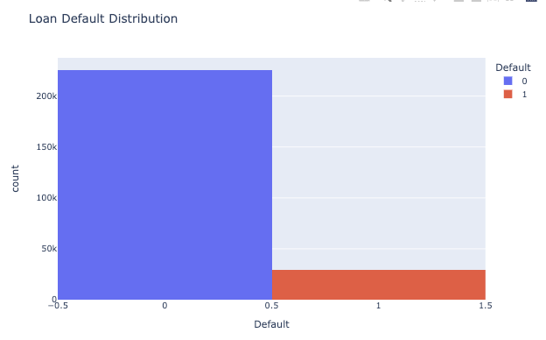
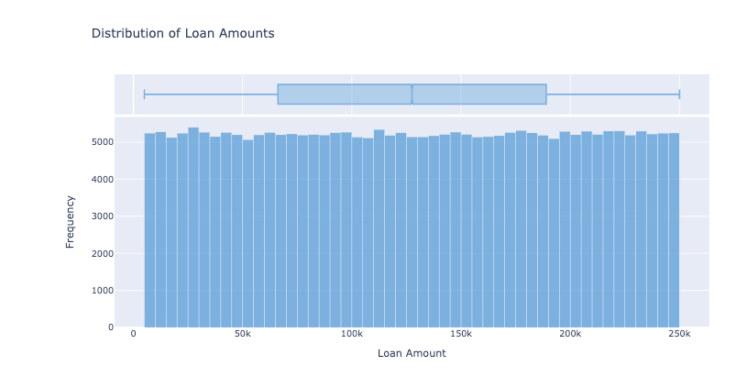
Exploratory Data Analysis(EDA)
There is clear class Imbalance in Target Variable.
This chart shows the distribution of even loan amounts across all borrowers, indicating that the data has likely been synthetically generated.
Notes:
One of the first things observed during EDA was a strong class imbalance.
Most borrowers repaid their loans, and only about 13% defaulted.
This imbalance can impact predictions because the model may learn to always predict “repaid”.
Although techniques like SMOTE can correct imbalance, I chose not to apply SMOTE because it can distort financial risk patterns in large synthetic datasets.
This histogram shows the distribution of loan amounts.
The distribution is very smooth and uniform, which indicates that the dataset is likely synthetically generated—common in large-scale simulation datasets used for model training.
Even though synthetic, the dataset still preserves realistic relationships among financial variables.

Slide 7
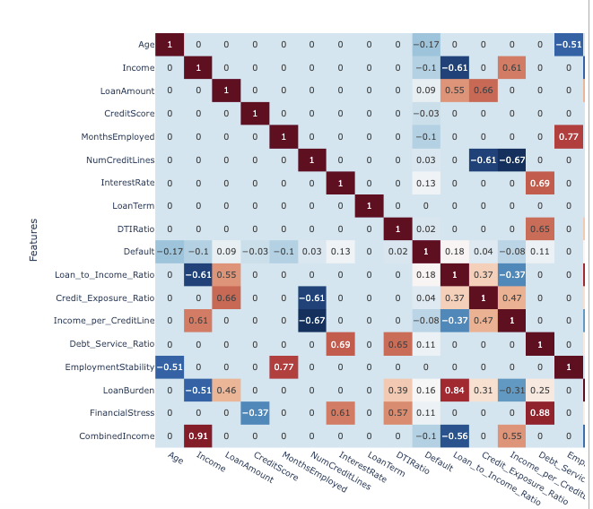
Correlation Matrices
This heatmap shows relationships among all numerical features.
We can see that credit score, income, and loan-to-income ratio are moderately correlated with default risk.
.
Also, some engineered features like loan burden and financial stress show strong relationships with each other, confirming that they capture meaningful financial patterns
Notes:
The correlation heatmap visualizes relationships among all numerical features.
Some important findings:
Credit Score and Income are moderately negatively correlated with default, meaning lower scores or lower income increase default risk.
Loan-to-Income Ratio and DTI Ratio show positive correlation with default.
Engineered features like LoanBurden and FinancialStress show strong relationships with each other, confirming that they effectively capture borrower risk.
This correlation analysis helps identify which variables may contribute most to prediction.

Slide 8
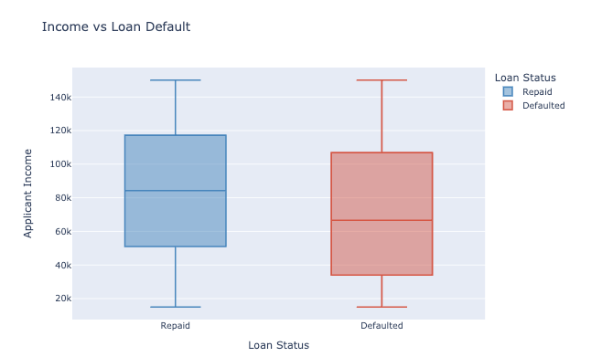
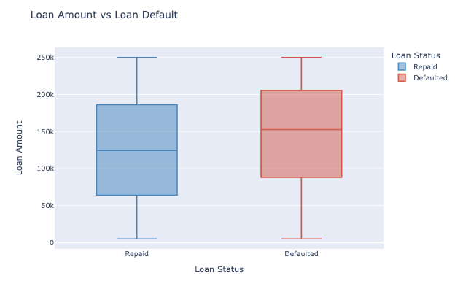
EDA continued..
Here, we can see how income and loan amount relate to loan defaults.
Borrowers with lower incomes are more likely to default, while those with higher incomes tend to repay their loans on time.
On the other hand, customers who took larger loan amounts show a higher chance of default, indicating higher financial stress or risk exposure.”
Notes:
Here, we compare borrower income levels between repaid and default cases.
Borrowers who defaulted tend to have lower incomes, while those who repaid generally earn more.
This suggests income stability is a strong factor in determining repayment capability.
This chart compares loan amounts between repaid and defaulted borrowers.
Borrowers with larger loan amounts show a noticeably higher risk of default.
This aligns with expectations—larger financial commitments may increase repayment difficulty.

Slide 9


Model Building
Trained and evaluated three machine learning models – Random Forest, Decision Tree and XGBoost – to Predict loan default risk based on borrower financial behavior
Selected XGBoost as the most effective model after comparing performance metrics such as precision, recall, and F1-score.
Notes:
I trained three machine learning models on this dataset:
Random Forest Classifier
Decision Tree Classifier
XGBoost Classifier
These models were chosen because they handle nonlinear relationships well and perform strongly on tabular financial data.
Each model was trained using a pipeline that included preprocessing and scaling to ensure consistency and prevent data leakage.

Slide 10
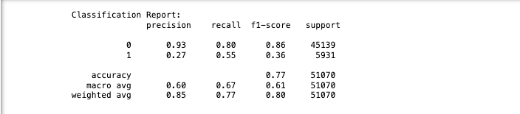
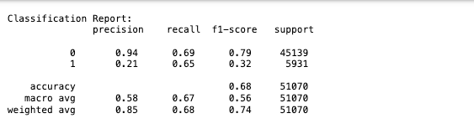
Model Performance Metrics
Random Forest: Decision Tress:
Notes:
“Random Forest provided decent accuracy but struggled with identifying default cases because of the strong class imbalance.
The recall for the default class remained relatively low
“The Decision Tree model was simple and interpretable, but it also suffered from the data imbalance, resulting in weak performance in detecting actual defaults

Slide 11
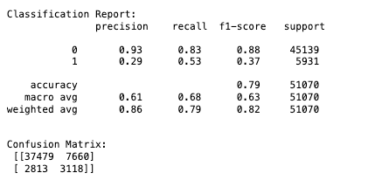
Model Performance Metrics continued..
XGBoost:
Notes:
. XGBoost performed the best among the models.
It captured more patterns from the engineered features and provided improved recall for default predictions.
Although the scores were not perfect due to the imbalance, this model showed the most promise.”

Slide 12
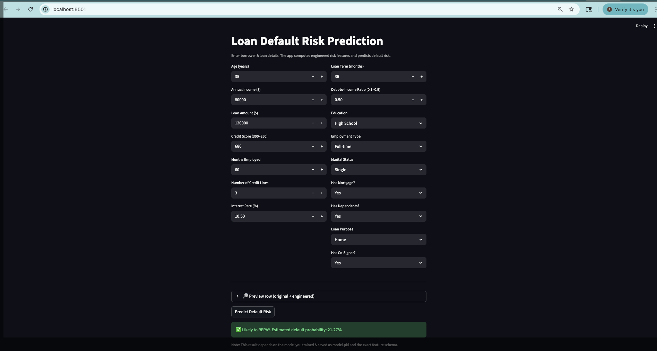
Streamlit Application
Notes:
To make the model usable, I deployed it as a Streamlit web application.
The app allows users to input borrower information such as income, credit score, loan amount, and other features.
The model then predicts whether the borrower is likely to default.
This demonstrates how machine learning models can be integrated into real-world financial decision systems.

Slide 13
Conclusion
Successfully implemented multiple machine learning algorithms, handled missing data, Applied encoding, and performed feature engineering to improve model accuracy and interpretability
Loan default prediction plays a vital role in helping financial institutions identify high-risk borrowers early.
By leveraging predictive analytics, lenders can minimize financial losses, make data-driven decisions, and enhance credit risk management.
Notes:
I successfully built a predictive modeling pipeline for loan default prediction.
Performed detailed EDA to understand borrower behavior.
Engineered meaningful financial features.
Trained and compared multiple machine learning models.
Created a functional web application for practical use.
This project shows how machine learning can significantly improve the loan assessment process by making it faster, data-driven, and more consistent.

Slide 14

Future Work
Explore deep learning and ensemble models to further enhance prediction accuracy and performance.
Integrate real-time financial and behavioral data to improve the reliability of loan default predictions.
Implement model interpretability tools to ensure transparency and trust in predictions.
Deploy the solution as a cloud-based application for automated and scalable loan risk assessment.
Notes:
There are several opportunities to expand this project:
Exploring deep learning and ensemble stacking to improve predictive power.
Integrating real-time financial and behavioral data, such as transaction history.
Using Explainable AI techniques to improve transparency for lenders.
Deploying the solution at scale through cloud platforms.
These enhancements would help institutions make even better lending decisions.

Slide 15
Thankyou
Notes:
Thank you so much for listening to my presentation.

