Slide 1


Slide 2

Presentation Outline:
Introduction
Understanding HTML
Learning HTML syntax
Adding headings and paragraph text
Using special characters
Adding web and email links
Adding images
Making clickable images

Slide 3
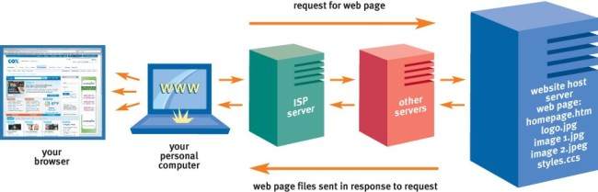
How does Website works?
Figure 1: How browser works?

Slide 4
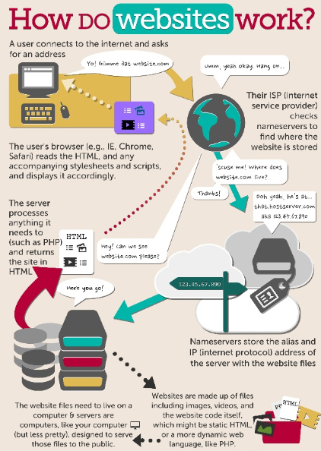

Figure 2: How Website works?

Slide 5

Getting started with HTML

Slide 6

HTML (Hypertext Markup Language) uses a markup system composed of elements which represent specific content.
HTML is sometimes called a programming language but it has no logic, so is a markup language. HTML tags provide semantic meaning and machine-readability to the content in the page.
In simple terms, a webpage (or HTML document) is a plain text file that has been
encoded using HTML so that it appears nicely formatted in a web browser.
Hypertext Text that you click to jump from document to document. This is a
reference to the ability of web pages to link to one another.
Markup Tags that apply layout and formatting conventions
to plain text. Literally, the plain text is “marked up” with the tags.

Slide 7
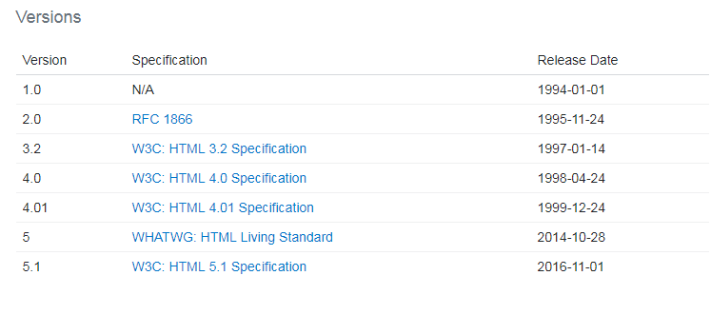

Versions

Slide 8
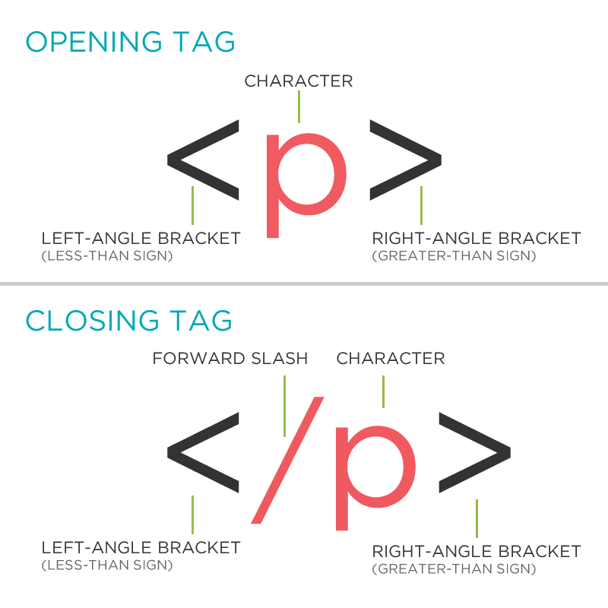

An element usually consists of an opening tag (<element_name>), a closing tag (</element_name>), which contain the element's name surrounded by angle brackets, and the content in between: <element_name>...content...</element_name>

Slide 9
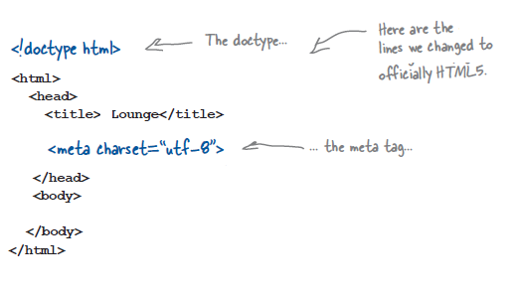
Document Outline:
UTF-8 is a character coding that has support for many alphabets, including non-western ones. You’ve probably seen other character sets used in the past, but UTF-8 is being promoted as the new standard. And it’s way shorter and easier to remember than previous character encodings.

Slide 10
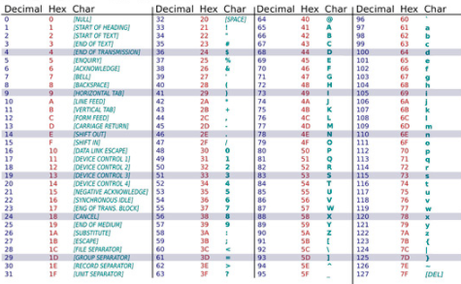
The HTML5 Standard: Unicode UTF-8
ISO-8859 was limited in size, and not compatible in multilingual environments
The Unicode Standard developed to covers (almost) all the characters, punctuations, and symbols in the world.
Unicode enables processing, storage, and transport of text independent of platform and language.
The default character encoding in HTML-5 is UTF-8.
The Difference Between Unicode and UTF-8
Unicode is a character set. UTF-8 is encoding.
Unicode is a list of characters with unique decimal numbers (code points). A = 65,
This list of decimal numbers represent the string "hello": 104 101 108 108 111
Encoding:
UTF-8 encoding will store "hello" like this (binary): 01101000 01100101 01101100 01101100 01101111

Slide 11
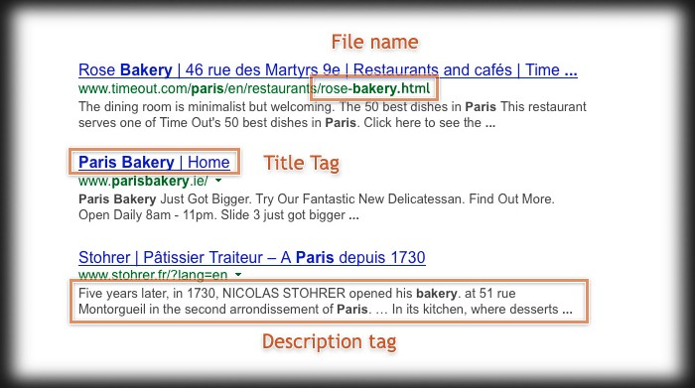
<head> <meta charset="UTF-8"> <meta name="description" content=“Our Web tutorials"> <meta name="keywords" content="HTML, CSS, XML, JavaScript"> <meta name="author" content=“Amar"> <meta name="viewport" content="width=device-width, initial-scale=1.0"> </head>
A <meta> viewport element gives the browser instructions on how to control the page's dimensions and scaling.
The width=device-width part sets the width of the page to follow the screen-width of the device (which will vary depending on the device).
The initial-scale=1.0 part sets the initial zoom level when the page is first loaded by the browser.

Slide 12
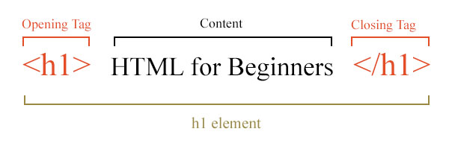
The difference between elements and tags:
Element insight
Let's break down a tag...
The <p> tag represents a common paragraph.
Elements commonly have an opening tag and a closing tag. The opening tag contains the element's name in angle brackets (<p>). The closing tag is identical to the opening tag with the addition of a forward slash (/) between the opening bracket and the element's name (</p>).
Content can then go between these two tags: <p>This is a simple paragraph.</p>.

Slide 13
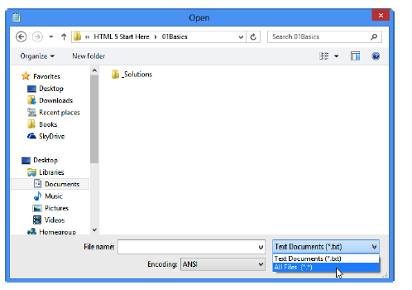
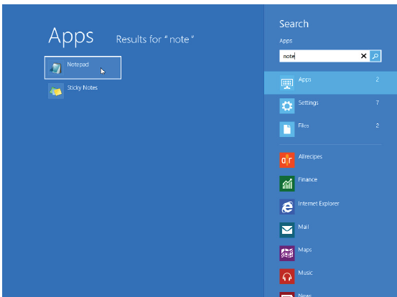
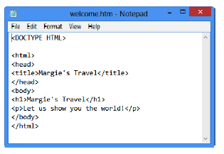
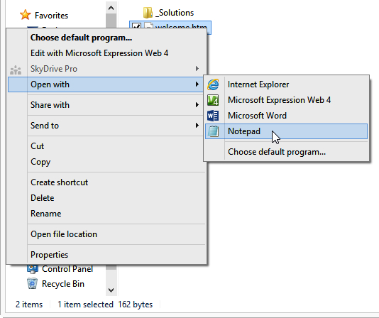
Or, if you’re working in an earlier Windows version, from the Start menu, click All Programs | Accessories | Notepad.

Slide 14
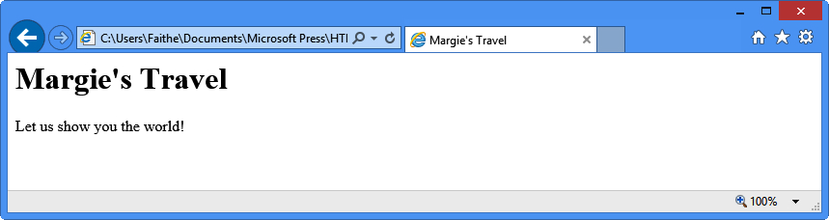

Slide 15
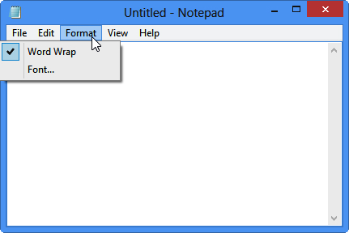
For Beginners
Open Notepad and then click the Format menu. Word Wrap should have a check mark next to it. If it does not, click it to enable the Word Wrap feature.

Slide 16
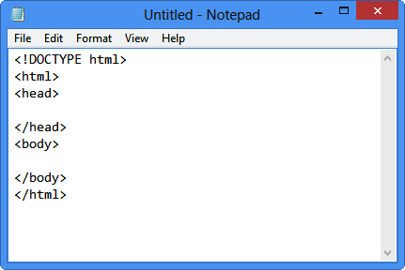
2. In the Notepad window, type the following:
<!DOCTYPE html>
3. Press Enter and then type:
<html>
<head>
4. Press Enter two or three times to insert some blank lines and then type:
</head>
<body>
5. Press Enter two or three times to insert some blank lines and then type:
</body>
</html>
Use the <title> and </title> tags to enclose the text that should display in the browser’s title bar. Place these in the <head> section of the file.
Use <meta> tags in the <head> section to indicate keywords and the document encoding language.

Slide 17
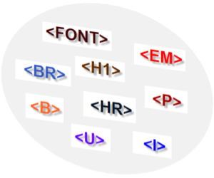
Formatting Text
with Tags

Slide 18
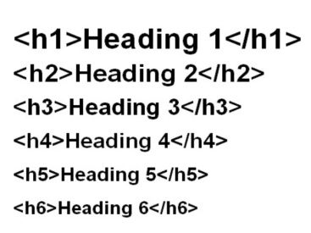
<h1> to <h6>
The HTML standard defines six levels of headings, <h1> through <h6>, each one progressively smaller in font size.
<p>
Defines a paragraph of text
Example:
<p>Example of a paragraph element.</p>
align
Defines the alignment of text inside a paragraph
<p align="justify">Example of a paragraph that is using the align attribute.</p>

Slide 19
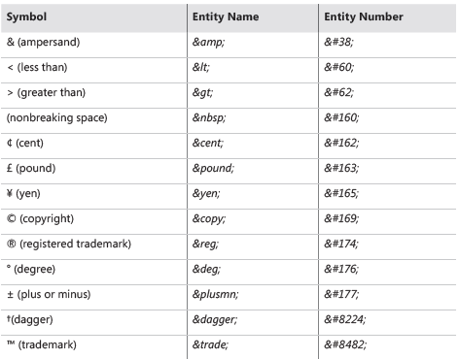
Special Characters
Special characters are characters that are not included on a standard English keyboard.
Examples include letters with accent marks over them (such as in the word résumé)
or an ownership symbol (such as © or ™).

Slide 20

Creating Hyperlinks
and Anchors

Slide 21
The web is based on hyperlinks. Each webpage contains active links to other pages, which in turn link to even more pages, until presumably the entire web (or at least a great chunk of it) is bound together. In fact, that’s where the name “web” comes from. Hyperlinks can connect to other places on a webpage, to other pages within your website, to pages outside your site
<a href="http://www.google.in">
Using Relative and Absolute Paths
<a href="http://www.google.com/windows/download.html">Download HTML Images</a>
<a href=“Welcome.html">Home Page</a>
You can also create a link to a file that is up one level (a parent folder)
with a relative reference.
You would precede the reference with ../ to indicate that the file is one level up:
<a href="../index.html">Welcome</a>

Slide 22
New/Target Window
To direct the hyperlink to open a page in a new tab, add the attribute target=“_blank” to the <a> tag. For example, to open the london.htm file in a new window, the tag would be structured like this:
<a href=“Abcd.html" target="_blank">Welcome</a>
Hyper linking to an Email Address
Hyperlinks can point to anything, not just to web pages. For example, you can create email hyperlinks that start the user’s default email program,
<a href="mailto:contact@abcd.com">Contact Us</a>
Email address on a publicly accessible webpage is bound to generate
a certain amount of incoming junk mail (also known as spam). For this reason, do not put your main email address on a public page.

Slide 23
To add a default subject line to the email, add ?subject=Comment (or whatever you want the text in the subject line to be) after the email address, like this:
<a href="mailto:support@contact.com?subject=Comment">Contact Us</a>
<a href="mailto:support@contact.com" title="Please contact us with questions
or comments">support@contact.com</a>
An anchor is a marker within an HTML document, roughly analogous to a bookmark in a Word document. You define a specific location in the document with an anchor name and then you can hyperlink directly to that anchor
<p id="conclusion">Conclusion</p>
<a href="#conclusion">View the Conclusion</a>

Slide 24
Images:
In HTML, images are defined with the <img> tag.
The <img> tag is empty, it contains attributes only, and does not have a closing tag.
The src attribute specifies the URL (web address) of the image:
<img src="url">
Example:
<img src="img/forest.png">
<!-- Image with Width and Height -->
<h2>Image with Width and Height</h2>
<img src="img/forest.png" width="300px" height="200px">
<!-- Image with Alt attribute -->
<h2>Image with Alt attribute</h2>
<img src="img/forest.png" width="300px" height="200px"
alt="Forest Image">
<!-- Float Image Example -->
<h2>Float Image</h2>
<img src="img/forest.png" width="300px" height="200px">
<img src="img/nature_path.png" width="300px" height="200px"
align="right">

Slide 25
Making Images clickable
<a href="https://www.google.com">
<img src=“images/abc.png“ width="100" height="100">
</a>

Slide 26
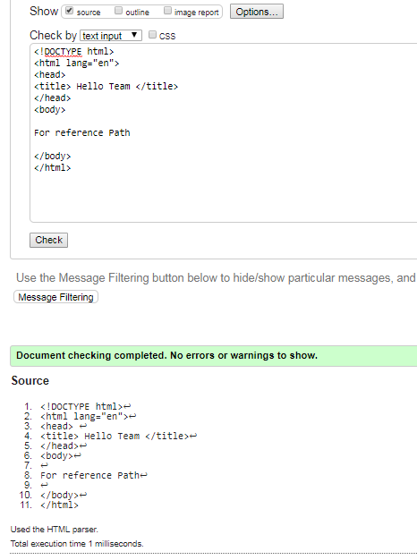
HTML validator:
https://validator.w3.org/

