Slide 1

BOOTSTRAP

Slide 2
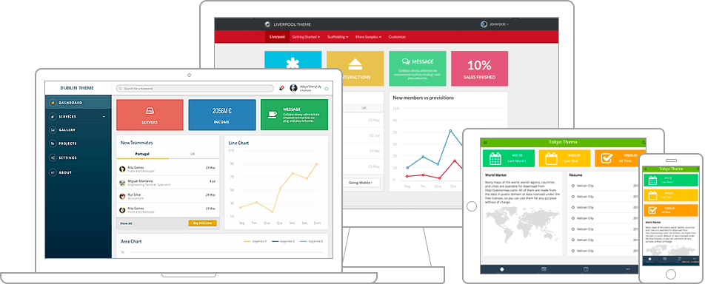
Bootstrap :
It is a free, open-source and is the most popular HTML, CSS and JavaScript framework developed by twitter for creating responsive web applications.
Advantages :
Supports responsive design
Saves lot of development time
Customizable
Support

Slide 3
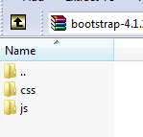
Setting up Bootstrap
Click on:
https://getbootstrap.com/
Click on Download Button:
https://getbootstrap.com/docs/4.1/getting-started/download/
You’ll able to see three :
Compiled CSS and JS
Source Code
CDN
Click on Compiled CSS and JS Download it you’ll able to download three folders
Inside
Bootstrap.css (Development phase & easy to debug)
Bootstrap.min.css (Production Server due to less size)
When you are in development environment you can use offline. When you are up for production CDN is better.

Slide 4
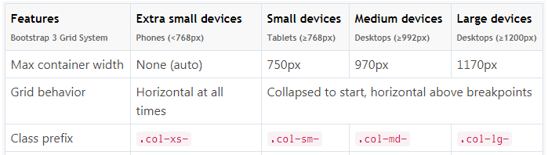
Bootstrap Grid System
Bootstrap Grid System is used for creating page layouts through a series of rows
and columns .
First create a container that acts as a wrapper for your rows and columns using the .container class, after that create rows inside the container using the .row class, and to create columns inside any row you can use the class .col-xs-*, .col-sm-*, .col-md-* and .col-lg-*.

Slide 5
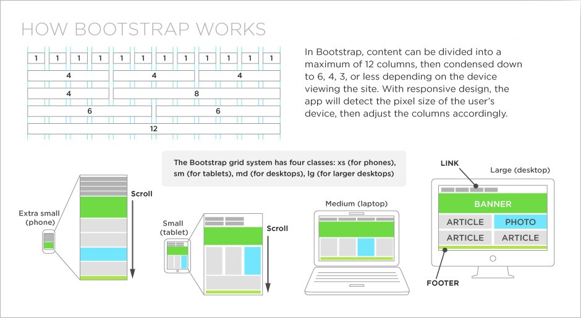

Slide 6
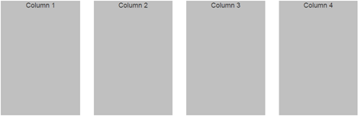
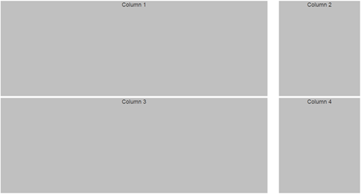
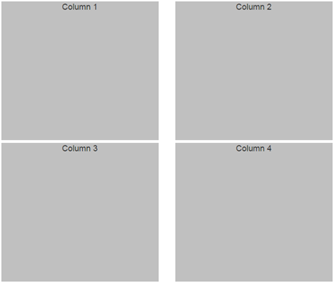
Bootstrap Grid Classes

Slide 7
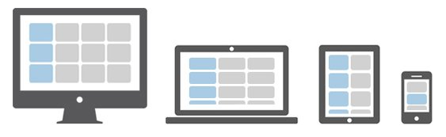
<div class="container">
<div class="row">
<div class="col-md-3 col-lg-9">
<div class="customDiv">Column 1</div>
</div>
<div class="col-md-3 col-lg-3">
<div class="customDiv">Column 2</div>
</div>
<div class="col-md-3 col-lg-9">
<div class="customDiv">Column 3</div>
</div>
<div class="col-md-3 col-lg-3">
<div class="customDiv">Column 4</div>
</div>
</div>
</div>

Slide 8
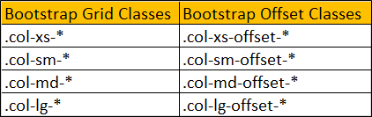
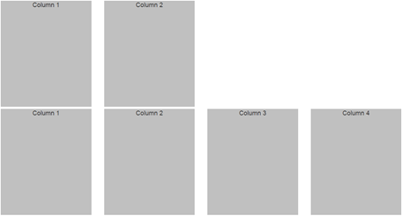
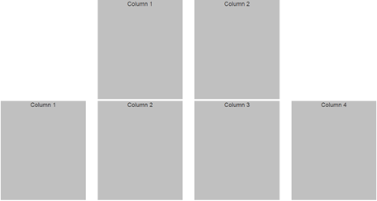
Bootstrap Offset
For Suppose we want the 2 columns in the first row to be centered. To center the columns, we need to push the first column to the right by 3 columns.

Slide 9
