Slide 1


Slide 2
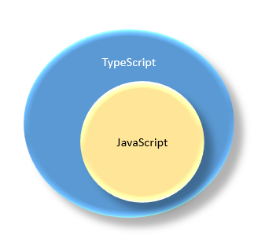
What is TypeScript?
TypeScript is a strongly typed, object oriented and compiled language and this language developed and maintained by Microsoft. It was designed by “Anders Hejlsberg” at Microsoft.
It is a superset of JavaScript. The TypeScript is JavaScript and also has some additional features like static typing and class-based object-oriented programming, automatic assignment of constructor parameters and assigned null values and so on.

Slide 3
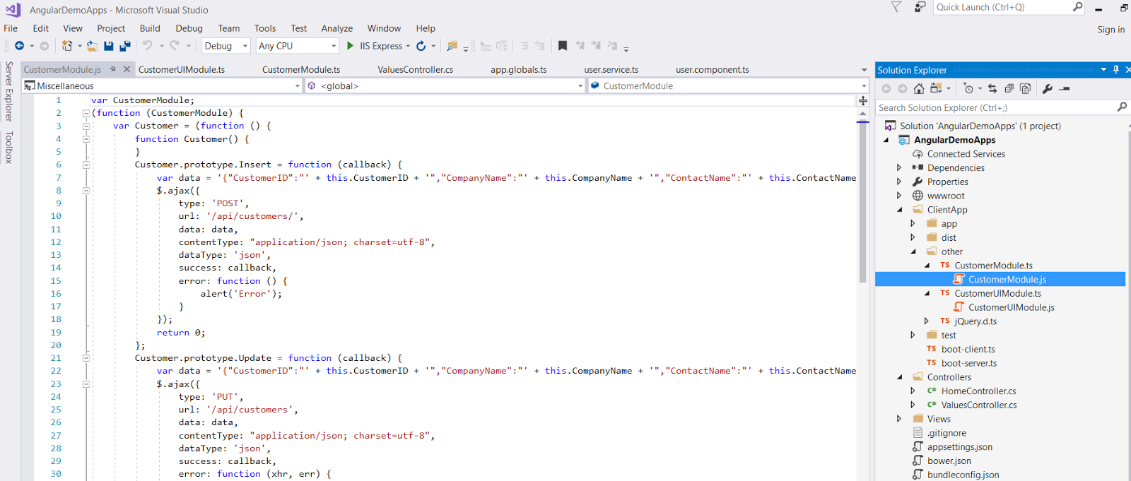
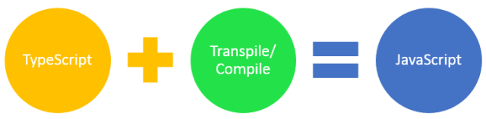
The entire JavaScript program is valid for TypeScript because the entire TypeScript (.ts) file converted to JavaScript (.js) file after compiled source compiled and this process is automatic.
See in the below compiled project pic.

Slide 4
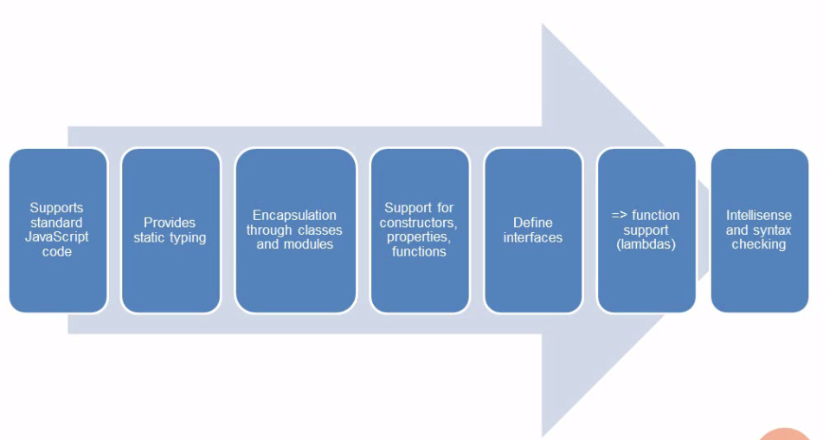
Benefits of Using TypeScript
1. Supports Object Oriented Programming.
2. Typescript adds static typing to JavaScript. Having static typing makes easier to develop and maintain complex apps.
3. Angular uses TypeScript a lot to simplify relations between various components and how the framework is built in general.
4. Provide an optional type system for JavaScript.
5. Provide planned features from future JavaScript editions to current JavaScript engines.
6. Supports type definitions.

Slide 5

Setup and Install Typescript NPM
Installing using npm
npm install -g typescript
Example1:
class Users {
userName: string;
constructor (name: string) {
this.userName = name;
}
getUserName() {
return "Hello, " + this.userName;
}
}
Example2:
class Users {
private firstName: string;
private lastName: string;
//Constructor
constructor(firstName: string, lastName: string) {
this.firstName = firstName;
this.lastName = lastName;
}
//Function
studentFullName(): void {
alert(this.firstName + ' ' + this.lastName);
}
}

Slide 6
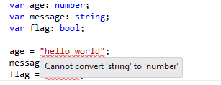
Variable declaration:
The variable is simply a name of storage location and all variables must be identified with unique names and these unique names are called identifiers.
A variable contains values such as "Hi" or 22. When you use the variable, you refer to the data it represents. For example –
let name: string = "Jhonny"; //var name: string = "Jhonny";
let num: number = 22; //var num: number = 22;
There are some rules while declaring variables i.e.
1. The variable names must begin with a letter
2. The variable names can contain letters, digits, underscores, and dollar signs.
3. The variable names can also begin with “$” and “_”
4. The variable names are case sensitive that means “a” and “A” are different variables.
5. The variable reserved words can’t be used as names.

Slide 7

Declaring Variables
let isActive: boolean = false;
let decimal: number = 6;
let hex: number = 0xf00d;
let name: string = “Janga Reddy";
let binary: number = 0b1010;
let octal: number = 0o744;
let numlist: number[] = [1, 2, 3];
let arrlist: Array<number> = [1, 2, 3];
//Any Keyword
let list: any[] = [1, true, "free"];
list[1] = 100;
//Any Keyword
let notSureType: any = 10;
notSureType = "maybe a string instead";
notSureType = false; // definitely a Boolean

Slide 8
What is scope variable?
The scope is set of objects, variables and function and the JavaScript can have global scope variable and local scope variable.
Example for global and local variable (var/let) declarations –
//DECLARED A VARIABLE NAMED NUM WITH THE VALUE 20.
let num = 20;
//DECLARE A VARIABLE INSIDE OF A FUNCTION
let getUser = function () {
let name = 'Jhonny';
return name;
} //RESULTS
getUser(); // returns 'Jhonny'
//ACCESS THOSE SAME VARIABLES WITHIN OTHER FUNCTIONS
let sum = function() {
let num = 20;
return function subNum () {
return num + 10;
}}
//RESULTS
sum(); // returns 30

Slide 9
What is an Interface in TypeScript?
An interface in TypeScript is similar to other object oriented programming languages interfaces.
An interface is a way to define a contract on a function with respect to the arguments.
In the below example, I am using an interface that describes objects that have a “name”, “age” and “address” fields and the following code defines an interface and a function that takes a parameter that adheres to that interface.
//USER INTERFACE
interface User {
name: string;
age: number;
address: string
}
//FUNCTION USING USER INTERFACE
let userInfo = function(user: User) {
let info = "Hello, " + user.name + " Your Age is - " + user.age + " and Address is -" + user.address;
return info;
}

Slide 10
//USER INFO JSON OBJECT
let info = {
name: "Jhonny",
age: 30,
address: "Hyderabad, India."
};
//RESULT
console.log(userInfo(info));

Slide 11
Optional Properties in TypeScript
We can specify optional properties on interfaces and the property may be present or missing in the object.
//USER INTERFACE
interface User {
name: string;
age: number;
address?: string //Optional
}
//FUNCTION USING USER INTERFACE
let userInfo = function(user: User) {
let info = "Hello, " + user.name + " Your Age is - " + user.age + " and Address is -" + user.address;
return info;
}
//USER INFO JSON OBJECT
let info = {
name: “Jhonny",
age: 30
}; //RESULT
console.log(userInfo(info));

Slide 12
Constructor Parameters in TypeScript
Parameter Property TypeScript?
The TypeScript has so many useful features which not have in other programming languages. The TypeScript has an automatic assignment of constructor parameters that is called “Parameter Property”.
It is automatic assignment of constructor parameters to the relevant property. It is great but it is different to other languages.
Declaring a class with constructor arguments in TypeScript –that is called automatic parameter assignment as,
export class Customer {
constructor(private name: string, age: number, private adrress: string) { }
}
Public, Private, and Protected modifiers as
1. Public - accessible outside of the class
2. Private - only accessible in the class only
3. Protected - accessible in the class and the derived classes

Slide 13
Functions in TypeScript
A function is a set of statements that perform a specific task and used to create readable, maintainable and re-usable code.
A function declaration tells to compiler about a function name, return type, and parameters.
TypeScript functions are almost similar to JavaScript functions but there are different ways of writing functions in TypeScript.
Different types of functions are available in the TypeScript i.e.
1. Normal function
2. Anonymous Function
3. Named Function
4. Lambda Function/Arrow Function
5. Class Function
6. Optional Parameters
7. Rest Parameters
8. Default Parameters

Slide 14
Normal function
function printHello() {
console.log('Hello Jhonny!');
}
printHello();
Anonymous function
JavaScript
var hello = function () {
console.log('Hello Team!, I am Anonymous.');
};
hello();//Return - Hello UI Team!, I am Anonymous.
OR
setTimeout(function () {
console.log('Hello Team!, I am Anonymous.');
}, 2000); //Return - Hello Team!, I am Anonymous.
TypeScript
var anonymousFunc = function (num1: number, num2: number): number {
return num1 + num2;
}
//RESULT
console.log(anonymousFunc(10, 20)); //Return is 30
//RESULT
console.log(anonymousFunc(10, "xyz"));
// error: Argument of type 'number' is not assignable to parameter of type 'string'.
//because return type is number for anonymous function).

Slide 15
Named Function -
The named function is very similar to the JavaScript function and only one difference - we must declare the type on the passed parameters.
Example – JavaScript
function addTwoNumer(num1, num2) {
return num1 + num2;
}
Example – TypeScript
function addTwoNumer(num1: number, num2: number): number {
return num1 + num2;
}

Slide 16
Lambda Function/Arrow Function -
The arrow function is additional feature in typescript and it is also known as a lambda function.
A lambda function is a function without a name.
var addNum = (n1: number, n2: number) => n1 + n2;
In the above, the “=>” is a lambda operator and (n1 + n2) is the body of the function and (n1: number, n2: number) are inline parameters.
For example –
let addNum = (n1: number, n2: number): number => { return n1 + n2; }
let multiNum = (n1: number, n2: number): number => { return n1 * n2; }
let dividNum = (n1: number, n2: number): number => { return n1 / n2; }
addNum(10, 2);// Result - 12
multiNum(10, 2);// Result - 20
multiNum(10, 2);// Result - 5

Slide 17
Optional Parameters Function -
We can specify optional properties on interfaces and the property may be present or missing in the object.
In the below example, the address property is optional on the following “User” interface.
For Example as,
//USER INTERFACE
interface User {
name: string;
age: number;
address?: string //Optional
}
//FUNCTION USING USER INTERFACE
let userInfo = function(user: User) {
let info = "Hello, " + user.name + " Your Age is - " + user.age + " and Address is -" + user.address;
return info;
}
//USER INFO JSON OBJECT
let info = {
name: "Jhonny",
age: 28
};
//RESULT
console.log(userInfo(info));

Slide 18
Rest Parameters:
The rest parameter syntax allows us to represent an indefinite number of arguments as an array.
The Rest parameters do not restrict the number of values that we can pass to a function and the passed values must be the same type otherwise throw the error.
For Example as,
//Rest Parameters
let addNumbers = function(...nums: number[]) {
let p;
let sum: number = 0;
for (p = 0; p < nums.length; p++) {
sum = sum + nums[p];
}
return sum;
}
//The Result
addNumbers(1, 2);
addNumbers(1, 2, 3);
addNumbers(1, 12, 10, 18, 17);

Slide 19
Default Parameters -
Function parameters can also be assigned values by default.
A parameter can't be declared as optional and default both at the same time.
For Example as,
let discount = function (price: number, rate: number = 0.40) {
return price * rate;
}
//CALCULATE DISCOUNT
discount(500); // Result - 200
//CALCULATE DISCOUNT
discount(500, 0.45); // Result - 225

Slide 20
TypeScript Public, Private, Protected and Readonly Modifiers
The TypeScript supports to multiple modifiers and it is by default public.
1. Public,
2. Private,
3. Protected and
4. Read-only
Public by default!
Public Modifier – Public by default! It is freely access anywhere.
In the below example, the class Employee and its members are by default public and we are freely access it.
Example –
class Employee {
empName: string;
constructor(name: string) {
this.empName = name;
}
salary(salary: number = 10000) {
console.log('Hello, ' + this.empName + ' Your Salary -' + salary);
}
}
let empSal = new Employee(“Jhonny");
console.log(empSal.salary());
console.log(empSal.salary(40000));

Slide 21
Private Modifier -When using private modifier, we can’t be accessed from outside of its containing class.
Example as,
class Employee {
private empName: string;
constructor(name: string) {
this.empName = name;
}
salary(salary: number = 10000) {
console.log('Hello, ' + this.empName + ' Your Salary -' + salary);
}
}
let emp = new Employee(“Jhonny").empName;
//error: property 'empName' is private and only accesible in the class 'Employee'.

Slide 22
Protected Modifier - The protected modifier is very similar to private but only one difference that can be accessed by instances of deriving classes.
Example as,
class Employee {
protected empName: string;
constructor(name: string) {
this.empName = name;
}
salary(salary: number = 10000) {
console.log('Hello, ' + this.empName + ' Your Salary -' + salary);
}
}
class Employer extends Employee {
private department: string;
constructor(empName: string, department: string) {
super(empName);
this.department = department;
}
salary(salary = 20000) {
super.salary(salary);
}
}
let empSal = new Employer(“Jhonny", "IT");
console.log(empSal.salary());
console.log(empSal.empName); //error- the property 'empName' is protected and only accesible within the class 'Employee' and its child class.

Slide 23
TypeScript Method Overriding
Method Overriding -
In Method Overriding, redefined the base class methods in the derive class or child class.
Example as,
class NewPrinter extends Printer {
doPrint(): any {
super.doPrint();
console.log("Called Child class.");
}
doInkJetPrint(): any {
console.log("Called doInkJetPrint().");
}
}
let printer: new () => NewPrinter;
printer.doPrint();
printer.doInkJetPrint();

Slide 24
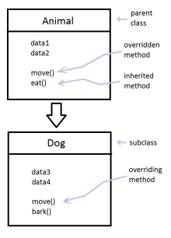
TypeScript - Inheritance
Inheritance - TypeScript is supports the concept of Inheritance.
Inheritance has ability of a program to extend existing classes to create new ones.
The extended class is called parent class or super class and the newly created classes are called child class or sub class.
Inheritance can be classified as -
1. Single - every class can at the most extend from one parent class
2. Multiple - doesn’t support multiple inheritances in TypeScript.
Multi-level

Slide 25
class Employee {
empName: string;
constructor(name: string) {
this.empName = name;
}
salary(salary: number = 10000) {
console.log('Hello, ' + this.empName + ' Your Salary -' + salary);
}
}
class Employer extends Employee {
constructor(empName: string) {
super(empName);
}
salary(salary = 20000) {
super.salary(salary);
}
}
let empSal = new Employee(“Jhonny");
console.log(empSal.salary());
console.log(empSal.salary(40000));

Slide 26
fields, constructor and function in TypeScript Class
A class is a template definition of the methods and variables in a particular kind of object. It is extensible program, code and template for creating objects.
A class captains the Public, Private, Protected and Read-only modifiers and Public by default.
A class definition can contains the following –
1. Fields
2. Constructors
3. Functions
Use of class field, constructor and function i.e.
//Example 1- A simple class based example.
class User { // Class
name: string; //field
constructor(nameTxt: string) { //constructor
this.name = nameTxt;
}
getName() {//function
return "Hello, " + this.name;
}}
let user = new User(“Jhonny");//Creating Instance objects

