Slide 1
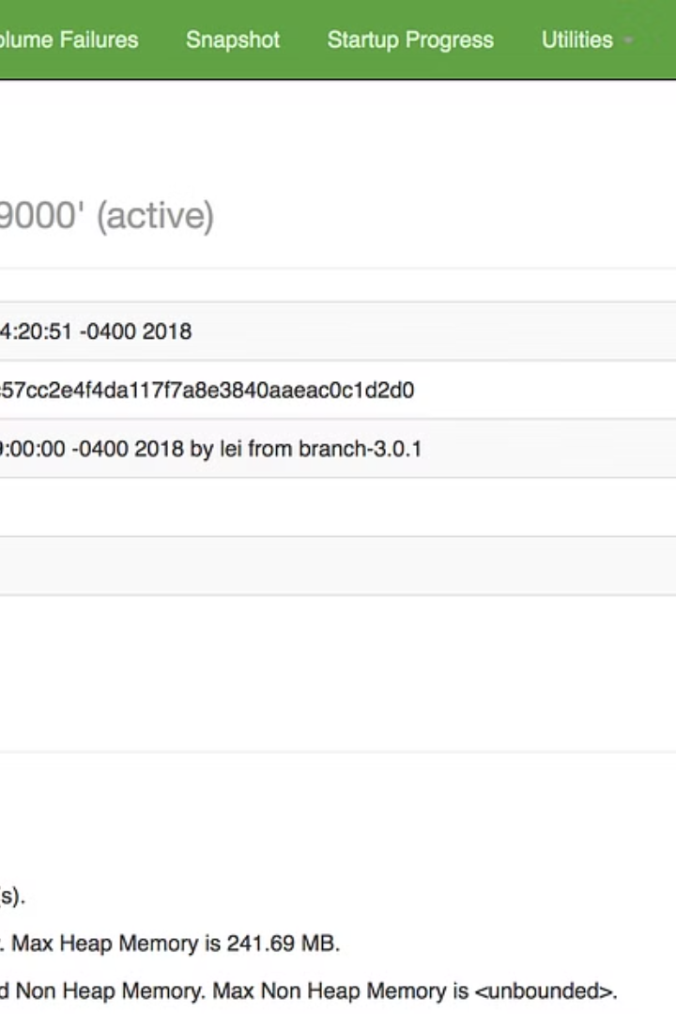

HADOOP
Hadoop is an open-source framework designed for distributed storage and processing of large sets of data using a cluster of commodity hardware. It is part of the Apache Software Foundation and is based on the Google File System (GFS) and the MapReduce programming model.
Pa
by Pranavi Reddy

Slide 2
Hadoop Distributed File System (HDFS)
Distributed Storage
Fault Tolerance
Scalability
HDFS divides large files into smaller blocks and distributes these blocks across multiple nodes in a Hadoop cluster.
HDFS achieves fault tolerance by replicating each data block multiple times across different nodes.
HDFS is designed to scale horizontally, allowing clusters to expand easily by adding more nodes.

Slide 3
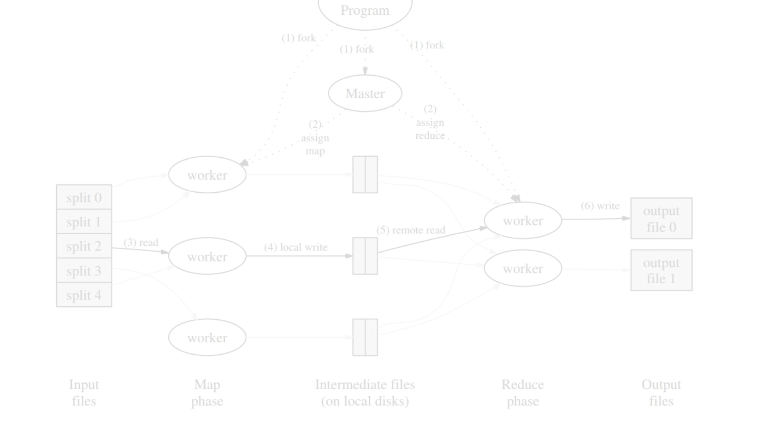
MapReduce
1
Programming Model
2
Parallel Processing
MapReduce is a programming model and processing engine for distributed computing.
It allows developers to write parallel processing applications that can process large datasets across a Hadoop cluster.

Slide 4
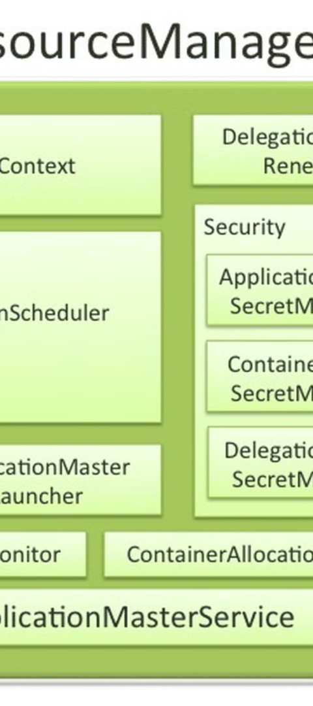
YARN (Yet Another Resource Negotiator)
1
Resource Management
YARN enables multiple data processing engines to share resources in a Hadoop cluster.
2
Flexibility
It separates the resource management and job scheduling/monitoring functions, allowing for more flexibility.

Slide 5

Hadoop Ecosystem
Rich Tools
Components
Hadoop has a rich ecosystem of tools and frameworks built around it to extend its functionality.
Components include Apache Hive, Apache HBase, Apache Spark, Apache Pig, and more.

Slide 6
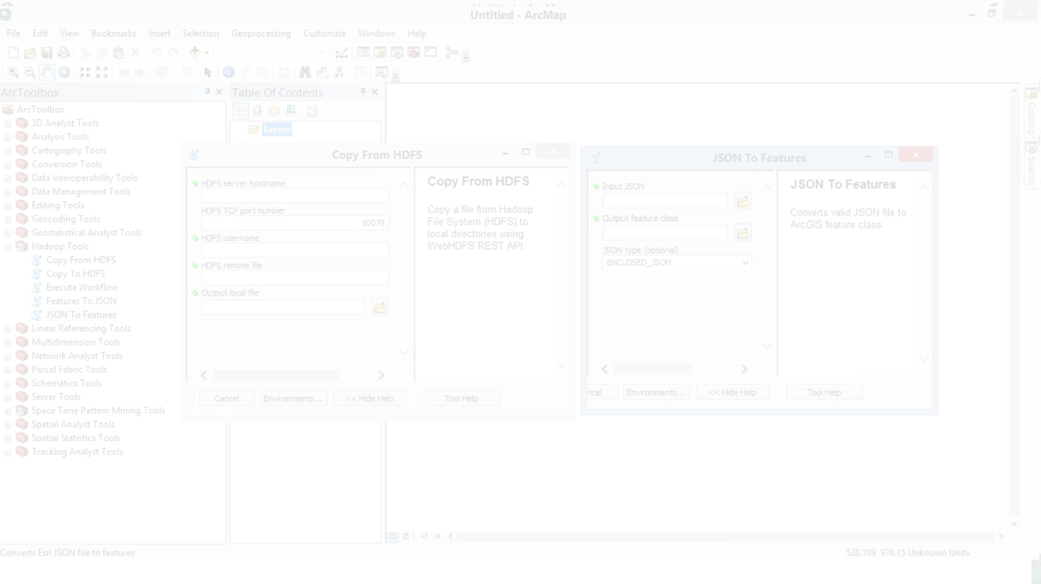


Scalability and Fault Tolerance
Horizontal Scaling
Fault Tolerance
Hadoop is designed to scale horizontally, allowing for handling increasing amounts of data and workload.
It provides fault tolerance by replicating data across nodes, ensuring data availability.

Slide 7
Big Data Processing
1K
3
Large Datasets
Organizational Use
Hadoop is particularly well-suited for processing and analyzing large datasets, often referred to as "Big Data."
It allows organizations to store and process data that exceeds the capabilities of traditional databases and tools.

Slide 8


Open Source and Community-driven
Open Source
Community
Hadoop is open-source, making it freely available for use, modification, and distribution.
The Apache Hadoop project is maintained by a diverse community of developers and organizations.

