Slide 1
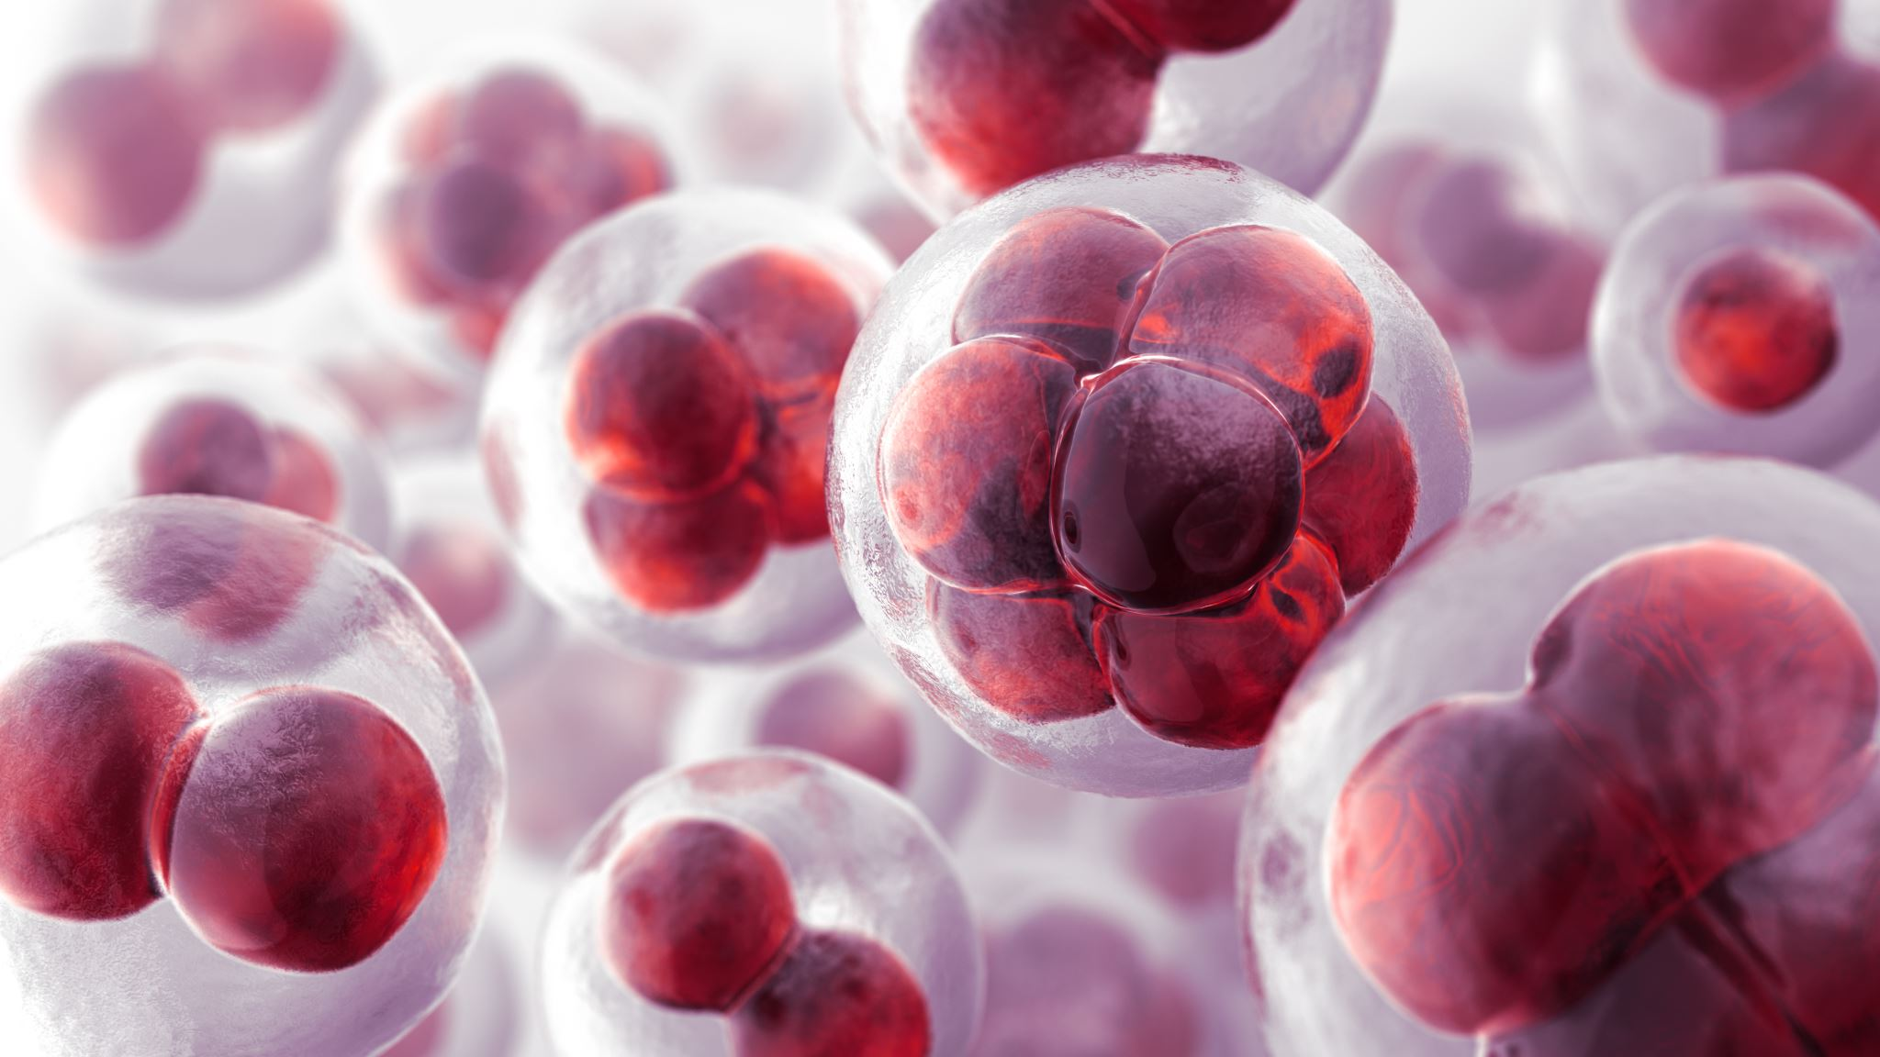
De novo Assembly and Differential Gene Expression of Enterococcus faecium E745
Redempta Kajungiro
Paper I – RNA-seq and Tn-seq reveal fitness determinants of vancomycin-resistant Enterococcus faecium during growth in human serum (Zhang et al. 2017)

Slide 2
Introduction
The Gram-positive bacterium Enterococcus faecium mutual live in human gastrointestinal tract
Problem
Cause bloodstream infections in hospitalized patients. (How????)
Aim
Identify genes that contribute to growth of E. faecium in human serum
Transcriptome profiling (RNA-seq)
transposon mutant library sequencing approach (Tn-seq)
Differential expression analysis between rich medium and heat-inactivated serum

Slide 3
Data
DNAseq from
PacBio RS II SMRT technology
illumina HiSeq 2500
NanoPore MinION 2D
RNAseq (and Tn) from rich medium and human serum
illumina HiSeq 2500

Slide 4
WORKFLOW
1. Quality check -FastQC
2. Reads preprocessing: trimming + quality check (after trimmed) –Trimmomatic
3. Genome Asembly
PacBio +Nanopore – Canu
Illumina + Nanopore Assembly- SPAdes
Illumina+Nanopore BWA aligned PacBio + Nanopore
4. Assembly evaluation
QUAST
MUMmerplot
Pilon (fixing misassemblies)
5. Structural and functional annotation-Prokka
Artemis
6. Homology Search
Blastn
Artemis ACT
7. Mapping (RNA-Seq reads alignment against the assembled genome)
BWA-MEM
8. Expression analyses
Read counting-HTSeq
Differential expression analysis- DESeq2

Slide 5
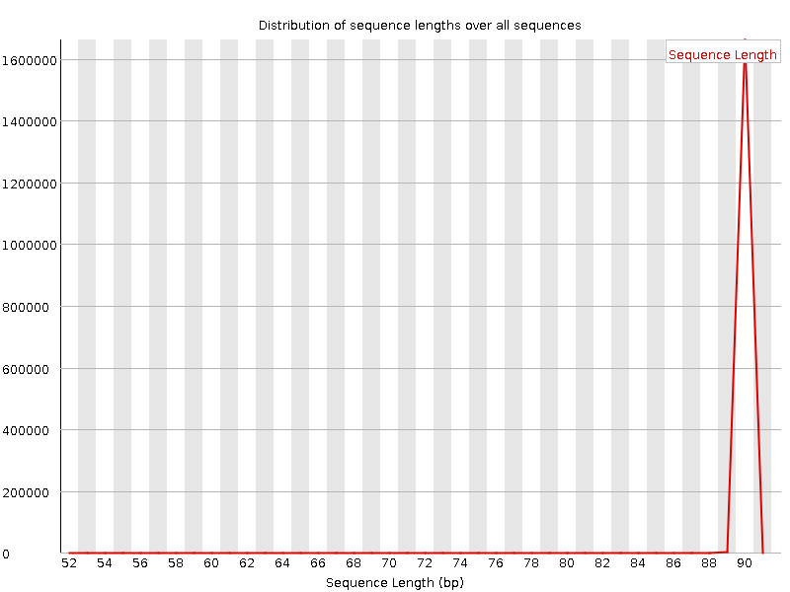
Results
FastQC
Before
After trim
Notes:
SLIDINGWINDOW: Performs a sliding window trimming approach. It starts scanning at the 5‟ end and clips the read once the average quality within the window falls below a threshold.
LEADING: Cut bases off the start of a read, if below a threshold quality
TRAILING: Cut bases off the end of a read, if below a threshold quality

Slide 6
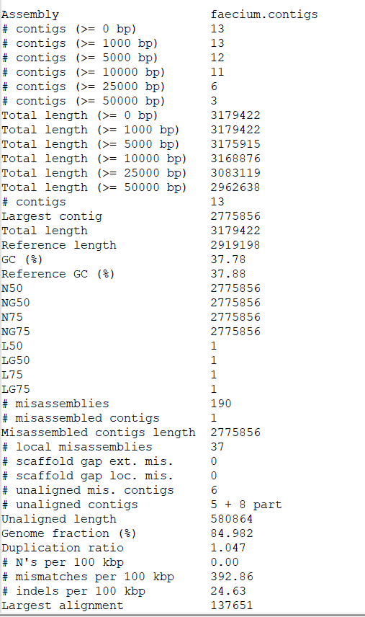
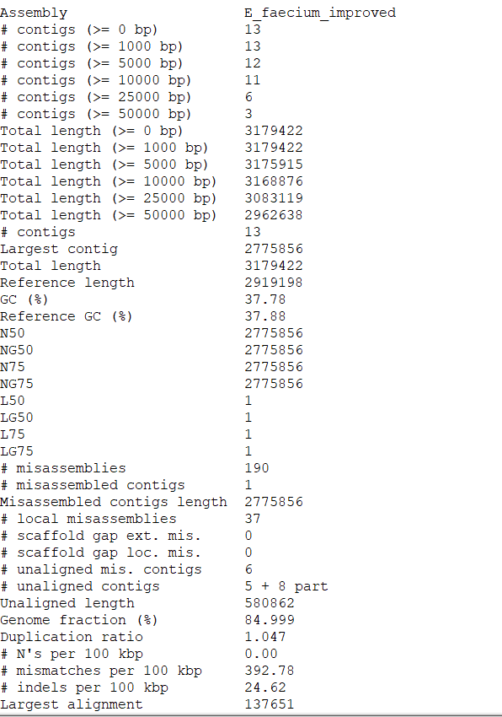



QUAST
Pilon
Canu
Article: 1 circular chromosome: 2.764Mb 6 plasmids: 9.3 - 223.7kbp 3095 predicted coding sequences
15 contigs
Higher N50 values indicate better contiguity and longer contiguous sequences
Notes:
N50: given a set of sequences of varying lengths, the N50 is defined as the length L of the shortest contig for which longer and equal length contigs cover at least 50% of the assembly.
L50: given a set of sequences of varying lengths, the L50 is defined as count of smallest number of sequences whose length sum makes up 50% of the assembly. ]
N50 describes a sequence length whereas L50 describes a number of sequences.

Slide 7
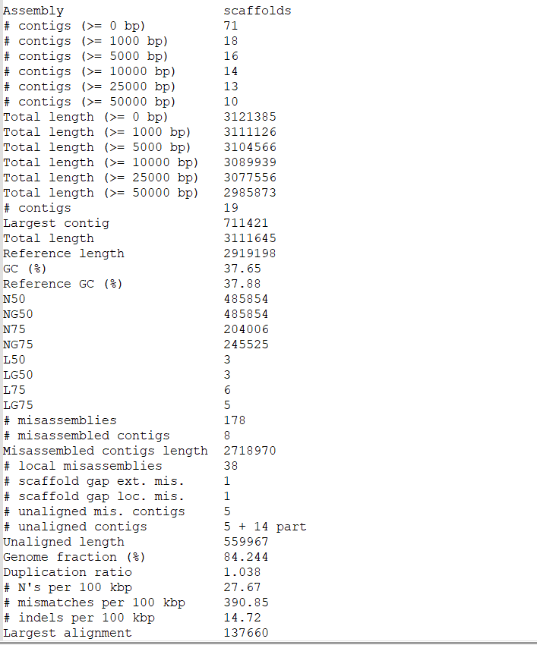



SPAdes
Higher N50 values indicate better contiguity and longer contiguous sequences
Using plasmidfinder and Blastn I detected 5 plasmids
Plasmid name | Size (bp) | Accession number
Chromosome | 2775856
rep17 | 16563 | AF507977
rep1 | 40010 | AF007787
repUS7 | 14316 | AB206333
repUS15 | 47809 | CP004064
rep29 | 15457 | Aus0085

Slide 8
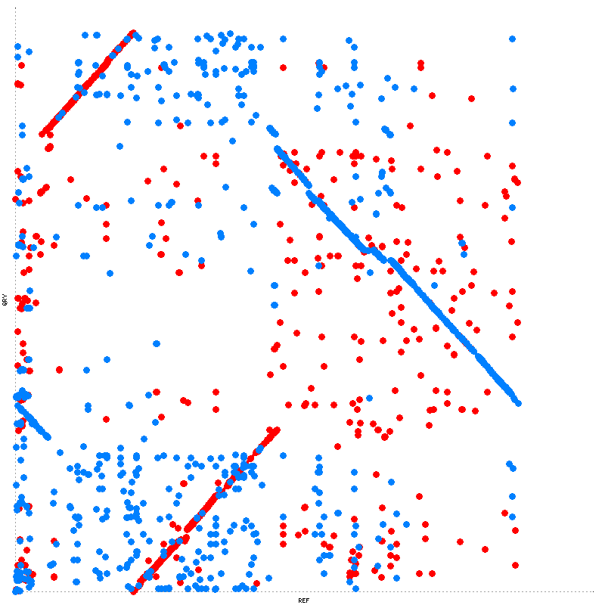
MUmmerplot
The red lines represent synteny segment of conservation between the reference and assembled genome while the blue lines represent inversion between two genomes.

Slide 9
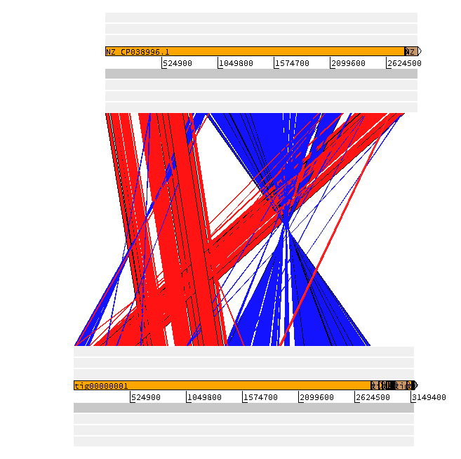
Homology Search
E. faecium E745 vs Reference E. faecium
Synteny comparison with a closely related genome
The red color shows homology. The blue line shows where the DNA is the reverse complimented (an inversion) between two genomes Synteny – look into region that are shared between genomes look at the big blocks

Slide 10
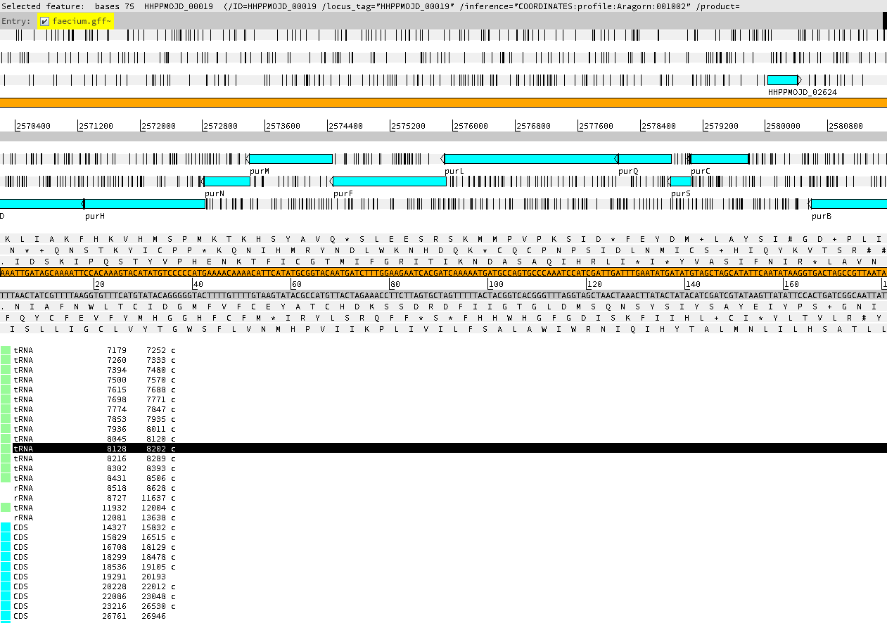
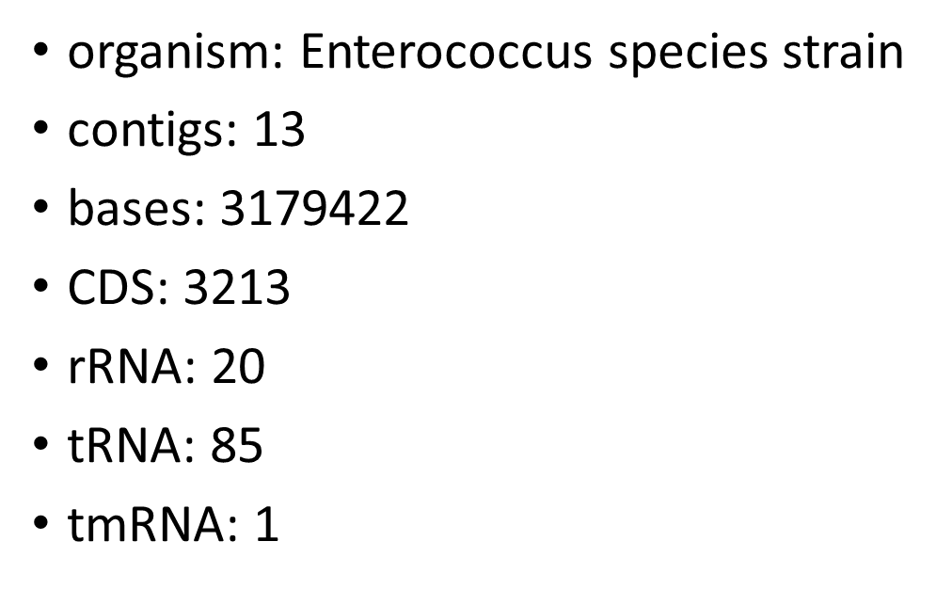
Annotation
<Feature tig00000001
885 244 CDS
db_xref COG:COG1455
gene licC_1
inference ab initio prediction:Prodigal:002006
inference similar to AA sequence:UniProtKB:P46317
locus_tag HHPPMOJD_00001
product Lichenan permease IIC component
1410 proteins as 'hypothetical protein

Slide 11
Transcriptomics
Mapping, counting reads, compare E. faecium in Rich Medium vs Human Serum
BWA (index, mem)
Samtools (sort, index)
Mapping RNA reads
into assembled genome
HTSeq
Count number of transcripts mapped to each gene
DeSeq2 RStudio
Differential expression Plots

Slide 12
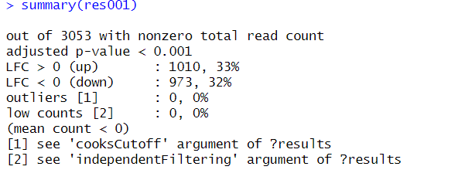
DeSeq2
531 genes was significantly expressed between cultures at (q < 0.001 and a fold change in expression of >2)
In the published article 860 genes exhibited significantly (q < 0.001 and a fold change in expression of >2 between cultures grown in BHI versus heat-inactivated serum) different.

Slide 13
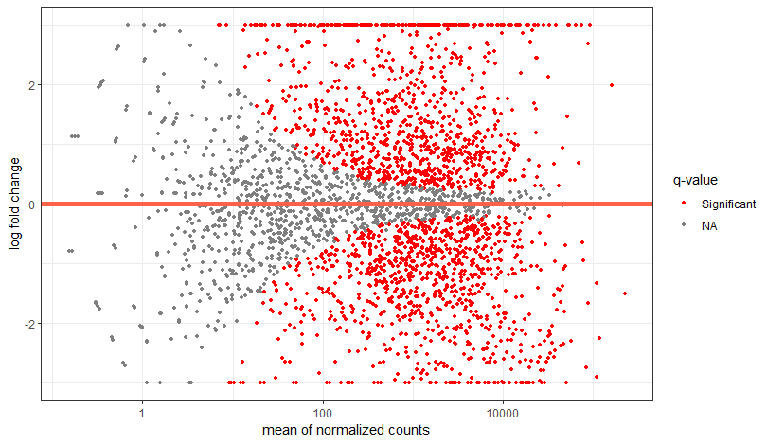
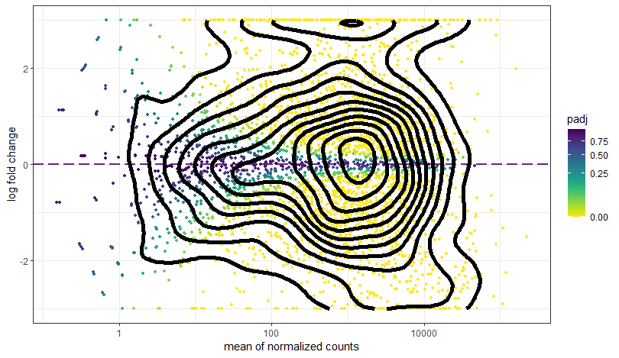
MA plot
An MA plot with a high number of data points falling above the one threshold on the y-axis would indicate a more significant number of genes being upregulated, while more below −1 would indicate high levels of downregulation in genes.

Slide 14
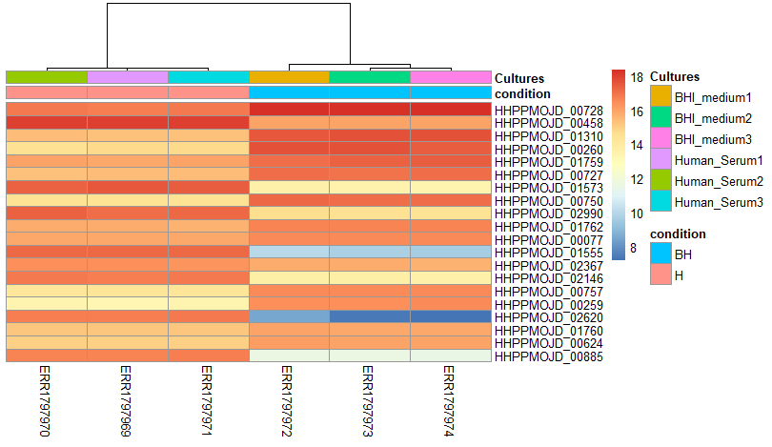
Heatmap
locus_tag | gene | product | GO terms
HHPPMOJD_00728 | tuf_1 | Elongation factor Tu | Biological function (polypeptide elongation process of protein synthesis)
HHPPMOJD_00458 |  | hypothetical protein
HHPPMOJD_01310 | fba | Fructose-bisphosphate aldolase | Biological process (Glycolysis)
HHPPMOJD_00260 | rplJ | 50S ribosomal protein L10 | Molecular function (Repressor, Ribosomal protein)
HHPPMOJD_01759 | gap_1 | Glyceraldehyde-3-phosphate dehydrogenase | Biological process (Glycolysis)
HHPPMOJD_00727 | fus | Elongation factor G | Molecular function (translation elongation factor activity)
HHPPMOJD_01573 | folT_1 | Folate transporter FolT | Biological process (Transport of protein and molecule)
HHPPMOJD_00750 | secY | Protein translocase subunit SecY | Biological process (Protein transport)
HHPPMOJD_02990 |  | hypothetical protein
HHPPMOJD_01762 | eno | Enolase | Biological process (Glycolysis), Transcription, Transcription regulation)
HHPPMOJD_00077 | ptsI | Phosphoenolpyruvate-protein phosphotransferase | Biological process ( Phosphotransferase system)
HHPPMOJD_01555 | dppE | Dipeptide-binding protein DppE | Dipeptide transport system
HHPPMOJD_02367 | pbp | Beta-lactam-inducible penicillin-binding protein | Biological process
HHPPMOJD_02146 | argS | Arginine--tRNA ligase | Biological process (Protein biosynthesis)
HHPPMOJD_00757 | rplQ | 50S ribosomal protein L17 | Molecular function
HHPPMOJD_00259 | rplL | 50S ribosomal protein L7/L12 | Molecular function
HHPPMOJD_02620 | purL | Phosphoribosylformylglycinamidine synthase subunit PurL | Biological process (Purine biosynthesis)
HHPPMOJD_01760 | pgk | Phosphoglycerate kinase | Biological process (Glycolysis)
HHPPMOJD_00624 | rpoB | DNA-directed RNA polymerase subunit beta | Molecular function (Nucleotidyltransferase, Transferase
HHPPMOJD_00885 | adhE | Aldehyde-alcohol dehydrogenase | Molecular function (Multifunctional enzyme)
Top 20 genes with the largest difference in expression between the two environments

Slide 15
Discussion
Many genes involving in glycolysis (glycolytic genes) gapA, pgk, fba and eno were highly expressed in Rich Medium BHI
Carbohydrate degradation genes (gap_1, pgk,fba),gene that involves in two metabolic pathways (eno) (conversion of D-2-phosphoglycerate (2PGA) and phosphoenolpyruvate (PEP) in glycolysis and gluconeogenesis) showed effect on growth of E.faecium
Glycolysis pathways involve breaking down glucose to lactate or pyruvate, resulting in energy stored in the form of adenosine triphosphate (ATP)
It produce energy during stress environment such as nutrient limitation.

Slide 16
Discussion
The genes that showed effect on growth of E. faecium in serum included genes that are involved in carbohydrate phosphotransferase system (PTS) (ptsL), protein biosynthesis (argS) and genes that involved in the biosynthesis of purine and pyrimidine nucleotides (purL)
Two hypothetical proteins (HHPPMOJD_00458 and HHPPMOJD_02990) highly expressed in human serum
purL gene which participates in Phosphotransferase system and plays a role as a major carbohydrate transport system in bacteria was highly expressed in human serum than rich medium BHI

Slide 17
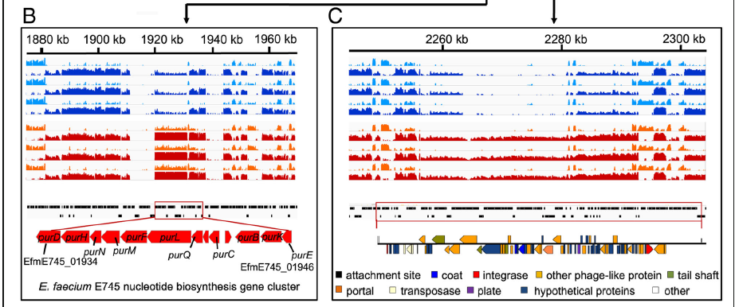
In Article
Biosynthetic gene clusters (BGCs) are responsible for the production of various secondary metabolites that contribute to interference competition between different microbes, and usually provide resistance against the self-produced antibiotic to protect the host cell

Slide 18
Conclusion
Canu was a good assembler (long reads)
Few genes were detected compared to the Article
Difference in analysis tools

