Slide 1



Slide 2

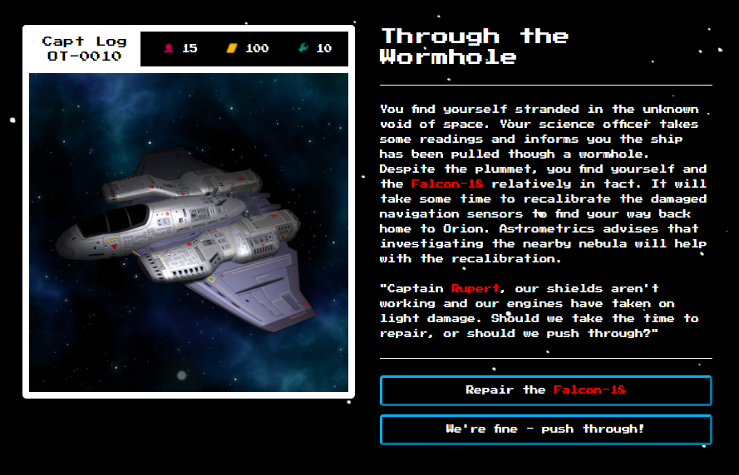

Slide 3
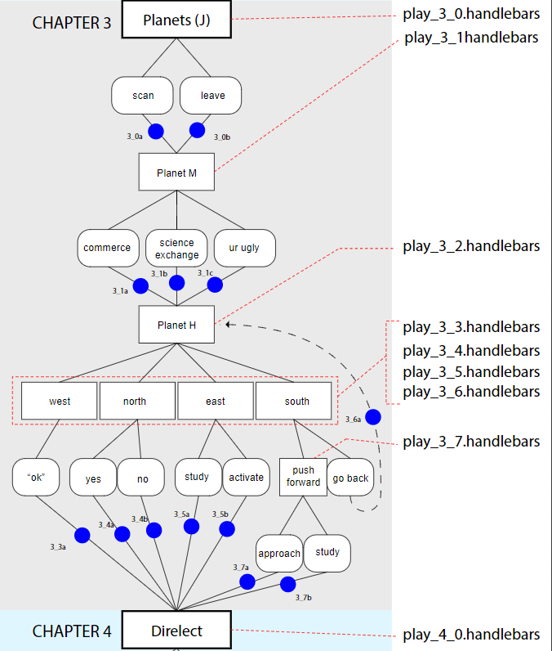

Slide 4




— To dynamically load content
— To dynamically load content
— To organize our file system
— New technology
— From the ground up

Slide 5

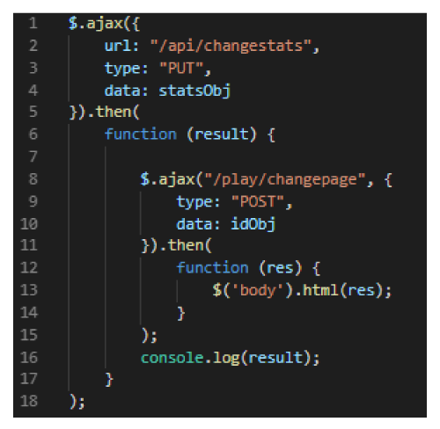

Stats to change
Page navigation
Data-scrap = “55”
Data-crew = “-4”
Data-prof = “0”
Data-chap = “2”
Data-page = “2a”
Render
play_2_2a.handlebars

Slide 6

Modular Design

Slide 7
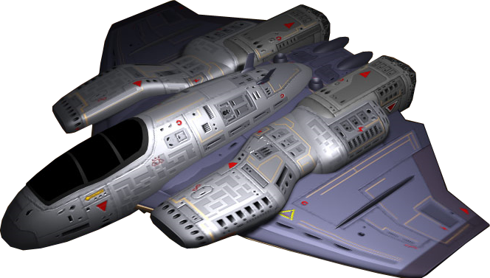

Slide 8
Ice Box Design
— User login to store progress
— A “stats” column
— Dynamic endings based on choices
— Player inventory table to add items
— Fully modular

