Slide 1
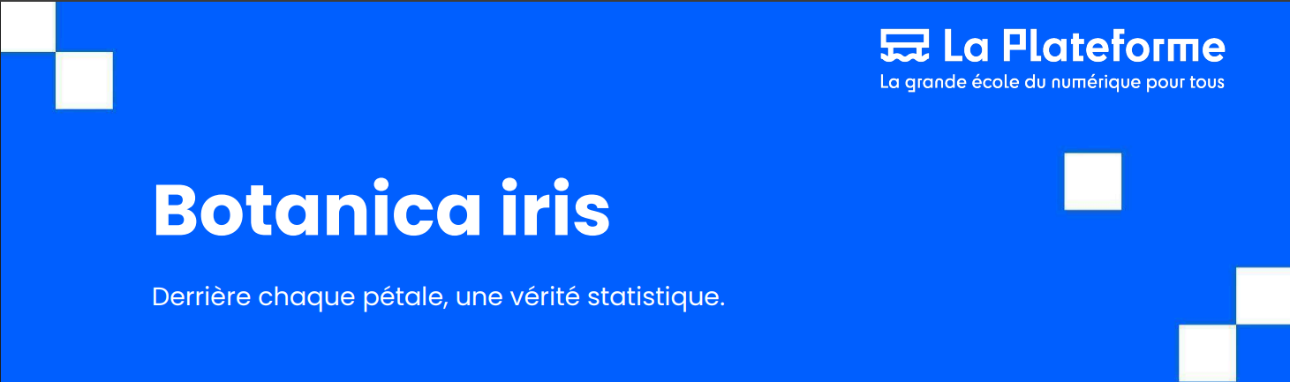
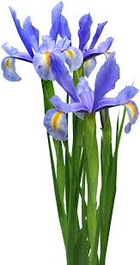
EXPLORATORY DATA ANALYSIS
Presented by: Redha & Rooney
10/06/2025
Supervisor: AKRAM

Slide 2
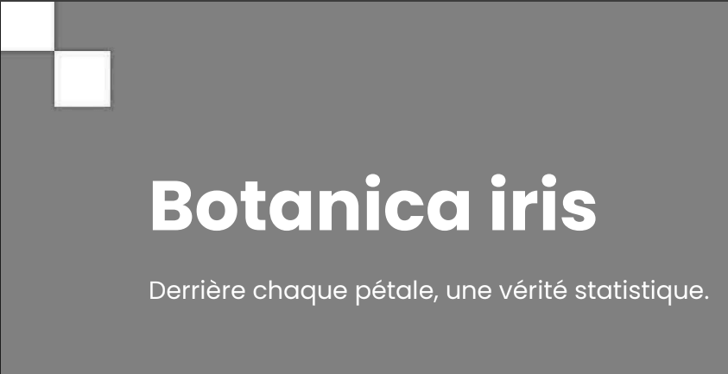
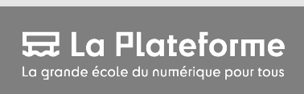

Outline
1. Project Objective & Approach
2. Data Structure & Preparation
3. Descriptive Statistics
4. Outlier Detection
5. Correlation & Visualization
6. Can We Predict Species?
7. Conclusion & Insights
Presented by: Redha & Rooney
10/06/2025

Slide 3
1. Project Objective & Approach
Objective: Analyze the Iris dataset to understand the structure, relationships, and differences between three species of flowers.
Approach: Use R for descriptive statistics, visualization, and detection of outliers/patterns.
Presented by: Redha & Rooney
10/06/2025

Slide 4
2. Data Structure & Preparation
The dataset contains :
150 flowers from three species (setosa, versicolor, virginica).
Variables: Sepal.Length, Sepal.Width, Petal.Length, Petal.Width (all numeric), plus Species (category).
No missing or duplicate values detected.
Distribution of species:50 Setosa, 50 Versicolor, 50 Virginica
Presented by: Redha & Rooney
10/06/2025

Slide 5
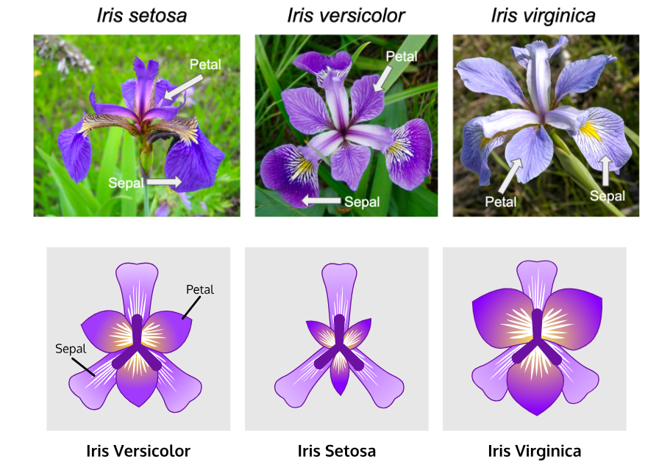
2. Data Structure & Preparation
Presented by: Redha & Rooney
10/06/2025

Slide 6
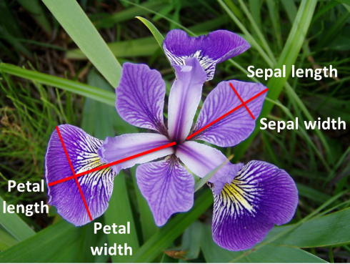
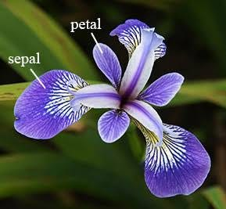
2. Data Structure & Preparation
Presented by: Redha & Rooney
10/06/2025

Slide 7
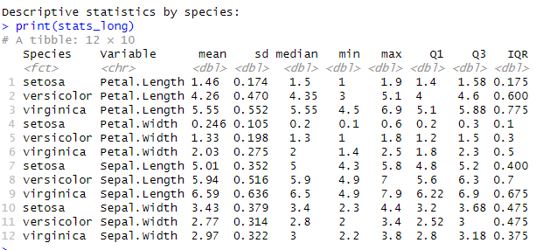
3. Descriptive Statistics
Means, Medians, Quartiles, Ranges, and Standard Deviations for each species and variable.
Presented by: Redha & Rooney
10/06/2025

Slide 8
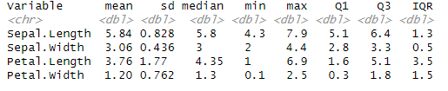

3. Descriptive Statistics
Means, Medians, Quartiles, Ranges, and Standard Deviations for each species and variable.
Presented by: Redha & Rooney
10/06/2025

Slide 9
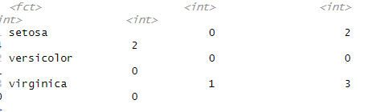
4. Outlier Detection
Outlier rule: Points outside 1.5*IQR from the first/third quartile.
Presented by: Redha & Rooney
10/06/2025

Slide 10

5. Correlation & Visualization
Presented by: Redha & Rooney
10/06/2025

Slide 11
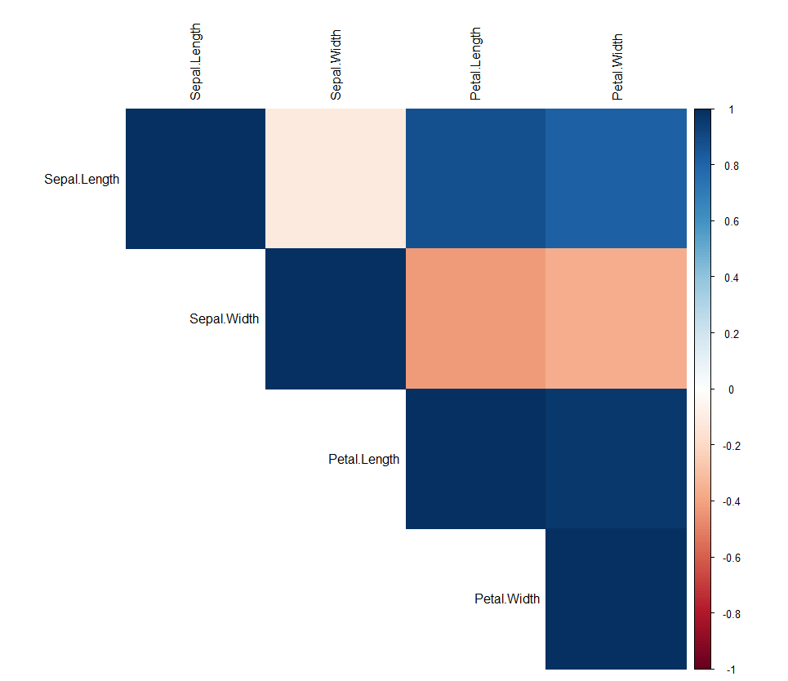
5. Correlation & Visualization
Correlation matrix:
Interpretation: Petal.Length and Petal.Width are strongly correlated
(r ≈ 0.96).
Correlation heatmap:
Presented by: Redha & Rooney
10/06/2025

Slide 12
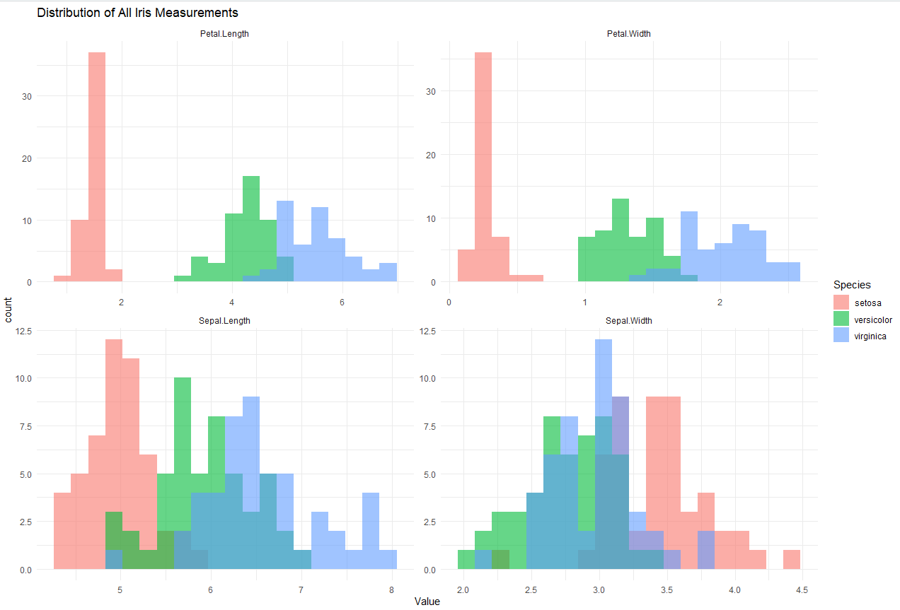
5. Correlation & Visualization
Presented by: Redha & Rooney
a. Histograms (All Variables, by Species)
10/06/2025

Slide 13
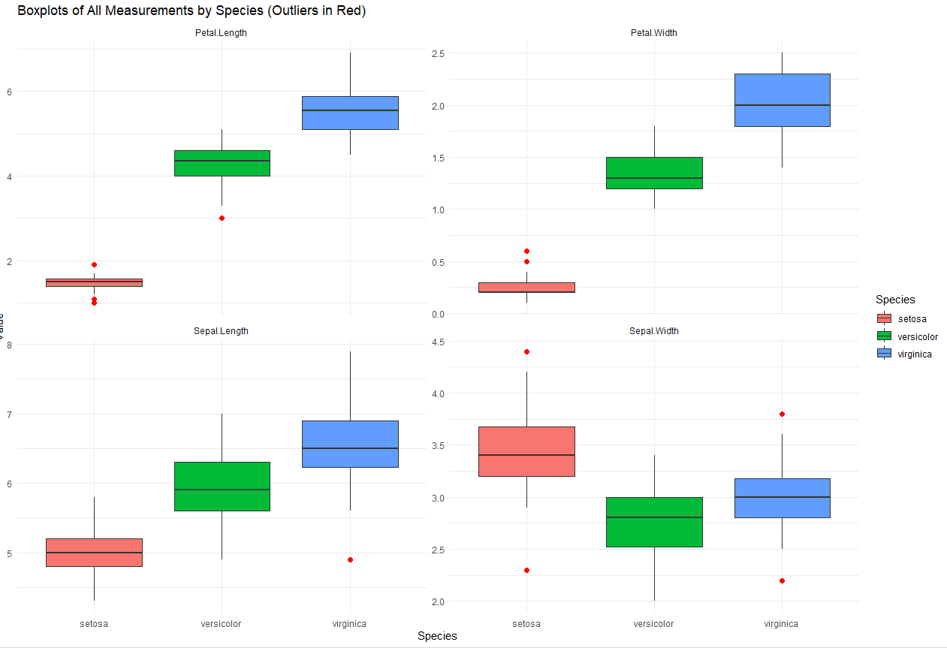
5. Correlation & Visualization
b. Boxplots (All Variables, by Species)
Presented by: Redha & Rooney
10/06/2025

Slide 14
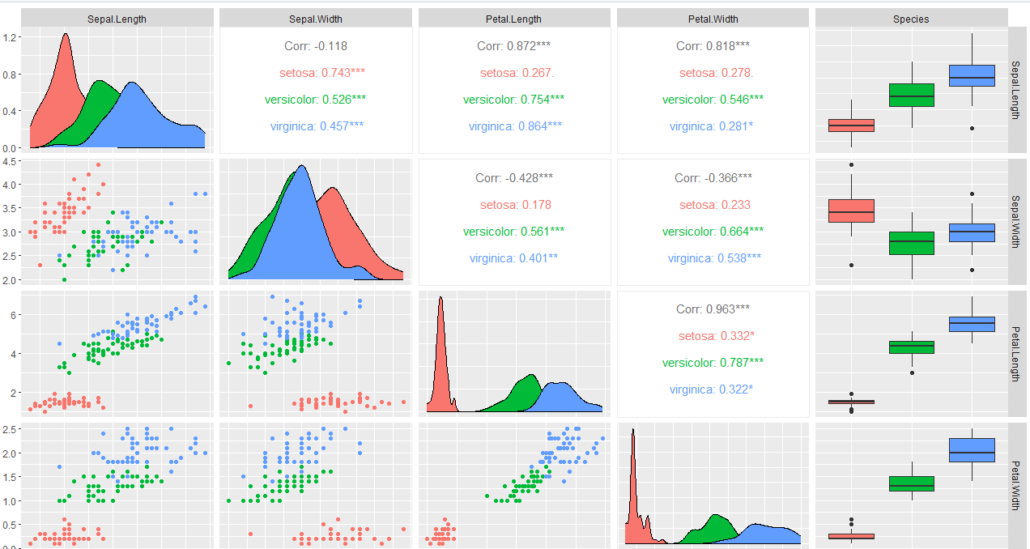
5. Correlation & Visualization
c. Pairwise Plots
Presented by: Redha & Rooney
10/06/2025

Slide 15
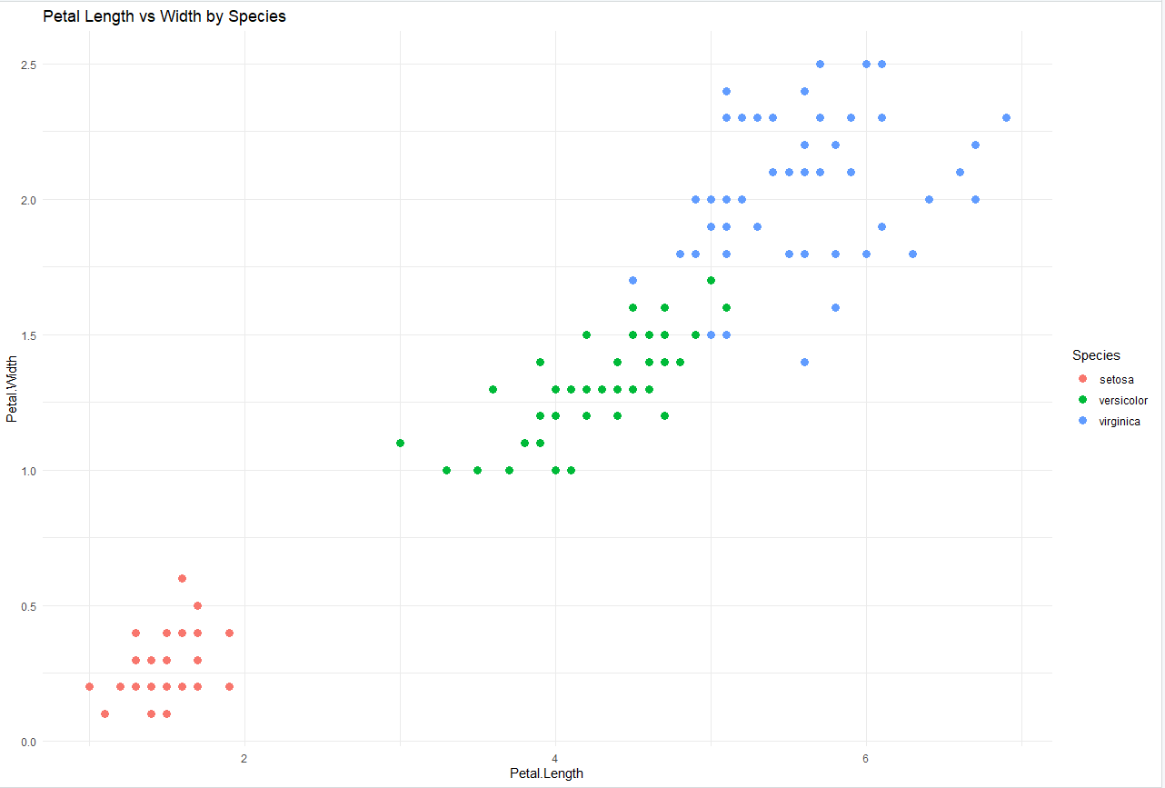
5. Correlation & Visualization
d. Scatter Plot: Petal.Length vs Petal.Width
Presented by: Redha & Rooney
10/06/2025

Slide 16
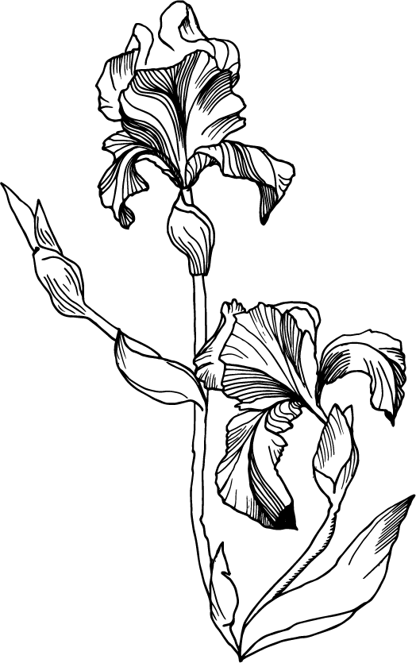

6. Can We Predict Species?
Presented by: Redha & Rooney
10/06/2025

Slide 17
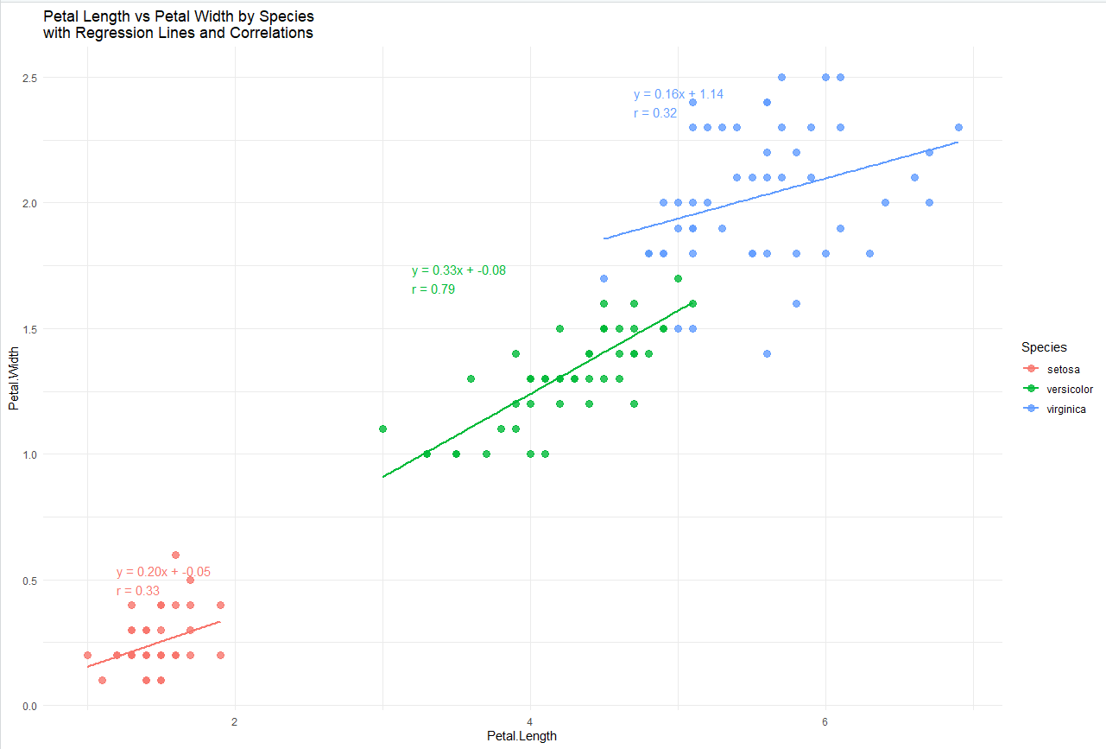
6. Can We Predict Species?
Presented by: Redha & Rooney
10/06/2025

Slide 18
6. Can We Predict Species?
Presented by: Redha & Rooney
10/06/2025

Slide 19
7. Conclusions
Findings:
Data is clean, with few outliers.
Petal measurements are highly informative.
Setosa is easily distinguishable.
Some overlap between Versicolor and Virginica, but overall good separation.
With R2 0.79 versicolor is the most predictible
Petal lenghth <4.5 and Width less than 1.5 very predictible.
Recommendation:
Petal.Width and Petal.Length are the best predictors for species.
With cluster analysis and machine learning we may improve prediction.
Presented by: Redha & Rooney
10/06/2025

