Slide 1
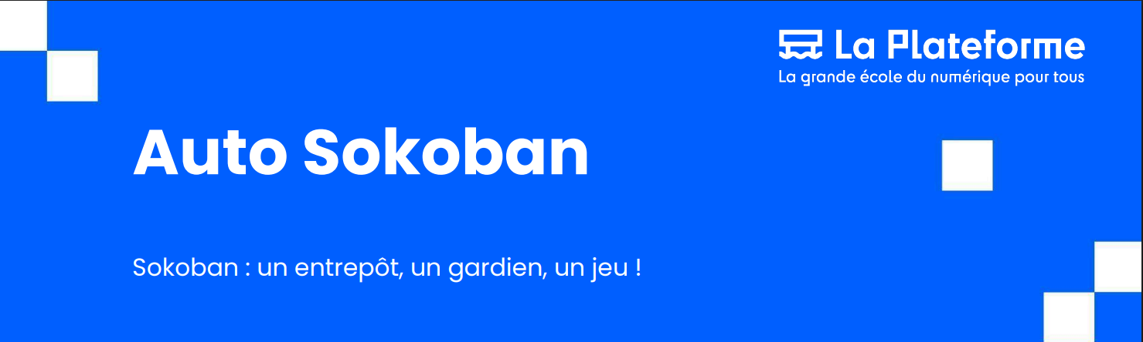
A feature-rich game with an integrated AI solver
Presented by: Redha & Rooney
03/07/2025
Supervisor: TRISTAN

Slide 2
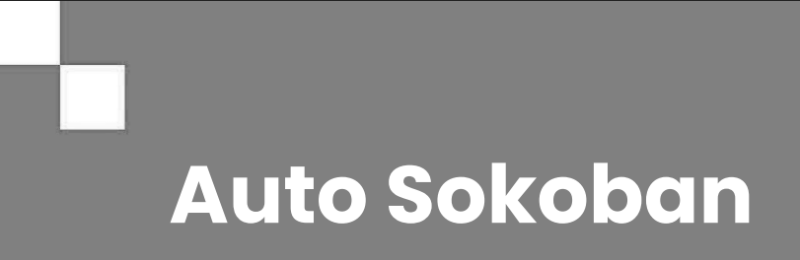

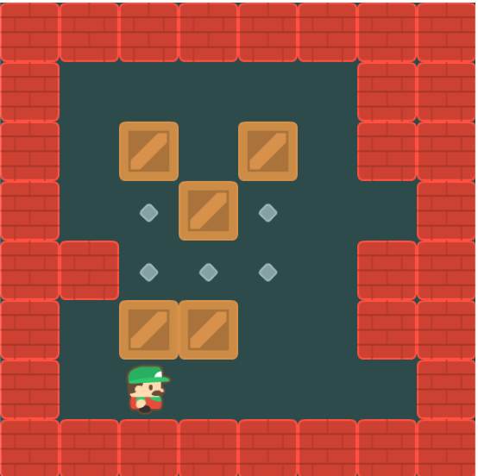
Project Overview & Objectives
Goal: To develop a complete Sokoban game
from scratch using Python
and Pygame.
Core Requirements:
Part 1: An "intelligent" solver.
An algorithm (BFS/DFS) to find the shortest solution.
A feature to visualize the solution step-by-step.
Part 2: A fully playable game.
User-controlled character.
Core puzzle mechanics (pushing, not pulling).
Essential features: multiple levels, undo, restart, music, and a player ranking system.
Presented by: Redha & Rooney
03/07/2025

Slide 3




BFS VS DFS
✅ BFS (Breadth-First Search)
Speed: Can be slower in big spaces because it explores many states level by level.
Shortest Path: Always finds the shortest path (least moves) because it goes layer by layer.
✅ DFS (Depth-First Search)
Speed: Can be faster if the solution is deep and lucky, but can also get stuck exploring long, wrong paths.
Shortest Path: Does not guarantee the shortest path, since it dives deep before trying other options.
👉 In short:
BFS = guaranteed shortest but can be slow.
DFS = might be faster but path is not guaranteed to be shortest.
Presented by: Redha & Rooney
03/07/2025

Slide 4
The AI Solver (Part 1)
Finding the Optimal Path
The Challenge: Find the shortest sequence of moves to solve any given level.
Our Algorithm Choice: Breadth-First Search (BFS)
We chose BFS over DFS because it explores the "game state tree" level by level.
This guarantees that the first solution it finds will be the one with the fewest moves.
Presented by: Redha & Rooney
03/07/2025

Slide 5
How does our BFS work?
Loop over steps: We keep searching until we reach a maximum number of steps.
Take from the queue: Grab the oldest board we haven’t explored yet.
Check for a win: See if we solved the puzzle! If yes, we stop.
Try moving: Look at all 4 directions (up, down, left, right).
If the move is OK, keep going.
If it hits a wall, ignore it.
Avoid repeats: We make sure not to look at the same board twice.
Add to the queue: Put the new board in line to explore it next.
Presented by: Redha & Rooney
03/07/2025

Slide 6
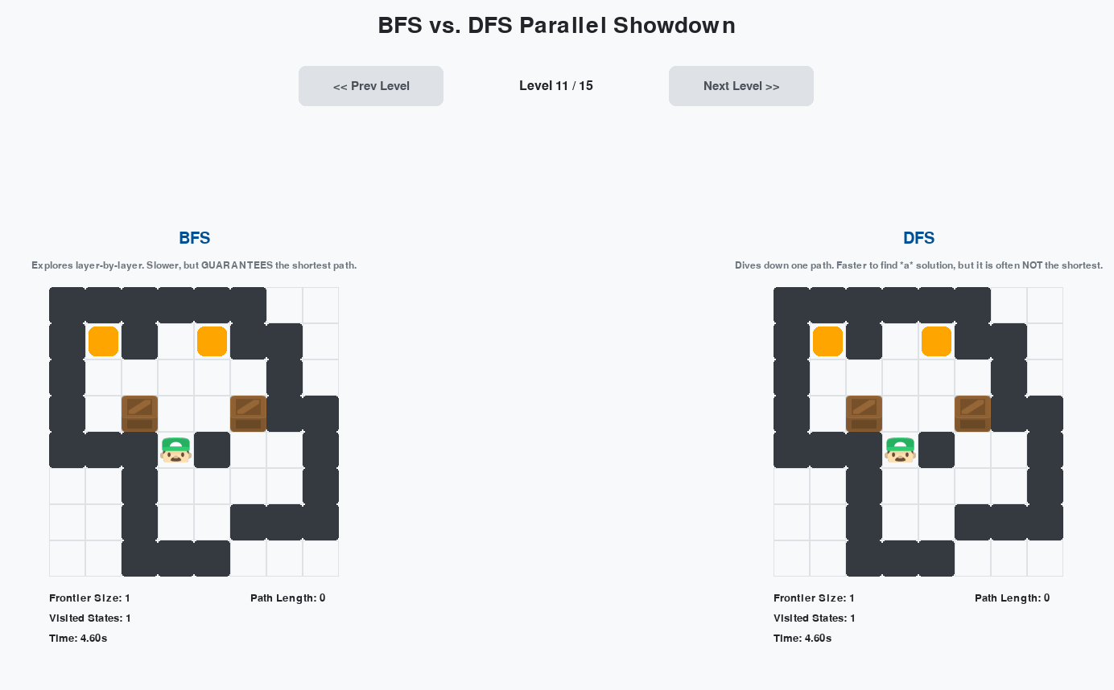
Algorithm Showdown: The BFS vs. DFS Visualizer
Purpose:
An interactive educational tool to demonstrate why BFS was chosen as the core solver for our game.
What it Does:
Live Side-by-Side Comparison: Runs BFS and DFS algorithms on the same Sokoban level simultaneously, visualizing their search process in real-time.
Demonstrates Key Trade-Offs:
Presented by: Redha & Rooney
03/07/2025

Slide 7
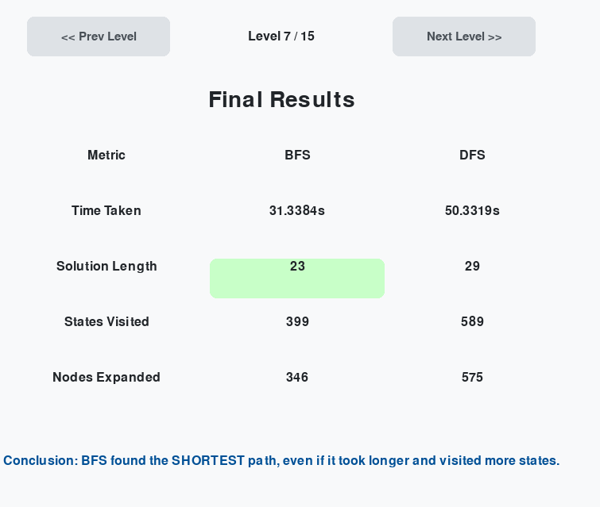
Algorithm Showdown: The BFS vs. DFS Visualizer
Purpose:
An interactive educational tool to demonstrate why BFS was chosen as the core solver for our game.
What it Does:
Live Side-by-Side Comparison: Runs BFS and DFS algorithms on the same Sokoban level simultaneously, visualizing their search process in real-time.
Demonstrates Key Trade-Offs:
Presented by: Redha & Rooney
03/07/2025

Slide 8


Our Solution: A Modern Architecture
How We Built It?
The assignment suggested a build-game.py and display-game.py structure. We opted for a more modular and scalable design to separate concerns effectively:
- main.py: The application's entry point and main game state manager.
- ui.py: The Display Layer. Manages all rendering, user interaction, and screens (menus, game, editor).
- game.py: The State Layer. Manages the state of a specific game session (current board, moves, timer, player data).
- core.py: The Logic Layer. Contains pure, stateless functions for game rules (move(), is_win()).
- solver.py: The AI Brain. Houses the BFS algorithm.
- assets.py & config.py: Centralized management for all assets and settings.
Presented by: Redha & Rooney
03/07/2025

Slide 9

├── assets/ # Contains all images and sound files ├── custom_levels/ # User-created levels are saved here as .json ├── main.py # Main application entry point and game loop manager ├── ui.py # Handles all UI screens, rendering, and user input ├── game.py # Core game state, level management, and player data ├── core.py # Stateless game logic (move function, win check) ├── solver.py # BFS-based puzzle solver ├── assets.py # Asset loading and management class ├── config.py # Game configuration (FPS, tile size, colors) ├── constants.py # Game object enumerations (Wall, Box, etc.) ├── save_load.py # Helper functions for saving/loading JSON data ├── sokoban_save.json # Save file for player profiles and scores └── requirements.txt # Python package dependencies └── README.md # This file
Presented by: Redha & Rooney
03/07/2025

Slide 10


Gameplay Features (Part 1 )
Creating a Complete Player Experience
✓ Dynamic Gameplay: Fluid movement, box pushing, and collision detection.
✓ Essential Controls: Fully implemented Undo (Z/U) and Restart (R) functions.
✓ Rich Content: A large set of pre-built levels and support for community-made maps.
✓ Immersive Audio: Background music for menus and specific sound effects for in-game actions
✓ Player Progression: A robust saving system (.json) tracks stars per level for multiple player profiles.
✓ Competitive Spirit: A high-score screen ranks all players by total stars earned.
Presented by: Redha & Rooney
03/07/2025

Slide 11
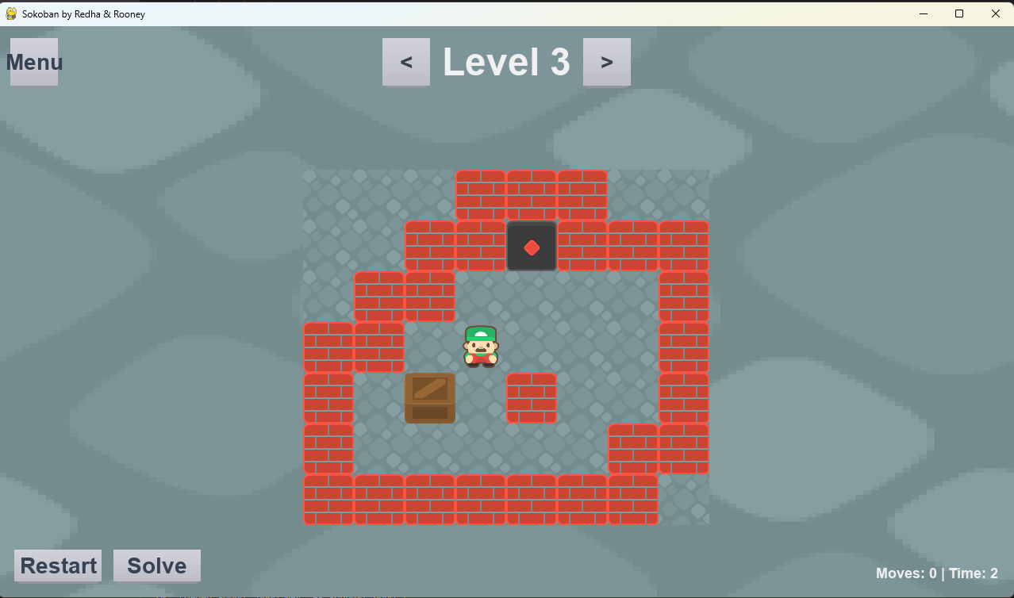
Feature Highlight: The Level Editor
Beyond the Assignment: Fostering Creativity
To make the project truly special, we added a complete in-game level editor.
Features:
Intuitive UI: Simple paint/stamp tools to design a layout.
Real-time Validation: The editor checks for valid rules (1 player, equal boxes/targets).
Solvability Check: On saving, the editor automatically runs our BFS solver to ensure the level is not impossible before adding it to the community pool.
This dramatically increases the game's replayability.
(Tip: Show a screenshot of the level editor in action.)
Presented by: Redha & Rooney
03/07/2025

Slide 12
Live Demonstration
Presented by: Redha & Rooney
03/07/2025

Slide 13
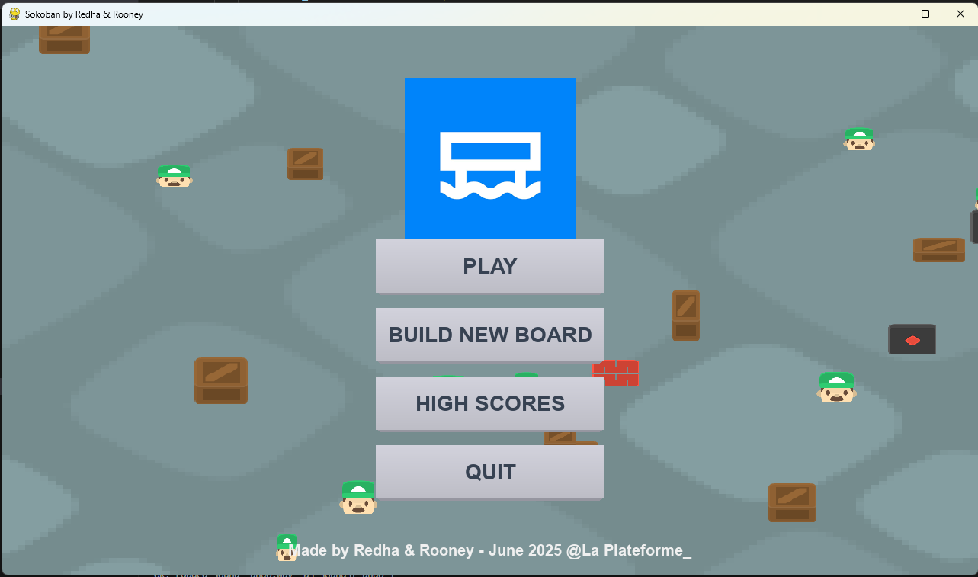
Project Summary
We successfully developed a complete and polished Sokoban game that meets all requirements of the assignment.
Our modular architecture proved effective for managing complexity and adding new features.
We not only implemented the core game and AI solver but also extended the project with significant features like a level editor and a persistent player ranking system.
The project was a fantastic exercise in game logic, UI design, and fundamental AI search algorithms.
Presented by: Redha & Rooney
03/07/2025

Slide 14
The Main BFS Loop
for _ in range(max_iters):: The main loop that drives the search, limited by max_iters.
if not queue: break: If the queue becomes empty, it means we have explored every reachable state from the start position and none of them was a winning state. The level is unsolvable.
current_board, path = queue.popleft(): This is the core of BFS. It retrieves the oldest un-explored state from the front of the queue.
if is_win(current_board, target_mask): return path: Checks if the current state is a solution. If it is, the path taken to get here is returned. Because BFS explores layer-by-layer, the first solution found is guaranteed to be one of the shortest in terms of move count.
for direction in [(-1, 0), (1, 0), (0, -1), (0, 1)]:: It iterates through the four possible moves (Up, Down, Left, Right).
next_board = move(...): Attempts to perform a move. The move function returns the new board state if the move is valid, or None if it's invalid (e.g., moving into a wall).
if next_board is not None:: Proceeds only if the move was valid.
key = get_board_key(next_board): Creates a unique key for the new board state.
if key not in visited:: This is the check to prevent cycles and redundant work. If we have never seen this state before:
visited.add(key): Mark it as visited.
queue.append((next_board, path + [direction])): Add the new state and its updated path to the end of the queue for future exploration.
Presented by: Redha & Rooney
03/07/2025

