Slide 1
Git and GitHub

Slide 2
Before we start…
<number>

Slide 3
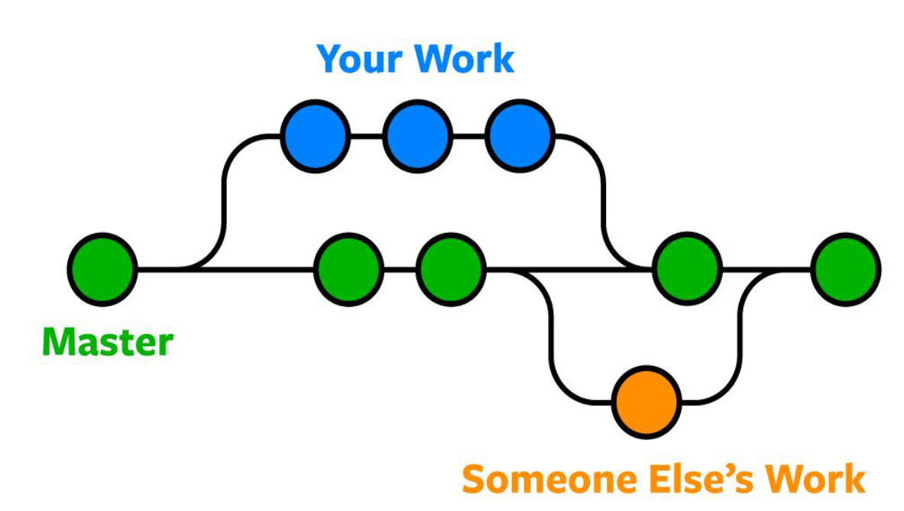

Introduction to today’s topic
What is git and GitHub used for?
to version your code
to collaborate
to store data

Slide 4
Git vs GitHub
Git
Git is a distributed version control system.
It helps you manage changes to your codebase over time.
It allows you to track revisions, collaborate with others, and easily revert to previous states.
GitHub
GitHub is a web-based platform that leverages Git for hosting and sharing repositories.
It offers collaborative tools, issue tracking, and a platform for showcasing your coding portfolio.
Alternatives:
There are other version control systems like Mercurial and web services like GitLab and Bitbucket. Each has its strengths and use cases.
<number>

Slide 5
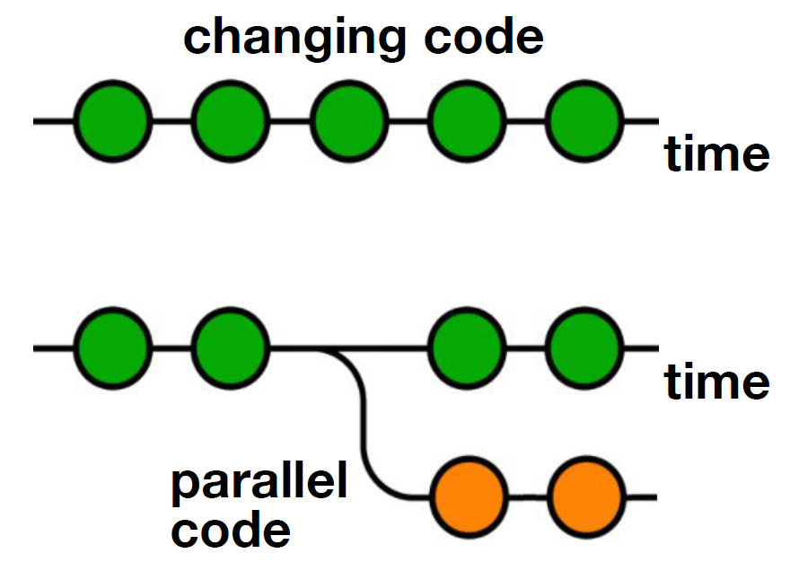

Version Control System
The code which is stored in git keeps changing as more code is added.
Also, many developers can add code in parallel.
<number>

Slide 6
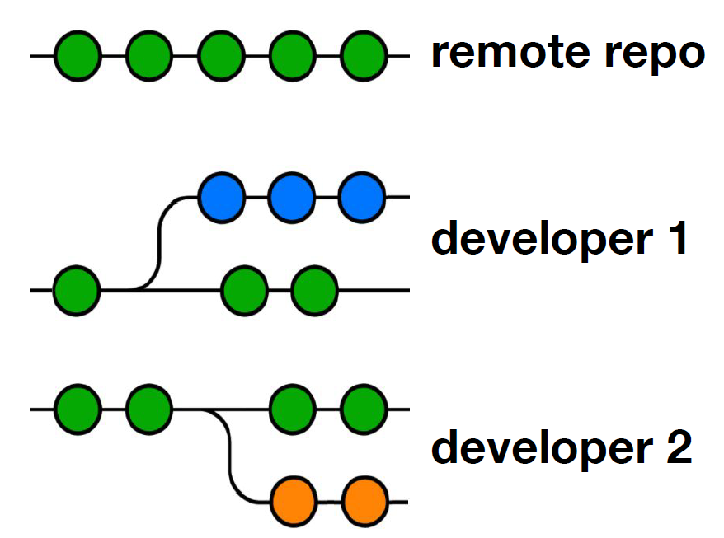
Distributed Version Control System
Git has a remote repo which is stored on a server and local repositories which are stored on the computer of each developer.
<number>

Slide 7

Workflow
<number>

Slide 8
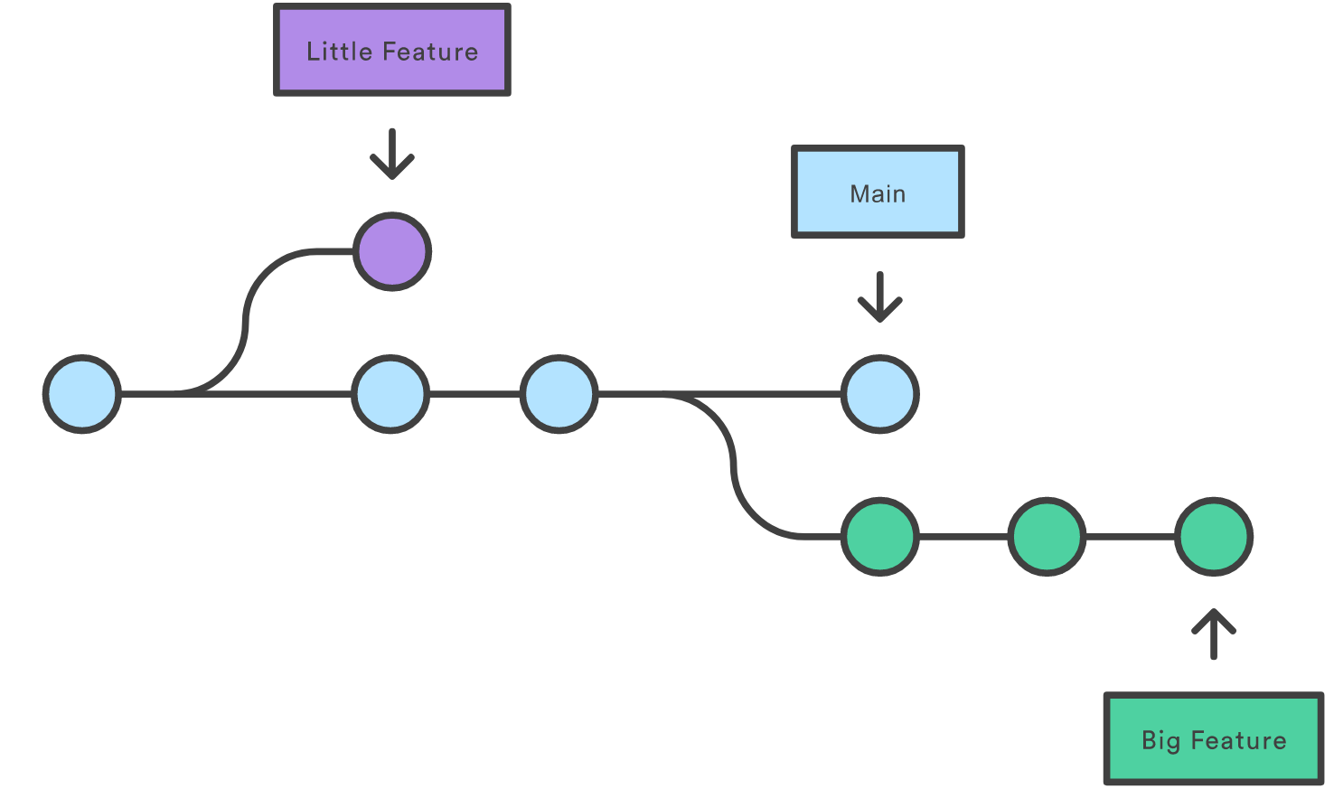
1. Branch
Branches to work on specific features or fixes without affecting the main codebase. Branches allow you to experiment and add new functionality.
<number>

Slide 9
2. Commit
Snapshots of your code at a specific point in time. Each commit should represent a single logical change, and commit messages provide context.
<number>

Slide 10
3. Pull Request
Pull requests facilitate code review and collaboration.
It’s the way to propose changes to the main branch and seek approval before merging.
<number>

Slide 11
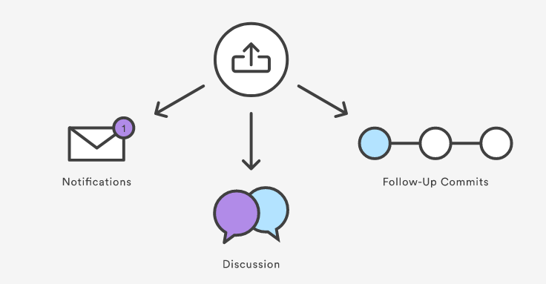
4. Collaborate
Collaboration often involves receiving feedback and making modifications based on comments. The goal is to ensure the quality of the code being merged.
<number>

Slide 12
5. Merge
Merging is the process of integrating changes from a branch into the main "production" branch.
This step ensures that new features or fixes become part of the project.
<number>

Slide 13
Workflow for Open Source
Usually you don’t have rights to create the branch in the repo.
But you can fork it under your own account, modify and then propose as a pull request.
<number>

Slide 14
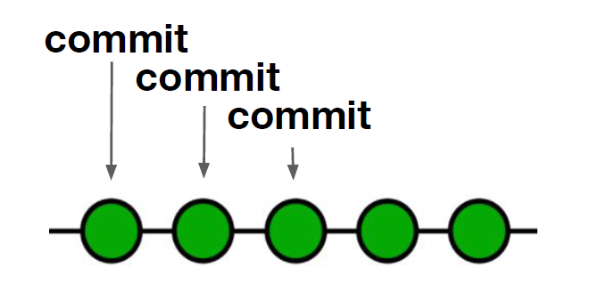

More on commit
At some point in time a developer can store a snapshot of the current code state;
This is called a commit.
<number>

Slide 15
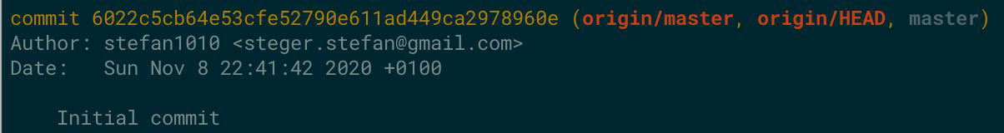
More on commit
Every commit is uniquely identified by a commit id
The developer should add a meaningful commit message
Stored with the commit is metadata like the author and
date of the commit
<number>

Slide 16
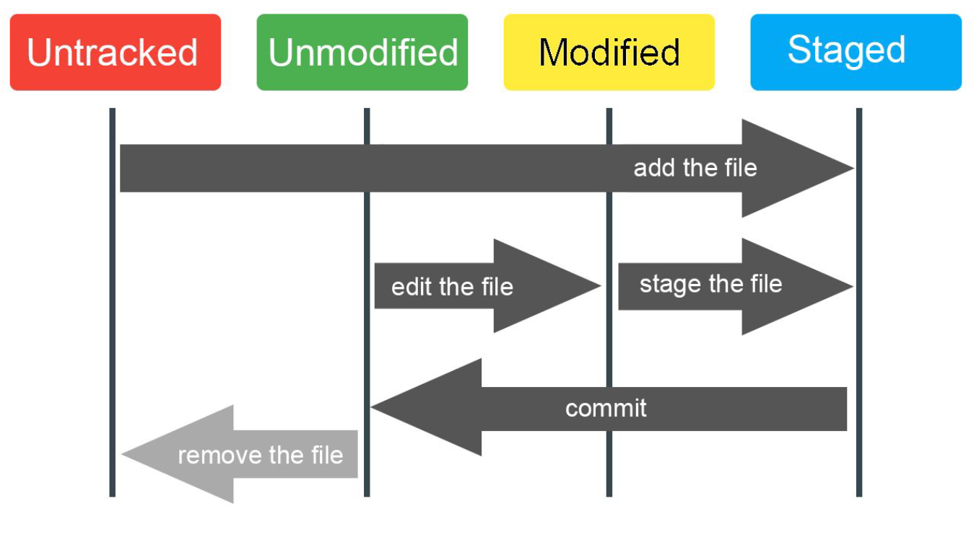
Photo caption or description.
<number>

Slide 17
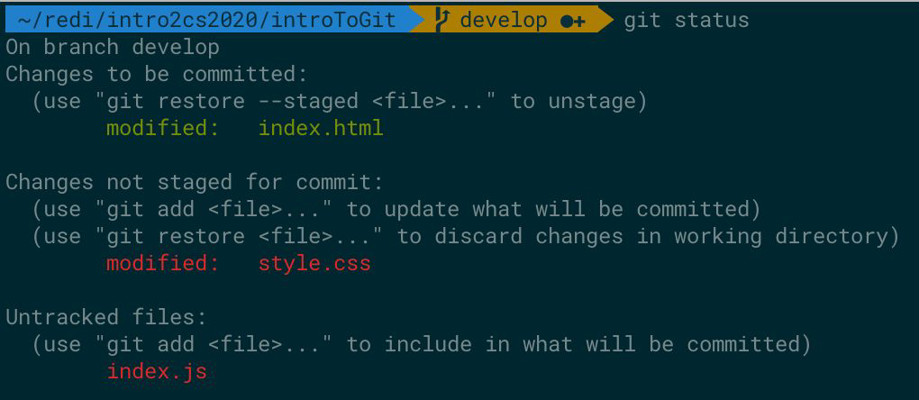
More on commit
Staged changes will be committed
Modified changes will not be committed
Untracked (new) files will not be committed
<number>

Slide 18
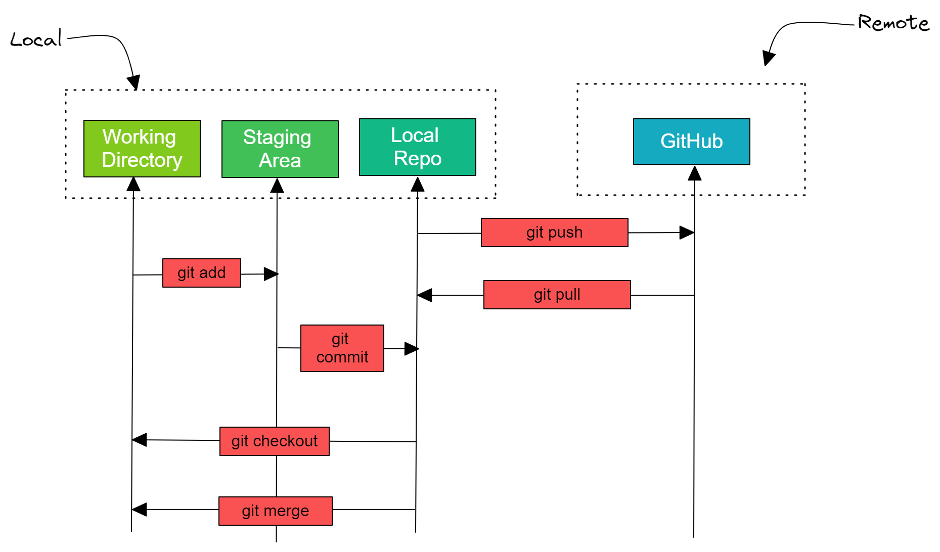
From: https://www.datacamp.com/tutorial/github-and-git-tutorial-for-beginners
<number>

Slide 19
Cloning repositories
When you clone a repository, you copy the repository from GitHub.com to your local machine:
The git pull command is used to fetch and download content from a remote repository and immediately update the local repository to match that content.
The git push command is used to upload local repository content to a remote repository.
<number>

Slide 20
Useful commands
git clone - https://git-scm.com/docs/git-clone
git pull - https://git-scm.com/docs/git-pull
git branch - https://git-scm.com/docs/git-branch
git checkout - https://git-scm.com/docs/git-checkout
git status - https://git-scm.com/docs/git-status
git add - https://git-scm.com/docs/git-add
git commit - https://git-scm.com/docs/git-commit
git push - https://git-scm.com/docs/git-push

Slide 21
Two-step commit process
Sometimes, you make changes in different parts of your project. Breaking these changes into several commits can help keep your commit history organized.
Learn how to use git add to choose specific files or changes to include in your commit. This allows you to group related changes together.
After adding specific files you can commit them.
<number>

Slide 22
Merging
To merge branches on GitHub you use pull requests.
On your local machine you use git merge.
You may have a merge conflict when you have a change in the same file in the same line on the two branches you are trying to merge together.
git status command will show more info, look there for merge.text file.
<number>

Slide 23

How to undo things
git revert – you are actually creating a new commit with exactly oposit changes to the commit you want to undo.
Other options:
git reset, git commit-amend, git cherry-pick
Please read documentation before using new commands!
Read more here: https://www.atlassian.com/git/tutorials/rewriting-history
<number>

Slide 24
Let’s take a break!
<number>

Slide 25
Let’s look at some examples!
<number>

Slide 26
Homework
<number>

Slide 27


Homework
Set up a GitHub account and create your first repo with a simple txt file.
You can initiate repo on your local machine or start by creating a remote repository first.
If you run into problems – google, then ask your classmates and tutor so we can google together.
<number>

Slide 28
Thanks a lot!
Questions?
<number>

