Slide 1
Git for Version Control
Notes:
https://medium.com/@lucasmaurer/git-gud-the-working-tree-staging-area-and-local-repo-a1f0f4822018
https://thoughtbot.com/blog/git-interactive-rebase-squash-amend-rewriting-history
https://www.atlassian.com/git/tutorials/merging-vs-rebasing

Slide 2
Version Control System Features
Collaborative Development
Data backup
Keeps records of folders and files and their history
Version Management
Keep records of your changes without duplication.
Access Control
History
Allows you to know who made what changes and when
Allows you to revert any changes and go back to a previous state
Branch Management

Slide 3
Git
A version control system for tracking changes in computer files
Coordinate work on those files among multiple people
primarily used for source code management in software development
Initially created by Linus Torvalds for development of the Linux Kernel
Pros
Most of the operations can be done locally, no need to connect to internet
Integrity
Excellent support for parallel development, support for hundreds of parallel branches
Fully compatible with Linux commands
Install Git
https://git-scm.com/downloads
Change Default VS Code As The Git Editor (Globally)
git config --global core.editor "code --wait"
Notes:
Git is not Github. Git is the version control software, and Github is a git repository hosting service which offers all the source code management provided in git. Github is where you upload your git repository.

Slide 4
Git Configuration
Designed to configure or read the corresponding environment variable
Can be stored in three different places
/etc/gitconfig file: The system for all users of general application configuration
C:/Program Files/Git/etc (the system config file location for Windows)
git config –system (command to add a new system config)
~/.gitconfig file: user profile directory apply only to that user.
C:/Users/rxing (the global config file location for Windows)
git config –global (command to add a new global config)
.git/config file: Git directory of the current project configuration file – use git init to add
H:/courses/MSD/445/Demos/.git (the local config file location for Windows)
git config (command to add a new local config)

Slide 5
Git Configuration
User Info
git config user.name tina
git config user.email rxing@miu.edu
View configuration information. If you don’t specify which of the configs you would like to see, you will get all 3 configs merged into the output in your console.
git config --list
git config --list --system
git config --list --global
git config --list --local

Slide 6
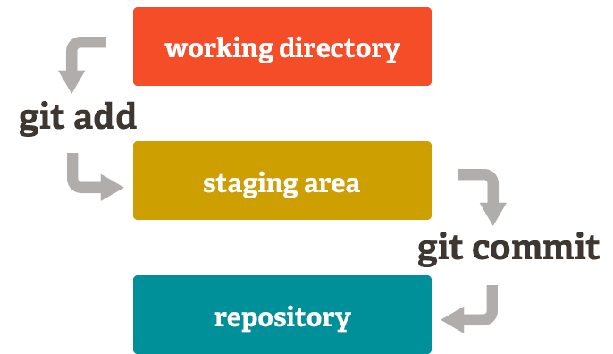
Git Main Components
Working Tree
Where you’re currently working, where your files live
“untracked” area of git
Git is not aware of the files or changes in the working tree until you tell it to pay attention to them.
Staging Area
Git starts tracking and saving changes that occurs in files
The saved changes reflect in the .git directory
Local Repo
Everything in your .git directory
All of your checkpoints or commits are in Local Repository
Don’t delete it.

Slide 7
Branch
A branch is when a new line of development is created that splits the main line of development. This alternative line of development can continue without altering the main line.
By default, any repo will have one master branch
The special HEAD pointer has a reference to currently Active Branch

Slide 8

Basic Operations

Slide 9
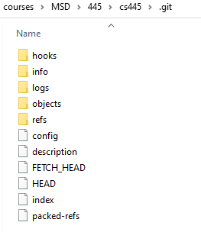
git init
Create a new, empty repository in the current directory.
It sets up all the necessary files and directories that Git will use to keep track of everything. All these files are stored in a directory called .git
This .git directory is the repo, it is where Git records all of the commits and keeps track of everything.

Slide 10
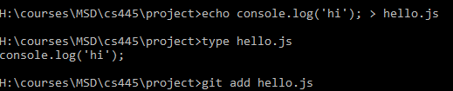
git add
Move files from the Working Directory to the Staging Area.
The period . can be used in place of a list of files to tell Git to add the current directory (and all nested files).

Slide 11
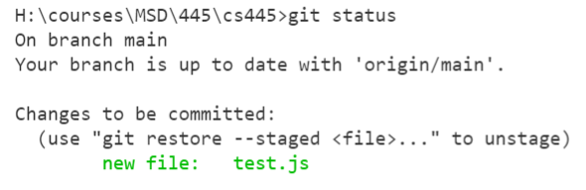
git status
Display the current status of the repository
The current Git Branch in your local repository
Tell us about new files that have been created in the Working Directory that Git hasn't started tracking, yet
Files that Git is tracking in the Staging area that have been modified

Slide 12
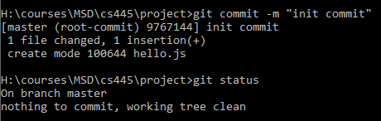
git commit -m "message"
Takes files from the Staging Area and saves them in the repository
A commit message should explain what the commit does (not how or why).
The goal is that each commit has a single focus. Each commit should record a single-unit change.
Do not use the word "and", if you have to use "and", your commit message is probably doing too many changes - break the changes into separate commits.

Slide 13
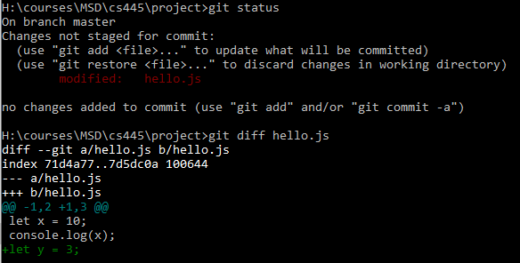
git diff
To see changes that have been made to files in the working area but haven't been added into staging area yet.

Slide 14
git log
Displays all the commits of a repository
git log view history
space – page down
b – page up
q - exit
git log --oneline lists one commit per line
git log --all --pretty=format:"%h %cd %s (%an)" --since="7 days ago" review changes made in the last week
git log --pretty=format:"%h %ad | %s%d [%an]" --graph --date=short
--pretty="..." defines the format of the output.
%h is the abbreviated hash of the commit
%d are any decorations on that commit (e.g. branch heads or tags)
%ad is the author date
%s is the comment
%an is the author name
--graph informs git to display the commit tree in an ASCII graph layout
--date=short keeps the date format nice and short

Slide 15
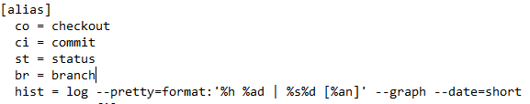
Aliases
Shortcuts for git commands
Change .gitconfig in global or project level as you want.
Make sure the value of property is single quote in config file.
git config --global alias.st status
git config alias.hist "log --pretty=format:'%h %ad | %s%d [%an]' --graph --date=short"

Slide 16
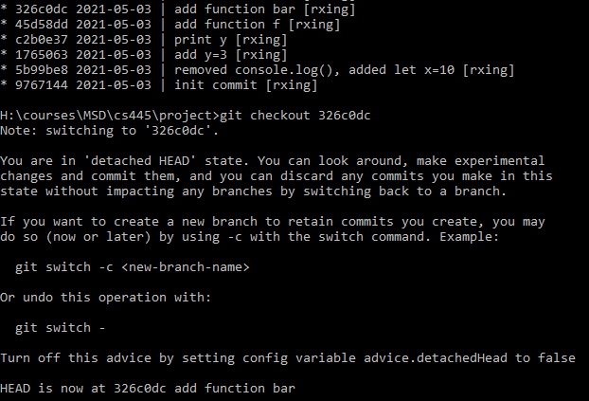
Get Old Versions
Checkout any previous snapshot into the working directory
Use the hashes for previous versions
git checkout <hash>
Return the latest version in the master branch
git checkout master
master is the name of the default branch

Slide 17
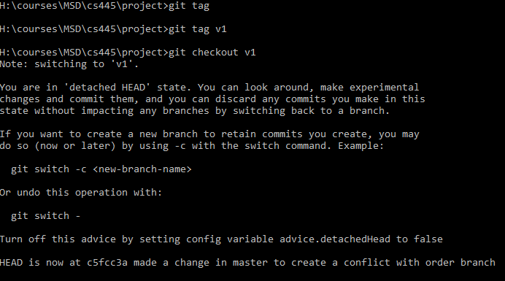
git tag -a <tagname>
Add a marker on a specific commit. The tag does not move around as new commits are added.
Tags can be viewed in log
git tag will display all tags that are in the repository.
git tag -a <tagname> -m <message> <SHA>
git tag -d <tagname> will delete a tag

Slide 18
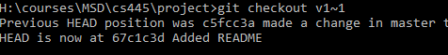

Tagging Previous Versions
Rather than look up the hash, we will use the ^ notation to indicate "the parent of v1".
If the v1^ notation gives you any trouble, you can also try v1~1, which will reference the same version. This notation means “the first ancestor of v1”.
Notes:
Windows: v1^ doesn’t work
The following indicate the parent commit of the current commit
HEAD^
HEAD~1
The following indicate the grandparent commit of the current commit
HEAD^^
HEAD~2

Slide 19
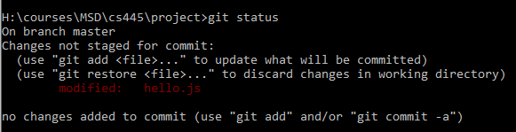
Undoing Local Changes (before staging)
Revert changes in the working directory
After making changes in working area, check status
Revert the changes in the working directory
Notes:
git checkout hello.js – also works

Slide 20
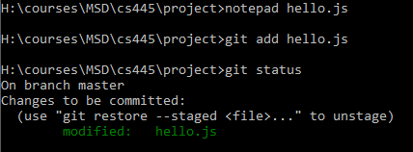
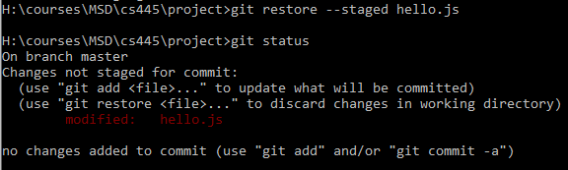
Undoing Staged Changes (before committing)
Revert changes that have been staged
Reset the Staging Area
Notes:
git reset HEAD hello.rb

Slide 21
Undoing Committed Changes
Revert changes that have been committed to a local repository.
To undo a committed change, we need to generate a commit that removes the changes introduced by our unwanted commit.
git revert HEAD
Since we were undoing the very last commit we made, we were able to use HEAD as the argument to revert. We can revert any arbitrary commit earlier in history by simply specifying its hash value.
The revert command of the previous section is a powerful command that lets us undo the effects of any commit in the repository. However, both the original commit and the “undoing” commit are visible in the branch history (using the git log command).

Slide 22
Removing Commits from a Branch
When given a commit reference (i.e. a hash, branch or tag name), the reset command will …
Rewrite the current branch to point to the specified commit
Optionally reset the staging area to match the specified commit
Optionally reset the working directory to match the specified commit
Our master branch now points to the v1 commit and other commits after v1 commit are no longer in the branch. The --hard parameter indicates that the working directory should be updated to be consistent with the new branch head.

Slide 23
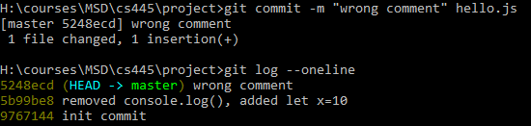
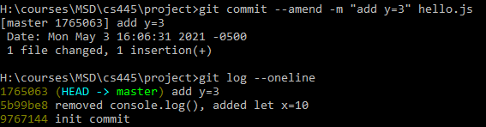
Updating The Last Commit
To update the most-recent commit instead of creating a new commit
git commit --amend -m "Your new commit message"
The --no-edit flag will allow you to make the amendment to your commit without changing its commit message.
Amended commits are actually entirely new commits and the previous commit will no longer be on your current branch.

Slide 24
Branch Operations

Slide 25
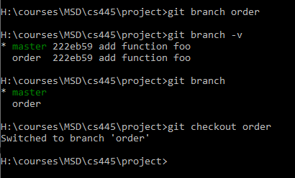
git branch
List all branch names in the repository, A branch is used to do development or make a fix to the project that won't affect the project.
Once you make the change on the branch, you can combine that branch into the master branch (merging).
git branch <branchname> will create a new branch
git branch -d <branchname> will delete a branch
git checkout <branchname> will switch to a branch
You can't delete a branch that you're currently on. To delete a branch, you'd have to switch to either the master branch or create and switch to a new branch.

Slide 26
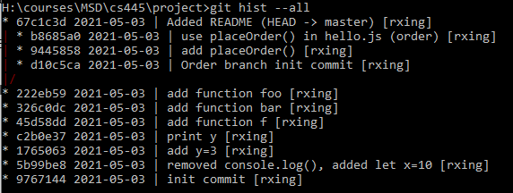
Use Case: deal with multiple branches with different (and possibly conflicting) changes
In order branch
Add a new file named order.js with placeOrder()
Call placeOrder() in hello.js
Add and commit
Switch to master branch
hello.js remains no change
Switch to master branch
git checkout master
Create and commit README to master
git add README
git commit -m "Added README"

Slide 27
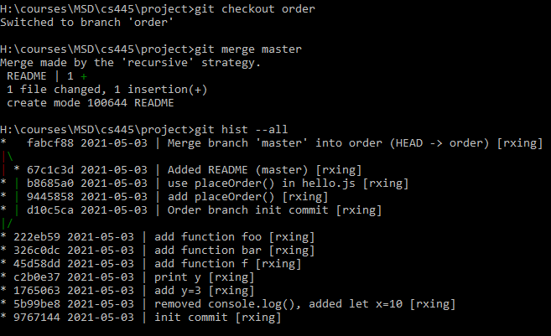
git merge <name-of-branch-to-merge-in>
Merging brings the changes in two branches together.
Steps:
git checkout <branchname> - switch to the branch you want to merge other changes
git merge <name-of-branch-to-merge-in> - merge
Merge master to order branch
Notes:
Fast-forward Merge
When the branch being merged in is ahead of the checked-out branch. The checked-out branch's pointer will just be moved forward to point to the same commit as the other branch.
When we combine two divergent branches, a commit is going to be made and a default message will be supplied.

Slide 28
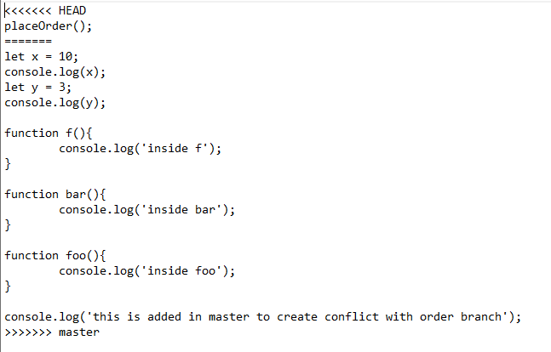
Use Case: Merge Conflict
Switch to master, edit hello.js, then commit to master
notepad hello.js
git add hello.js
git commit –m "Changes in master"
Merge master to order branch
git merge master
Conflict happens
notepad hello.js

Slide 29

Fix Merge Conflict
A merge conflict will happen when the exact same line is changed in separate branches.
<<<< HEAD: code in current checked-out active branch.
|||| merged common ancestors: original code.
==== until >>>> <branchname>: code in the branch we want to merge.
To solve a merge conflict
Edit the file, remove all lines with indicators (special characters)
Edit the file till you’re satisfied, save and exit
git add <filename> - add to staging
git commit –m "commit message" - commit

Slide 30
Remote Repository

Slide 31
Git vs Github
Git is a distributed version control system which means there is not one main repository of information. Each developer has a copy of the repository.
A remote repository is the same Git local repository but it exists somewhere else.
Github is a hosting service for version control repositories can be managed from your browser. This is where we will host our remote repositories to be shared with other developers.
Starting October 1, 2020 all master branches will be called main branches to avoid any unnecessary references to slavery.

Slide 32
README.md
A README is a text file that introduces and explains a project. It contains information that is commonly required to understand what the project is about.
This is where someone who is new to your project will start out.
While READMEs can be written in any text file format, the most common format is Markdown.
Code hosting services such as GitHub will also look for your README and display it along with the list of files and directories in your project.

Slide 33
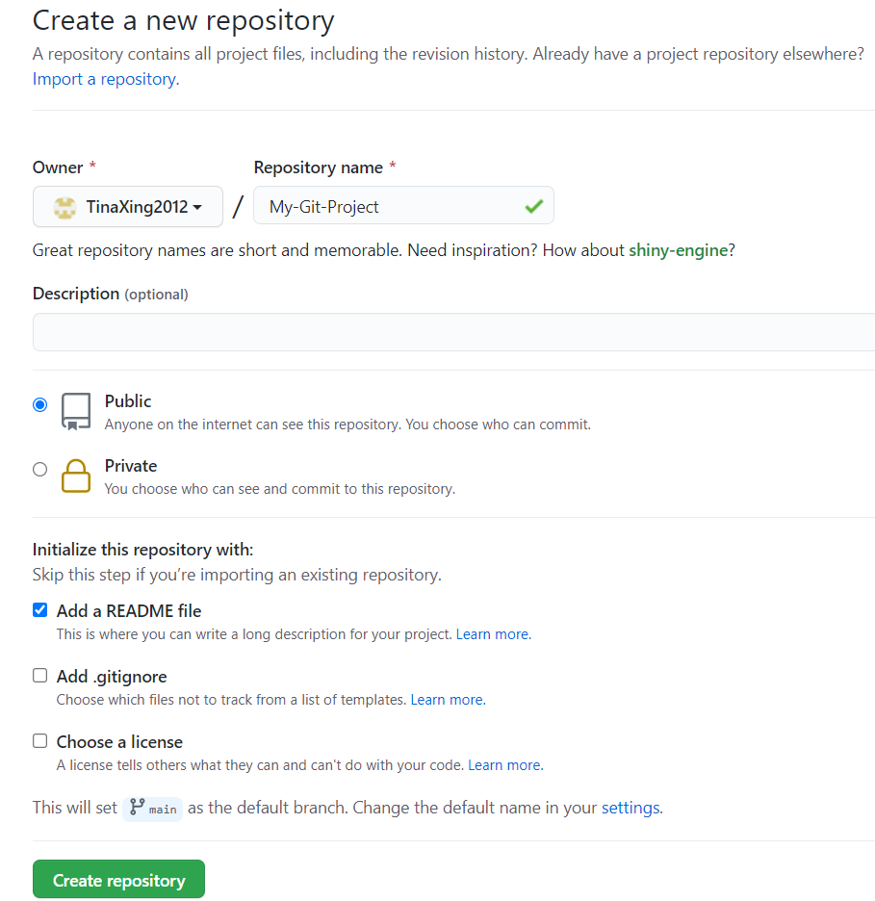
1. Create the repository, clone it to your PC, and work on it.(Recommended)

Slide 34
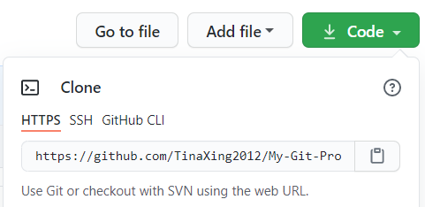
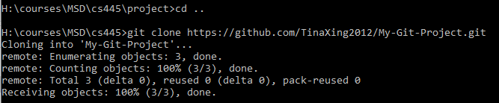
git clone <path-to-repository-to-clone>
Create an identical copy of an existing repository:
Takes the path to an existing repository
By default will create a directory with the same name as the repository that's being cloned (can be given a second argument that will be used as the name of the directory)
Create the new repository inside of the current working directory

Slide 35
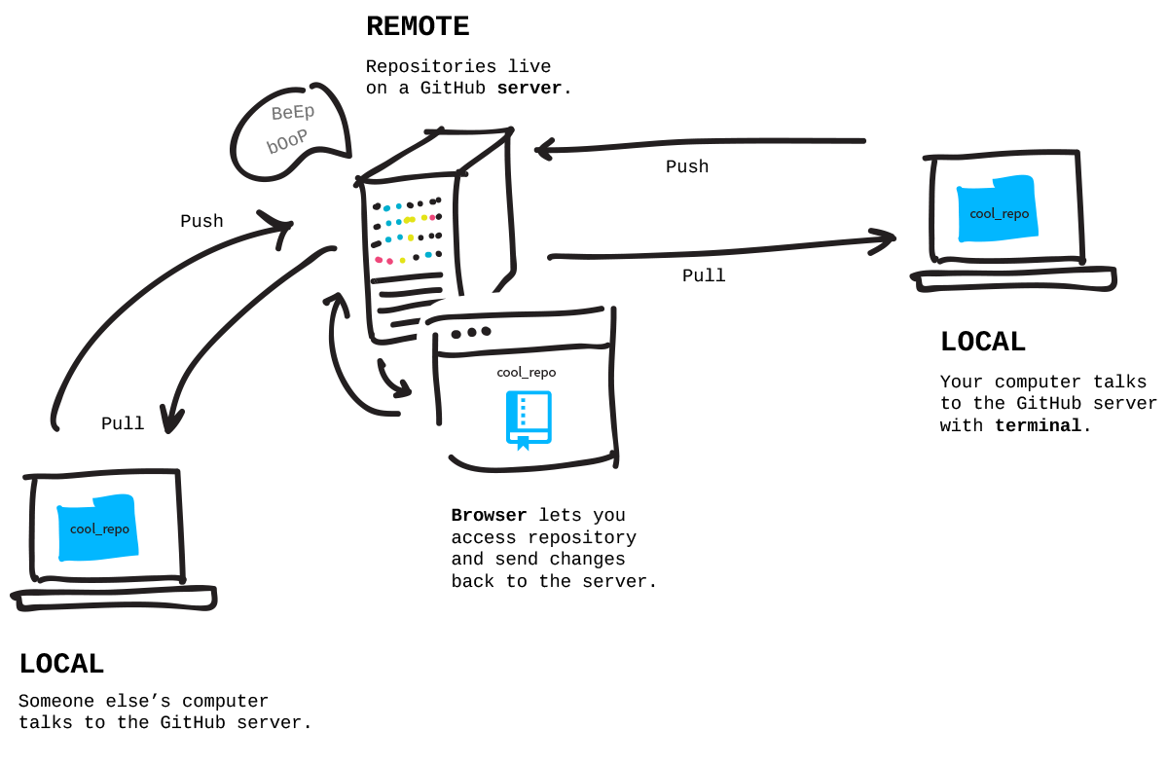
Describes how pull & push work

Slide 36
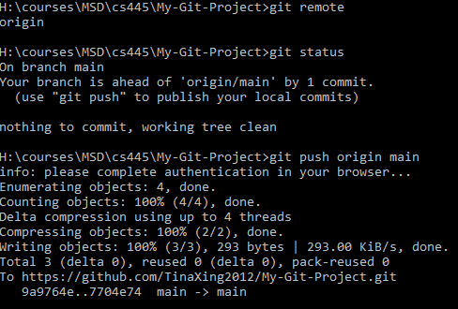
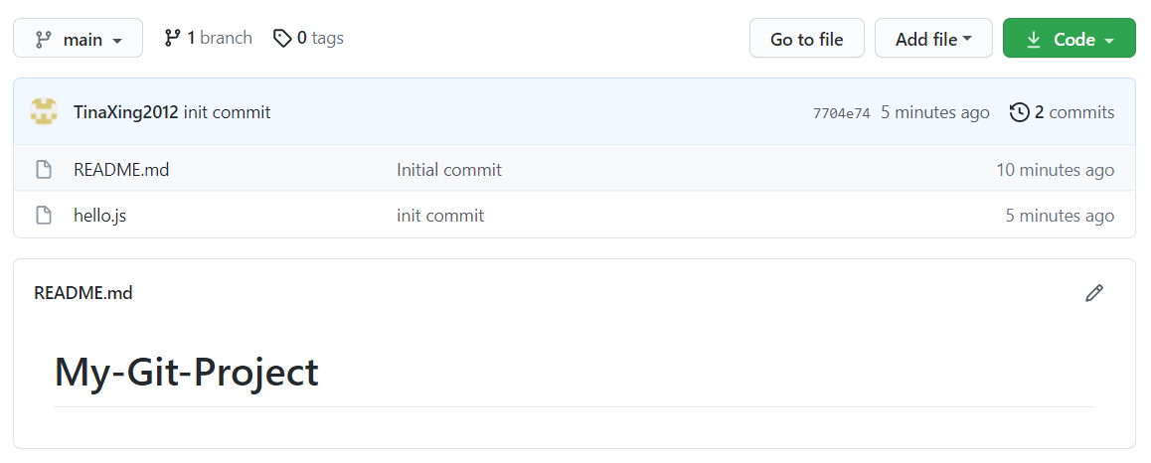
git push <remote-shortname> <branch>
The git push command is used to send commits from a local repository to a remote repository.
A new marker origin/main is called a tracking branch.
The tracking branch is telling us that the remote origin has a master branch that points to a certain commit (and includes all of the commits before it).
Figure out the remote’s name (mostly is named origin)
git remote
git push origin main
Notes:
o see which remote servers you have configured, you can run the git remote command. It lists the shortnames of each remote handle you’ve specified. If you’ve cloned your repository, you should at least see origin — that is the default name Git gives to the server you cloned from:

Slide 37
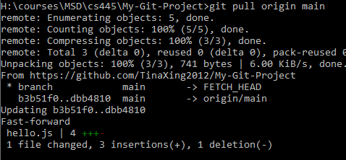
git pull <remote-shortname> <branch>
If there are changes in a remote repository that we would like to include in your local repository, then we want to pull in those changes.
Adds the commits from the remote branch to the local repository
Moves the tracking branch
The local tracking branch (origin/main) is merged into the local branch (main)
⚠️ Although, changes can be manually added on GitHub, it is not recommended, so don't do it.

Slide 38
Collaborate with pull request

Slide 39
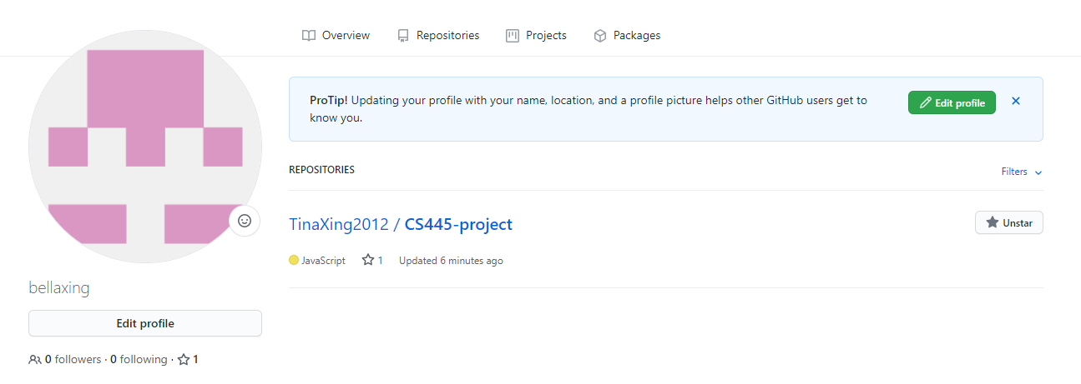

Star a repository
Users on the GitHub website are able to "star" other people's repositories, thereby saving them in their list of Starred Repos. Some people use "stars" to indicate that they like a project, other people use them as bookmarks so they can follow what's going on with the repo later.

Slide 40
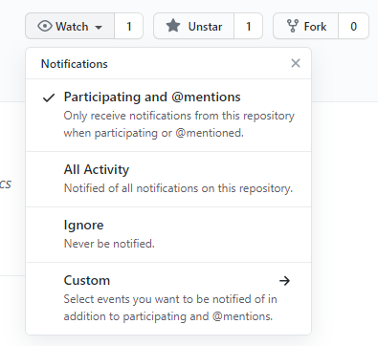
Watch a repository
If you are watching a repository, you will receive notifications for all discussions — project issues, pull requests, comments on commits and any other comments. If you’re not watching a repo you’ll just receive notification for the discussions you participate in.

Slide 41

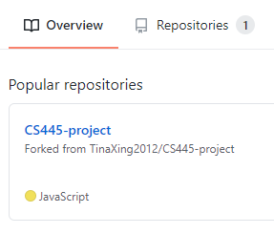
Fork a Repository
A fork is a copy of a repository that you manage. Forks let you make changes to a project without affecting the original repository.
You can fetch updates from or submit changes to the original repository with pull requests.
Forking a repository is similar to copying a repository, with two major differences:
You can use a pull request to suggest changes from your user-owned fork to the original repository, also known as the upstream repository.
You can bring changes from the upstream repository to your local fork by synchronizing your fork with the upstream repository.
⚠️ Forking is not done on the command line
Notes:
The term upstream and downstream refers to the repository. Generally, upstream is from where you clone the repository, and downstream is any project that integrates your work with other works. However, these terms are not restricted to Git repositories.

Slide 42

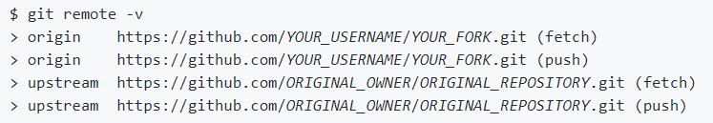
Configuring a remote for a fork
You must configure a remote that points to the upstream repository in Git to sync changes you make in a fork with the original repository.
List the current configured remote repository for your fork.
Specify a new remote upstream repository that will be synced with the fork.
Verify the new upstream repository you've specified for your fork.

Slide 43
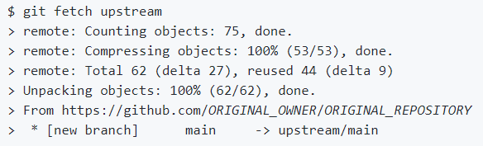


Syncing a fork
Sync a fork of a repository to keep it up-to-date with the upstream repository.
Fetch the branches and their respective commits from the upstream repository. Commits to BRANCHNAME will be stored in the local branch upstream/BRANCHNAME.
Check out your fork's local default branch - in this case, we use main.
Merge the changes from the upstream default branch - in this case, upstream/main - into your local default branch. This brings your fork's default branch into sync with the upstream repository, without losing your local changes.

Slide 44
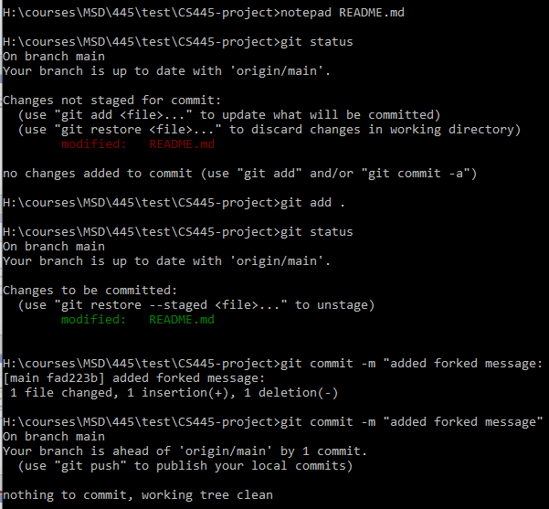
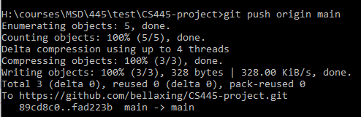
Working with your Fork
Because forking a repository gives you a copy of it in your account, you can clone it down to your computer, make changes to it, and then push those changes back to your forked repository.
Keep in mind that you push the changes back to your remote repository not to the original remote repository that you forked from.

Slide 45
Pull Request
Pull requests let you tell others about changes you've pushed to a GitHub repository. Once a pull request is sent, interested parties can review the set of changes, discuss potential modifications, and even push follow-up commits if necessary.
There are 2 main workflows when dealing with pull requests:
Pull Request from a forked repository –study by yourself
Pull Request from a branch within a repository
Notes:
Let’s say, for example, that you want to contribute to your favorite open-source project in GitHub. Most open-source projects have a maintainer who can control which changes are approved and merged into the project. They have the control to approve and decline changes as they wish.
They are especially necessary when working with open-source projects.

Slide 46
1. Create a Feature/Topic branch
When you start working on a new feature/bug fix, you should create a feature/topic branch. A feature/topic branch is normally created off a develop/integration branch. This feature/topic branch can reside in your local machine throughout the entire development lifecycle of the feature.
You will push this branch to the remote repository whenever you are ready to merge the change set with the develop/integration branch.
Examples: bugfix-login-form, bugfix-signup
Make sure your repository is up to date
git pull origin main == git fetch + git merge
Create a branch
git checkout -b feature-login
Push to github
git push origin feature-login
Notes:
https://backlog.com/git-tutorial/branching-workflows/

Slide 47
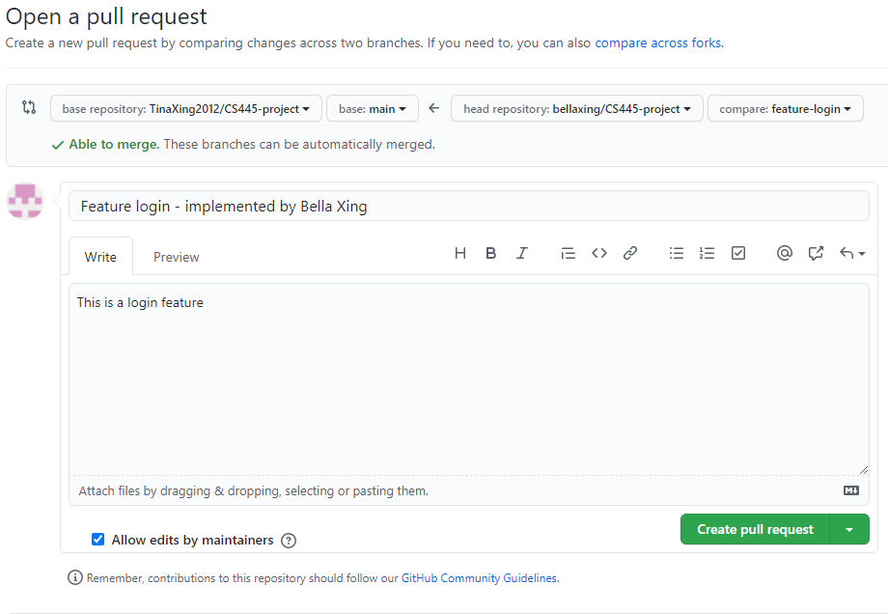
2. Create a Pull Request
To create a pull request, you must have changes committed to the your new branch
Go to the repository page on Github. And click on "Pull Request" link in the repo header.
Pick the branch you wish to compare and pull request
Create a pull request

Slide 48
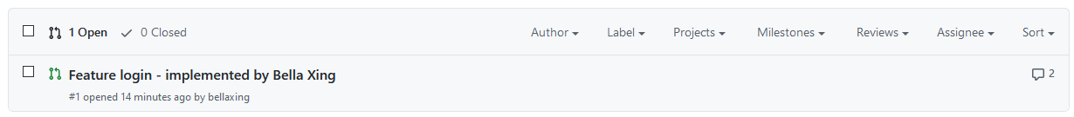
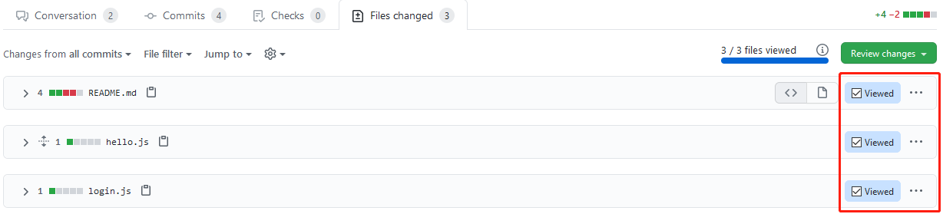
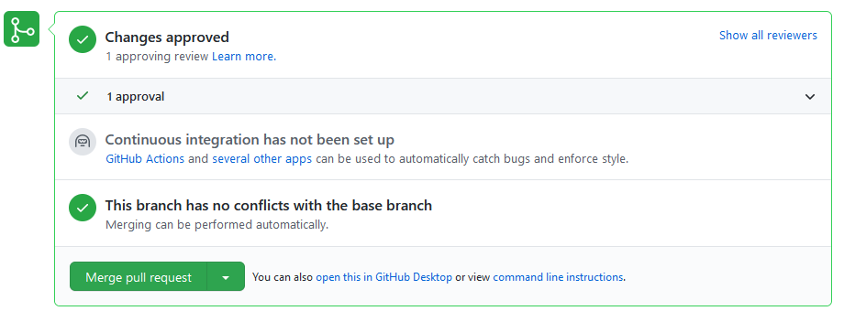
3. Merge changes in upstream repository
As maintainer of the upstream repository, you’re able to view all pull requests
Go to “File Changed” tabs, view and approve changes
Merge pull request

