Slide 1
ETHIOPIAN STATISTICAL SERVICE
ESS AI Assistant
A bilingual, retrieval-augmented chatbot that turns years of
ESS reports into instant, cited answers — in English and Amharic.
Flask + RAG
ChromaDB
Groq / Gemini / Ollama
EN + AM
Project Briefing · Prepared for Internal Presentation

Slide 2






AGENDA
What we'll cover
01
02
The Problem
System Architecture
Why ESS needs a self-service data assistant
How the widget, app, and AI layer fit together
03
04
Data & Indexing Pipeline
LLM Layer & Reliability
Turning PDF reports into searchable knowledge
Groq, Gemini, and local fallback
05
06
Features & Demo
Roadmap
What's live today, in screenshots
Model upgrade path and what's next
ESS AI Assistant
1

Slide 3
THE PROBLEM
Data is published. Answers are still hard to find.
ESS publishes dozens of census, economic-survey, livestock, and price-index reports every year — each dozens of pages long.
59+
official ESS reports
currently indexed
Journalists, researchers, and staff need one specific figure (e.g. "EFY 2018 food inflation") and have no fast way to search across reports.
10,162+
Manually opening and scanning PDFs — often bilingual, sometimes scanned images — doesn't scale, and Amharic-speaking users are underserved by search tools.
searchable text & table
chunks in the knowledge base
The result: slow turnaround on simple data requests, and under-use of the statistics ESS already collects.
2
languages served —
English & Amharic
ESS AI Assistant
2

Slide 4






THE SOLUTION
One assistant, two doorways
Full Dashboard
Embeddable Widget
A dedicated chat app at /chat with saved conversation history, session management, and account sign-in for staff and researchers.
A one-line <script> tag drops a floating assistant bubble onto the public ESS website — no rebuild of the main site required.
BOTH SHARE THE SAME AI CORE
Bilingual EN / አማ
Voice Input
Upload & Ask
Listen to Answers
Full UI + answers in both languages
Ask by speaking, English or Amharic
Attach a PDF for on-the-spot Q&A
Text-to-speech playback per answer
ESS AI Assistant
3

Slide 5
HOW IT'S BUILT
System architecture
User
Chat UI
Flask App (app.py)
PostgreSQL
Web visitor · ESS staff
/chat dashboard · /widget embed
Auth · sessions · streaming API
Users · sessions · file tracking
ChromaDB
Retriever (retriever.py)
rag.py — LLM orchestration
Vector store
10,162+ chunks
Embed query → ChromaDB similarity search
Builds prompt, streams cited answer
LLM providers
Groq → Gemini → Ollama (local fallback)
index_pdfs.py (offline pipeline)
data/pdf/
PDF → text/OCR/tables → chunks → embeddings → ChromaDB
59+ official ESS PDF reports
Guest chat, mic input, and PDF upload all flow through the same Flask app and RAG core — one AI brain behind both doorways.
ESS AI Assistant
4

Slide 6





DATA PIPELINE
From PDF report to searchable answer
PDF Report
Text Extraction
OCR Fallback
Table Extraction
Chunking
Embedding
ChromaDB
Dropped into
data/pdf/
PyMuPDF reads
the text layer
Tesseract (amh+eng)
for scanned pages
pdfplumber →
Markdown tables
700 chars,
100 overlap
Multilingual
MiniLM model
Stored &
searchable
Two safety nets built in
File-level tracking: a Postgres table records every file already indexed, so re-running the script only processes new PDFs — nothing is duplicated. Shared extraction logic: pdf_extract.py is used by both the bulk indexer and the in-chat “attach a PDF” upload feature, so OCR/table fixes never need to be made twice.
ESS AI Assistant
5

Slide 7
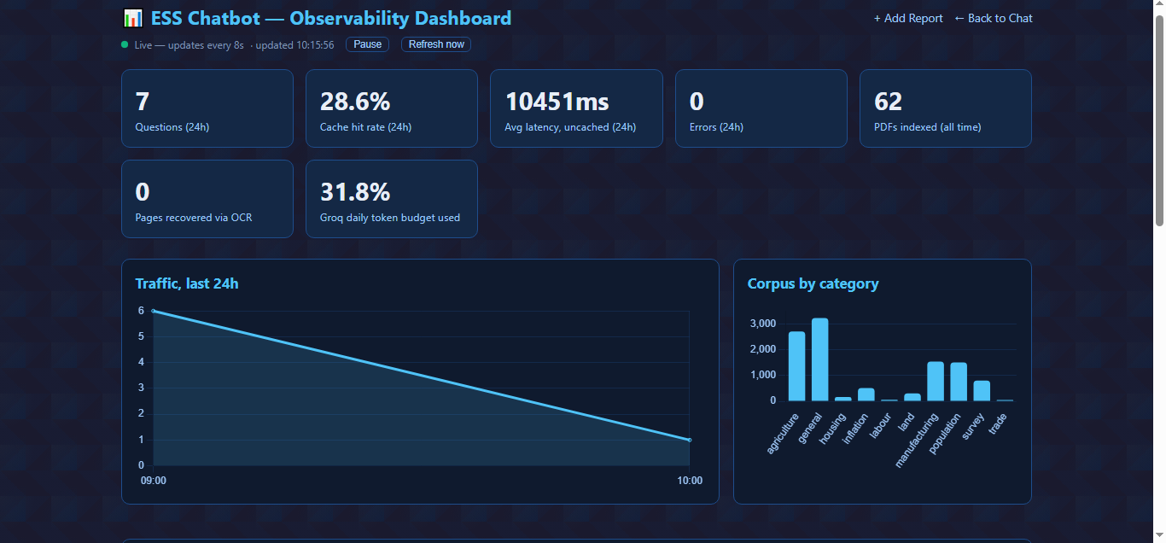
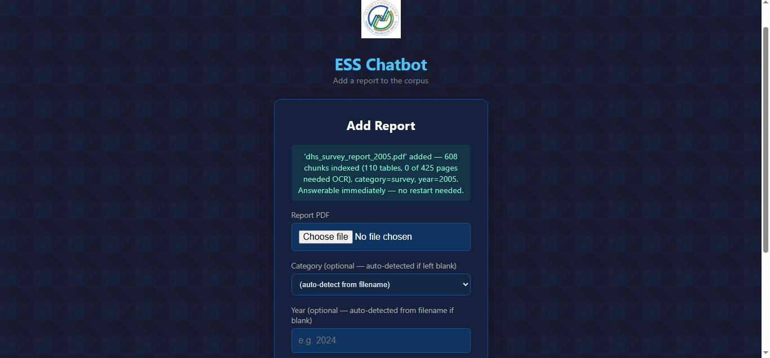
ADMIN TOOLS
Adding a report is now one click
Live observability dashboard
One-click report upload
Traffic, cache-hit rate, latency, errors, OCR pages, and token budget — updated live every 8 seconds, at /admin/dashboard.
Drag in a PDF — category and year auto-detect. Indexed in under a minute; the next chat question can already use it, no restart.
What used to mean server access and running a script by hand now happens from any browser — no restart, no downtime.
ESS AI Assistant
6

Slide 8



HOW A QUESTION GETS ANSWERED
Retrieval-augmented generation, step by step
1. Understand the question
2. Find the relevant evidence
3. Answer with citations
4. Stream it back
The user's question (typed, spoken, or from an uploaded PDF) is embedded into the same vector space as the indexed reports.
ChromaDB returns the top 5 most similar chunks; a distance-score filter (≤ 1.65) drops anything too weakly related to be trustworthy.
The LLM is prompted with only that retrieved evidence — not open knowledge — so answers cite the actual report, page, and figures.
The answer streams token-by-token to the UI, tagged with its source, page, and response time, in the language the user is asking in.
ESS AI Assistant
7

Slide 9



RELIABILITY ENGINEERING
One question, three chances at an answer
The chatbot never just fails silently — if the primary AI provider is rate-limited or down, it automatically falls through to the next tier.
TIER 1 — PRIMARY
TIER 2 — FALLBACK
TIER 3 — LAST RESORT
Groq
Gemini
Ollama (local)
openai/gpt-oss-120b
(fast fallback: 20b)
Free tier
(Flash-Lite)
llama3.2:1b
on-server
Cloud API — fast, high quality
Used only if Groq is exhausted
Keeps answering with zero internet dependency
Extra guardrails: per-model request timeouts, capped rate-limit retries, and an auto-override that catches when Groq retires a model name — so a silent “decommissioned model” error can never take the whole chatbot down.
ESS AI Assistant
8

Slide 10






WHAT'S LIVE TODAY
Features already shipped
Bilingual interface
Voice input
Listen to answers
Upload & ask
Full UI and AI answers in English and Amharic, switchable anytime.
Click-to-start, click-to-stop mic — no accidental cut-offs or auto-send.
Per-answer text-to-speech playback in the matching language.
Attach a PDF in chat and ask questions about that document alone.
Accounts & guest mode
Chat history
Embeddable widget
Rich answers
Sign in to save history, or try it as a guest with a question allowance.
Signed-in users can revisit, rename, and delete past conversations.
One script tag adds a floating assistant bubble to the public website.
Streamed responses render Markdown tables, source tags, and timing.
ESS AI Assistant
9

Slide 11
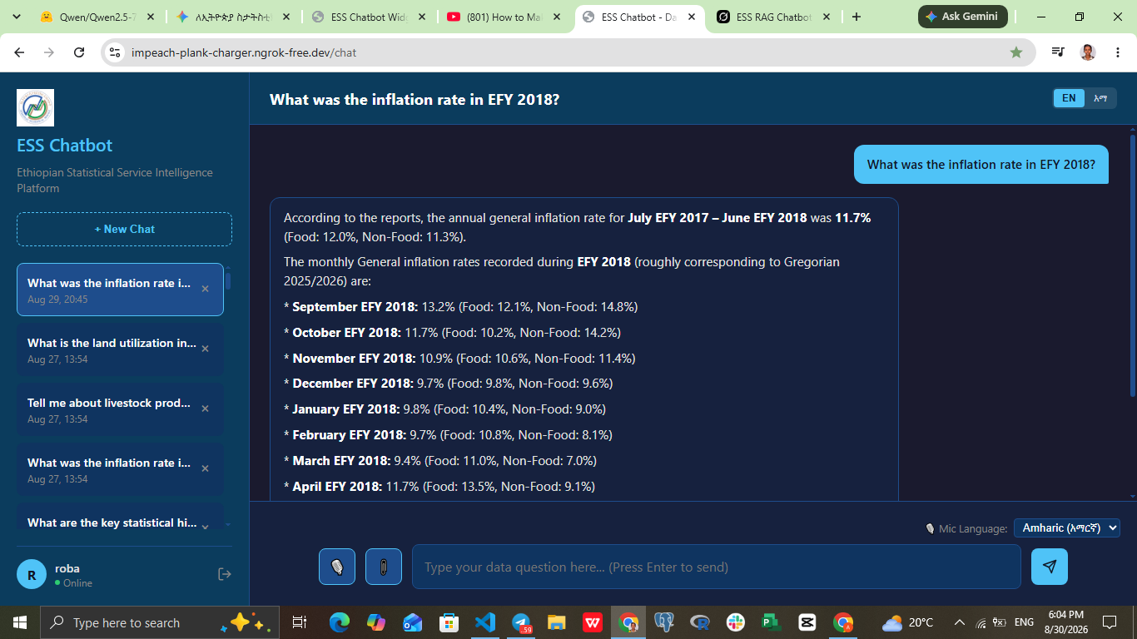
LIVE PRODUCT
The dashboard, in use
Real report data
Answers pull exact figures — EFY 2018 inflation by month, food vs. non-food — straight from indexed ESS reports.
Session sidebar
Every past question is saved and searchable, so staff can return to a conversation later.
Bilingual toggle
The EN / አማ switch at the top instantly re-renders the whole interface.
ESS AI Assistant
10

Slide 12
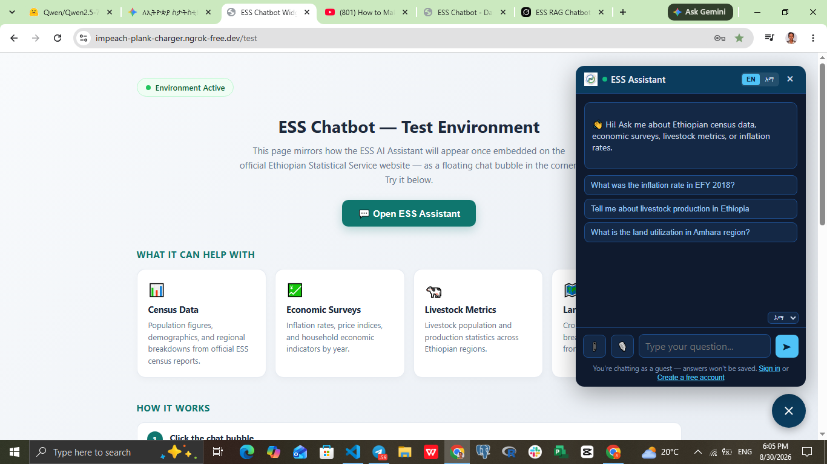
LIVE PRODUCT
Embedded on the public website
Floating bubble
ess-embed-loader.js injects a chat bubble with a single <script> tag — no changes to the rest of the site.
Same AI core
The popup runs on the exact same Flask + RAG backend as the dashboard — one brain, two front doors.
Guest-friendly
Visitors can ask questions immediately, then optionally sign in to save the conversation.
ESS AI Assistant
11

Slide 13




HONEST ASSESSMENT
Known challenges & limitations
Amharic OCR is weaker than English
Tesseract's Amharic script support is less mature, so scanned Amharic pages OCR with more errors than English ones — a library limitation, not a bug in the pipeline.
Scanned tables lose their structure
pdfplumber reads vector/ruling lines; on a scanned (image) page there's no structure to parse, so a scanned table comes back as plain OCR'd text, not a table.
Running on a free-tier LLM API
Groq's free tier can rate-limit under load; the Gemini/Ollama fallback chain covers this, but a dedicated model would remove the dependency entirely.
Hosted on a temporary tunnel
The current test environment runs behind an ngrok tunnel for demos — production needs a permanent domain and server.
ESS AI Assistant
12

Slide 14





ROADMAP DEEP-DIVE
Future improvement: a dedicated open-source model
Today the chatbot depends on free-tier cloud APIs (Groq, Gemini). The team evaluated Qwen2.5-7B-Instruct as a self-hosted alternative that runs entirely on ESS's own infrastructure.
Why Qwen2.5-7B-Instruct
Hardware to run it well
Strong bilingual performance
16–32 GB
Understands Amharic grammar and English equally well — the team's testing found it extracts exact figures from ESS documents (RAG) more reliably than Llama-based models.
System RAM — 16 GB minimum, 32 GB for better speed
8–16 GB VRAM
Fully free & open-source
NVIDIA GPU (e.g. RTX 3060/4060 or above) for fast responses
No per-token API cost and no rate limits — removes the dependency on Groq/Gemini free-tier quotas entirely.
15 GB
Data stays on ESS infrastructure
Free disk space to store the model weights
Reports and user questions never leave ESS's own servers — a meaningful privacy and sovereignty upgrade over cloud APIs.
Without a GPU, it can run on CPU only — but noticeably slower.
ESS AI Assistant
13

Slide 15
ROADMAP DEEP-DIVE
Recommendation & path forward
Recommendation: host Qwen on ESS's own server — not a laptop
The current development machine can't meet the GPU/VRAM requirement above. If ESS's server has a suitable GPU, that's the right place to deploy Qwen2.5-7B for full data privacy and zero API cost. While that's arranged, keep the existing Groq → Gemini → Ollama chain running, and evaluate other free-trial cloud APIs (e.g. OpenRouter, Together AI, Cerebras) as an interim bridge — no user-facing downtime either way.
NOW — SHIPPED
NEXT — IN PROGRESS
LATER — PLANNED
Bilingual dashboard + embeddable widget live
Automatic watch-folder indexing (no manual run needed)
Move off the ngrok tunnel to a permanent domain
3-tier reliability fallback (Groq → Gemini → Ollama)
Evaluate Qwen2.5-7B on ESS server hardware
Deeper analytics: top questions, query gaps, per-report usage
Admin panel: live dashboard + one-click PDF upload
Trial free-tier APIs as a bridge while GPU is arranged
Scheduled re-indexing as new reports are published
ESS AI Assistant
14

Slide 16
THANK YOU
Questions & Discussion
ESS AI Assistant — built to turn Ethiopian Statistical Service reports into fast, cited, bilingual answers.
Ethiopian Statistical Service · Project Briefing

