Slide 1
Topology #1
Running a single node RP Cluster with Single Containers in a Single Host Machine
Topology #2
Running a multi-node RP Cluster with Multiple RP Containers in a Single Host Machine
Topology #3
Running a multi-node RP Cluster with a Single RP Containers in a Single Host Machine
Host Machine
Redis^{e} Pack Container
…

Slide 2
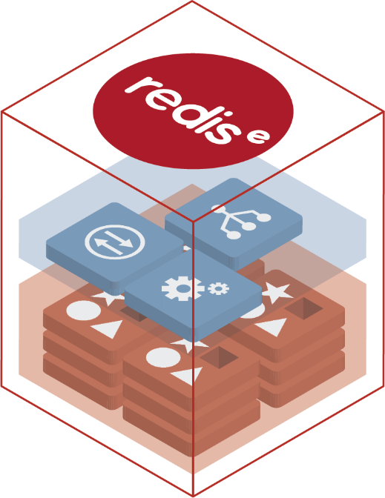
Redis^{e} Technology – Node Architecture
Redis^{e} Pack
Node Architecture
Cluster Manager
Govern Cluster, Orchestrate Failure Detection, Failover, Stats Collection & more
Proxy
Scale Connections &
Improve Application Performance
Secure UI & REST API
Allow programmable and visual administration over HTTPS
Redis^{e} Shards
Based on Open Source Redis

