Slide 1
Volume 1_Section 1
Chapter 8: Decontamination and Reprocessing of Medical Devices
IPC and PS for Healthcare Setting in Ethiopia

Slide 2
Chapter Outline
PPP 8.1: Overview
PPP 8.2: Level of disinfection or serialization required
PPP 8.3: Introduction to chemical disinfectants
Description of steps in processing item
Monitoring sterilization procedure
Safe storage and transport of sterile/ HLD Instrument
Summery

Slide 3
Learning Objective
Understand General overview of sterile services
Describe the steps of instruments and other items processing
List commonly used disinfectants
Elucidate the steps of cleaning process, sterilization and HLD
Explain how to store safely sterilized and high level disinfected instrument and other items

Slide 4
PPP 8.1:
Overview

Slide 5
Overview
Instruments which are reused without being properly processed and made safe are one of the causes of infections in developing countries.
Healthcare workers are increasingly at risk of becoming infected with serious blood borne viruses such as HBV, HCV and HIV.
The basic infection prevention processes recommended to reduce disease transmission from soiled instruments; surgical gloves and other reusable items are by way of cleaning and either sterilization or high-level disinfection (HLD).
In all steps, special attention should be given to proper handling of the instruments and other items to
  Minimize the risk of accidental injury or exposure to blood and other body fluids of the sterile processing staff and
  To attain high quality end result.

Slide 6
PPP 8.2:
Level of Disinfection or Sterilization

Slide 7
Level of Disinfection or Sterilization Required
A rational approach for processing medical devices and surgical instruments for patient care was first described by Earle H. Spaulding in 1968.
It is still relevant in making decisions about the final approach to instrument processing.

Slide 8
Spaulding’s category of potential infection risk
Spaulding classified instruments and patient care devices into three categories, based upon how the device is used. Items are classified as:
  Non-critical—come in contact with intact skin but not mucous membranes
  Semi-critical—come in contact with mucous membranes or non-intact skin
  Critical—come in contact with sterile areas of the body including the vascular system

Slide 9
Spaulding’s Risk Classification and Level of Processing
Risk category | Level of disinfection/sterilization | Examples
Critical | Sterilization | Reusable surgical instruments
Semi-critical | High-level disinfection | Respiratory instruments, specula used for vaginal examination ,endoscopes
Non-critical | Cleaning | Blood pressure cuffs, stethoscopes

Slide 10
PPP 8.3:
Guideline for Instrument Processing

Slide 11
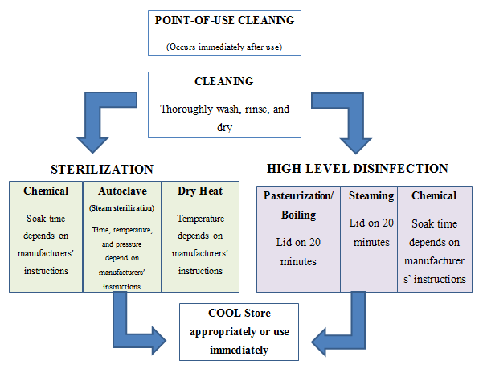
Work flow for instrument processing and other medical devices

Slide 12
Overview cont’d…
Soaking of instruments in disinfectant prior to cleaning
According to the WHO and PHAO, soaking of instruments in 0.5% chlorine solution or any other disinfectant prior to cleaning is not recommended for the following reasons:
  It may damage/corrode the instruments
  The disinfectant may be inactivated by blood and body fluids, which could become a source of microbial contamination and formation of biofilm
  Transportation of contaminated items soaked in chemical disinfectant to the decontamination area may pose a risk to health care workers and result in inappropriate handling and accidental damage May contribute to the development of antimicrobial resistance to disinfectants.

Slide 13
PPP 8.4:
Introduction to Chemical Disinfectants

Slide 14
What are Disinfectants?
Disinfectants are chemicals that destroy or Inactivate microorganisms in inanimate objects.

Slide 15
Commonly Used Chemical Disinfectants
  Alcohols
  Chlorine and chlorine releasing compounds
    Sodium hypochlorite (Chlorine bleach)
    Calcium hypochlorite or chlorinated lime
    Sodium dichloroisocyanurate
  Glutaraldehyde
  Formaldehyde
  Iodine and Iodophor solutions
  Hydrogen Peroxide
  Orthophthalaldehyde (OPA)

Slide 16
  Properties of an Ideal Disinfectant
Wide antimicrobial spectrum
Rapidly kills microorganisms
Active in the presence of organic matter and compatible with soaps, detergents, and other chemicals encountered in use
Non-toxic
Does not cause the deterioration of cloth, rubber, plastics, and other materials.
Easy to use with clear label instructions
Pleasant odor or no odor to facilitate its routine use
Not prohibitively high in cost
Soluble in water
Stable in concentrate and at use-dilution
Good cleaning properties
Environmentally friendly on disposal

Slide 17
PPP 8.5:
Description of Steps in Processing Items
1. Cleaning

Slide 18
  Cleaning
Cleaning is a process of physically removing infectious agents and other organic matters on which they live and thrive but does not necessarily destroy infectious agents.
It is an essential pre-requisite to ensure effective disinfection or sterilization by reducing the number of microorganisms, especially endospores causing tetanus.
Cleaning is the first and a critical step in reprocessing a device after use..
It reduces damage to instruments.
It makes instruments easier to process.
One can clean without sterilizing, but one cannot sterilize without cleaning!

Slide 19
If instruments are not properly cleaned:
Bioburden and residual cleaning agents remaining on an item can inactivate chemical disinfectants or sterilants and protect microorganisms from destruction, which can result in disinfection and sterilization failures.
And also instruments and materials used during an operation that are covered with blood and tissue remains may also have been in touch also with chemicals and fluids, dirt and dust.
Hinged instruments may have remnants of blood and tissue from the operation. The tubing of hollow instruments may be also full of these soiled materials.
Therefore, it is important to follow all the necessary steps to properly clean instruments prior to high-level disinfection or sterilization.

Slide 20
Effectiveness of Methods of Processing Instruments
METHOD | EFFECTIVENESS (kill or remove microorganisms) | END POINT
Cleaning (soap and rinsing with water) | Up to 80% | Until visibly clean
High-Level Disinfection | 95% (does not inactivate endospores) | Boiling or chemical for 20 minutes
Sterilization | 100% | High-pressure steam, dry heat or chemical for the recommended time

Slide 21
Steps of manual cleaning:
Put on Personal Protective Equipment (PPE) including a water resistant gown, gloves, face mask and head cover.
  If gloves are torn or damaged, they should be discarded; otherwise, they should be cleaned and left to dry for re-use in the following day.
  Even when wearing heavy-duty utility gloves, care should be taken to prevent needle sticks or cuts when washing sharps.
Fill sink or appropriate basin with sufficient warm water for complete immersion of the devices being cleaned.
Add the appropriate quantity of detergent following the manufacturer’s instructions for dosage.
Clean the device under the surface of the water so that aerosols are not produced.
All devices be disassembled so that all surfaces may be cleaned and disinfected, irrespective of the cleaning method chose.

Slide 22
Steps of manual cleaning cont’d…
Use appropriate brushes to properly clean box locks, lumens and other hard-to-clean areas
  Use soft (nylon) bristle brushes so that the surface of the instrument is not damaged.
  Brushes used to clean lumens must be the same diameter as the instrument to ensure that all internal surfaces can be reached.
  Brushes must also be long enough to exit the distal end of the instrument
  Brushes should be thermally or chemically disinfected at the end of the day, if this is not possible, they should be cleaned and left to dry.
  Brushes should be replaced when damaged.
In another sink or basin, completely immerse the device in clean purified water and rinse the device thoroughly.
Air-dry or hand-dry using a disposable clean, non-linting cloth.
Items that cannot be cleaned thoroughly should not be reused, but be discarded after use.

Slide 23
Cleaning Products and their properties
There is no single cleaning agent that removes all types of bioburden.
Bioburden is made up of a variety of matter, which may be soluble or insoluble in water and can be organic or inorganic.
Properties associated with ideal cleaning agents:
  Emulsification
  Surfactation
  Dispersion and suspension
  Water softening
  Free rinsing
  Non-toxic

Slide 24
Selection of cleaning agents
Deposits of dust, soil and microbial residue on equipment can contribute to healthcare-associated infections.
Cleaning agents remove organic, inorganic and microbial contaminants.
No single compound has all the properties that are required to remove all soil deposits.
The first step in cleaning is the use of surfactants or surface-active agents to reduce tension, which assists in soil being held in the cleaning solution.

Slide 25
PPP 8.5:
Description of Steps in Processing Items
2. Packing and Wrapping

Slide 26
  Packing and Wrapping
The inspection, assembly and packaging of reusable surgical instruments and medical devices is a crucial part of the reprocessing cycle.
All instruments and other items should be thoroughly cleaned and dried before being disinfected or prepared for sterilization.
In some cases, it is not necessary to completely dry the items (needles or the like which have small openings) being sterilized for the small amount of water left inside these openings help in the steam sterilization process.
For such items, flushing them with distilled or boiled water just prior to packaging for steam sterilization should be done after cleaning.

Slide 27
  Packing and Wrapping cont’d…
Finally, all jointed instruments should be open (or be unlocked) and disassembled.
Reusable cloth items should be laundered and dried after use or prior to sterilization in order to:
  Remove organic matter, and
  Prolong the life of the cloth by restoring the fabric’s normal moisture (water) content.

Slide 28
Inspection and function testing (post-cleaning)
Each set should be inspected separately
Box joints, serrations and crevices should be critically inspected for cleanliness
Hinges on devices, such as artery forceps and clamps, should be checked for ease of movement
Jaws and teeth should be checked for alignment
Ratchets should be checked for security
Multi-part instruments should be assembled to ensure that all parts are complete and working

Slide 29
Inspection and function testing (post-cleaning) cont’d…
Multi-part instruments should be assembled or disassembled for sterilization per manufacturers’ instructions.
Any damaged, incomplete or malfunctioning devices should be reported immediately to the supervisor.
Cutting edges on devices, such as scissors, rongeurs, chisels and curettes, should be checked for sharpness.
Hinges on devices, such as artery forceps and clamps, should be checked for ease of movement.
Each device should be checked after each cleaning cycle to ensure that all screws on jointed devices are tight and have not become loose during the cleaning process.

Slide 30
Packing and wrapping for steam sterilization
Wrapping items to be sterilized permit sterile items to be handled and stored without being contaminated
Materials used for wrappers should:
  Allow air removal and steam penetration
  Act as a barrier to microorganisms and fluids
  Capable of withstanding high temperatures
  Resist tears and punctures and be free of holes
  Be nontoxic and low-lint
  Not be costly

Slide 31
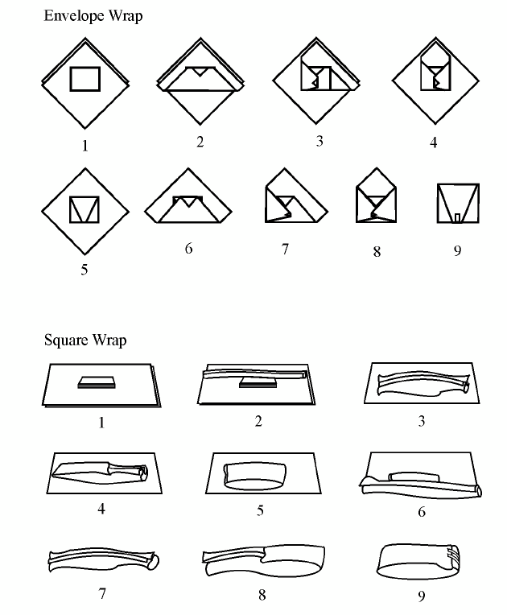
Typical Wrapping Techniques

Slide 32
Tips for wrapping
At least two layers of wrapping should always be used to reduce the possibility of contaminating the contents during unwrapping.
Do not wrap packages too tightly.
  If they are wrapped too tightly, air can become trapped at the center of the packages preventing the temperature from getting high enough to kill all the microorganisms.
  Also, wrapping with strings or rubber bands or tying linen too tightly can prevent steam from reaching all surfaces.
Hemmed strips of about ½ inch wide and of varied lengths., one or two of such strips can be used for each package.
Because they can fit to almost any size of package, they eliminate the need for an expensive and hard-to-remove indicator tape.

Slide 33
Tips for wrapping cont’d…
The outer wrapper of the pack can be loosely secured using linen ties.
Packs can be secured with linen ties made from the same cloth.
Do not wrap items in any waterproof material such as plastic or canvas for steam sterilization as the steam cannot penetrate the material and leave the item unsterilized.
Wrappers should not be reused if they are torn, stained with oils or have hard or gummy deposits.

Slide 34
Packing and wrapping for dry heat sterilization
Packaging materials for dry-heat sterilization should
  Allow easy heat penetration,
  Provide an adequate barrier to microorganisms after sterilization,
  Resist tearing or puncturing before and after sterilization,
  Have proven seal integrity,
  Allow for ease of aseptic presentation,
  Be free of toxic ingredients,
  Be low-linting or lint-free, and
  Be cost-effective and readily available.
  The material should have been approved for use with dry-heat sterilization.

Slide 35
PPP 8.5:
Description of Steps in Processing Items
High Level Disinfection

Slide 36
High level disinfection
Sterilization is the safest and most effective method for the reprocessing of surgical instruments because it kills all vegetative microorganisms and microbial spores.
However, sterilization is not always suitable because some materials cannot with-stand the high temperatures used during the sterilization process and sterilization may not be consistently available in some low-resource settings.
Per the Spaulding classification, devices that come in contact with intact skin are classified as non-critical items and should be processed by intermediate- or low-level disinfection.
Surgical instruments and medical devices that come in contact with non-intact skin or mucous membranes (classified as semi-critical devices) must, at a minimum, be high level disinfected, though sterilization is always preferable when possible.

Slide 37
High level disinfection cont’d…
Destroys all microorganisms including HBV, HCV, and HIV; does not reliably kill all bacterial endospores
High-level disinfection can be achieved by:
  Pasteurization/ Boiling in water,
  Steaming
  Soaking instruments in chemical disinfectants (chemical disinfection).

Slide 38
High-level disinfection by boiling
Pasteurization can be used to achieve HLD of instruments and medical devices. It is carried out by heating at 77⁰C (170.6⁰F) for 30 minutes or boiling at 100⁰C (212⁰F) for 20 minutes.
Boiling has been a common practice for HLD of instruments and equipment used for semi-critical and sometimes critical procedures as it was the only available option in some low-income countries.
Pasteurization/ Boiling in water is an effective and practical way to high-level disinfect instruments and other items. Although boiling instruments in water for 20 minutes will kill all vegetative forms of bacteria, viruses (including HBV, HCV and HIV), yeasts and fungi; it will not kill all endospores reliably.

Slide 39
Instructions for HLD by boiling
STEP 1 Clean all instruments along with other items to be high level disinfected.
STEP 2 If possible, completely immerse items in the water. Adjust the water level so that there is at least 2.5cm (1 inch) of water above the instruments.
Further, make sure that all bowls and containers to be boiled are full of water. For example, one needs to empty bowls that turned bottom side up and float on the surface containing air pockets.
Metal instruments should be completely covered with water during boiling.

Slide 40
Instructions for HLD by boiling cont’d…
STEP 3 Close-lid over pan and bring water to a gentle rolling boil. Boiling too vigorously wastes fuel, rapidly evaporates the water and may damage delicate [or sharp] instruments or other items.
Hence, a gentle rolling boil is sufficient and will prevent instruments or other items from being bounced around and possibly damaged by striking other instruments or the side walls of the boiling pot.
STEP 4 Start timer. In the HLD log, note time on the clock and record the time when rolling boil begins.
Do not add anything to the pot after timing begins.

Slide 41
Instructions for HLD by boiling cont’d…
STEP 5 Boil all items for the required time: 30 minute at 77⁰C (170.6⁰F) or 20 minutes at 100⁰C (212⁰F).
Always boil for the required time period in a container with a lid.
Start timing when the water begins to boil.
STEP 6 Remove all items after the recommended time with a high-level disinfected forceps.
Never leave boiled instruments in the water that has stopped boiling. Because, as the water cools and the steam condense, air and dust particles are drawn down into the container and may contaminate those instruments.

Slide 42
Instructions for HLD by boiling cont’d…
STEP 7 Use instruments and other items immediately or else, pick them up with high-level disinfected forceps or gloves and place objects in a high-level disinfected container with a tight-fitting cover.
If any pooled water remains in the bottom of the container, remove the already dried items and place them in another high-level disinfected container that is dry and can be tightly covered.

Slide 43
High-level disinfection by steaming
High-level disinfection by steaming is an option for plastic items used for patient care.
Materials needed for high-level disinfection by steaming include:
  Steamer pan without holes to hold water (such as momo steamer)
  Two to three additional pans with holes to allow steam to move to upper pan
  The pans should be deep enough to fit the largest item being steamed
  A tight-fitting lid to cover the upper pan
  An additional bottom pan for drying the processed items

Slide 44
Instructions for HLD by steaming
STEP 1 Perform hand hygiene and
STEP 2 Fill the bottom pan of the steamer with approximately 1 liter of clean water – about half the volume of the pan
STEP 3 Place instruments, plastic MVA cannula and other items in one of the steamer pans with holes in its bottom.

Slide 45
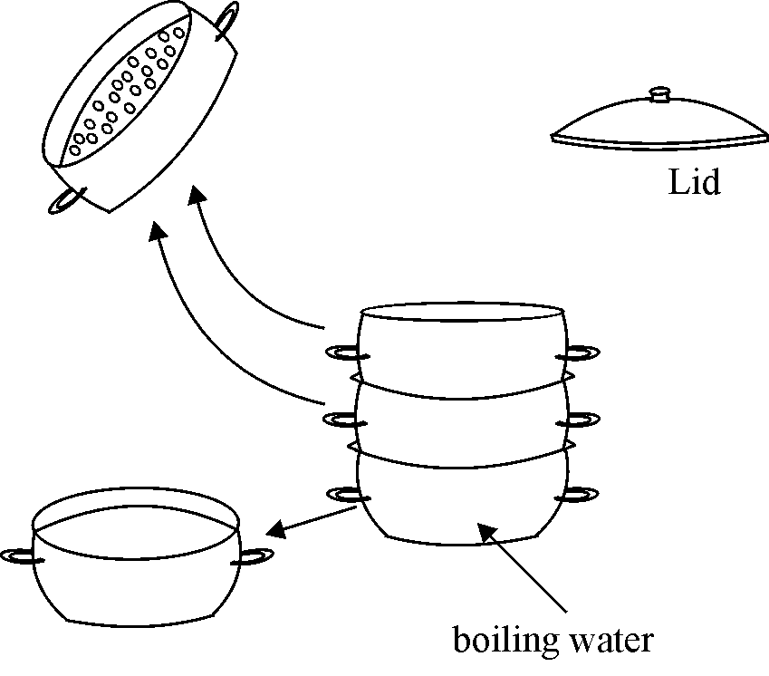
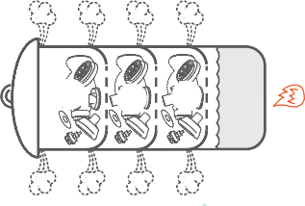
Steamer Used for HLD

Slide 46
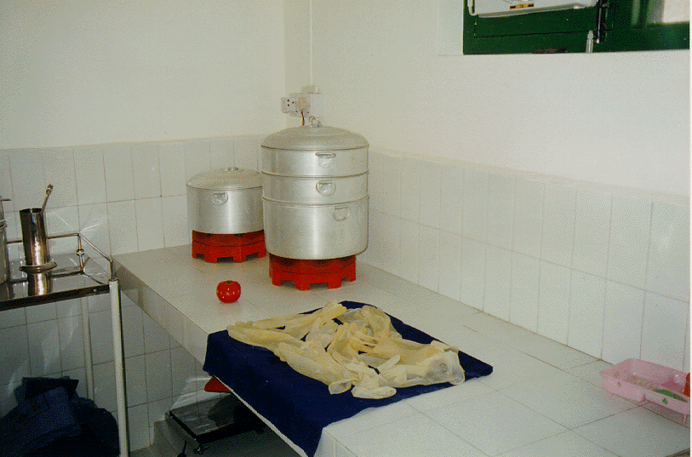
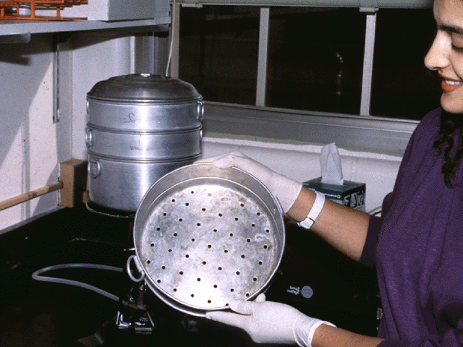
Steamer Used for HLD

Slide 47
Instructions for HLD by steaming
To make removal from the pan easier, do not overfill the pan.
Repeat this process up until three steamer pans have been filled. Stack the filled steamer pans on top of a bottom pan containing water for boiling. A second empty pan without holes should be placed on the counter next to the heat source (see Step 7)
STEP 4 Place a lid on the top pan and bring the water to a full rolling boil.
It should be noted that when water only simmers, very little steam is formed and the temperature may not get high enough to kill microorganisms.

Slide 48
Instructions for HLD by steaming
STEP 5 When steam begins to come out between the pans and the lid, start the timer or note the time on a clock and record the time in the HLD log.
STEP 6 Steam items for 20 minutes.
STEP 7 Remove the top steamer pan and put the lid on the pan that was below it (the pan now on top). Gently shake excess water from the pan just removed.
STEP 8 Put the pan just removed onto the empty pan (see Step 3). Repeat until all pans are restacked on this empty pan and cover the top pan with the lid. This step allows the items to cool and dry without becoming contaminated.

Slide 49
Instructions for HLD by steaming
STEP 9 Allow items to dry in the air while in the steamer pans (1 to 2 hours) before using.
STEP 10 Using a high-level disinfected forceps; transfer the dry items to a dry, high-level disinfected container3 with a tight-fitting cover.
Instruments and other items can also be stored in the stacked and covered steamer pans as long as a bottom pan (with no holes) is used.

Slide 50
Boiling Versus Steaming
In both boiling and steaming, moist heat is used to kill microorganisms.
Steaming has several distinct advantages over boiling for the final processing of surgical gloves and other items such as plastic cannula and syringes.
It is less destructive and more cost-effective for it uses much less fuel than boiling
it is free from discoloration of instruments resulting from calcium or other heavy metals contained in some tap water for the steam contains only pure water molecules.

Slide 51
Boiling Versus Steaming
The major limitation of steaming is that if the steamers available locally are small, they can practically be used only for a small number of items
For steaming to be effective, the bottom pan must contain enough water to continue boiling throughout the steaming process
By contrast, large boiling pots are easier to use for metal instruments and do not need to be monitored the entire time to be sure that the process is being done correctly.

Slide 52
High-level disinfection using chemicals
Although a number of disinfectants are commercially available in most countries, four disinfectants-
  OPA,
  Glutaraldehydes,
  Formaldehyde and
  Peroxide-are routinely used as high- level disinfectants.
These chemicals can achieve high-level disinfection if the items being disinfected are thoroughly cleaned before immersion.
A high-level disinfectant should be selected for use based on the characteristics of the items to be disinfected, the physical area and the skills of personnel available to do the procedure.

Slide 53
Key steps in chemical high-level disinfection
STEP 1 Thoroughly Clean instruments and other items that may have been contaminated with blood and body fluids and thoroughly clean and dry them before placing them in the disinfectant solution.
STEP 2 Completely immerse all items in the high-level disinfectant.
STEP 3 Soak them for 20 minutes.
STEP 4 Remove items using high-level disinfected or sterile forceps or gloves.
STEP 5 Rinse well with boiled and filtered (if necessary) water three times and air dry.
STEP 6 Use promptly or store in a dry, high-level disinfected and covered container

Slide 54
Factors That Affect Disinfection Process
Quantity and location of the microorganisms
Quantity and location of organic matter
Concentration of the disinfectant
Physical and chemical factors
Duration of exposure
Resistance of microorganism to the chemical agent

Slide 55
PPP 8.5:
Description of Steps in Processing Items
Sterilization

Slide 56
Sterilization
Sterilization is a process in which the destruction of all micro-organisms including bacterial endospores takes place.
This can be achieved by either physical or chemical methods and is necessary especially for medical devices penetrating sterile body sites or having direct contact with the
Sterilization in health facilities can be achieved by:
  High pressure steam (autoclaves),
  Dry heat (oven),
  Chemical sterilants (Glutaraldehyde or formaldehyde solutions)

Slide 57
Essentials of Sterilization Process:
The sterilants and sterilizing equipment must be validated and appropriate in design and operation to correctly integrate key yardsticks like: time, temperature, contact, pressure (for steam sterilization) and right sterilants (for chemical sterilization) to be as effective as they should be.
Instruments must be thoroughly cleaned to reduce dirt in order to guarantee effectiveness of the sterilization process.
The higher the dirt the greater the challenge to the sterilization process. Therefore, it could be said that the effective sterilization is entwined with an effective removal of the dirt before making it ready for sterilization.
There must be close and adequate contact between the chemical sterilant and all surfaces and crevices of the device to be sterilized.

Slide 58
The effectiveness of any sterilization method is dependent upon four other factors
The type of micro-organism present.
The number of micro-organisms present.
The amount and type of organic material that protects the micro-organisms. Blood or tissue remaining on poorly cleaned instruments acts as a shield to microorganisms during the sterilization process.
The number of cracks and scratches on an instrument that might harbor micro-organisms.
Sterilization is a process, not a single event; therefore, all phases and steps in the process must be carried out correctly.

Slide 59
High pressure steam sterilization method
Saturated steam is an extremely effective carrier of thermal energy that makes it many times more effective in conveying the necessary energy to the items to be sterilized than dry air.
Steam is an effective sterilant in that it can soften any resistant and protective outer layer of the micro-organisms allowing coagulation of the inner sensitive portion of the micro-organisms.
Advantages
  Most commonly used effective method of sterilization.
  Sterilization cycle time is shorter in steam sterilization than in any other type of sterilization.

Slide 60
High pressure steam sterilization method cont’d…
Limitation
  Requires a continuous source of heat (wood fuel, kerosene or electricity).
  Requires a trained biomedical technician to perform preventative maintenance.
  Requires strict adherence to time, temperature and pressure settings.
  Difficult to produce dry packs because breaks in procedure are common (e.g. not allowing items to dry before removing, especially in hot, humid climates).
  Repeated sterilization cycles can cause pitting and dulling of cutting edges of instruments i.e. scissors).
  Plastic items cannot withstand high temperatures.

Slide 61
There are three types of high-pressure steam sterilizers:
Gravity displacement
Prevacuum
Flash or Immediate use sterilizers (IUS)

Slide 62
Operation
A steam sterilizer will reliably sterilize items only when kept in good working condition and operated correctly.
Sterilization by steam requires four conditions:
  Adequate contact,
  Sufficient temperature,
  Proper time and
  Sufficient moisture.
Even if these conditions are all necessary for sterilization to take place, sterilization failures in clinics and hospitals are most often caused by lack of steam contact or failure to attain adequate temperature

Slide 63
Effective sterilization depends on correctly following procedures of the process
These include:
  Routine maintenance,
  Preparing items to be sterilized,
  Packaging and wrapping,
  Loading,
  Operating, and
  Unloading the sterilizer.

Slide 64
Routine Maintenance
The chamber should be cleaned daily using a soft cloth, or for large sterilizers, a long- handled mop which is used only for this purpose. Do not use abrasives or steel wool because they may scratch the stainless steel surface and increase the occurrence of corrosion.
All door gaskets should be cleaned daily with a lint-free cloth and checked for defects. Defective rubber gaskets should be replaced.
The carriage (loading cart used to hold the packs placed in a sterilizer) should be cleaned daily using a mild soap and lint-free cloth.
The exhaust line (or chamber drain) should be flushed weekly.

Slide 65
Loading
To load items into the autoclave in such a way that it allows passage of the most steam through the load.
The total weight of an individual pack should not exceed 11 kg (24 pounds).
When loading, leave sufficient space for steam to circulate freely and avoid overloading. Always leave 3 inches between the top-most pack and the top of the chamber. Items should not touch the chamber wall. Never overload the sterilization chamber.
Do not place packages on the floor of the chamber.

Slide 66
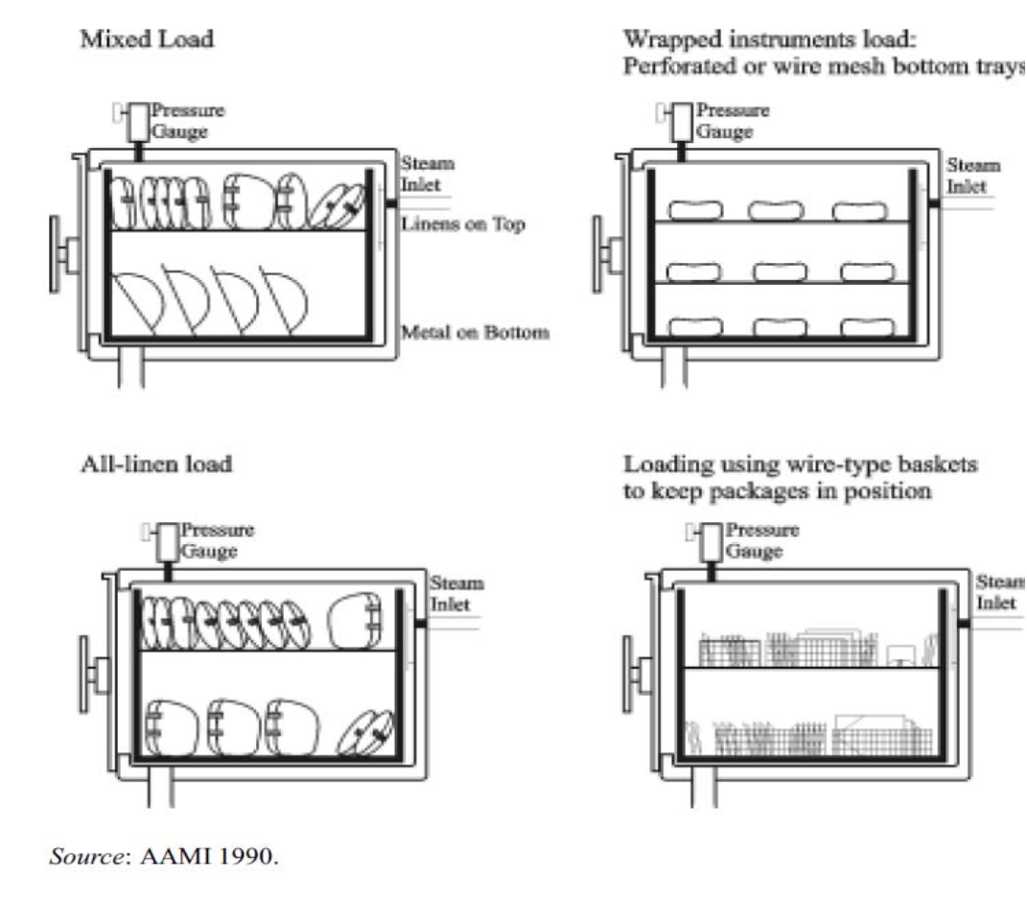
Loading Steam Sterilizer

Slide 67
Unloading
To unload the steam autoclave so as to maintain the sterility of the items processed through a sterilizing cycle.
Open the sterilizer door slightly 12-14 cm (5-6 inches) at the end of the cycle (when the chamber gauge reaches “0”) and allow items to remain inside to reduce the potential for condensation (formation of water drops on the packages).
Allow instrument packs to dry completely before removal (usually takes 30 minutes). Cooling time could be as long as 2 hours, based on room temperature and humidity.
Wet packs are never acceptable.
Return any pack that is wet for reprocessing (remove items from the package and repackage before reprocessing).
Do not handle the packs during the cooling time

Slide 68
Unloading cont’d
Place sterile trays and packs on surfaces padded with paper or fabric (avoid placing warm packs on cold metal surfaces so as to prevent condensation).
Store when packs reach room temperature (usually takes about an hour).
Sterilized packs and articles should be handled gently and used as reasonably as possible.
Return any pack that drops on the floor for reprocessing (remove items from the package and repackage before reprocessing).
If a pack is dropped, turns to be moist or comes into contact with moisture, it must be considered contaminated.

Slide 69
Instructions of operating a steam sterilizer
STEP 1 Thoroughly clean and dry all instruments and other items to be sterilized.
STEP 2 All jointed instruments should be in an open or unlock position, while instruments composed of more than one part or sliding parts should be disassembled.
STEP 3 Instruments should not be held tightly together by rubber bands or any other means that will prevent steam contact with all surfaces.
STEP 4 Arrange packs in the chamber to allow free circulation and penetration of steam to all surfaces.
STEP 5 When using a steam sterilizer, it is best to wrap clean instruments or other clean items in a double thickness of muslin or newsprint. (Unwrapped instruments must be used immediately after removal from the sterilizer, unless they are kept in a covered, sterile container.)

Slide 70
Instructions of operating a steam sterilizer
STEP 6 Sterilize at 121⁰C (2500F) for 30 minutes for wrapped items and 20 minutes for unwrapped items; set time of the clock.
STEP 7 Wait 20 to 30 minutes (or until the pressure gauge reads zero) to permit the sterilizer to cool sufficiently. Then open the lid or door to allow steam to escape. Allow instrument packs to dry completely before removal which may take up to 30 minutes (Wet packs act like a wick drawing in bacteria, viruses and fungi from the environment). Wrapped instrument packs are considered unacceptable if there are water droplets or visible moisture on the package exterior when they are removed from the steam sterilizer chamber. If using rigid containers (e.g. drums), close the gaskets.
STEP 8 To prevent condensation when removing the packs from the chamber, place sterile trays and packs on a surface padded with paper or fabric.
STEP 9 After sterilizing, items wrapped in cloth or papers are considered sterile as long as the pack remains clean, dry (including no water stains) and intact. Unwrapped items must be used immediately or stored in covered sterile containers.

Slide 71
Remember
    Maintain a steam sterilizer log including heat begun, correct temperature and pressure achieved, heat turned down, and heat turned off.
    Each load should be monitored with mechanical (time, temperature and pressure) and chemical (internal and external chemical test strips) indicators.
    Autoclave should be tested daily with an air-removal test to ensure proper removal of air.
If steam escapes from the safety valve or under the lid, the autoclave is not working correctly. Rather, it is merely steaming items at low-pressure (which may be equivalent to HLD, not sterilization). Then, what is to be done?
  If steam escapes from the safety valve instead of the pressure valve, the pressure valve must be cleaned and inspected.
  If steam escapes from under the lid, the gasket (rubber ring) must be cleaned and dried or replaced.

Slide 72
Dry heat sterilization method
Dry heat sterilization is caused by hot air that destroys micro-organisms through oxidation that causes slow destruction of the micro-organisms protein.
It is accomplished by thermal (heat) conduction. Initially, heat is absorbed by the exterior surface of an item and then passed to the next layer.
Eventually, the entire object reaches the temperature needed for sterilization.
Dry heat sterilization methods have limited value because it is difficult to maintain the same temperature throughout the process.
Moreover, dry heat sterilization takes longer than steam sterilization, because the moisture in the steam sterilization process significantly speeds up the penetration of heat and shortens the time needed to kill microorganism.

Slide 73
Dry heat sterilization method cont’d…
Just as with steam sterilization, thorough cleaning of the object prior to dry heat sterilization is critical. If an instrument is not properly cleaned, effective sterilization cannot be ensured regardless of how long the instrument is heated.
Advantages
  An effective method as dry heat reaches all surfaces of instruments by conduction , even for instruments that cannot be disassembled.
  Protective of sharps or instruments with a cutting edge (fewer problems with dulling of cutting edges).
  Leaves no chemical residue.
  Eliminates “wet pack” problems in humid climates.

Slide 74
Dry heat sterilization method cont’d…
Limitation
  Plastic and rubber items cannot be dry-heat sterilized because temperatures used (160 to 170⁰C) are too high for these materials.
  Dry heat penetrates materials slowly and unevenly.
  Requires oven and continuous source of electricity.

Slide 75
Conditions for effective use of dry-heat sterilizers
Adherence to specific instructions
Airflow rate and distribution
Load configuration and distribution
Temperature
Time

Slide 76
Instructions for operating on dry heat oven
STEP 1 Decontaminate, clean and dry all instruments and other items to be sterilized.
STEP 2 If desired, wrap instruments in aluminum foil or place in a metal container with a tight- fitting closed lid. Wrapping helps prevent recontamination prior to use. Hypodermic or suture needles should be placed in glass tubes with cotton stoppers.
STEP 3 Place loose (unwrapped) instruments in metal containers or on trays in the oven and heat them to the desired temperature.
STEP 4 After the desired temperature is reached, begin timing. The following temperature/time ratios are recommended
STEP 5 After cooling, remove packs and/or metal containers and store. Loose items should be removed with sterile forceps/pickups and used immediately or placed in a sterile container with a tight-fitting lid until the time of use.

Slide 77
Recommended time cycle for dry heat sterilization
  170⁰C (3400F) 60 minutes
  160⁰C (3200F) 120 minutes
  150⁰C (3000F) 150 minutes
  140⁰C (2850F) 180 minutes
  121⁰C (2500F) overnight
Depending on the temperature selected, the total cycle time (preheating, sterilization time and cool down) will range from about 2.5 hours at 170⁰C to more than 8 hours at 121⁰C.
  Heat treatment in 170⁰C (3400F) for an hour (total cycle time-placing instruments in the oven for an hour, and then cooling for 2 to 2.5 hours), or
  Heat treatment in 160⁰C (3200F) for 2 hours (total cycle time is from 3 to 3.5 hours).

Slide 78
Chemical sterilization
Chemical sterilization is an alternative to high-pressure steam or dry-heat sterilization and often called “cold sterilization”.
If objects need to be sterilized and when the availing methods like high-pressure steam or dry-heat sterilization would damage them or equipment are not available (or operational), they can be chemically sterilized.
Many chemicals, both in liquid and gas form, are available for processing instruments. Chemicals that are approved as sterilant’s can also be used as high-level disinfectants but those approved only for HLD cannot be used as sterilants.
Formaldehyde is no longer included as a sterilant or a high-level disinfectant due to its toxicity.

Slide 79
Instructions on the use of chemical sterilization
STEP 1 Thoroughly clean and dry all instruments and other items to be sterilized.
STEP 2 Check the expiry date on the container and prepare the chemical sterilant solution following manufactures instruction.
STEP 3 Completely submerge items in a clean container filled with the chemical solution and place the lid on the container for the recommended period of time..
STEP 4 Remove objects from the solution with sterile forceps; rinse all surfaces three times in sterile water; and airdry them. Ideally, three separate (sequential) rinse containers should be used.
STEP 5 Store objects in a sterile container with a tight-fitting lid if they will not be used immediately.

Slide 80
PPP 8.6:
Monitoring Sterilization Procedures

Slide 81
Monitoring Sterilization Procedures
Sterilization procedures can be monitored routinely using a combination of
  Biological,
  Chemical and
  Mechanical indicators as parameters.
Different sterilization processes have different monitoring requirement.

Slide 82
PPP 8.7:
Storage of Sterilized of HLD Instrument

Slide 83
Storage area
All sterile items should be stored appropriately to protect them from dust, dirt, moisture, animals and insects.
The storage area should be located next to the place of sterilization or connected to it in a separately enclosed area with limited access that is used just to store sterile and clean patient care supplies.

Slide 84
Instructions for Storing Sterile Items
Keep the storage area clean, dry, dust-free and lint-free.
Control temperature and humidity (approximate temperature 24⁰C and relative humidity <70%) when possible.
Packs and containers with sterile (or high-level disinfected) items should be stored 20 to 25cm off the floor, 45 to 50cm from the ceiling and 15 to 20cm from an outside wall.
Do not use cardboard boxes for storage because cardboard boxes shed dust and debris and may harbor insects.
Date and rotate the supplies (first in/first out). This process serves as a reminder, but does not guarantee sterility of the packs.
Distribute sterile and high-level disinfected items from this area.

Slide 85
Shelf Life
The shelf life of an item (how long items can be considered sterile) after sterilization is event-related.
An item remains sterile until something causes the package or container to become contaminated as time goes on since sterilization is not the determining factor.
An event can be a
  Tear or worn-out area in the wrapping,
  The package becoming wet or
  Anything else that will enable microorganism to enter the package the package or container.

Slide 86
The shelf life of sterilization depends on the following factors
Quality of the wrapper or container.
Number of times a package is handled before use.
Number of people who have handled the package.
Whether the package is stored on open or closed shelves.
Condition of storage area (e.g. humidity and cleanliness).
Frequent or improper handling or storage.
Use of plastic dust cover and method of sealing

Slide 87
Summary
Applying Spaulding’s classification of non-critical, semi-critical, or critical items determines the method that should be used to process instruments.
All instruments must be thoroughly cleaned before further processing. Cleaning is the most important step in instrument processing.
All semi-critical instruments and devices that come in contact with mucous membranes and non-intact skin should be, at a minimum, high-level disinfected.
Sterilization of medical devices and surgical instruments plays a vital role in reducing surgical site infections and infection as a result of other invasive procedures.
Monitoring the quality of the sterilization process as well as appropriately following recommendations will assist health care facilities in optimizing the safety of sterile medical devices and surgical instruments used for patient care

