Slide 1
Volume 1_Section 1
Chapter 9: Processing Reusable Textiles and Laundry Service
IPC for Healthcare Setting in Ethiopia

Slide 2
Learning objectives
Explain Minimum requirements for standard Laundry service
Elaborate Periodic Monitoring and routine maintenance of laundry service
List the PPE used in processing textile and laundry service
Describe Key steps in processing used textile
Demonstrate how used textiles collected, transported, sorted
Distinguish the steps of hand washing and machine washing
Illustrate how clean textiles should be stored, transported, and distributed hygienically

Slide 3
Brain storming
What is the Minimum requirements of standard laundry service in your facility?

Slide 4
9:1 The Minimum requirements of standard laundry service
The receiving area for contaminated textiles has bigger space than clean areas of the laundry
Laundry areas should have hand washing facilities and products and appropriate PPE
Laundry equipment are used and maintained according to manufacturers' instructions.
Textiles or fabrics not left in machines overnight.
Gross soil from items should be removed off from washing and drying machines before washing

Slide 5
9.2 Periodic Monitoring and routine maintenance of laundry service
Facility should conduct monitoring and check
  Cleanness, functionality,
  Availability of all necessary detergent,
  PPE, water and space for collection, storage

Slide 6
Recommended PPE for Processing Textiles
When collecting and handling, transporting and sorting use PPE:
  Utility gloves
  plastic or rubber apron
  protective eyewear and
  closed shoes (boot if available))that protect feet from dropped items/blood/fluid

Slide 7
Collecting, transporting and sorting used textile,

Slide 8
Collecting
Collect and remove soiled textiles from patient rooms after each procedure daily, or as needed.
Use Standard Precautions, including PPE , when collecting used textiles.
Do not sort textiles in patient care areas.
Use leak-proof containers for all textiles
Roll items that are heavily contaminated with blood or body fluids carefully into the center of the item

Slide 9
Collecting cont’d…
Do not sort or rinse textiles heavily contaminated with blood and body fluids in patient care areas.
Label clearly or use color-code containers for collecting and transporting used textiles.
Wash and dry containers routinely before subsequent use.

Slide 10
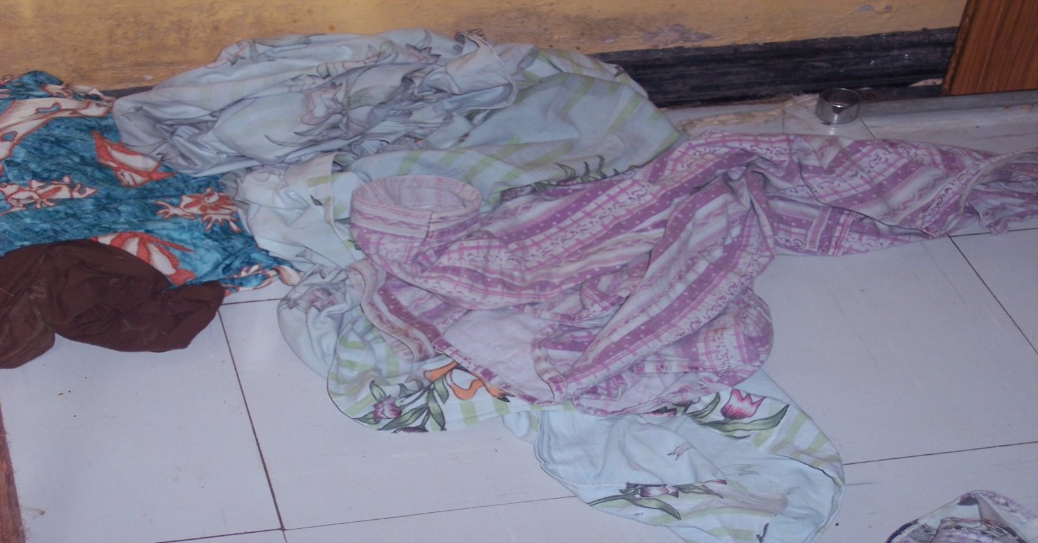
Soiled linen thrown to the floor

Slide 11
Handling
Handle soiled textiles as little as possible.
To avoid the spread of microorganisms in the environment and among HCWs and patients, do not shake soiled textiles.
Two bags may be indicated for highly soiled and non soiled

Slide 12
Transporting
Transport collected used textiles to the processing area in closed bags, containers with lids, or covered carts.
Transport soiled textiles and clean textiles separately. If there are separate carts, trolleys, or containers available for soiled and clean textiles, they should be labeled accordingly.
If soiled and clean textiles are transported in the same cart or container:
  Clean the containers and trolleys or carts thoroughly after transporting soiled textiles using disinfectant cleaning solution

Slide 13
Sorting Soiled textiles
The processing area for soiled textile must be separate from areas used for folding and storing .
Maintain adequate ventilation and physical barriers between the clean and soiled textile areas.
Do not sort or pre-rinse soiled textiles in patient care areas;
They should be sorted in the laundry area.

Slide 14
Sorting Soiled textiles
Sort soiled textiles into appropriate wash loads by classification such as (e.g., whites’ items, type of fabric, soil type or soil load, cotton/wool items, mop heads, surgical drapes, etc.)
Always wear protective eyewear, utility gloves, appropriate footwear and plastic or rubber apron while handling soiled textile.
Wash hands after removing the gloves.

Slide 15
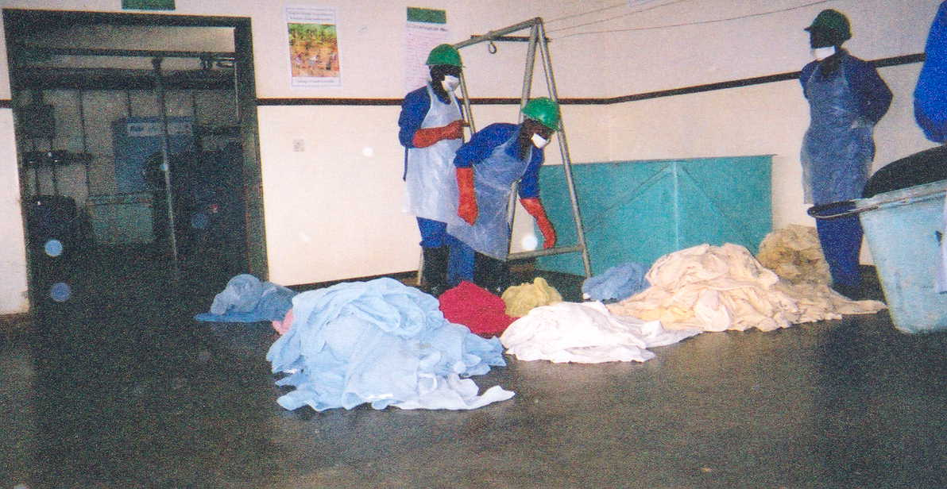
Sorting textile

Slide 16
Washing Textiles

Slide 17
Washing textiles
Effective laundering is dependent on the following factors, when used together, have a greater effect than when used separately:
  Duration of cleaning
  Mechanical action (i.e., agitation)
  Chemicals used in the process
  Temperature of water and air in the dryer machine

Slide 18
Washing textiles cont’d…
If one of these factors is decreased (e.g., temperature), then other factors (e.g., chemicals, mechanical action, or time) must be increased to result in the same level of cleanliness.

Slide 19
Drying, inspecting, and folding textiles
Completely air or machine-dry cleaned
check for holes and threadbare (worn) areas
Air-dried textiles should be ironed
Clean, dry textiles should be folded

Slide 20
Steps for Machine Washing
STEP 1: Wear PPE while handling and loading machines.
STEP 2: Separate heavily soiled textiles from non-soiled textiles and wash separately.
STEP 3:Follow manufacturers’ instructions to adjust temperature settings, cycle time, type of soap, and other washing agents to be added.

Slide 21
Steps for Machine Washing Cont’d…
STEP 4: For hot-water washing at 70–80ºC (158–176ºF), use soap for ≥ 25 minutes to aid in loosening soil. Add bleach and sour if stain removal is required.
  If not using hot water, soaking textiles in 0.05%–0.5% chlorine solution for 15–30 minutes and then wash with soap and water to remove the bleach.
STEP 5: When the wash cycle is complete, check the item for cleanliness. Rewash if it is dirty or stained. (Heavily soiled textiles may require two wash cycles.)

Slide 22
Washing textiles by hand
The steps to properly hand wash textiles are:
STEP 1: Wear PPE while washing textiles by hand.
STEP 2: Separate heavily soiled textiles from non-soiled textiles and wash separately.
STEP 3: Wash the entire item in water with soap to remove all dirt and debris, even if not visible.

Slide 23
Washing textiles by hand cont’d…
STEP 4: Soak in clean water with chlorine solution (0.005–0.015% or 50–150 parts per million [ppm]) for 30 minutes.
  Add sour (a mild acid agent) to prevent yellowing of the textile.
STEP 5: Wash again with soap and water to remove bleach.
STEP 6: Check the item for cleanliness. Rewash if it is still dirty or stained.
STEP 7: Rinse the item with clean water.

Slide 24
Storing, Transporting, and Distributing Clean Textiles

Slide 25
How do you do Store, Transporting, and Distributing hygienically clean textiles at your facility?

Slide 26
Storing Hygienically Clean Textiles
Procedures for proper storing of hygienically clean textiles:
  Store clean textiles in clean, closed storage areas.
  Store clean textiles in an area free of pests, dust, and lint and at room temperatures of 20–25.6°C (68–78°F).
  Use physical barriers to separate folding and storage rooms from soiled areas.

Slide 27
Storing Hygienically Clean Textiles Cont’d…
Ensure that storage shelves are:
  2.5 to 5 cm (1 to 2 inches) from the wall
  Bottom shelf: 15 to 20 cm (6 to 8 inches) from the floor
  Top shelf: 30 to 45 cm (12 to 18 inches) below the ceiling
Keep shelves clean and textiles covered, which can be achieved by:
  Covering clean textiles on a clean cart
  Wrapping bundles of clean textiles in plastic or other suitable material and closing securely.
Restrict access to the laundry storage room to authorized staff.

Slide 28
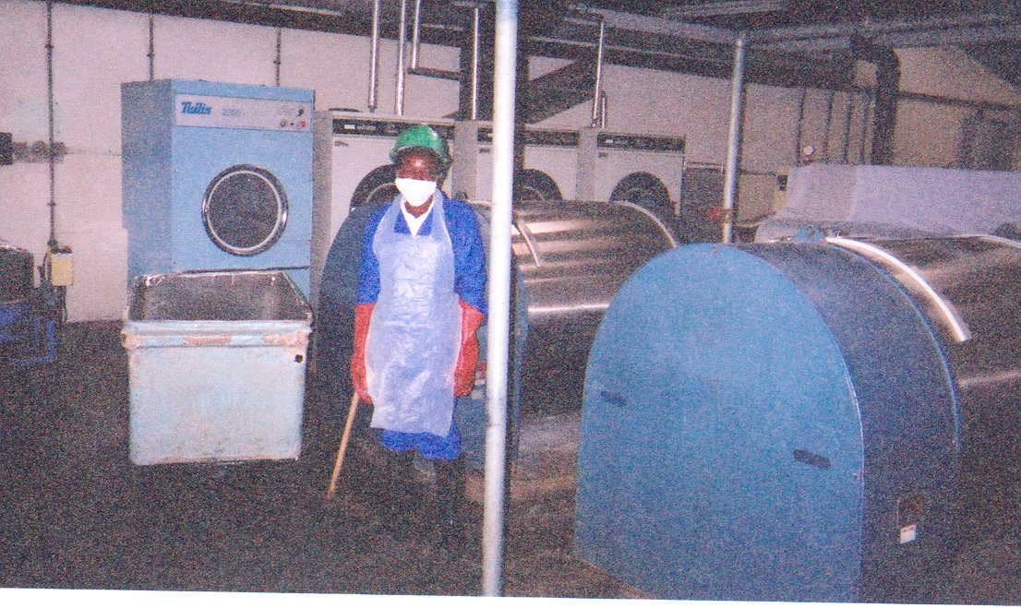
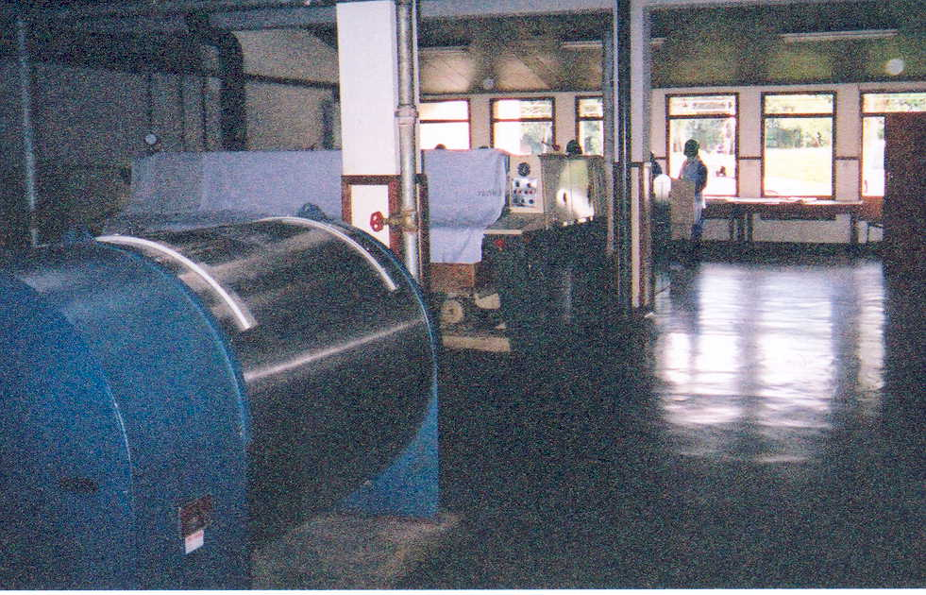
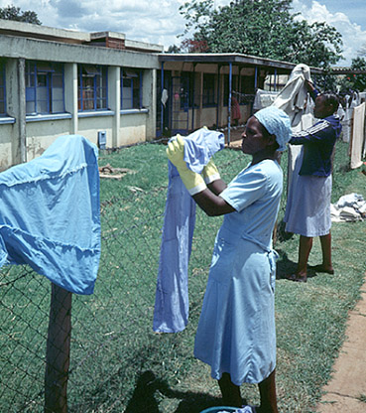
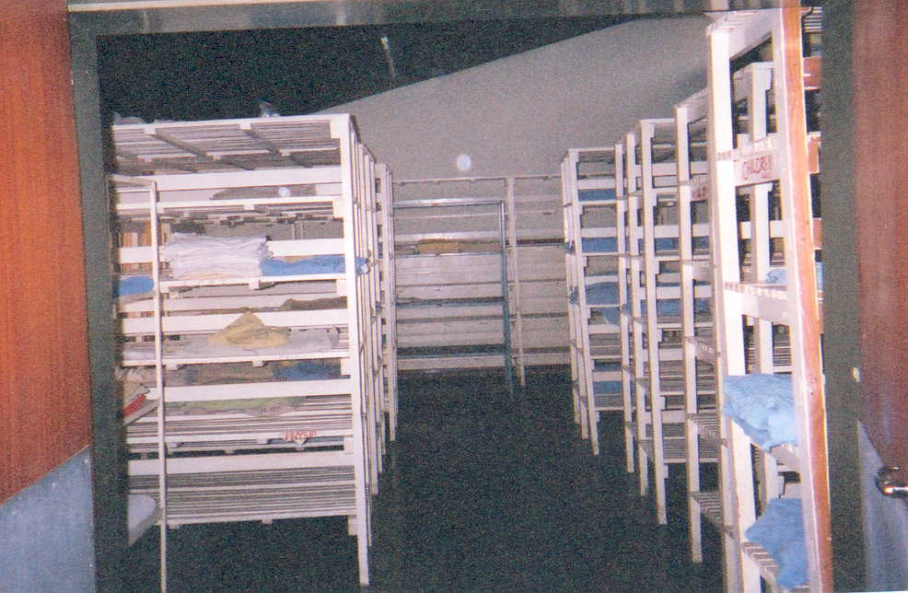
Washing linen
Drying linen
Storing linen

Slide 29
Thank you

