Slide 1
Volume 1
Chapter 9: Environmental Cleaning in Healthcare Facility
IPC for Health for health care settings In Ethiopia

Slide 2
Chapter Outline
Chapter Objective
PPP 9.1: Significance of housekeeping in hospitals and clinics.
PPP 9.2: General principles of cleaning.
PPP 9.3: Ways of preparing disinfectant cleaning solutions.

Slide 3
Chapter Outline cont’d
PPP 9.4: Cleaning Methods and schedule.
PPP 9.5: Cleaning spills of blood or other body fluids.
PPP 9.6: Cleaning the housekeeping equipment
Summery

Slide 4
Chapter Objective
At the end of this module, participants will be able to:
Explain the importance of house keeping
State the general principles of housekeeping in health care facilities
Able how to select cleaning solutions
List the type of PPE used during environmental cleaning
Demonstrate how to prepare disinfectant cleaning solution
Identify cleaning methods
Explain how to clean low and high risk area

Slide 5
PPP 9.1: Significance of housekeeping in hospitals and clinics

Slide 6
Significance of housekeeping in hospitals and clinics
Accumulation of dust, soil and microbial contaminants on environmental surfaces is both unsightly and potential source of HAIs.
Effective and efficient cleaning methods and schedules are, therefore, necessary to maintain a clean and healthy environment in healthcare settings.
Housekeeping practices in the healthcare facilities including: the compound, the floors, walls, various type of equipment, tables and other surfaces.

Slide 7
Significance of housekeeping in hospitals and clinics cont’d…
The purpose of general housekeeping is to:
  Reduce the number of microorganisms that may come in contact with patients, visitors, staff and the community; and
  Provide a clean and pleasant atmosphere for patients and staff.

Slide 8
Significance of housekeeping in hospitals and clinics cont’d…
Housekeeping staff be trained to perform their assigned tasks and are supervised on a regular basis. As part of their training, it is important that the housekeeping staff:
  Understand the risk of exposure to contaminated items and surfaces when performing environmental cleaning procedures; and
  Follow recommended policies and guidelines including the use of appropriate personal protective equipment (PPE).

Slide 9
Significance of housekeeping in hospitals and clinics cont’d…
Areas | Level of risk | Cleaned using
waiting rooms and administrative offices | low-risk | soap and water
Toilets and latrines; Patient rooms items touched bare handedly by patients and staff Operating rooms, pre- and postoperative recovery areas, dressing areas and intensive care units (ICUs). Blood or body fluid spills areas | High-risk (heavy contamination) | Disinfectants like 0.5% Chlorine or 1% Phenol

Slide 10
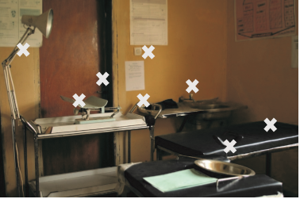
Frequently Touched Surfaces in an Examination Room

Slide 11
PPP 9.2: General principles of Cleaning

Slide 12
General principles of Cleaning
Cleaning is required prior to any disinfection process because dirt, debris and other materials can decrease the effectiveness of many chemical disinfectants
Scrubbing (frictional cleaning) is the best way to physically remove dirt, debris and microorganisms.
Cleaning products should be selected based on their use, efficacy, safety and cost.
Cleaning should always progress from the least soiled areas to the most soiled areas and from high to low areas so that the dirtiest areas and debris falling on the floor will be cleaned up last.
Dry sweeping, mopping and dusting should be avoided to prevent dust, debris and microorganisms from getting into the air and landing on clean surfaces.
Airborne fungal spores are especially important as they can cause fatal infections in immune-suppressed patients.

Slide 13
General principles of Cleaning cont’d…
Instructions for mixing (dilution) should strictly be followed when using disinfectants. (Too much or too little water may reduce the effectiveness of disinfectants).
Cleaning methods and written cleaning schedules should be based on the type of the surface, the amount and the extent of the soil present and the purpose of the area.
Routine cleaning is necessary to maintain the standard of cleanliness. Also, schedules and procedures should be consistent and posted.

Slide 14
How to Select Cleaning Products
An ideal cleaning product should accomplish the following:
  Able to suspend fats in water
  Saponification of fat (make fats water-soluble).
  Surfaction (decreasing surface tension of water and allowing greater penetration of the agent into the dirt or soil).
  Dispersion (break up of soil into small particles).
  Protein destruction (break up proteins).
  Softening the water by removing calcium and magnesium from it.

Slide 15
How to Select Cleaning Products cont’d…
The Main Guiding Principles for Resource Limited Areas are:
  Unnecessarily expensive products should not be selected.
  What is selected and bought should be based on evidence (not to be left to chance).
  The right product should be for the right purpose.

Slide 16
How to Select Cleaning Products cont’d…
Selection of disinfectants and cleaning products should be based on the following factors:
  Intended use of the product/s.
  Efficacy of the product/s.
  Acceptability of the product/s.
  Environment friendly.
  Safety of the product/s.
  Cost-effectiveness of the product/s.

Slide 17
Personal Protective Equipment for Housekeeping
The housekeeping staff in health facilities deals with dirt, soils and other materials that expose them to risks of infections and other health hazards.
To avoid this hazardous exposure, they must be equipped with the relevant personal protective equipment.

Slide 18
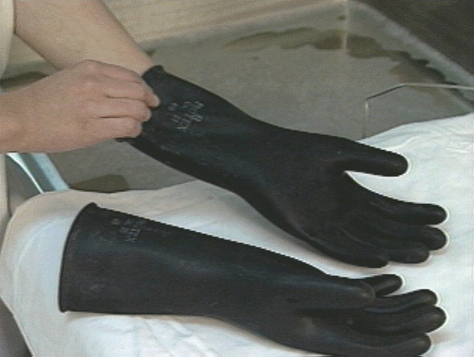
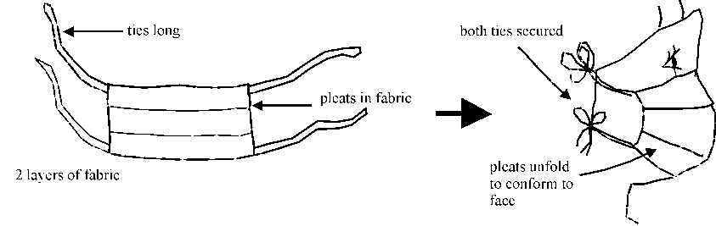
Personal Protective Equipment for Housekeeping cont’d…
Some of personal protective equipment for housekeeping purposes are:
  Gloves preferably the utility or Heavy duty gloves
  Protective shoes
  Plastic or rubber apron
  Masks
  Protective eye wears

Slide 19
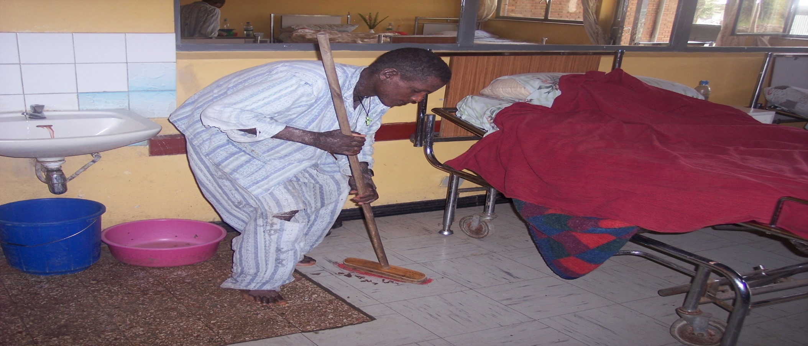
Dry sweeping by patients

Slide 20
PPP 9.3: Ways of preparing disinfectant cleaning solutions.

Slide 21
How to prepare cleaning disinfectant solution
STEP 1 Prepare a 0.5% Chlorine solution from liquid concentrates or from Chlorine powder compounds
      Alternative disinfectants that can be used include 1 to 2% Phenols or 5% Carbolic acid.
STEP 2 Add enough detergent to the 0.5% Chlorine solution or another disinfectant to make a mild and soapy cleaning solution.

Slide 22
How to prepare cleaning disinfectant solution cont’d…
When we use Chlorine solution, we should be very cautious.
Although chlorine-containing solutions (sodium hypochlorite) are excellent and inexpensive disinfectants, they should not be mixed with cleaning solutions containing an acid (e.g. phosphoric acid) like Ammonia or Ammonium chloride (NH₄Cl).
So doing will release chlorine gas and other by- products that can result in temporary illness (nausea, tearing, headache or shortness of breath) of the staff inhaling fumes in a poorly ventilated area.

Slide 23
How to Prepare Chlorine Solution
For liquid bleach
To make a 0.5% chlorine solution from 5% bleach, mix 1 part bleach to 9 parts water.
Total parts (TP) (H₂O) =
- 1
Total parts (TP) (H₂O) =
- 1
= 9 Total parts (TP) (H₂O)

Slide 24
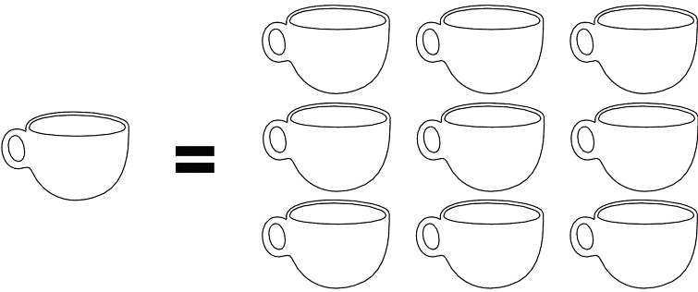
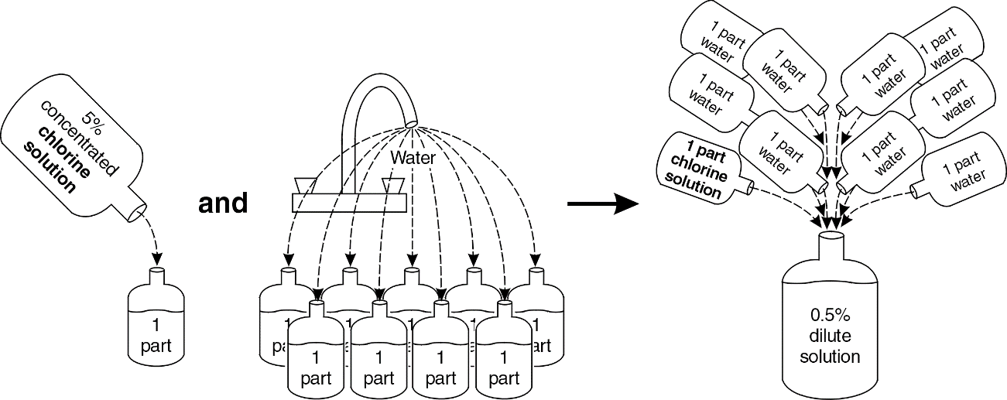
Examples Using 5% Bleach for
0.5% Concentration
One part bleach to 9 parts water (use the same container to measure the bleach and water)

Slide 25
How to Prepare Chlorine Solution cont’d…
For powder chlorine form
To make a 0.5% chlorine solution form a 35% chlorine powder, mix 14.2 grams of powder chlorine to 1 liter of water
Gram/Liter =
X 1000
Gram/Liter =
X 1000
= 14.2 Gram/Liter

Slide 26
PPP 9.4: Cleaning Methods and Schedules

Slide 27
Cleaning Methods
Cleaning should start with the least soiled area and extend to the most soiled area and from high to low surfaces.
Common methods of cleaning are briefly described below:

Slide 28
Wet Mopping Method (Preferable for Floor Cleaning)
Single-Bucket (Basin) Technique
  Only one bucket of cleaning solution is used here.
  The solution, however, needs to be changed when dirty.
  The killing power of the cleaning product decreases with the increased load of soil and organic material present
Double-Bucket Technique –
  Two different buckets are used here---
  one containing a cleaning solution and the other containing water for rinsing.
  The mop is always rinsed and wrung out before it is dipped into the cleaning solution.
  The double-bucket technique extends the life of the cleaning solution (fewer changes are required) saving both labor and material costs.
Triple-Bucket Technique
  The third bucket is used for wringing out the mop before rinsing
  this extends the life of the rinse water.

Slide 29
Flooding Followed by Wet Vacuuming Method
It is preferable for surgical suits.
It eliminates mopping and minimizes the spread of micro-organisms.
It increases the contact time of the disinfectant and the area to be cleaned.
Preferably, it should be done at night when the traffic flow of the facility is low.

Slide 30
Dusting
Should be used for cleaning walls, ceilings, doors, windows, furniture and other environmental surfaces..
Dry dusting should be avoided and dust cloths should not be shaken for fear of spreading of micro-organisms.
Should be performed in a systematic way using a starting point as a reference to endure that all surfaces have been reached.
Check for a stain that may indicate possible leaks when doing high dusting, (ceiling tiles and walls).

Slide 31
Dry Vacuuming
This is recommended only for cleaning carpets

Slide 32
Schedule and Procedure Cleaning
In health facilities, housekeeping activities should be scheduled.
  Housekeeping schedule should be planned, written and closely followed.
  Cleaning schedules should be developed per the need of each area.
  Disinfectant should be used when contaminations from blood or other body fluid spills are present.

Slide 33
Schedule and Procedure Cleaning cont’d…
Walls, Windows, Ceilings and Doors, including Door Handles
  These should be cleaned at the spot when visibly dirty with a damp cloth, detergent and water. In general, routine damp dusting is adequate for these areas (disinfection is unnecessary).
Chairs, Lamps, Tables, Tabletops, Beds, Handrails, Grab Bars, Lights, Tops of Doors and Counters
  These items should be wiped daily and whenever visibly soiled with a damp cloth containing disinfectant cleaning solution.

Slide 34
Schedule and Procedure Cleaning cont’d…
Non-Critical Equipment (e.g. stethoscopes and blood pressure cuffs)
  These ones can just be wiped daily and whenever visibly soiled with a damp cloth with detergent and water.
  If the equipment is visibly soiled with blood or other body fluids or when the patient is under contact precautions, however, it should be cleaned and disinfected before it is reused.
Floors
  Floors usually cleaned (daily and as needed) with a wet mop, detergent and water.

Slide 35
Schedule and Procedure Cleaning cont’d…
Sinks
  Scrub frequently (daily or more often as needed) with a separate mop, cloth or brush is using a disinfectant cleaning solution. Following this, it needs to be rinsed with water.
Toilets and Latrines
  Scrub them frequently (daily and more often as needed) with a separate mop, cloth or brush and a disinfectant cleaning solution.
Patient Rooms
  They should be cleaned daily and right after patient is discharged using the processes described above.

Slide 36
Schedule and Procedure Cleaning cont’d…
Procedure Rooms
  Wipe horizontal surfaces, equipment and furniture used for the procedures, with a disinfectant cleaning solution after each procedure and whenever visibly soiled.
Examination Rooms
  Wipe horizontal surfaces with a disinfectant cleaning solution whenever visibly soiled.
  Linen or paper on the examination table should be changed and laid out for each patient.
  Clean blood or other body fluid spills .

Slide 37
Schedule and Procedure Cleaning cont’d…
Laboratory
  Wipe countertops with a disinfectant cleaning solution after each shift and whenever visibly soiled. Clean blood or other body fluid spills as described below.
Curtains
  Change and clean curtains according to the routine schedule and when visibly soiled.
Carpets
  Vacuuming daily carpets in patient rooms or weekly in offices or conference rooms.
Soiled Linen
  Collect soiled linen daily (or more often as needed) put them in closed and leak proof containers.

Slide 38
Schedule and Procedure Cleaning cont’d…
Waste
  Collect waste from all areas at least daily (or more frequently as needed) and avoid overflowing.
Waste Containers
  Clean contaminated waste containers each time following emptying.
  Clean no contaminated waste containers when visibly soiled and at least once a week.
  Use a disinfectant cleaning solution and scrub to remove soil and organic material.

Slide 39
Schedule and Procedures for the Operating Room
At the beginning of each day, all flat (horizontal) surfaces (table, chairs, etc.) should be wiped with a clean, lint-free and moist cloth to remove dust and lint that may have collected overnight.
Total cleaning is not necessary between each case for surgical procedures.
Total cleaning or terminal cleaning (mopping floors and scrubbing all surfaces from top to bottom) of the operating room should be done at the end of each day.
Do not dry mop or sweep the operating room

Slide 40
PPP 9.5: Cleaning spills of blood or other body fluids.

Slide 41
Cleaning Procedure for Small and large Spill
Clean spills of blood, body fluids and other potentially infectious fluids immediately:
  For small spills, remove visible material using a cloth soaked in a 0.5% Chlorine solution, then wipe clean with a disinfectant cleaning solution while wearing utility or examination gloves.
  For large spills, flood the area with a 0.5% Chlorine solution leave for 10 minutes and mop up the solution

Slide 42
Cleaning Procedure for Soiled and Contaminated Cleaning Equipment
STEP 1 Decontaminate cleaning equipment that has been contaminated with blood or body fluids by soaking it for 10 minutes in a 0.5% Chlorine solution or other locally approved and available disinfectants.
STEP 2 Wash cleaning buckets, cloths, brushes, mops and the like with detergent and water daily or right away if visibly dirty.
STEP 3 Rinse them in clean water.
STEP 4 Dry them completely before reuse. (Wet clothes and mop heads are heavily contaminated with microorganisms).

Slide 43
Summary
Don’t:
Dry mop or dust
Sweep
Do:
Wet mop and dust
Terminal cleaning of the surgical unit every 24 hours
Clean the OR and procedure rooms between patients
Post cleaning methods and schedules
Cleaning should start with the least soiled area and extend to the most soiled area
Housekeeping staff should be trained
Decontaminate, wash, and dry cleaning equipment before reuse

