Slide 1
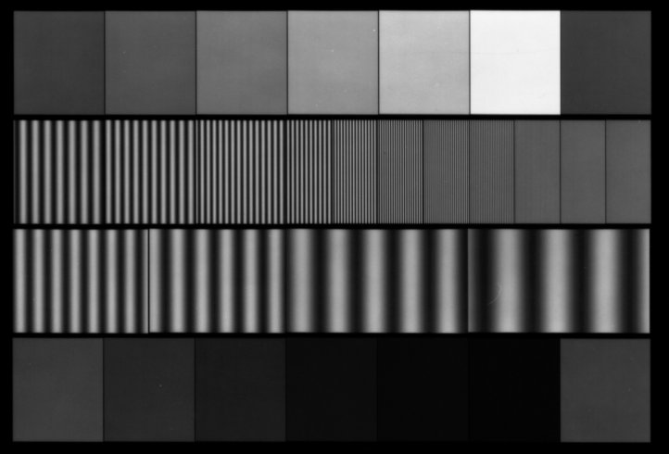
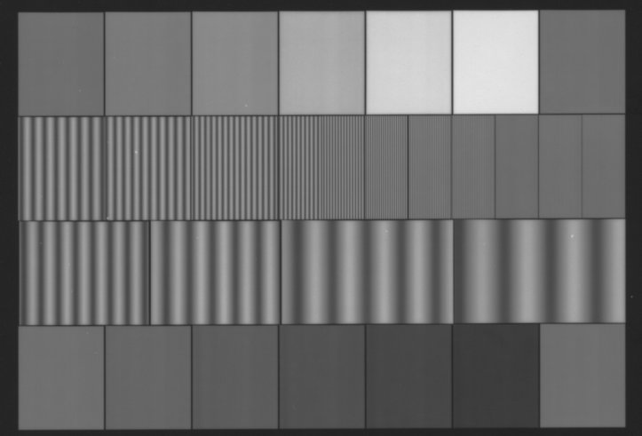
Geometry of M-13 targets changed during 2014 for serial numbered M13-60-1X targets. (Possibly 1/2X targets as well.) Serial numbers after #889 are known to use the newer (v2) geometry. Serial numbers prior to #816 use the older (v1) geometry. The two target versions can be distinguished visually as shown below. Use the appropriately labeled sample data file.
Old M-13 (v1): Separation between adjacent rows of patches is larger than separation between adjacent density patches.
New M-13 (v2): Separation between adjacent rows of patches is the same as separation between adjacent density patches.

