Slide 1
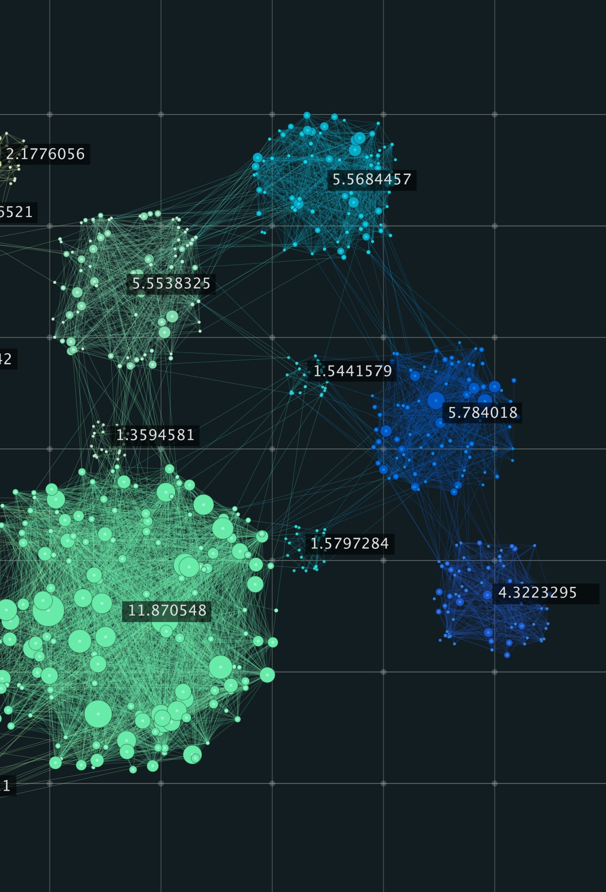

AGGLOMERATIVE CLUSTERING & DBSCAN
Explanation, use cases, comparison to K-Means

Slide 2
Table of contents
K-Means
Agglomerative (hierarchical) Clustering
DBSCAN
Use cases

Slide 3
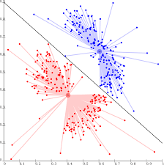
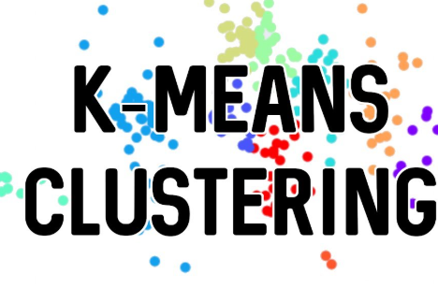
K-Means
Let's recall the basics of the K-Means algorithm

Slide 4
How does K-Means work
Choose how many clusters (K) you want ➤ For example, you decide you want to group your data into 3 clusters.
Randomly place K points (called centroids) ➤ These are just "guesses" of where the center of each cluster might be.
Assign each point to the nearest centroid ➤ Each data point “joins” the cluster whose centroid is closest to it.
Move each centroid to the average of its assigned points ➤ Basically, recalculate the center of each cluster.
Repeat steps 3 and 4 until nothing changes ➤ That means the points stay in the same clusters, and centroids stop moving.

Slide 5
An illustration of the K-Means algorithm
Given:
a set of points for clustering
K(3) clusters to be searched for

Slide 6

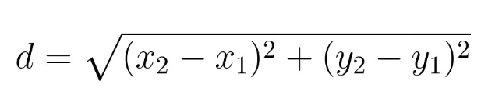
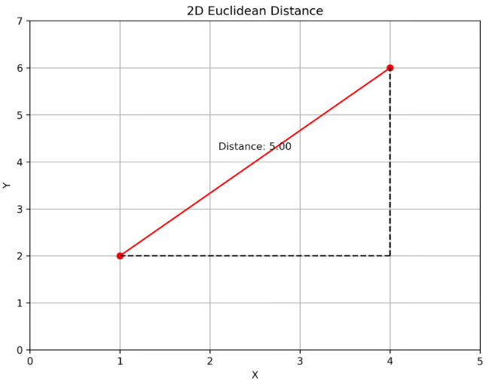
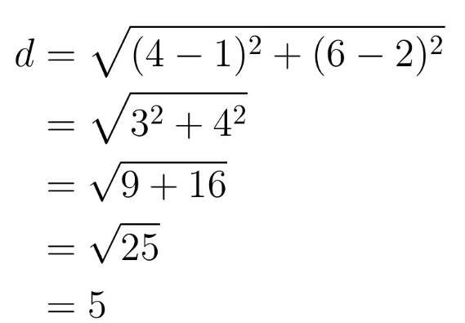
Euclidean Distance
Formula (for 2D space):

Slide 7
Pros of K-Means algorithm
Easy to understand and implement ➤ Simple logic: group by closeness to the center (centroid).
Scales well ➤ Can handle thousands or even millions of data points quickly.
Fast and efficient ➤ Works well with large datasets and high-dimensional data.
Works well when clusters are spherical and evenly sized ➤ Great for clean, well-separated data.
Widely used and supported ➤ Available in almost every machine learning library.

Slide 8
Cons of K-Means algorithm
Sensitive to outliers and noise ➤ A single outlier can distort a cluster's centroid.
Assumes clusters are circular (spherical) ➤ Doesn't work well with irregular or elongated shapes.
Must choose the number of clusters (K) beforehand ➤ Can be tricky if you don’t know how many groups exist in your data.
Can converge to local minimum ➤ Different initial centroid positions may give different results.
Not good with different cluster sizes or densities ➤ It may split a large cluster or merge small, dense clusters incorrectly.

Slide 9
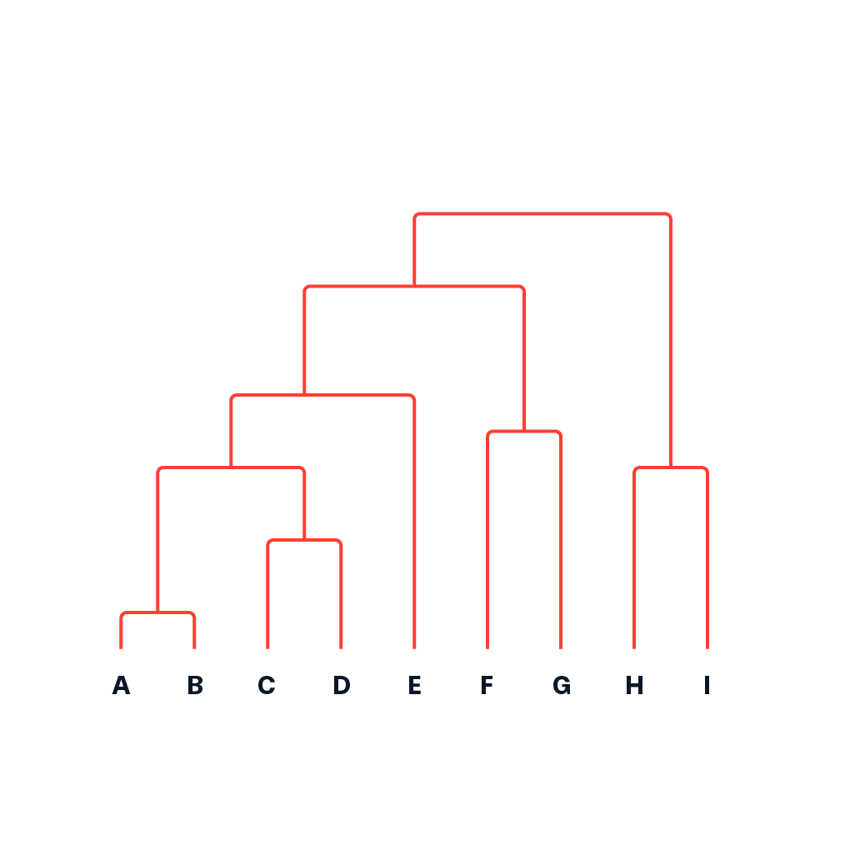

Agglomerative (hierarchical) clustering

Slide 10
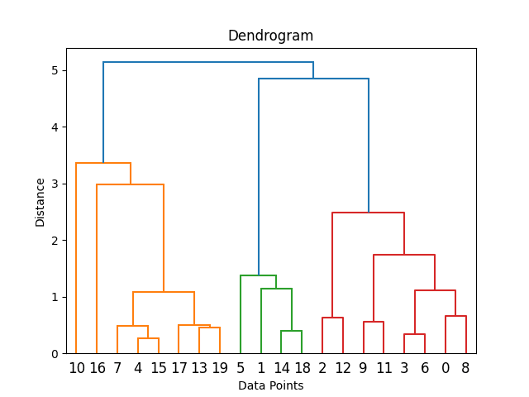
How does Agglomerative clustering work
Start with each point as its own cluster ➤ If you have 10 points, you start with 10 tiny clusters.
Find the two closest clusters ➤ Look for the pair that are the most similar or closest to each other. Uses Euclidean distance as well.
Merge them into one cluster ➤ Combine those two into a single group.
Repeat steps 2 and 3 ➤ Keep finding and merging the closest clusters.
Stop when you have the number of clusters you want ➤ Or, stop when everything is merged into one big cluster (you can cut it into pieces later).

Slide 11
An illustration of the Agglomerative clustering works

Slide 12
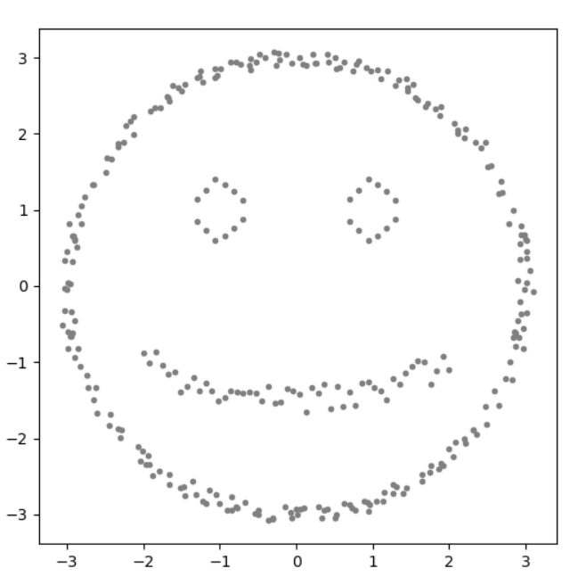
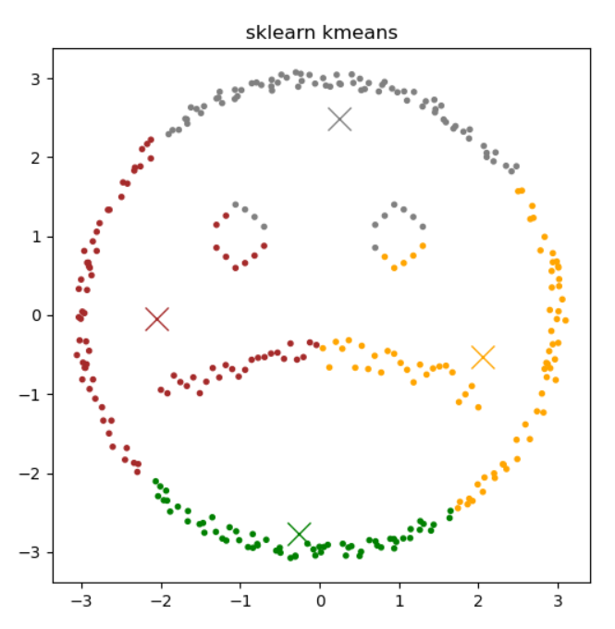
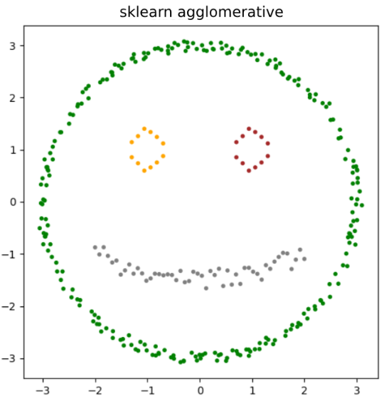
An example of different clustering algorithms

Slide 13
Linkage Methods
How to determine which cluster to assign a new point to?
To determine how clusters should be merged in hierarchical clustering, we use different linkage methods — ways to measure the distance between clusters.
Some commonly used linkage methods include:
Single Linkage (also known as Minimum Linkage)
Complete Linkage (or Maximum Linkage)
Average Linkage
Centroid Linkage
Ward’s Linkage
These methods influence how clusters are formed and can lead to different results depending on the dataset.

Slide 14
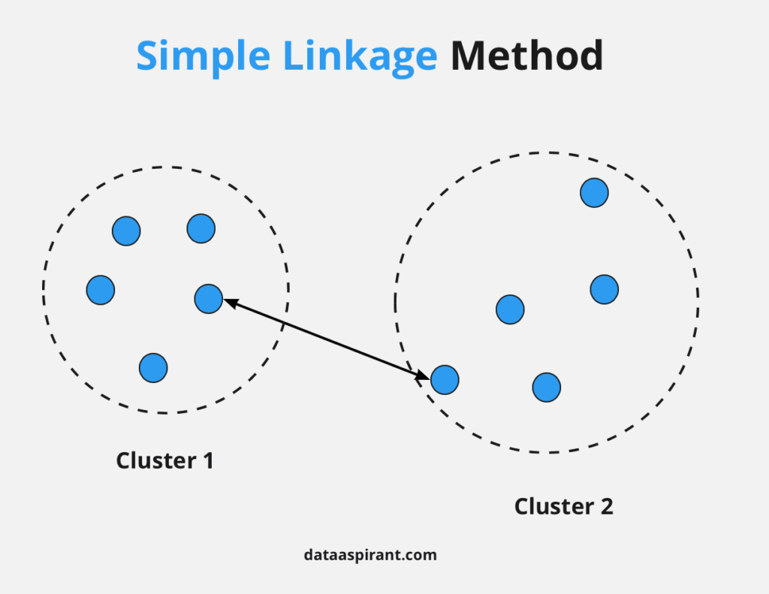
Single Linkage (Minimum, Simple Linkage)
What it does: Measures the shortest distance between any two points in two clusters.
Purpose: Tends to create long, chain-like clusters.
Good for: Handling non-elliptical shapes. It is the best for capturing clusters of different sizes. Dealing with clean data.

Slide 15
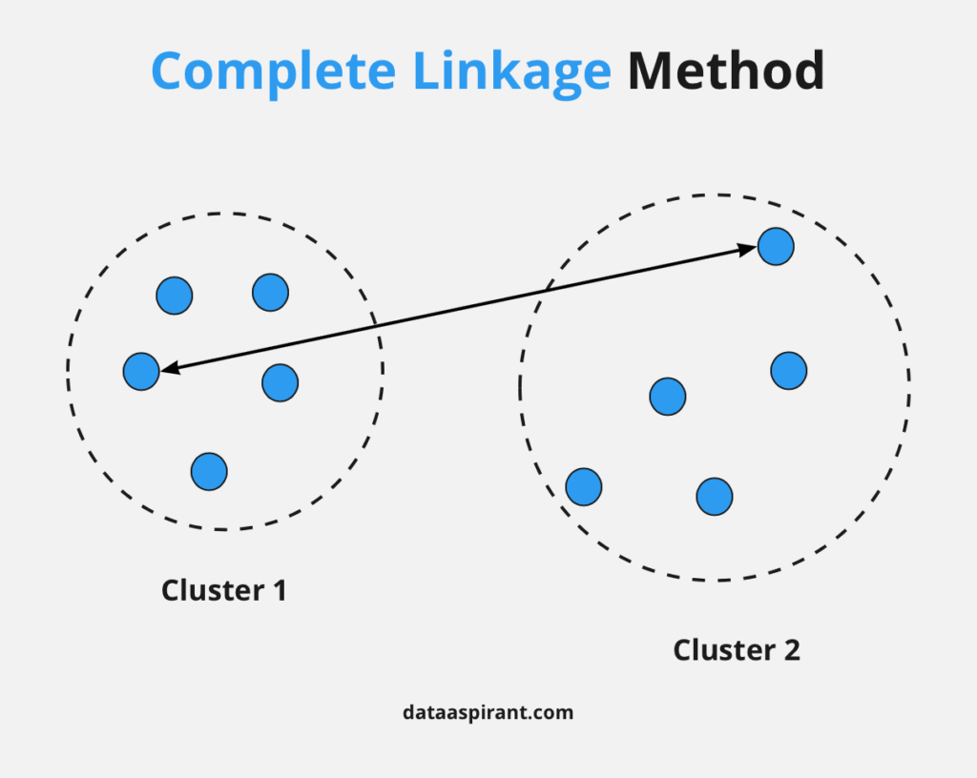
Complete Linkage (Maximum Linkage)
What it does: Measures the farthest distance between any two points in two clusters.
Purpose: Produces compact, tightly grouped clusters.
Good for: Avoiding long or stretched clusters. Dealing with noise and outliers.

Slide 16
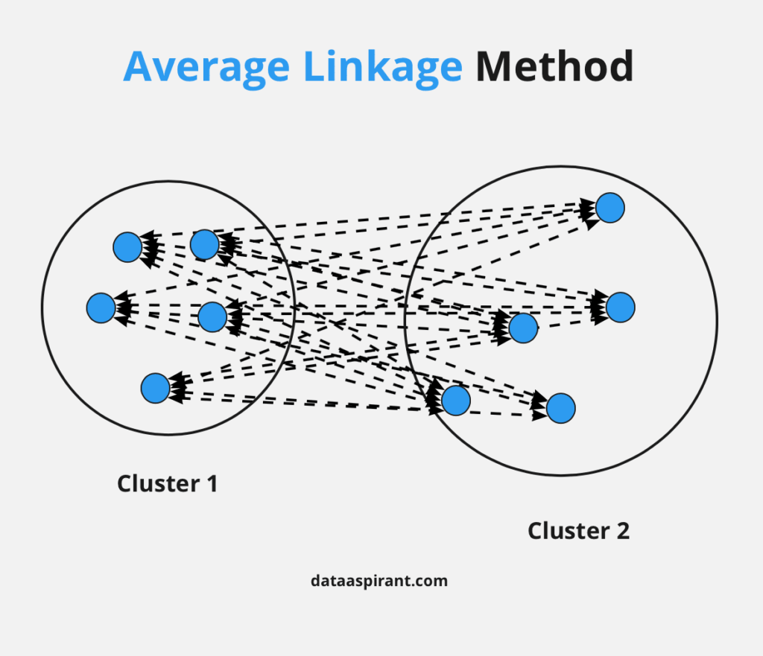
Average Linkage
What it does: Calculates the average distance between all pairs of points across two clusters.
Purpose: Balances between single and complete linkage.
Good for: Getting more stable and natural clusters.

Slide 17
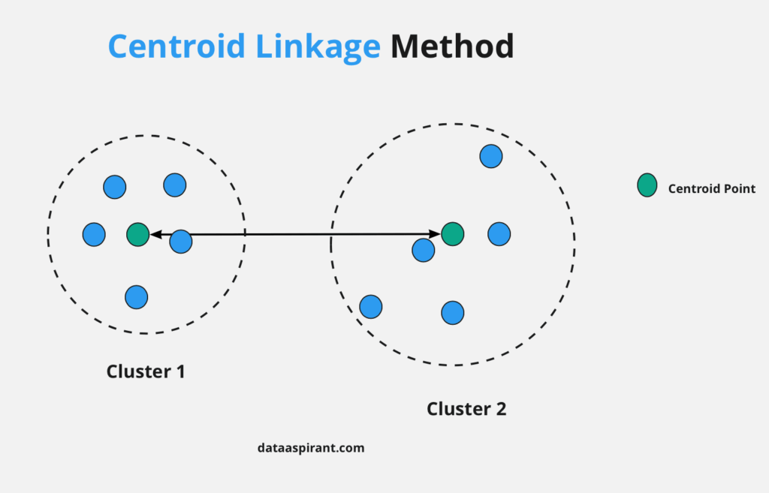
Centroid Linkage
What it does: Measures the distance between the centroids (mean points) of two clusters.
Purpose: Merges clusters based on the center point.
Good for: Separating clusters if there is any noise between the clusters. Smooth transitions between clusters.

Slide 18
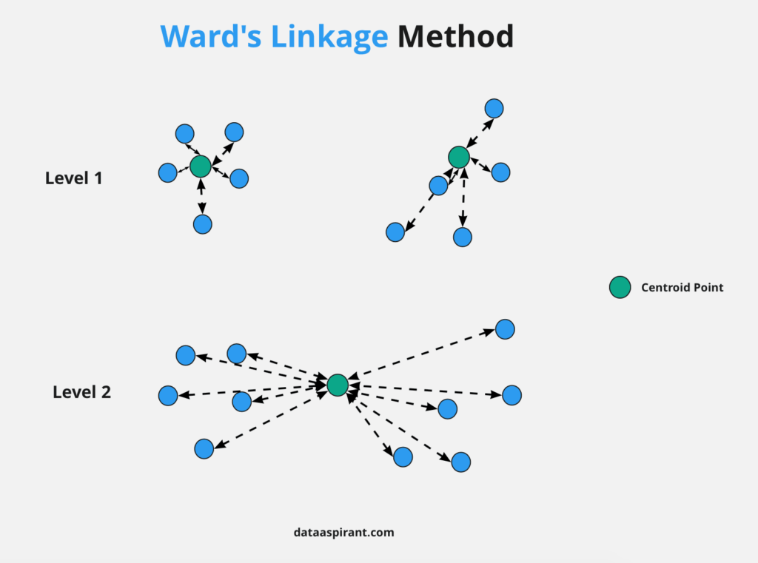
Ward’s Linkage
What it does: Merges clusters that result in the smallest increase in total within-cluster variance (compactness).
Purpose: Minimizes how much clusters “spread out” when they are merged.
Good for: Generating better cluster hierarchies. Less sensitive to noise and outliers.

Slide 19
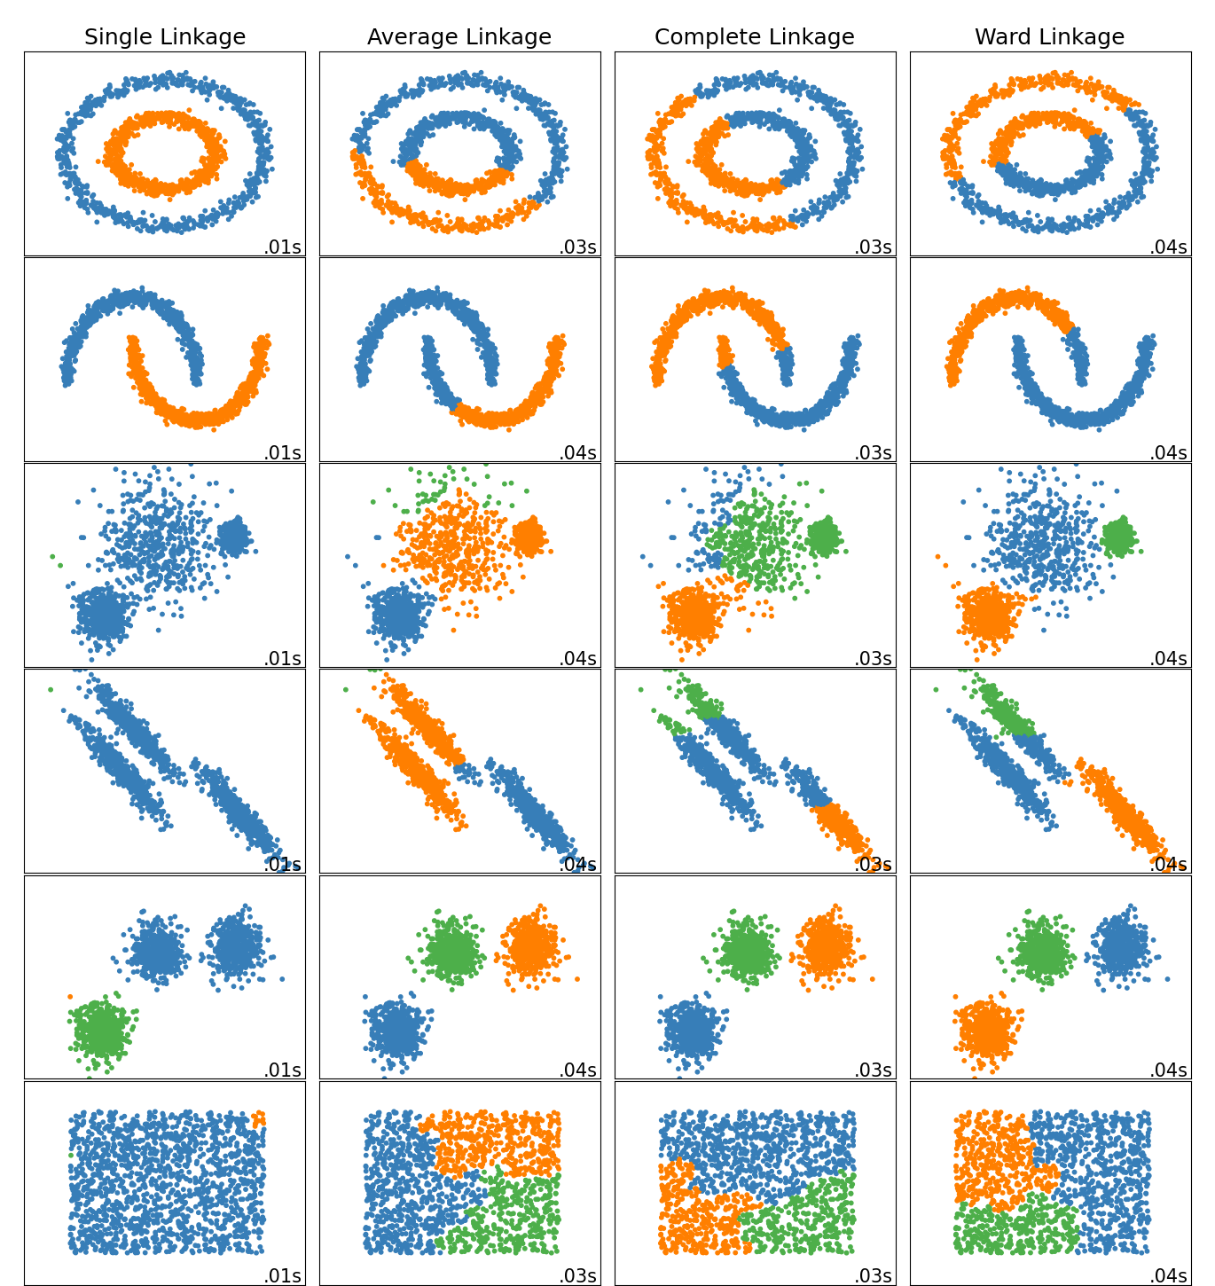
Linkage Examples

Slide 20
Pros of Agglomerative clustering
No need to pre-specify number of clusters ➤ You can build the full hierarchy and decide later how many clusters you want.
Works well with non-spherical ➤ Unlike K-Means, it doesn’t assume clusters are round or evenly sized.
Creates a dendrogram (tree diagram) ➤ Helps visualize the merging process and understand the data structure.
Can handle small datasets effectively
Flexible linkage criteria ➤ You can choose different ways to define “closeness” between clusters (e.g., single, complete, average linkage).

Slide 21
Cons of Agglomerative clustering
Hard to undo wrong merges ➤ Once two clusters are merged, they stay merged — mistakes can’t be fixed.
Sensitive to noise and outliers ➤ Outliers can affect the clustering structure.
Scales poorly with large datasets ➤ It’s computationally expensive — slow with lots of points.
Less efficient than K-Means ➤ Especially when dealing with high-dimensional data.

Slide 22
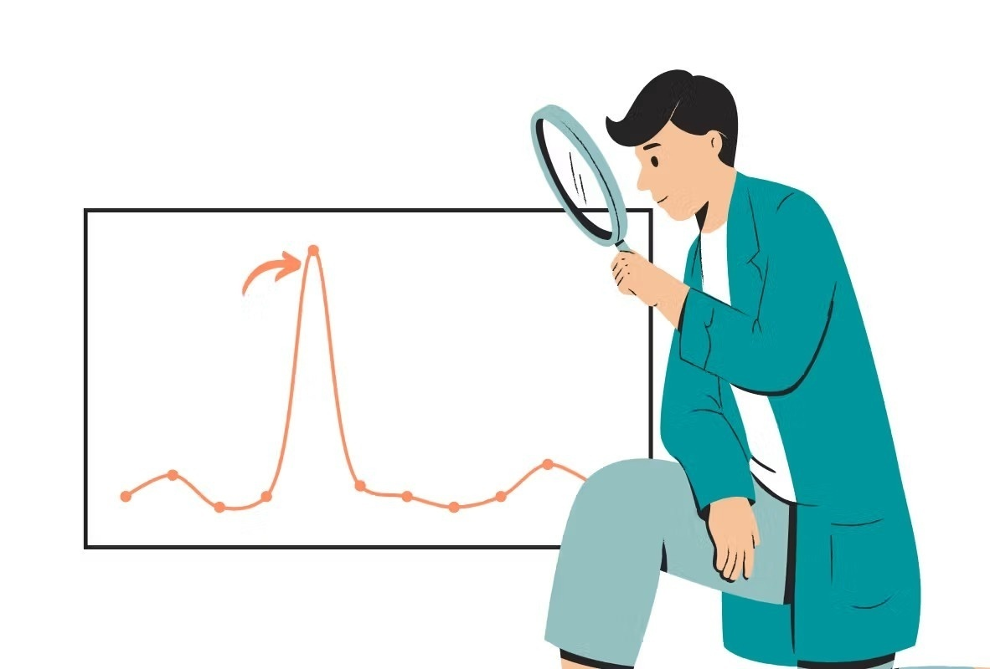
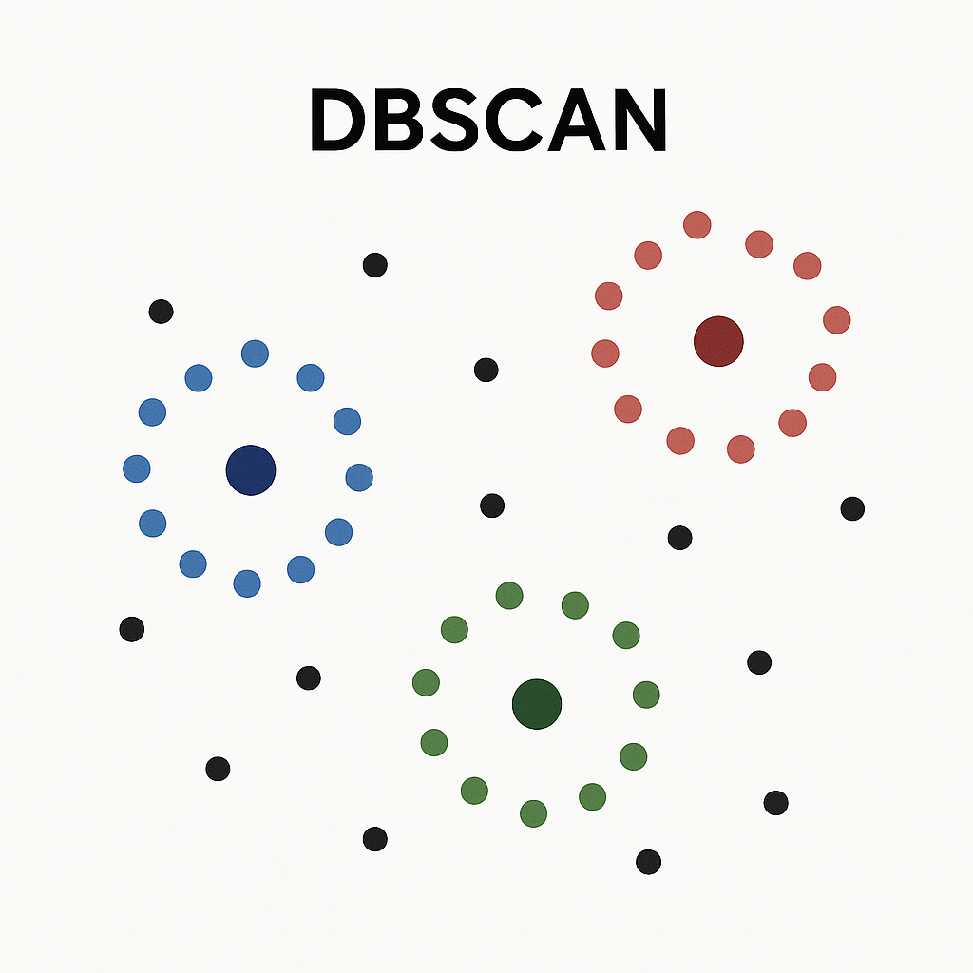
DBSCAN
(DBSCAN = Density-Based Spatial Clustering of Applications with Noise)

Slide 23
How does DBSCAN work
Pick a point ➤ Start with a random point in the dataset.
Decide if it's a core point ➤ If it has enough neighbors (at least min_samples), it's a core point — start a new cluster.
Expand the cluster ➤ Add all directly reachable points to the cluster. If they’re also core points, keep expanding from them.
Check its neighborhood ➤ Find all points within a certain distance (called ε — epsilon).
Repeat for remaining points ➤ Go through unvisited points and repeat the process.
Label the rest as noise ➤ Points that don’t meet the neighborhood rule are marked as noise or outliers.

Slide 24
An illustration of the DBSCAN
Given:
a set of points for clustering
min_samples
eps

Slide 25
What does “eps” parameter mean
Meaning of eps (epsilon) – Neighborhood Radius
eps defines the maximum distance between two points for them to be considered as neighbors.
Think of it as a radius you draw around each point. Any other points that fall within this radius are considered "close enough" to possibly be in the same cluster.
It controls the density sensitivity of DBSCAN:
A small eps means only very close points will be grouped together — this makes the algorithm look for dense clusters.
A large eps allows points that are farther apart to be grouped — this may lead to fewer clusters or even one big one.
DBSCAN uses this radius to decide if a point is part of a dense region (a cluster) or if it is an outlier (noise).

Slide 26
What does “min_samples” parameter mean
Meaning of min_samples — Minimum Points in a Neighborhood
min_samples defines the minimum number of points that must be within a point’s eps radius (including the point itself) for it to be considered a core point.
This helps DBSCAN determine whether a point is important enough to start forming or expanding a cluster.
Based on min_samples, DBSCAN classifies each point as:
Core point: Has at least min_samples neighbors — can start a new cluster.
Border point: Has fewer than min_samples neighbors but is near a core point — can be part of a cluster but can’t start one.
Noise point: Doesn’t meet the requirement — treated as an outlier.
The value of min_samples affects the sensitivity to noise:
Lower min_samples → easier to form clusters but may include noise.
Higher min_samples → clusters need more density, so sparse regions are ignored.

Slide 27
Pros of DBSCAN
Can find arbitrarily shaped clusters ➤ Works well with clusters that aren’t round or spherical.
Handles noise and outliers naturally ➤ Points that don’t belong to any cluster are labeled as noise — very useful in real-world messy data.
Works well when clusters vary in size and density ➤ Especially good for datasets where clusters are uneven.
No need to specify number of clusters in advance ➤ Unlike K-Means, you don’t have to guess how many clusters exist.

Slide 28
Cons of DBSCAN
Sensitive to parameter choice (eps, min_samples) ➤ Requires careful tuning; poor values can lead to bad clustering or all points marked as noise.
Not good for high-dimensional data ➤ In high dimensions, distance becomes less meaningful (curse of dimensionality), making DBSCAN less effective.
Performance can degrade with large datasets
Struggles with varying densities ➤ If clusters have very different densities, DBSCAN might fail to detect them properly, e.g., your dataset has some clusters that are tight and dense, and others that are sparse and spread out.

Slide 29


Use cases
DBSCAN, K-Means, Agglomerative clustering

Slide 30
Example: GPS-based City Detection
Problem description: You have GPS data points collected from mobile devices or vehicles and want to identify dense areas (like cities or traffic zones) without knowing how many cities are in the data.
Which algorithm covers this problem better: DBSCAN
Why does this algorithm cover this problem better: It finds areas where lots of dots are close together (cities), and ignores dots that are far apart (countryside or roads). You don’t have to tell it how many cities to look for.

Slide 31
Example: Finding Fraud in Bank Transactions
Problem description: We want to find strange bank transactions that look different from normal ones, like someone using your card in a different country.
Which algorithm covers this problem better: DBSCAN
Why does this algorithm cover this problem better: It groups all the usual transactions together and leaves the weird ones out. Those “left out” ones are what we care about — possible fraud.

Slide 32
Example: Grouping News Articles by Topic
Problem description: We have lots of news stories, and we want to organize them into topics like sports, politics, and technology — maybe even break those down into subtopics.
Which algorithm covers this problem better: Agglomerative Clustering
Why does this algorithm cover this problem better: It builds a tree that starts with each article by itself and slowly joins similar ones together. So, you can see how topics are grouped step by step — from small to big groups.

Slide 33
Example: Grouping Patients by Symptoms
Problem description: Doctors want to group patients who have similar symptoms, to better understand diseases or choose treatments.
Which algorithm covers this problem better: Agglomerative Clustering
Why does this algorithm cover this problem better: It starts by treating each patient as their own group, then keeps combining the most similar ones. This way, doctors can see which symptoms often appear together.

Slide 34
Example: Customer Segmentation in Retail
Problem description:
The store wants to group customers according to how they shop - for example, high spenders, occasional shoppers or frequent shoppers.
Which algorithm covers this problem better: K-Means
Why does this algorithm cover this problem better: It’s fast and easy to use. It splits customers into groups that are clear and easy to understand — great for making ads or offers for each group.

Slide 35
Example: Reducing Colors in an Image
Problem description:
We want to make a picture smaller in size by using fewer colors, without changing how it looks too much.
Which algorithm covers this problem better: K-Means
Why does this algorithm cover this problem better: It picks a few main colors and changes the other colors in the picture to the nearest one. The picture still looks good, but now it uses fewer colors, so it takes up less space.

Slide 36
Homework
Apply different clustering algorithms to the given dataset :
Agglomerative clustering using `complete` linkage
Agglomerative clustering using `single` linkage
DBSCAN
Use “elbow method” to determine the best k for K-Means
P.S. If you haven't studied the “elbow method” yet: read about it yourself online

