Slide 1
Best location for a car rental agency in Paris

Slide 2
Business problem
Paris being a city where relatively few people possess a car (due to excessive taxes and parking fees). So a car rental agency can be a juicy business because a lot of residents may need occasionally a car
For this project let's put ourselves in the shoes of an entrepreneur looking to open a car rental agency. So for the location we have to find a balance between the real estate prices and the presence of competitors.

Slide 3
Data Description
To solve this problem we will use the following data :
An excel file (Arrondissements_Paris.xlsx) downloaded from "Open platform for French public data" containing the list of all the Paris districts with their coordinates. [1]
Foursquare API to get the car rental agencies for each district [2]
The real estate prices for all Paris districts [3]

Slide 4
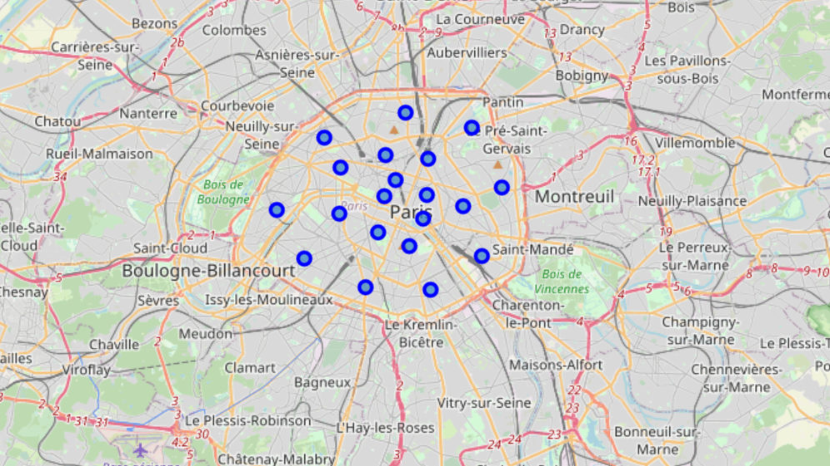
Paris districts visualization

Slide 5
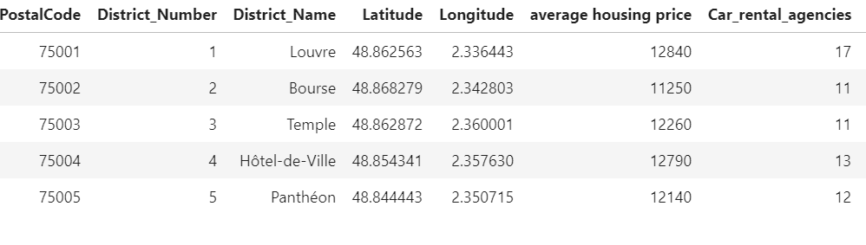
Data set & method selection
After some processing we obtain the following data set
We used unsupervised learning K-means algorithm to cluster the districts because the data is unlabeled
We applied K-means algorithm on the two last columns after normalizing them

Slide 6
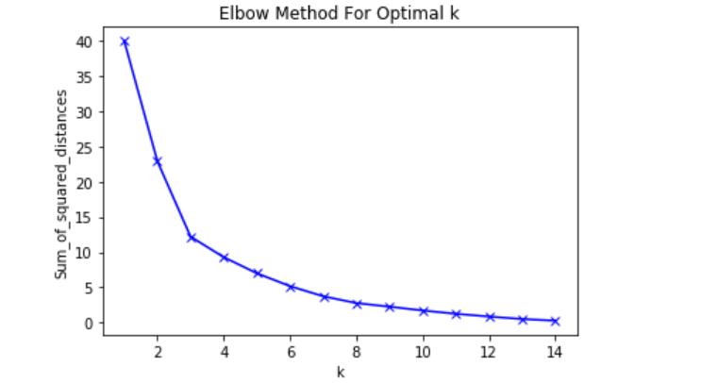
Clustering Paris districts with Kmeans method
In the plot above the elbow is at k=3 indicating the optimal k for this dataset is 3

Slide 7
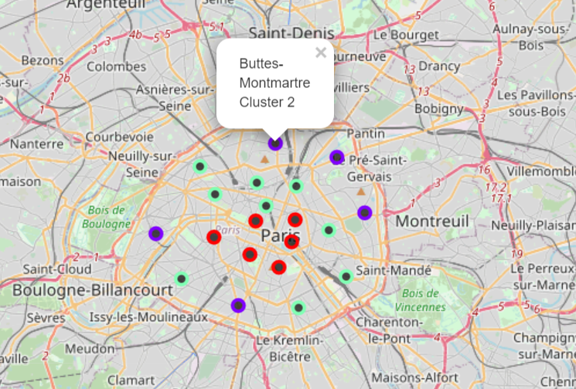
Results : Clusters visualization
We can label the clusters as follows :
Cluster 0 (green) : High number of car rental agencies and low housing prices
Cluster 1 (red) : High number of car rental agencies and high housing prices
Cluster 2 (purple) : low number of car rental agencies and low housing prices

Slide 8
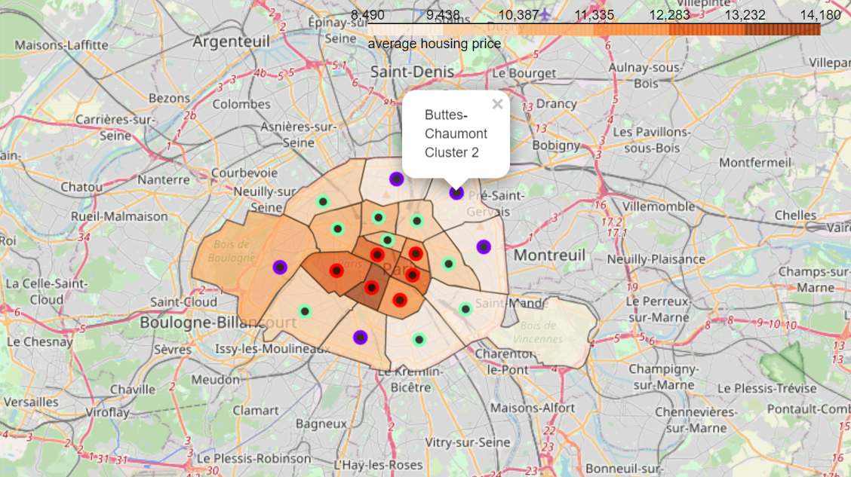
Results : clusters visualization with choropleth for housing prices
We use choropleth map to better catch the level of variability and the contrast within paris

Slide 9
Discussion/conclusion
It would be better chose to locate a rental car agency in the districts labeled as cluster 2 (low number of car rental agencies and low housing prices)
That is to say in one of the following districts : "Buttes-Montmartre","Buttes-Chaumont","Ménilmontant","Passy" or "Observatoire
But the final decision has to take into account some more factors such as the road traffic and the availability of building lands.

