Slide 1



Meslouh Mohamed Arselan
Amour Redouane
Amour Chadi
Meneceur Leila
Bouisson Arnaud
Communication
Understanding Bluetooth Low Energy
architecture and communication

Slide 2
Summary
General Concepts
Channels and Physical Layer
MAC Layer role in BLE
Security Mechanism for data
Energy Consumption

Slide 3

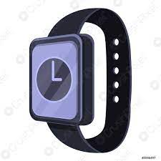
General Concepts
General Concepts
Range : 50 meters at best
Smart Bluetooth
4th version of Bluetooth
BLE stands out from Bluetooth due to its low energy consumption

Slide 4

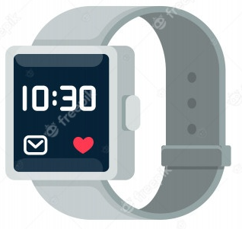
General Concepts
periodically advertising
discovery process
sleep mode
periodically advertising
initiator
Connection request

Slide 5
General Concepts
Connection request
Connection process
Accept Connection
Master
Slave
data exchanges

Slide 6
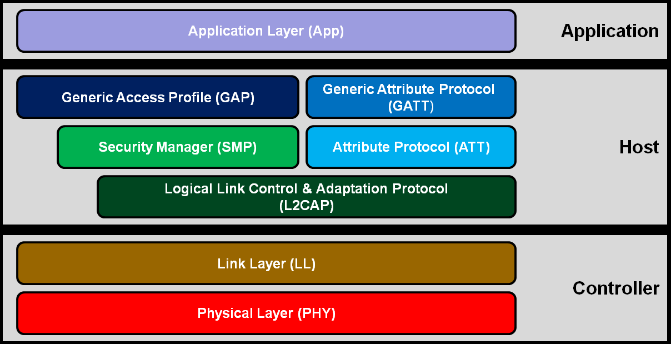
General Concepts

Slide 7
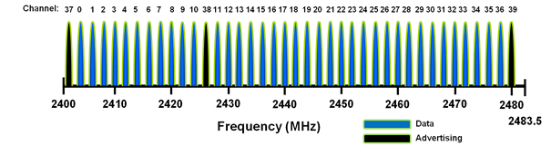
Physical Layer
Radio access (frequency bands and channel arrangement)
BLE operates on the 2.4GHz ISM Band (2400 MHz - 2480 MHz)
40 channels, 2MHz each
3 advertising channels and 37 DATA Channels
see reference 7

Slide 8
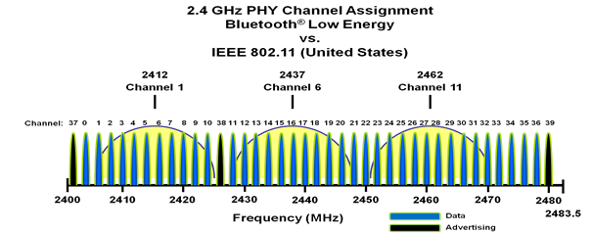
Physical Layer
Coexistence with 802.11 ac Wi-Fi
The BLE shares the same frequency Band with the 802.11/ Wi-Fi.
Thus, the advertising channels have been assigned center frequencies that minimize overlapping with the Wi-Fi channels.

Slide 9
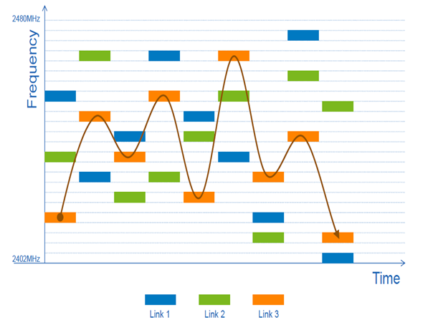
Physical Layer
Adaptive Frequency Hopping
fn+1=(fn+hop)mod 37
used by the link layer to remap a given packet from a known bad channel to a known good channel
see reference 7

Slide 10
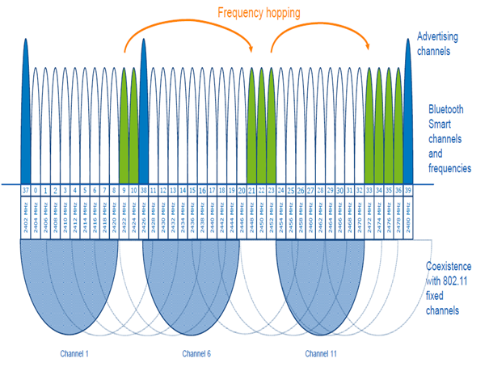
Physical Layer
Adaptive Frequency Hopping
fn+1=(fn+hop)mod 37
used by the link layer to remap a given packet from a known bad channel to a known good channel

Slide 11
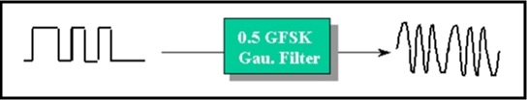
Physical Layer
Modulation and transmission power
The GFSK in order to make the frequency transitions smoother
The modulation index of 0.5 allows reduced peak power consumption
The physical layer data rate is 1 Mbps with 1 bit per symbol
Up to 100 mW (20 dBm) transmission power

Slide 12
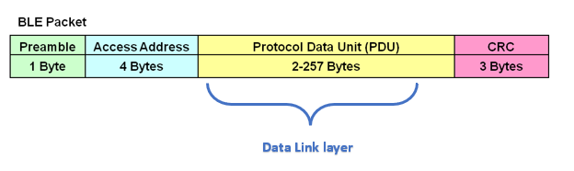
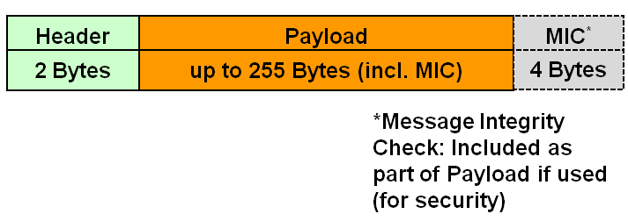
Data Link Layer
BLE Packet
Data Link Packet

Slide 13
Data Link Layer
Discovery process
Scanning
Advertising
ADV_IND Packet: Ch 37
ADV_IND Packet: Ch 38
ADV_IND Packet: Ch 39
.
.
.

Slide 14
Data Link Layer
Discovery process
Advertising packet PDU
Header
Payload
2 Bytes
6-37 Bytes
ADV address
ADO structure
. . .
ADN structure
AD Length
AD Type
AD Data
see reference 7

Slide 15
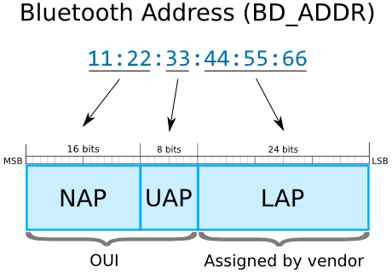
Data Link Layer
Discovery process

Slide 16
Data Link Layer
Connection process
Scanning
ADV_IND Packet: Ch 37
Advertising
ADV_IND Packet: Ch 38
ADV_IND Packet: Ch 39
CONNECT_REQ: Ch 38

Slide 17
Data Link Layer
Connection process
Header
Payload
2 Bytes
6-37 Bytes
CONNECT_REQ TYPE
Medium parameters !

Slide 18
Data Link Layer
Connection process
LLData
CRCInit
(3 Bytes)
Interval
(2 Bytes)
Latency
(2 Bytes)
Timeout
(2 Bytes)
Hop
(5 bits)
TDMA !
see reference 8
time

Slide 19
Data Link Layer
Define the channel used for communication to identify the type of packets
Use the right Bluetooth Device Address
Set connection intervals

Slide 20
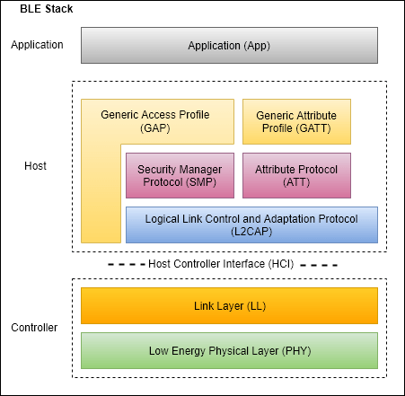
Data Link Layer
L2CAP protocol
Functions :
multiplexing
segmentation and reassembly of packets
QoS management for higher layers

Slide 21
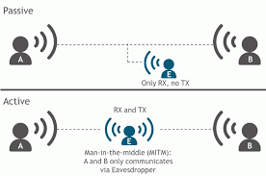
Security mechanisms
Security threats and cyber-attacks
Eavesdropping
Notes:
Let’s talk about now the security mechanisms in BLE. The very purpose of BLE is to counter attack three major cyber issues :
1) the passive eavesdropping : It happens when a third device actually listens to the communication between the transmistter and the receiver. It always happen at the very beginning of the communication called the pairing phase where the exchanged messages are not encrypted. This type of attack is slightly dangerous because the listenner can access to the confidential information provided by the speakers.
2) The active eavesdropping : it happens when a third device not only listens to the communication but literally interferes right in the middle of the conversation between a transmitter and the receiver. That is the reason this problem is called MAN THE MIDDLE issue. More specifically the man in the middle receives the data, he can process it as much as he wants to (add fake information, change the data) and then he transmits it to the point B. This is the most dangerous attack.

Slide 22
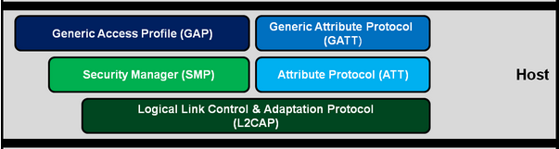
Security mechanisms
How security is handled ?
Identification
(UUID, Authentification)
The Host layer
Encryption
address
Notes:
To answer those problems, The BLE architecture deploys a third layer called the Host layer which is right above the physical layer and the link layer. The host layer covers the security mechanims through several protocols such as the GAP, the GATT and the ATT which contain with very private and confidential information about the device such as the UUID, the Authentication ID and passwords, the address and so on..
BUT The very central protocol here is the security manager called the SMP, it literally orchestrates every other protocols, and more importantly its the one protocol that is gonna be responsible for the encryption of the messages in order to avoid the cyber attacks.
=> How does this encryption work ?

Slide 23
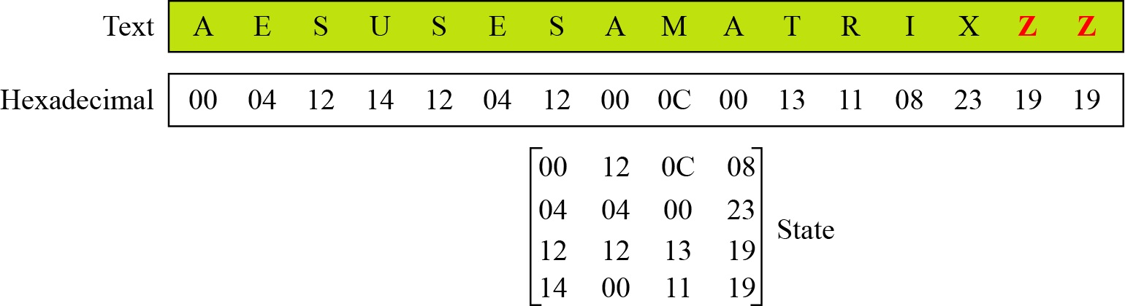
Security mechanisms
How is security handled ?
=> Advanced Encryption Standards (AES cryptography)
128 bits
Cipher Blocks
Notes:
The SMP uses the AES cryptography standing for the Advanced Encryption Standards. The message you wanna send which is called the plain text is written over 128 bits. This message is then converted into a Hexadecimal basis with 16 bytes which makes in total 128 bits). Those bytes will then be arranged in a state Matrix contains 16 blocks called the cypher blocks of the state matrix

Slide 24
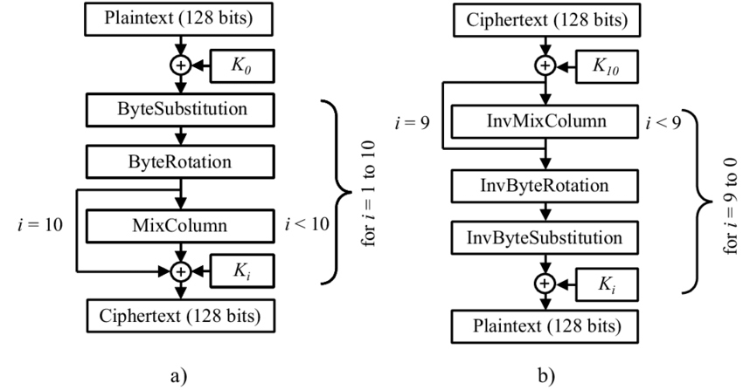
Security mechanisms
How is security handled ?
Emission
Reception
Ki (i from 1 to 10)
Key
see reference 7
Notes:
What happens next : Well the state matrix that we just generated is going to follow an algorithm with a succession of mathematical operations such as the rotation of the matrix, the multiplication, the substitution and so on and those operations will be proceeded thanks to the key matrices noted Ki and repeated from 1 to 10 times in order to arrange the matrix in a very complexe matrix called the cypher matrix
The receiver opens this cyphertext and will apply the exact same algorithm but backwards, that means it will invert all the whole process that I just mentionned. However to actually do this, the receiver will necessarily need the key matrices in order to uncode the message and get to the initial plain text. As you can see, the very central element of the algorithm is the key matrices.

Slide 25
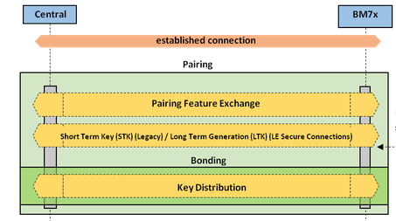
Security mechanisms
How is security handled ?
No encryption
encrypted
Notes:
In BLE, those keys are actually exchanged at the very beginning of the communication called the pairing phase of the devices. This pairing phase consists of a simple agreement between the transmitter and the receiver concerning the input output capabilities, the ids, the authentification password and more importantly they will generate a temporary key which is the short term key that will contain the key matrices I just talked about. As you can see, the pairing phase is very critical because the messages are not encrypted yet and thats exactly the right moment when passive eavesdropping and active eavesdropping happen.

Slide 26
Energy Consumption
Energy consumption of a BLE IC depends on multiple factors being the packet data length, the number of channels used to communicate, the advertising Interval and the transmission power.
In the sleep phase, BLE is very low energy consuming since it only consumes 3 nJ.
In the advertising phase, BLE consumes on average from 128 nJ/b to 625 nJ/b.
In the connection (DATA) phase, BLE consumes from 0.47 uJ/b to 18 uJ/b.
In average, BLE has a power consumption of 50mW when in transmission, and has a data rate of 1Mbps, so the average consumption ratio would be something around 50 nJ/b.
see references 1 and 2

Slide 27
Conclusion
Data link layer very important
Low energy consumption protocol
Security issues
Remains one of the easiest protocol to use and understand

Slide 28
Bibliography
Oller, Joaquim, Carla Gomez, et Joseph Paradells. « Overview and Evaluation of Bluetooth Low Energy: An Emerging Low-Power Wireless Technology », 26 June 2012.
Tosi, Jacopo, Fabrizio Taffoni, Marco Santacatterina, Roberto Sannino, et Domenico Formica. « Performance Evaluation of Bluetooth Low Energy: A Systematic Review ». Sensors, 13 december 2017.
Katsandres, Jim. « Bluetooth Low Energy – It Starts with Advertising ». Bluetooth.com. Bluetooth Blog (blog), 15 february 2017. https://www.bluetooth.com/blog/bluetooth-low-energy-it-starts-with-advertising/.
Horbenko, Yuliia. « How Secure Is the BLE Communication Standard? » Lembergsolutions.com, 4 march 2019. https://lembergsolutions.com/blog/how-secure-ble-communication-standard.
SILICON LABS. « UG103.14: Bluetooth® LE Fundamentals ». s. d. https://www.silabs.com/documents/public/user-guides/ug103-14-fundamentals-ble.pdf.
Oudji, Salma (PhD). « Analyse de la robustesse et des améliorations potentielles du protocole RadioFréquences Sub-GHz KNX utilisé pour l’IoT domotique ». Université de Limoges, December 2016.
Microchip. « Bluetooth® Low Energy ». Developer Help, 2021. https://microchipdeveloper.com/wireless:ble-phy-layer.
Afaneh, Mohammad. « A Deep Dive into BLE Packets and Events ». BLE Technology, Tools (blog), avril 2020. https://www.novelbits.io/deep-dive-ble-packets-events/.

Slide 29
Thank you for your attention

