Slide 1


MAC protocols for the Wireless Sensors Networks
Redouane AMOUR
5ISS A2 - GP

Slide 2




GENERAL OVERVIEW
Introduction
II. Medium Access techniques
III. MAC protocols for WSN
IV. CONCLUSION

Slide 3




INTRODUCTION
Wireless Sensors Networks
Issues
Collisions
Idle listenning
Latency
3
Notes:
Today, as the number of IoT smart devices keeps growing, the number of nodes increases exponentially as well. This might cause significant collisions that require the device to re-send the previous messages, it also induces a waste of energy because the nodes of the network need to be powered by battery which is limited in longevity. The main sources of energy waste in the Medium Access Control are the collisions, the passive hearing and idle listenning which consumes 50% to 100% of the energy to receive packets. The latency is also one major issue that needs to tackled by MAC

Slide 4
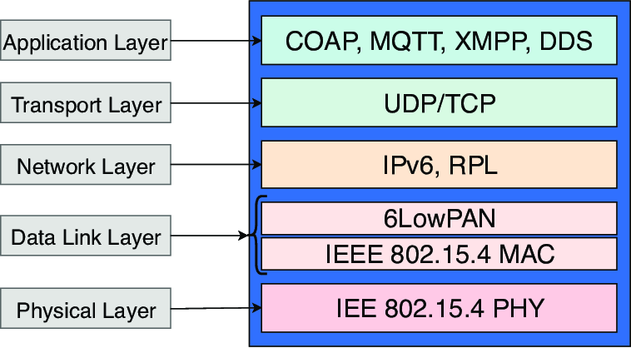
INTRODUCTION
OSI for IoT
S-MAC
DS-MAC
T-MAC
W-MAC
4
Notes:
In the OSI model for IoT nodes, the MAC layer is at the interface between the physical and the network layer and more specifically the 6LowPAN
The very purpose of MAC layers in Wireless sensor networks is to try reducing all this waste as much as possible.
Throughout this presentation, we will tackle 4 different MAC protocols used in the WSN: S-MAC, T-MAC, DS-MAC, W-MAC.

Slide 5
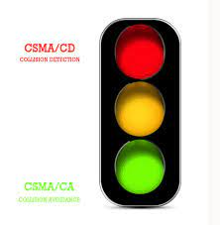
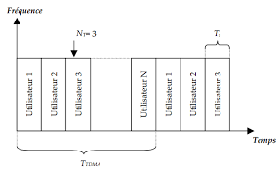
II. Medium Access Techniques
CSMA
TDMA
First-come, first-served
CSMA
S-MAC
T-MAC
DS-MAC
W-MAC
TDMA
TRAMA
D-MAC
5
Notes:
The MAC protocols can first be distinguished by their techniques to access the Medium : CSMA and TDMA technique
1) CSMA is a protocol whereby station first listens to the medium before talking, to ensure it is clear. It relies on the behavior “first-come, first-served”. However, there are slightly different behaviors we can separate. The behavior when the channel will persist to talk first on the channel and the behavior when the channel will wait until it is free. There are two main variations of CSMA: CSMA/CD – Carrier Sense Multiple Access with Collision Detection and CSMA/CA – Collision Avoidance.
TDMA divided the medium access in time slots fully dedicated to each station. When transmitting, the nodes can use the full bandwidth and the radio frequency is the same for everyone, but they will not transmit at the same moment. It’s temporal multiplexing. It’s impossible for users to transmit on the same time slot which enables the collision avoidance.

Slide 6
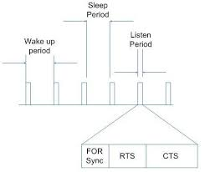
III. MAC PROTOCOLS
A. Sensor Medium Access Control (S-MAC)
Fixed Duty cycle
Synchronization
Mobile nodes
Hidden nodes avoided
Saves energy
Idle listenning + bad latency
6
Notes:
This protocol has been made at the Los Angeles California university to answer the issue of energy waste due to passive listening. Devices are constantly listening even when they are not addressed. To overcome it, the idea with S-MAC is to use nodes within an alternance of sleeping mode and active mode. While sleeping, nodes turn off the radio to save energy and they can neither transmit nor receive. The corresponding period of each mode is based on a fixed duty cycle (Tactive/Tactive + Tsleep).
This protocol uses Synchronization packets to synchronize the duty cycle of each node and communicate at the right moment. To maintain synchronization, the schedules of each nodes are constantly broadcasted between neighbors. Each node contains a table in which they actually register their own schedule and their neighbors schedule. Why ? Because If a node asks to modify the synchronization, each node is able to adapt! => the node are mobile and adapting.
The listening time is therefore divided in two parts : one for SYN schedules and one for the data.
Finally, the S-MAC also avoids the issue of “hidden nodes” thanks to CTS and RTS packets. These packets oblige the immediate neighbors to instantly sleep to avoid interferences and collisions.
In conclusion : S-MAC saves energy because of duty cycle but does not solve the idle listening because nodes can still listen without receiving informations.+ the fixed duty cycle is not optimal when traffic get overloaded => bad latency

Slide 7
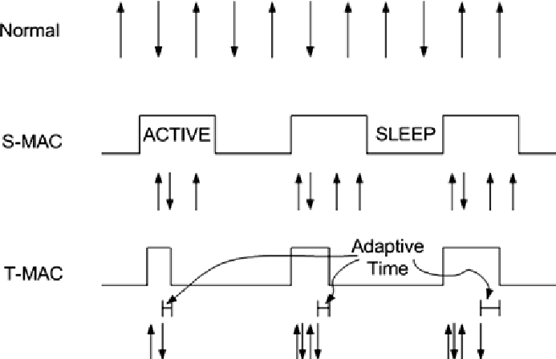
III. MAC PROTOCOLS
B. Time Out Medium Access Control (T-MAC)
Fixed duty cycle
Time out
Active time adapted
Idle listenning + energy
Synchronization
Oversleep and packet losses
7
Notes:
T-MAC is the protocol that derives from S-MAC in which the non-sleep and sleep are fixed. Although S-MAC saves energy, fixed duty cycle does not provide optimality because messages’ rate usually varies by time and location. To overcome this, T-MAC proposes a time out activation that adapts the Active time depending on the traffic load. When the traffic load is too high, the time out wont be activated and the node will continue to exchange. However if the traffic gets unloaded, the TIME out immediately ends the active time. Therefore, This protocol reduces the idle listening and saves energy. However the main problem of T-MAC is the packet losses due to oversleep because of the early time out activation.

Slide 8
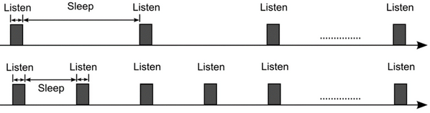
III. MAC PROTOCOLS
C. Dynamic Sensors Medium Access Control (DS-MAC)
Latency shared
Synchronized
Low Latency
Dynamic Duty cycle
8
Notes:
The main purpose of DS-MAC which is a synchronized protocol is to reduce the high latency due to the traffic loads by using a dynamic duty cycle: As all nodes share their one-hop latency values, every node calculates the average value. If this value is too high, a node will decide to shorten the sleep time and announce this in the SYNC period. The major aim in this extension is to decrease the latency for delay-sensitive applications. When the latency is too high, the nodes can double their active time. When the latency decreases, the nodes lower their active time. In each case, the SYNC packet is shared between every node to synchronize the duty cycle and avoid packets loss.
However the overuse of sync packets to adapt latency does not really save energy. => compromise.

Slide 9
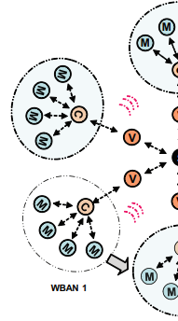
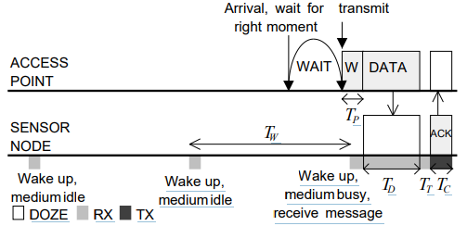
III. MAC PROTOCOLS
D. Wise Medium Access Control (DS-MAC)
Sampling
Wake-up preambles
Asynchronous
9
Notes:
The wise Mac protocol is used in a network topology including a Sink Node and sensors nodes . With Wise Mac, the sensor nodes are switching from active states to idle states which are very low power state. When active, the sensor nodes periodically sample the Medium to listen for activity. This sampling activity is actually scheduled for each node and registered in the sink Node which coordinates exchanges because there are no synchronization. When a message needs to be transmitted, the Sink node already knows the schedules and waits until the receiver is about to wake up : right before waking, the Sink node sends a wake up preamble to start the transmission to make sure the sensor node is awake (since there are not synchronization , wake up preamble ensures the listening).
DRAWBACK : energy wastes through preambles.

Slide 10
IV. Conclusion
S-MAC
DS-MAC
T-MAC
Wise MAC
SAVE ENERGY
HIGHER LATENCY
CONSUME ENERGY
LOWER LATENCY
10
Notes:
In conclusion, the S-MAC and T-MAC protocol enable to avoid idle listenning and therefore save energy. DS-MAC is more adapted to the traffic loads and enable to reduce the latency. However the use of dynamic duty cycle needs more energy to send the SYNC packet.
Finally, the

