Slide 1
Longest Common Subsequence

Slide 2



Slide 3


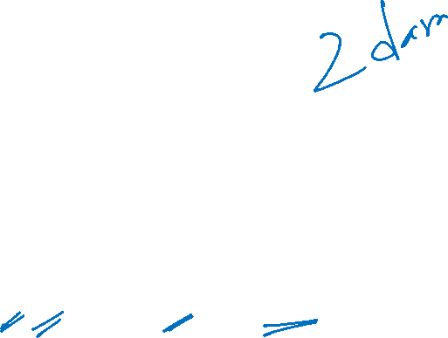

Slide 4
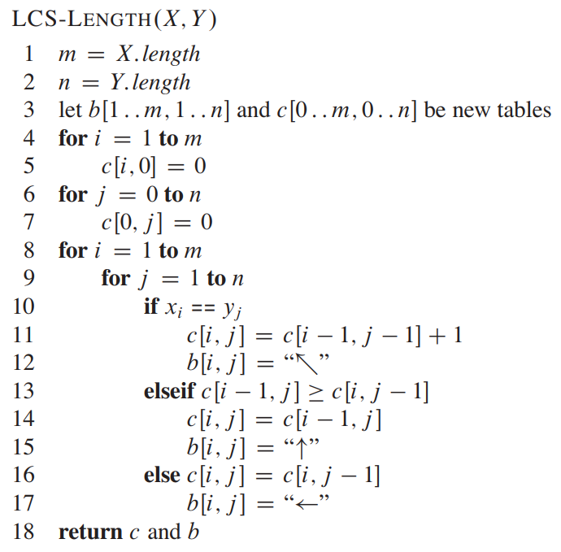

Slide 5
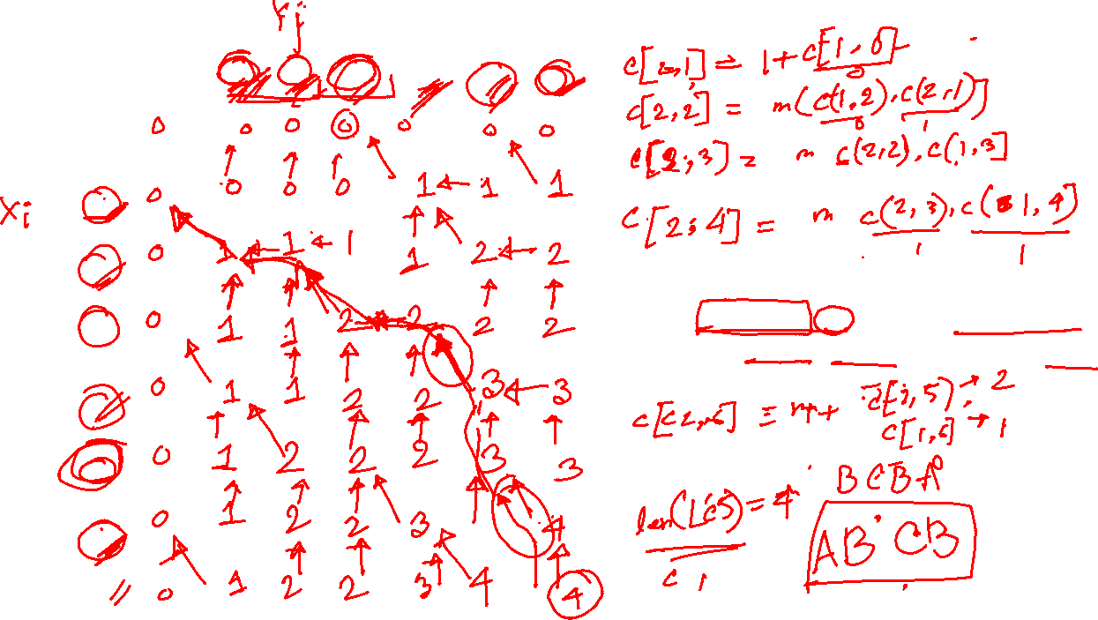
 | 0 | 1 B | 2 D | 3 C | 4 A | 5 B | 6 A
0
1 A
2 B
3 C
4 B
5 D
6 A
7 B

Slide 6
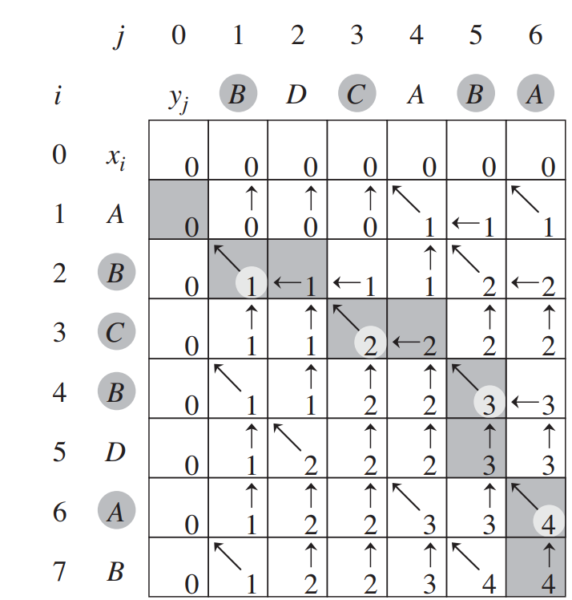


Slide 7


Slide 8

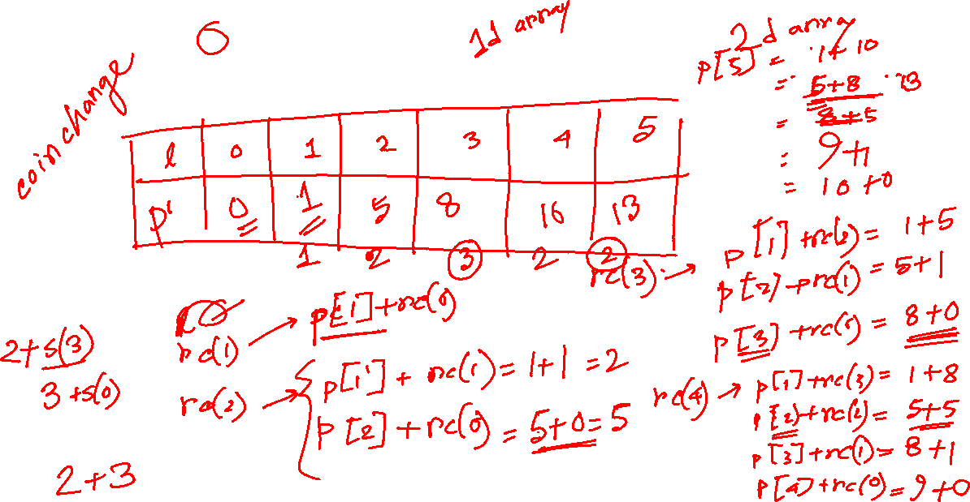

Slide 9
[5, -10, 2, -5, -2, 7, 7]

