Slide 1
University Management System
CSE3036
Section:11
Information System Design & Software Engineering Lab
Submitted By:
Redoy kumar das 2017100000136
Pronay shaha 2017100000110

Slide 2

1
ERD
2
Use Case Diagram
3
Activity Diagram
4
Sequence Diagram
5
Class Diagram
6
Data Flow Diagram

Slide 3
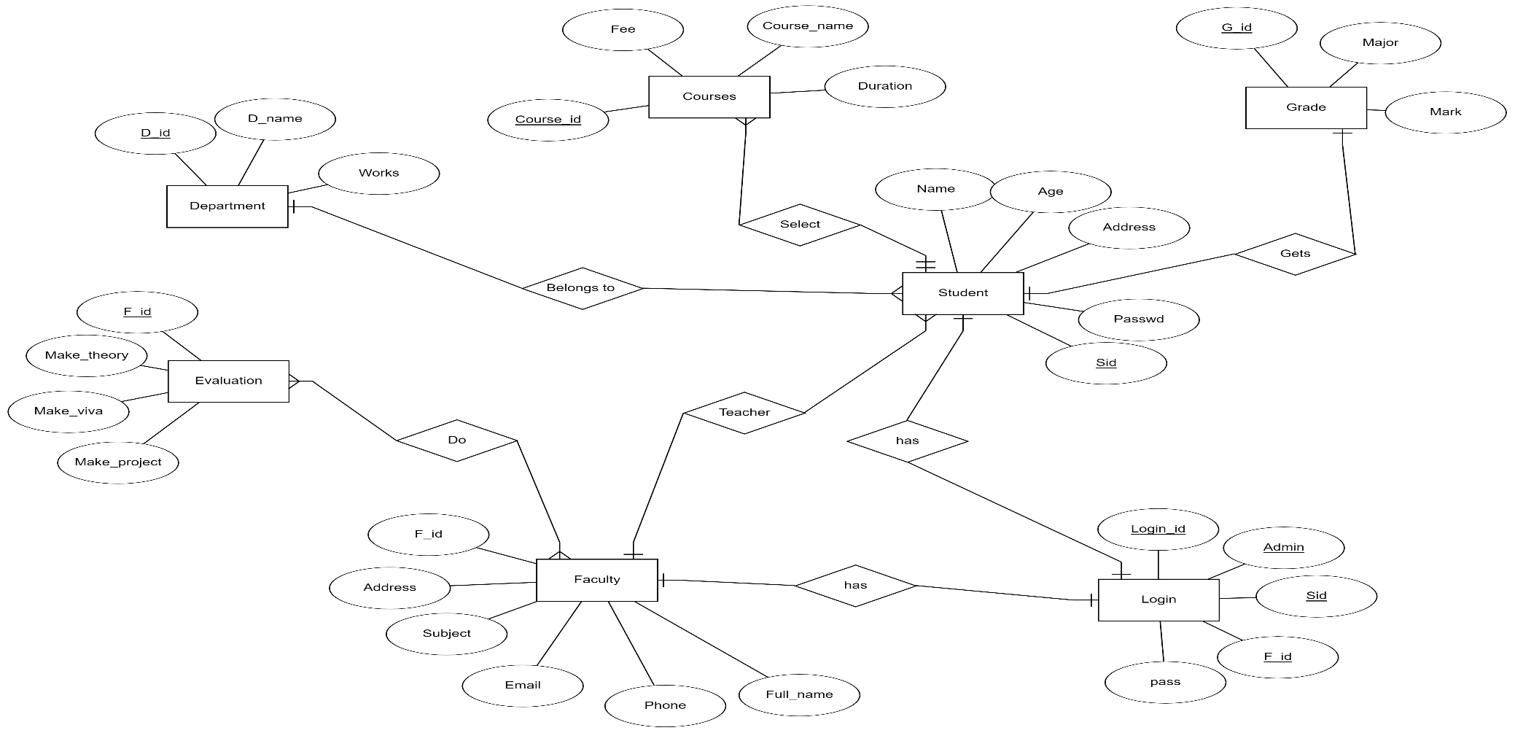
1.ERD

Slide 4
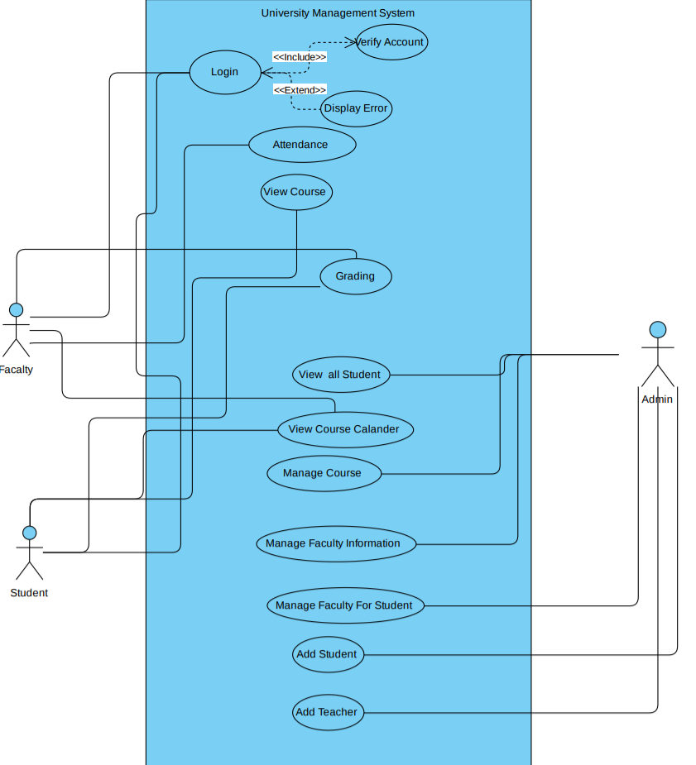
2. Use Case Diagram

Slide 5
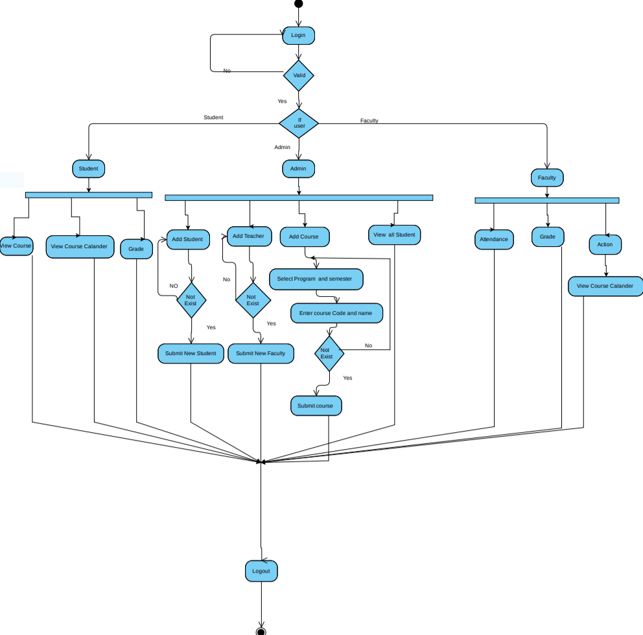
3. Activity Diagram

Slide 6
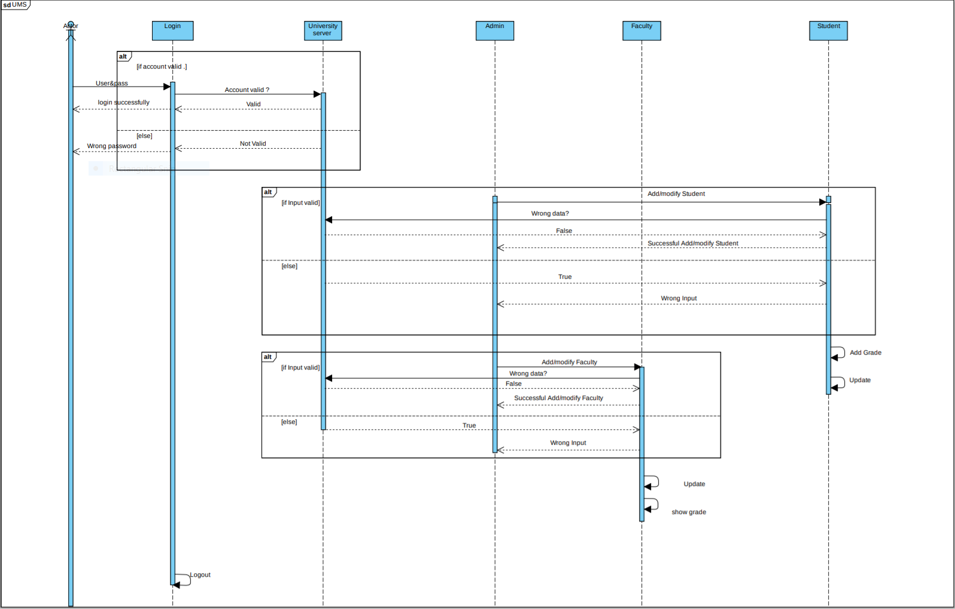
4.Sequence Diagram

Slide 7
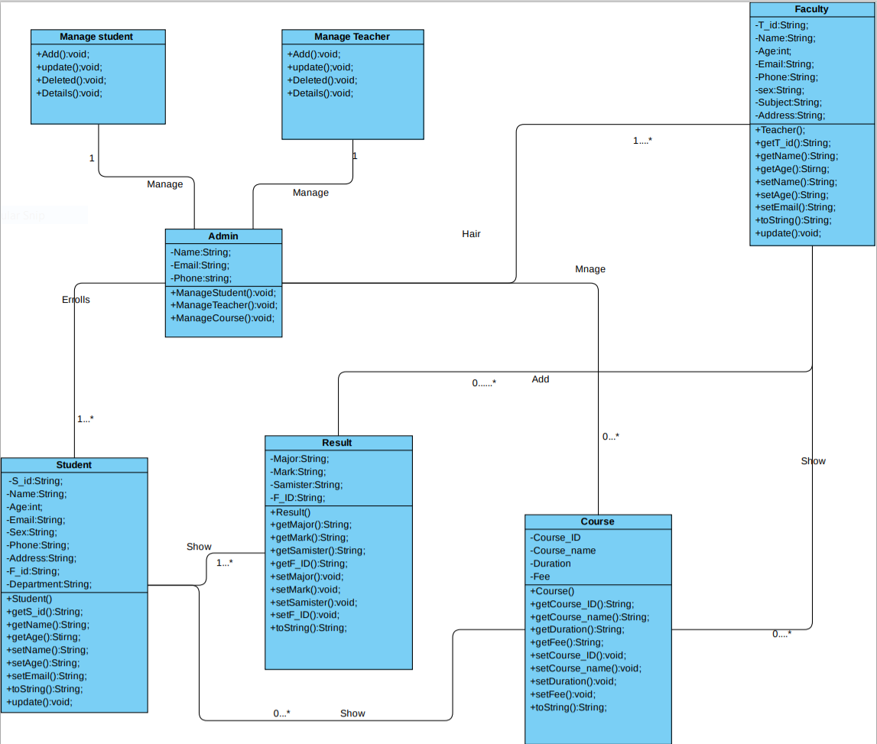
5. Class Diagram

Slide 8
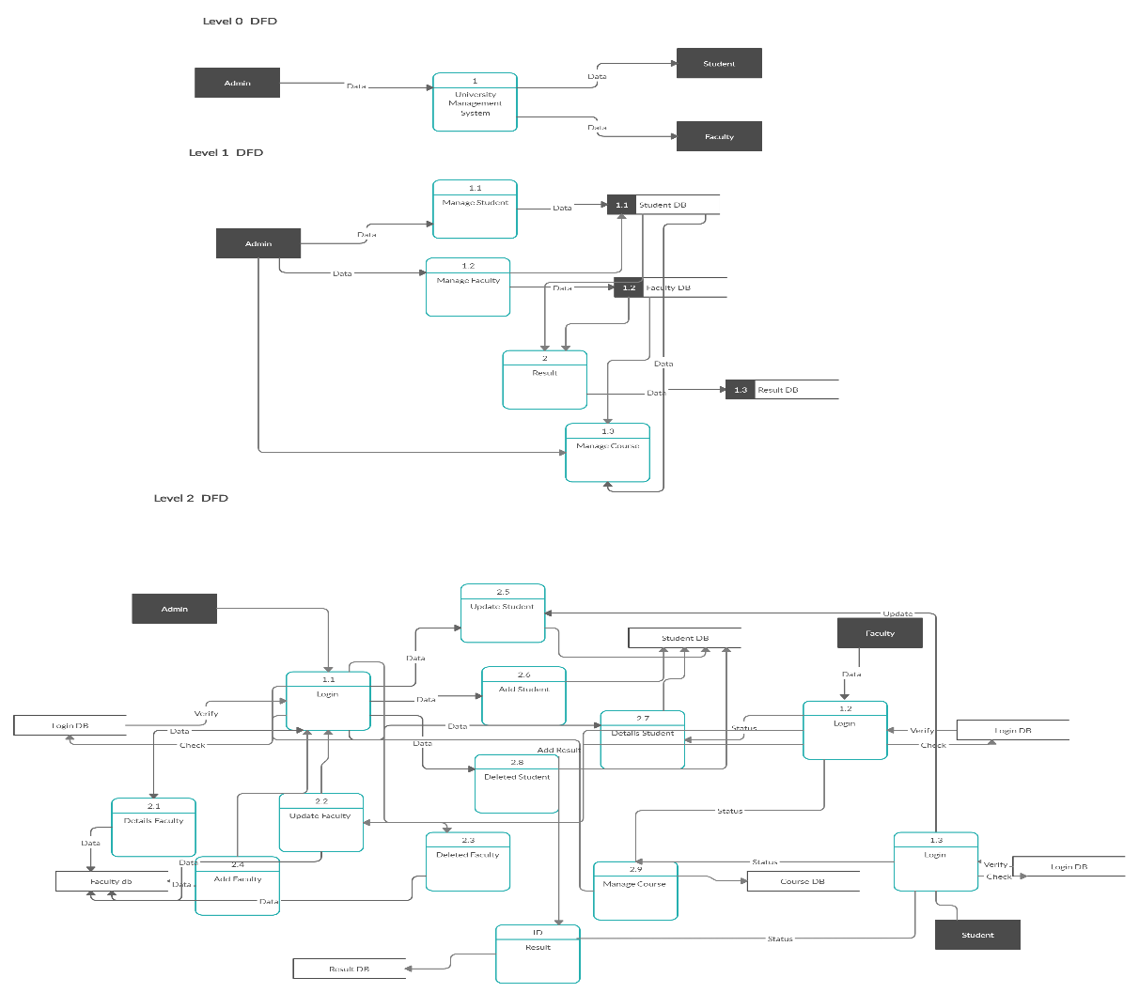
6. Data Flow Diagram

Slide 9
Thank you

