Slide 1

Anon-Pass: Practical Anonymous Subscriptions
S&P 2013
Michael Z. Lee, Alan M. Dunn, Brent Waters, Emmett Witchel, Jonathan Katz
Presenter: Mingxin Chen
StudentID: 2120140994

Slide 2
Outline
Motivation & Contribution
1
Construction
2
Implementation
3
My Thought
4
Conclusion
5

Slide 3
1
Motivation

Slide 4





Motivation & Contribution
Motivation
electronic-subscription
Today, widespread electronic-subscription services are used to manage access to streaming music and video, journalistic and academic articles, Internet hotspots, and public transportation.
Notes:
传统的订阅（或订购）服务是一种预定方式，指的是报纸读者预交一段时间的报纸订阅费，由专门负责投送的人员在指定的时间段把读者所订的报纸按期投递到读者指定的地点。
相对于传统上对订阅的理解，由于网络技术的发展，新闻订阅，博客订阅等电子信息订阅越来越深入日常生活。还有就是像一些视频音乐网站，像爱奇艺优酷什么的，提供VIP用户这样的用户形式，也算是一种订购方式吧，相当于VIP用户可以观看需要付费才能观看的视频。

Slide 5
Motivation & Contribution
Motivation
Electronic-subscription systems can be divided into two categories.
1
Customers should pay each time they use some favorite services or subscribe to these services to access them for a fixed number of times.
2
Customers may subscribe to his interested services for a certain period of time, and there is no limit on the maximum times that the services can be used during the valid time interval.
Notes:
2010年发表的一篇文章，《Untraceability and profiling are not mutually exclusive》，将典型的匿名订购系统分为两类。在类型I的系统中，顾客可以在每次访问服务时付费，或者一次性地付费，从而能访问该服务直至固定的次数。在类型II中，顾客在付费后可以在固定的时间周期内随意地访问所订购的服务[4,5,13]（13应该是属于这一类，付费后可以在固定的时间周期内随意访问，只是每次登录的账号都不一样）。然而，这对于用户并不公平，因为用户即使在订购的周期内不经常地访问服务，也必须为此支付固定的费用。

Slide 6

Motivation & Contribution
Motivation
Monitor the users
The Service Provider
The User
Unfortunately, it is extremely easy for the service provider to monitor the online activities of a user, and as a result, sensitive information about the subscriber’s personal habits and interests may be exposed.
Notes:
在互联网当中，在线用户的隐私是一个日益凸显的重要问题。很多的在线服务都提供各种类型的电子信息，其中在订购服务中，服务提供者向付费的客户提供重要的信息和服务。然而在客户获取服务的同时，服务提供商却能很容易地监视用户的在线活动或对客户的敏感信息进行收集，从而导致对该客户利益的严重损害。并且也能从用户的订阅或购买行为的信息中推断出用户的隐私信息，包括用户身份信息，习惯和喜好等，并且服务提供者也可能会为了其自身利益而将用户订阅信息出卖给第三方。因此在订阅服务中，如何能为客户提供便捷的服务又能充分保护用户隐私是一个亟待解决的问题。

Slide 7
Motivation & Contribution
Motivation
In such subscription systems there is a fundamental tension between enforcing admission control and providing a user with anonymity and privacy.
Admission control
Anonymity and privacy
Notes:
准入控制，也就相当于可靠性，能够保证一个服务提供商能够获取适当的费用补偿，保证其商业运作，不能说谁都能去访问其资源，只有订购了的用户才能访问和使用。
另一方面，如果一个用户在一个订购服务当中的行为被服务提供商追踪了，那么用户的个人隐私信息，比如用户的个人喜好，用户习惯等就会被服务提供商获取。

Slide 8
Motivation & Contribution
Contribution
A new primitive called an anonymous subscription scheme with conditional linkage.
Correctness
Unforgeability
Sharing resistance
Pseudonymity
Unlinkability
Anon-Pass
soundness
anonymity
Anon-Pass is designed for anonymous access to modern web services like audio streaming, video streaming, and reading articles.
Notes:
这篇文章提出的这个Anon-pass匿名订购协议，保证了可靠性和匿名性。
其中这里正确性的意思是一个服务提供者能够接受一个未登录的合法用户的请求，或者一个已经登录的用户的连接请求。不可伪造性的意思是一个服务提供者只会接受在该服务提供者处注册过的合法用户。反共享性的意思是，在一个给定的周期内，一个服务提供者只能接受有一个注册私钥的用户的登录。
此外假名性的意思是服务提供者无法确定用户的身份。不可关联性的意思是任何一个用户的任何多次登录都无法被关联，服务提供者都无法判断是否是来自同一个用户。

Slide 9
2
Construction

Slide 10
Construction
Overview
setup algorithm
login protocol
end-of-epoch
registration
link protocol
1
2
3
4
5
End

Slide 11
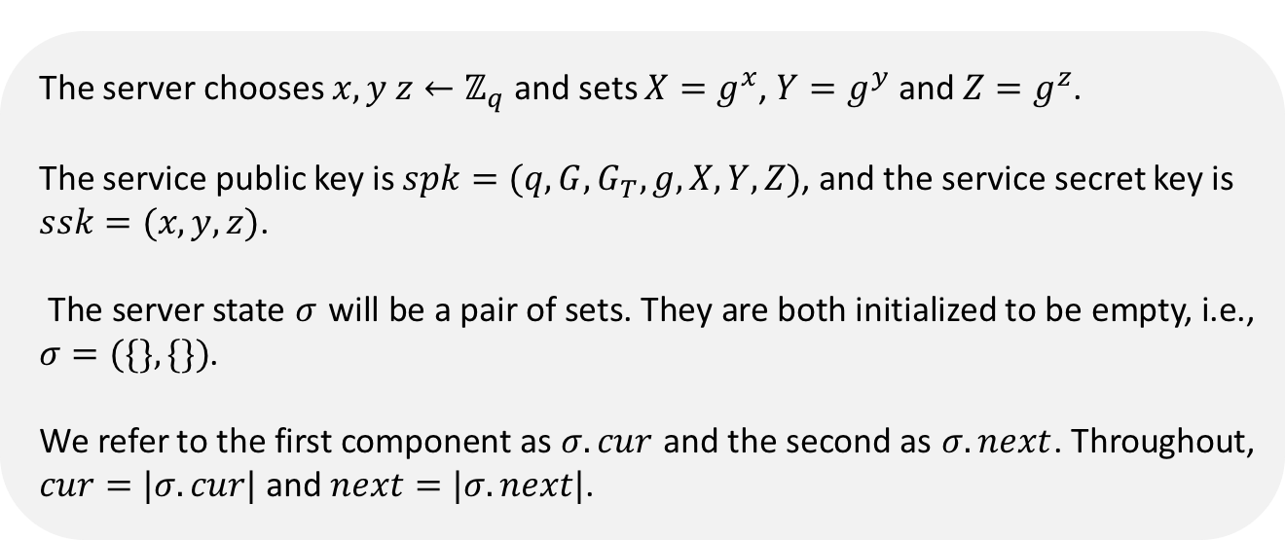
Construction
Construction
Setup: $(spk, ssk, σ)←Setup$
The server chooses $x, y z←ℤ_{q}$ and sets $X=g^{x}$, $Y=g^{y}$ and $Z=g^{z}$.
The service public key is $spk=(q, G, G_{T}, g, X, Y, Z)$, and the service secret key is $ssk=(x, y, z)$.
The server state $σ$ will be a pair of sets. They are both initialized to be empty, i.e., $σ=(\{\},\{\})$.
We refer to the first component as $σ.cur$ and the second as $σ.next$. Throughout, $cur=|σ.cur|$ and $next=|σ.next|$.

Slide 12
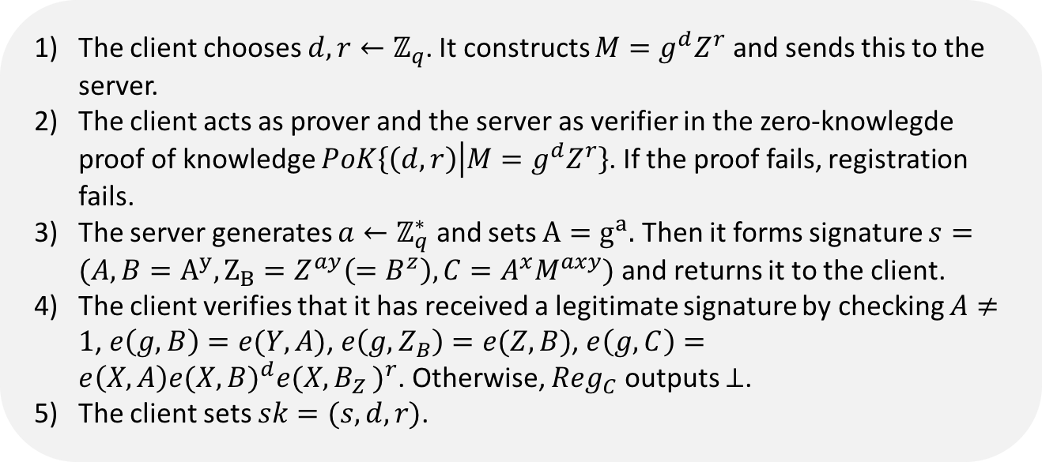
Construction
Construction
Registration: $\left(∅, sk\right)←<{Reg}_{S}\left(ssk\right), {Reg}_{C}(spk)>$
The client chooses $d, r←ℤ_{q}$. It constructs $M=g^{d}Z^{r}$ and sends this to the server.
The client acts as prover and the server as verifier in the zero-knowlegde proof of knowledge $PoK\left\{\left(d, r\right) | M=g^{d}Z^{r}\right\}$. If the proof fails, registration fails.
The server generates $a←ℤ_{q}^{∗}$ and sets $A=g^{a}.$ Then it forms signature $s=(A, B=A^{y}, Z_{B}=Z^{ay}\left(=B^{z}\right),C=A^{x}M^{axy})$ and returns it to the client.
The client verifies that it has received a legitimate signature by checking $A≠1$, $e\left(g, B\right)=e(Y,A)$, $e\left(g,Z_{B}\right)=e(Z,B)$, $e\left(g,C\right)=e\left(X,A\right){e(X,B)}^{d}{e(X{, B}_{Z})}^{r}$. Otherwise, ${Reg}_{C}$ outputs $⊥$.
The client sets $sk=(s,d,r)$.

Slide 13
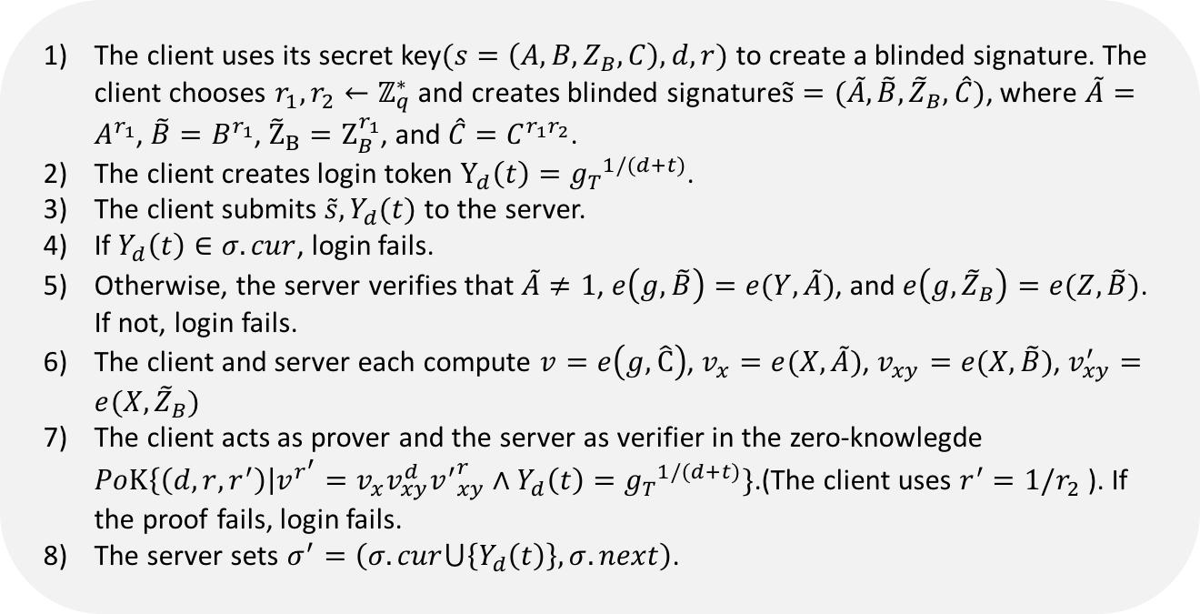
Construction
Construction
Login: $\left(σ^{′},{cur}^{′}\right)←<{Login}_{S}\left(ssk,σ,cur,t\right), {Login}_{C}(sk,spk,t)>$
The client uses its secret key$(s=\left(A,B,Z_{B},C\right),d,r)$ to create a blinded signature. The client chooses $r_{1}, r_{2}←ℤ_{q}^{∗}$ and creates blinded signature$\tilde{s}=(\tilde{A},\tilde{B},{\tilde{Z}}_{B},\hat{C})$, where $\tilde{A}=A^{r_{1}}$, $\tilde{B}=B^{r_{1}}$, ${\tilde{Z}}_{B}=Z_{B}^{r_{1}}$, and $\hat{C}=C^{r_{1}r_{2}}$.
The client creates login token $Y_{d}\left(t\right)={g_{T}}^{1/(d+t)}$.
The client submits $\tilde{s}, Y_{d}(t)$ to the server.
If $Y_{d}\left(t\right)∈σ.cur$, login fails.
Otherwise, the server verifies that $\tilde{A}≠1$, $e\left(g, \tilde{B}\right)=e(Y,\tilde{A})$, and $e\left(g,{\tilde{Z}}_{B}\right)=e(Z,\tilde{B})$. If not, login fails.
The client and server each compute $v=e\left(g,\hat{C}\right)$, $v_{x}=e(X,\tilde{A})$, $v_{xy}=e(X,\tilde{B})$, $v_{xy}^{′}=e(X,{\tilde{Z}}_{B})$
The client acts as prover and the server as verifier in the zero-knowlegde $PoK\left\{\left(d,r,r^{′}\right)\right|v^{r^{′}}=v_{x}v_{xy}^{d}{v^{′}}_{xy}^{r}∧Y_{d}\left(t\right)={g_{T}}^{1/(d+t)}\}$.(The client uses $r^{′}=1/r_{2}$ ). If the proof fails, login fails.
The server sets $σ^{′}=\left(σ.cur⋃\left\{Y_{d}\left(t\right)\right\},σ.next\right)$.

Slide 14
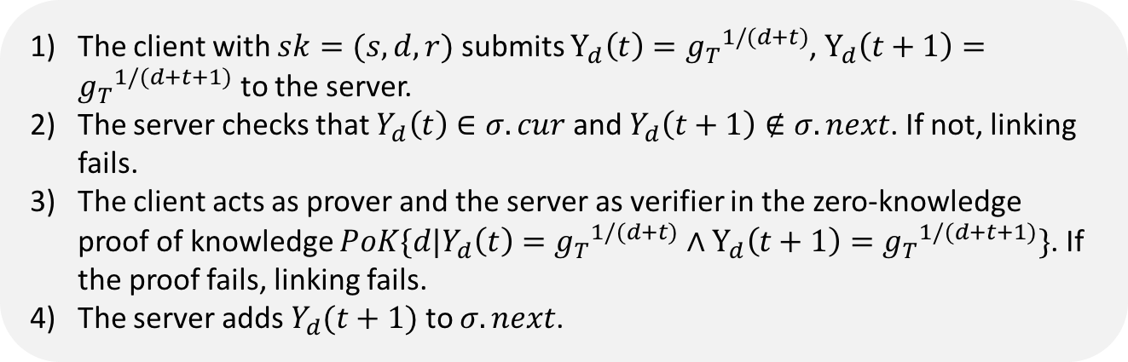
Construction
Construction
Link: $\left(\left(σ^{′},{next}^{′}\right), ∅\right)←<{ReUp}_{S}\left(ssk,σ,next,t\right), {ReUp}_{C}(sk,spk,t)>$
The client with $sk=(s,d,r)$ submits $Y_{d}\left(t\right)={g_{T}}^{1/(d+t)}$, $Y_{d}\left(t+1\right)={g_{T}}^{1/(d+t+1)}$ to the server.
The server checks that $Y_{d}\left(t\right)∈σ.cur$ and $Y_{d}\left(t+1\right)∉σ.next$. If not, linking fails.
The client acts as prover and the server as verifier in the zero-knowledge proof of knowledge $PoK\{d|Y_{d}\left(t\right)={g_{T}}^{1/(d+t)}∧Y_{d}\left(t+1\right)={g_{T}}^{1/(d+t+1)}\}$. If the proof fails, linking fails.
The server adds $Y_{d}(t+1)$ to $σ.next$.

Slide 15
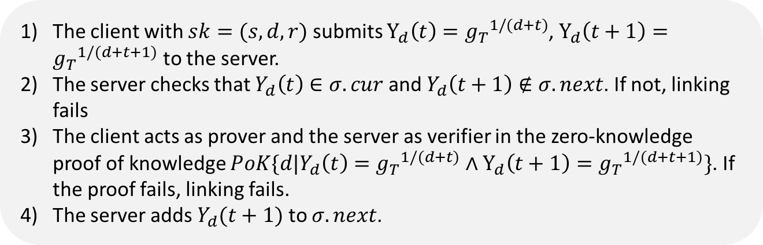
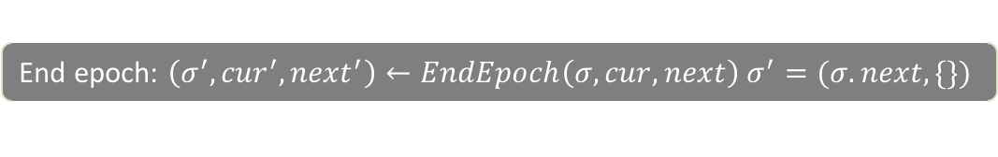
Construction
Construction
End epoch: $\left(σ^{′}, {cur}^{′},{next}^{′}\right)←EndEpoch\left(σ,cur,next\right) σ^{′}=(σ.next,\{\})$
The client with $sk=(s,d,r)$ submits $Y_{d}\left(t\right)={g_{T}}^{1/(d+t)}$, $Y_{d}\left(t+1\right)={g_{T}}^{1/(d+t+1)}$ to the server.
The server checks that $Y_{d}\left(t\right)∈σ.cur$ and $Y_{d}\left(t+1\right)∉σ.next$. If not, linking fails
The client acts as prover and the server as verifier in the zero-knowledge proof of knowledge $PoK\{d|Y_{d}\left(t\right)={g_{T}}^{1/(d+t)}∧Y_{d}\left(t+1\right)={g_{T}}^{1/(d+t+1)}\}$. If the proof fails, linking fails.
The server adds $Y_{d}(t+1)$ to $σ.next$.

Slide 16
3
Implementation

Slide 17
Implementation
Three Applications
Streaming
Music Service
Public
Transit Pass
Access Proxy

Slide 18

Implementation
Streaming Music Service
Implements the music service by modify the source code of VLC.
VLC Media Player
Streaming Music Service
A streaming music service over HTTPS by exposing media from web accessible URIs.
The service allows a user to choose the granularity of an anonymous session as either a full playlist or as an individual song.
We modify VLC to communicate with our user-agent and pass our session token as an additional cookie.

Slide 19

Implementation
Public Transit Pass
Provide safeguards and without leaking users’ movements.
Currently, public transit providers who issue month long or week long “unlimited” access passes limit user access to prevent cheating.
Without safeguards, a user could give her pass to all of her friends to ride for free.
Anonymous subscriptions are able to provide these safeguards without revealing user’s identity (so users’ movements cannot be tracked).

Slide 20


Implementation
Access Proxy
implement a server to allow users to proxy access to websites and achieve users’ anonymity.
The server could authenticate for users with legitimate accounts provided by the service to access news sites and other content.
All traffic and accesses appear to originate from the same entity and it is up to the proxy service to multiplex the user credentials.
Users’ anonymity leverages both the wide variety of accessible services as well as the number of proxy users.

Slide 21
4
My Thought

Slide 22


My Thought
Some questions
论文中用户不提供任何真实身份，任何人可以使用随机的匿名身份注册很多个用户？
My answer
对于论文中提到的场景，并没有提供用户的真实身份，只是直接匿名，这样在一般情况下会造成女巫攻击和垃圾邮件攻击等，也就是说恶意用户可以随意无限次注册账号。我猜测可能是因为注册阶段需要进行订购支付费用，所以可以随意注册，但是只是通过支付费用来约束，这样便可以抵抗女巫攻击，因为如果攻击者要进行女巫攻击的话，每次注册都必须支付费用，代价很高。此外，在注册阶段的费用支付是通过匿名支付的方式进行的，文中具体未阐述，只是提到e-cash和BitCoins。

Slide 23
My Thought
Some questions
用户未提供任何真实身份，何谈保护其隐私，而且完全匿名了再去跟踪记录用户的行为有什么意义？
My answer
攻击者可以进行关联性分析。即使用户匿名了如果某一个匿名账户的行为都被关联起来，就能从这个匿名账户的行为，推断出其喜好和偏好，习惯等信息，再加上一些背景知识推断出真实用户或者某一个用户群的一些信息。比如一个用户在一个购物网站上的购买行为被服务提供者给跟踪和记录了，如果买的东西都是一些计算机相关的书籍，那么就可以推断出该用户是计算机专业的人士。又如，如果购买的东西都是婴儿用品，说明可能是个孕妇。并且服务提供商可以根据这样的关联性分析，分析出一个群体的一些信息。因此即使匿名了也要做无关联性的操作。

Slide 24
My Thought
Some ideas
考虑新的场景，比如视频网站，通过购买视频观看卡的形式来付费，那么视频观看卡有个卡号，是与支付账号，比如银行卡号，支付宝账号等真实信息关联的。之后再利用Anon-pass的协议进行交互。
1
通过购买视频观看卡的形式来付费，视频观看卡对应一个卡号。
2
用户需要使用这个观看卡和服务器进行交互，服务器端需要增加一个验证卡号的合法性的过程，卡号合法则继续进行操作。
3
之后用户和服务器就执行Anon-pass协议。

Slide 25
5
Conclusion

Slide 26
Conclusion
1
We present the design, security proof, and implementation of an anonymous subscription service.
2
We add an efficient operation for clients who do not need unlinkability to cheaply re-authenticate themselves for the next time period.
3
We implement a music service, an Android-based subway-pass application, and a web proxy,.

Slide 27
Thanks!

